Slide 1
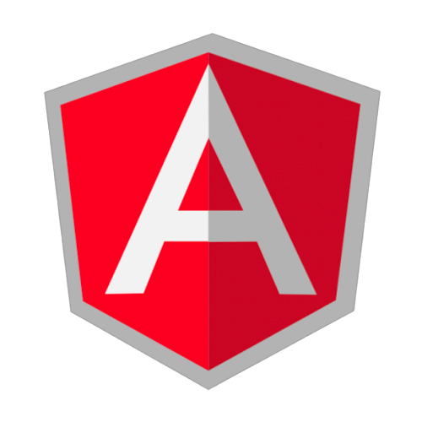
AngularJS
@vinaymavi
Notes:
https://docs.angularjs.org/guide/

Slide 2
Agenda
SPA Introduction.
Basic Introduction of AangularJS.
Directives
Basic of Directives.
Modules.
AngularJS Bootstrap, Config and Run phase.
Template Compiling and Linking.
Bi-Directional binding.
Controller
Scope.
Scope Life Cycle.
Scope Inheritance.
Watches.
Digest Cycles and dirty checking.
Providers
Providers
Factory
Services

Slide 3
SPA (Single Page Application)
A Single Page Application (SPA) is a web application or website that loads all of the resources required to navigate throughout the site on the first page load. As the user clicks links and interacts with the page, subsequent content is loaded dynamically. The application will often update the URL in the address bar to emulate traditional page navigation, but another full page request is never made.

Slide 4
The Challenge with SPAs
DOM Manipulation
Routing
History
Module Loading
View Loading
Object Loading
Caching
Ajax Data loading
Data binding

Slide 5
AngularJS
MVC Javascript Framework by Google for Rich Web Application Development
Notes:
How angularJs app boot.
how many steps to boot.
how angular app parsed and create bi-directional map.
angularjs phases
can two module instanciate within single html page? why?
scope life cycle?
How angularJS manage controller,constantans,factory,services internally.

Slide 6
Why AngularJS ?

Slide 7
Motivation
It fulfills all SPA challanges
Provides testing feature
Good community support
Notes:
Motivation topics
Bidirectional bindings (add/ subtract/ multiplication/ divide) examples.
Routing
custom element creation

Slide 8
AngularJS Installation
To initialize AngularJS
<script src="angular.js"></script>

Slide 9
How Angular app look like
<html ng-app> Open
<head lang="en">
<meta charset="UTF-8">
<title>Angular JS app</title>
<script src="angular.js"></script>
</head>
<body ng-init='hello="Hello World!"'>
{{hello}}
</body>
</html>

Slide 10
AngularJS Compilation
Step-1 Compiler finds that an element matches a directive, then the directive is added to the list of directives that match the DOM element. A single element may match multiple directives
Step-2 Once all directives matching a DOM element have been identified, the compiler sorts the directives by their priority and compile function will execute.
Step-3 links the template with the scope by calling the combined linking function.

Slide 11
AngularJS Directive
At a high level, directives are markers on a DOM element (such as an attribute, element name, comment or CSS class) that tell AngularJS's HTML compiler ($compile) to attach a specified behavior to that DOM element (e.g. via event listeners), or even to transform the DOM element and its children
Notes:
need to explain compile and link function to explain compilation phase.

Slide 12
AngularJS Module
You can think of a module as a container for the different parts of your app
Controllers
Services
Filters
Directives
etc

Slide 13
AngularJS application can look like.
http://codepen.io/vinaymavi/pen/QNmjLG?editors=1010

Slide 14
Dynamic Injection or Dependency Injection
angular.module('myapp', [])
.controller("MyCtrl", function ($scope, $interval) {
$scope.name = "";
});

Slide 15
Bi-Directional Binding
Notes:
http://codepen.io/vinaymavi/pen/QNmjLG

Slide 16
Bi-Directional binding
http://codepen.io/vinaymavi/pen/aNYvZR?editors=1010

Slide 17
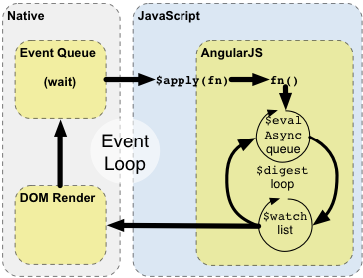
Digest Cycle
Notes:
http://www.bennadel.com/blog/2605-scope-evalasync-vs-timeout-in-angularjs.htm

Slide 18
Digest Cycle
$watcher list
$apply phase
$digest phase
dirty checking
$evelAsync queue
Time spent in digest cycle
Notes:
http://ryanclark.me/how-angularjs-implements-dirty-checking/
http://www.bennadel.com/blog/2605-scope-evalasync-vs-timeout-in-angularjs.htm
Eaxmples
$watcher list - angular.element($0).scope()
Dirty checking - http://codepen.io/vinaymavi/pen/JGeLZz
$apply + $evelAsync - http://codepen.io/vinaymavi/pen/qZoOQW?editors=1010

Slide 19
Controller
AngularJS application mainly relies on controllers to control the flow of data in the application. A controller is defined using ng-controller directive. A controller is a JavaScript object containing attributes/properties and functions.

Slide 20
Controller Instance
this
$scope class of $scope
controller vs controller as syntax.
Scope Inheritance.
Notes:
https://docs.angularjs.org/guide/concepts
https://docs.angularjs.org/guide/controller
“When a Controller is attached to the DOM via the ng-controller directive, Angular will instantiate a new Controller object, using the specified Controller's constructor function. A new child scope will be created and made available as an injectable parameter to the Controller's constructor function as $scope.
If the controller has been attached using the controller as syntax then the controller instance will be assigned to a property on the new scope.”
This statement need a example.
https://docs.angularjs.org/guide/scope
Examples -

Slide 21
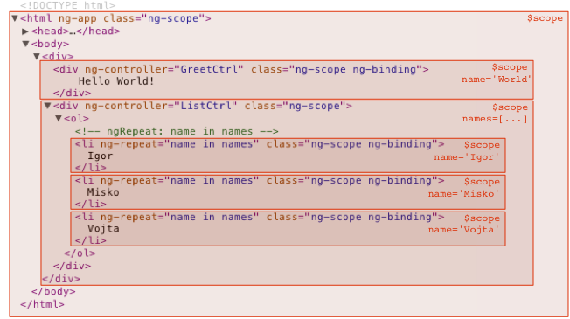
Scope Inheritance.

Slide 22
Singleton Instances
Service
Factory
Provider
Notes:
Examples
Service - http://codepen.io/vinaymavi/pen/VaXvRe?editors=1010
Factory - http://codepen.io/vinaymavi/pen/KzodEe?editors=1010
Provider - http://codepen.io/vinaymavi/pen/greaym?editors=1010

Slide 23
How Following directive working
Ng-model
Ng-repeat

Slide 24
Thank you !

