Slide 1
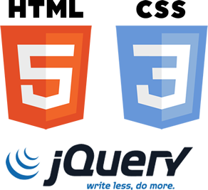
HTML/CSS/jQuery
@vinaymavi
@prerna

Slide 2
TODOs
HTML
HTML basics
Examples with most useful tags
CSS2
How to use it
Class,id creation
Selectors
jQuery
What is jQuery?
Basic selectors

Slide 3
HTML

Slide 4
HTML
HTML is a markup language for describing web documents (web pages).

Slide 5

HTML
Why We need it?
Why We need it?
Notes:
Need some examples to explain why we need HTML.
Examples Link.
http://codepen.io/vinaymavi/pen/WwXLPQ

Slide 6
Why we need it cont...
Structured information
Linked Information
Different media type support
Notes:
Examples Link.
Structured Information - http://codepen.io/vinaymavi/pen/zqPybE
Linked Information - http://codepen.io/vinaymavi/pen/pydqXN
Different media support - http://codepen.io/vinaymavi/pen/YqEByg

Slide 7
HTML file looks like
<!DOCTYPE html>
<html lang="en">
<head>
........................
........................
</head>
<body >
........................
........................
........................
</body>
</html>
Saved with .html extension
Notes:
Example:

Slide 8
Tag Types
Pair
h1,h2….h6
P
Form
Table etc..
Exp.
<h1>Hello Audience</h1>
Standalone
HR
Img
Input etc..
Exp.
<input type="text"/>

Slide 9
Comment Syntax
<!--
<input type="text"/>
-->
<!--input type="text"/-->
OR
Notes:
Examples:
From1 - http://codepen.io/vinaymavi/pen/oxpEZQ?editors=1010
File-upload - http://codepen.io/vinaymavi/pen/jqYZGy?editors=1010
Table - http://codepen.io/vinaymavi/pen/xVpYXJ?editors=1010
Table (Span Examples) - http://codepen.io/vinaymavi/pen/vGpdpq?editors=1000
Your choice - http://codepen.io/vinaymavi/pen/ZWvrmx?editors=1000 - Default List examples.
Fieldset - http://codepen.io/vinaymavi/pen/QNaQYg?editors=1000
Img - http://codepen.io/vinaymavi/pen/YqEByg

Slide 10
CSS

Slide 11
CSS (Cascading Style Sheet)
Cascading Style Sheets (CSS) are a stylesheet language used to describe the presentation of a document written in HTML or XML.

Slide 12
CSS
Why We need it?
Notes:
Examples:-
whitout CSS - http://codepen.io/vinaymavi/pen/vGpdpq
With CSS - http://codepen.io/vinaymavi/pen/QNarBL?editors=1100
Two more examples required.

Slide 13
CSS
Separation of Style from document.
Single Style for all site.
Single Style for multiple site.
Cacheable style.
Easy to maintain.

Slide 14
How to use
Inline
<h1 style="color:#444444">Hello World!</h1>

Slide 15
How to use
Embed
<!DOCTYPE html>
<html lang="en">
<head>
<style>
h1{color:#444444;}
</style>
</head>
<body >
</body>
</html>

Slide 16
How to use
External
<!DOCTYPE html>
<html lang="en">
<head>
<link href=’style.css’ rel=’stylesheet’></link>
</head>
<body >
</body>
</html>
//style.css
h1{color:#444444;}

Slide 17
How does it work?
Step 1 - you create style sheet.
Step 2 - Browser download it.
Step 3 - Match element on the page.
Step 4 - Style matched element.

Slide 18
Syntax
<selector> {
/*Comments*/
property: value;
}

Slide 19
Selector
Class
ID
Tag
Attribute
Child
Group
Notes:
Examples:

Slide 20
Selector
Class
/*css file*/
.<class_name>{
property:value;
}
<!--HTML File-->
<h1 class=’class_name’>
</h1>
Notes:
Example:

Slide 21
Selector
ID
/*css file*/
#<id_name>{
property:value;
}
<!--HTML File-->
<h1 id=’id_name’>
</h1>
Notes:
Example:

Slide 22
Selector
Tag
/*css file*/
<tag_name>{
property:value;
}
<!--HTML File-->
<h1>Hello Audience</h1>
Notes:
Example:

Slide 23
Selector
Attribute
/*css file*/
<[attr_name]>{
property:value;
}
<!--HTML File-->
<h1 attr_name >Hello Audience</h1>
Notes:
Example:

Slide 24
Selector
Child
/*css file*/
<parent> <child>{
property:value;
}
<!--HTML File-->
<div>
<h1>Hello Audience</h1>
</div>
Notes:
Example:

Slide 25
Grouping selector
Child
/*css file*/
<xyz_1>,...,<xyz_n>{
property:value;
}
<!--HTML File-->
<h1>Hello</h1>
<h2>Hello</h2>
<h3>Hello</h3>
<h4>Hello</h4>
Notes:
Example: http://codepen.io/vinaymavi/pen/vGdgdG?editors=1100

Slide 26
Specificity/The Cascade
Find all declarations that apply to a given element/property combination, for the target media type.
Sort declarations according to their importance (normal or important) and origin (author, user, or user agent). From highest to lowest precedence
Notes:
Reference:-
http://nicolasgallagher.com/css-cascade-specificity-inheritance/

Slide 27


Slide 28
Specificity/The Cascade
Specificity have 4 distinct categories.
a, b, c, and d each has a value of 0 by default.
a is equal to 1 if the declaration comes from a style attribute in the HTML (“inline styles”) rather than a CSS rule with a selector.
b is equal to the number of ID attributes in a selector.
c is equal to the number of other attributes and pseudo-classes in a selector.
d is equal to the number of elements and pseudo-elements in a selector.

Slide 29
Specificity/The Cascade
Selector | a | b | c | d | Specificity
li | 0 | 0 | 0 | 1 | 0,0,0,1
ul li | 0 | 0 | 0 | 2 | 0,0,0,2
div ul li | 0 | 0 | 0 | 3 | 0,0,0,3
div li .myliclass | 0 | 0 | 1 | 2 | 0,0,1,2
#myli | 0 | 1 | 0 | 0 | 0,1,0,0
<li style=’color:red’> | 1 | 0 | 0 | 0 | 1,0,0,0
Notes:
Calculate specificity Examples:
Exp1- http://codepen.io/vinaymavi/pen/zqpQma?editors=1100
Exp-2 http://codepen.io/vinaymavi/pen/grvWwy?editors=1100
Exp-3 http://codepen.io/vinaymavi/pen/VaQbmG?editors=1100

Slide 30
jQuery
Notes:
What?
Why?
Check other tutorials.
Possibilities with jquery.

Slide 31
Document Object Model
The Document Object Model (DOM) is a cross-platform and language-independent convention for representing and interacting with objects in HTML, XHTML, and XML documents

Slide 32
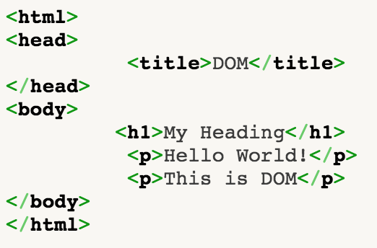
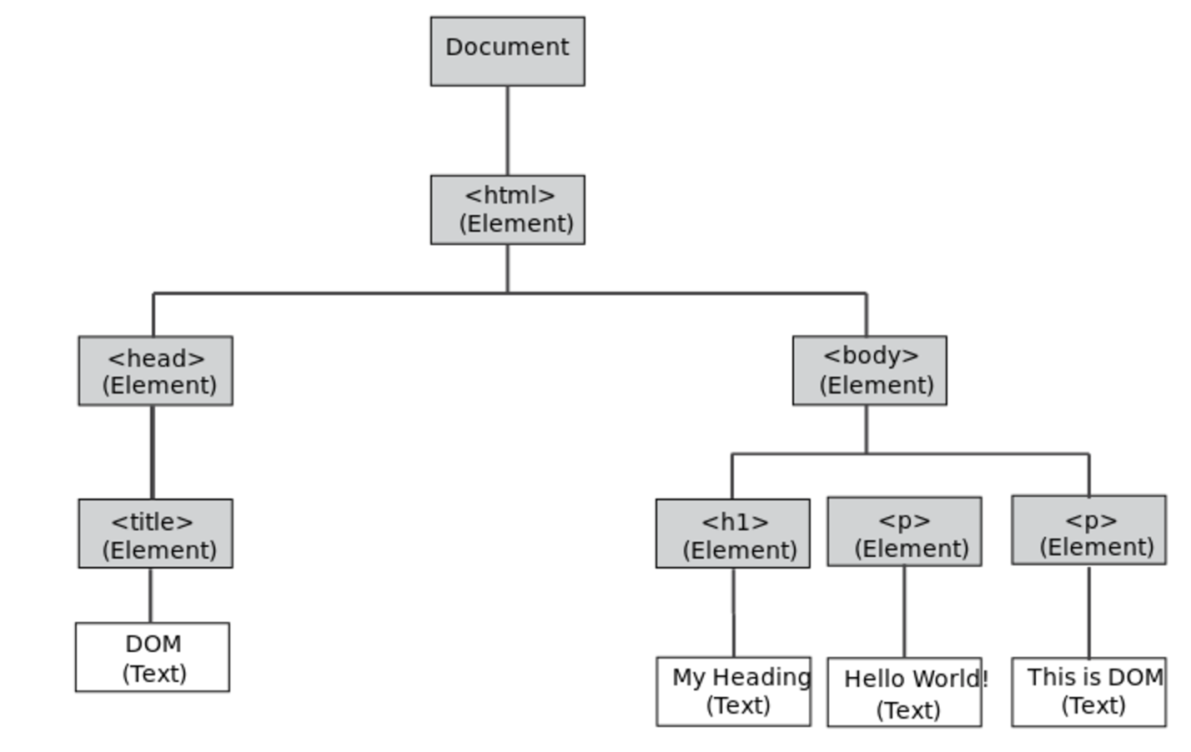
Document Object Model

Slide 33
How to install
<script
src="//code.jquery.com/jquery-1.11.3.min.js">
</script>

Slide 34
Selector
Class
ID
Tag
Attribute
Child
Group
Selector Syntax
$('<Selector>')
Or
jQuery('<Selector>')
Notes:
Examples:
Exp-1 http://codepen.io/vinaymavi/pen/MyQOoX

Slide 35
Ready Event
$(document).ready(function(){
// statements
});
Notes:
Examples:

