Slide 1
Capstone Project – The Battle of Neighborhoods
Coffee Shops in Toronto

Slide 2
Background
Coffee is essential to start the day
Toronto is Canada’s busiest Business Hub

Slide 3
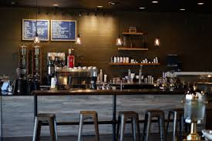
Business Problem
"Where should I open a coffee shop to succeed?"

Slide 4
Solution
Clustering Toronto neighborhoods for recommendation
Density of Coffee Shops in Toronto

Slide 5
Data & Methodology
Wrap neighborhood data from Wikipedia page https://en.wikipedia.org/wiki/List_of_postal_codes_of_Canada:_M
Include geocoordinates of each neighborhood from http://cocl.us/Geospatial_data
Obtained locations of coffee shops via FourSquare API
Methodology: Looking into the density of the coffee shops in Toronto

Slide 6
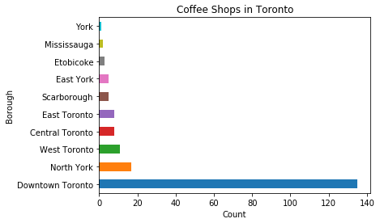
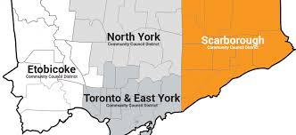
Results and Recommendations
Downtown Toronto has the most coffee shops
Financial Hub
University of Toronto
Scarborough would be a nice location
Huge population
Limited competitors

