Slide 1
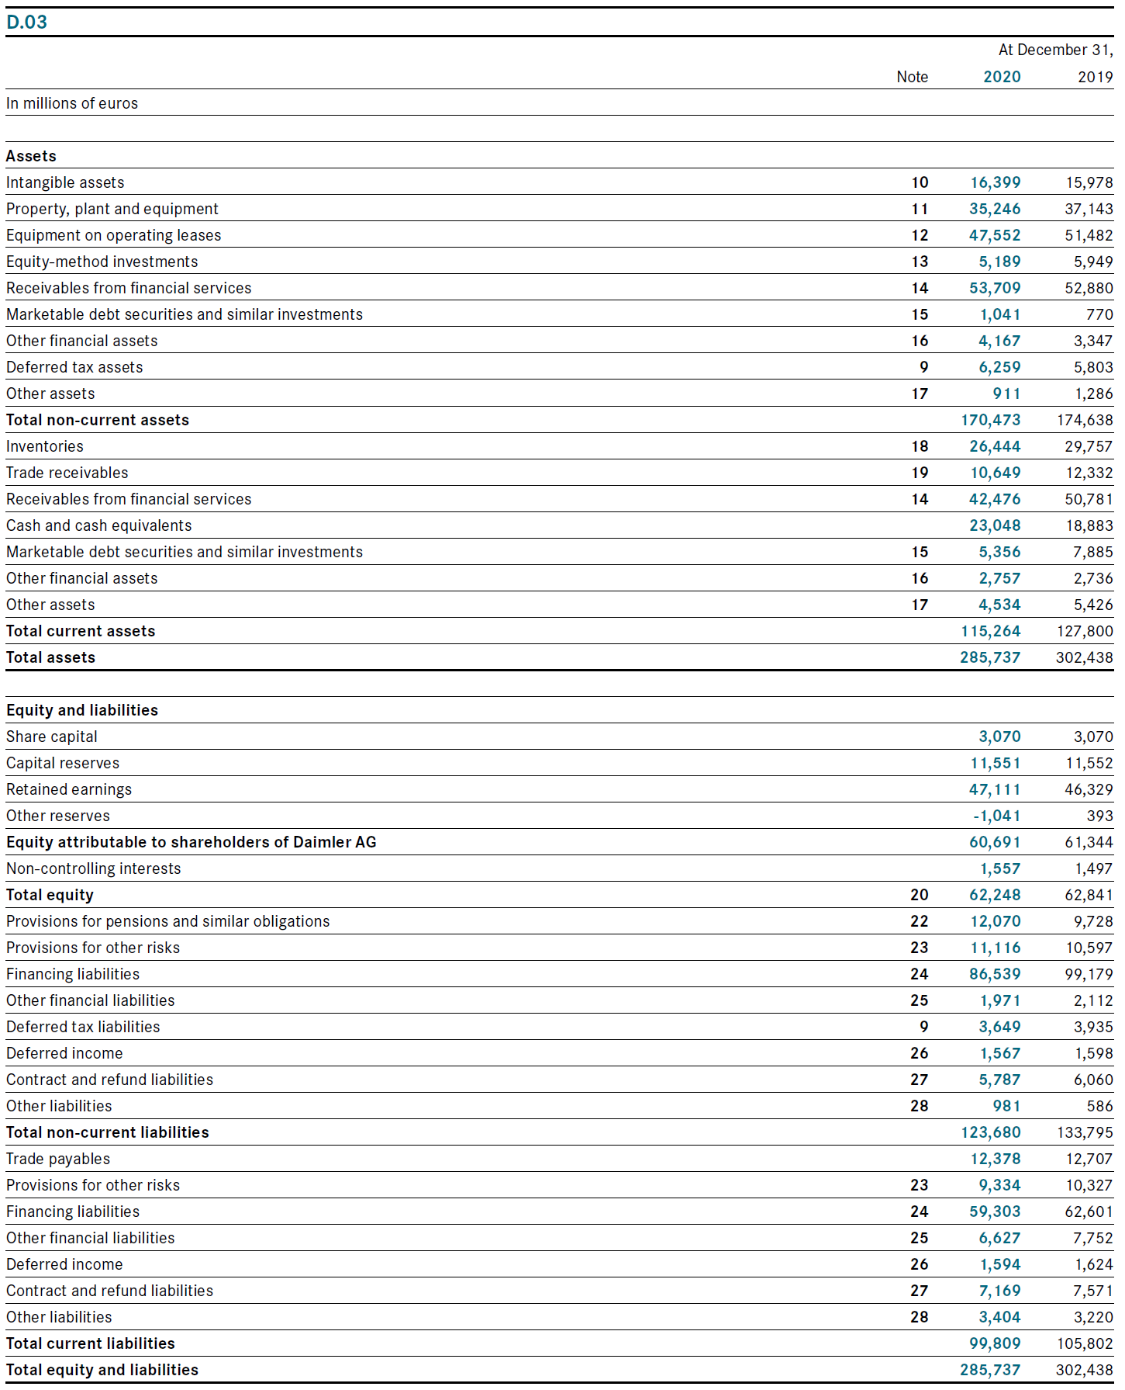
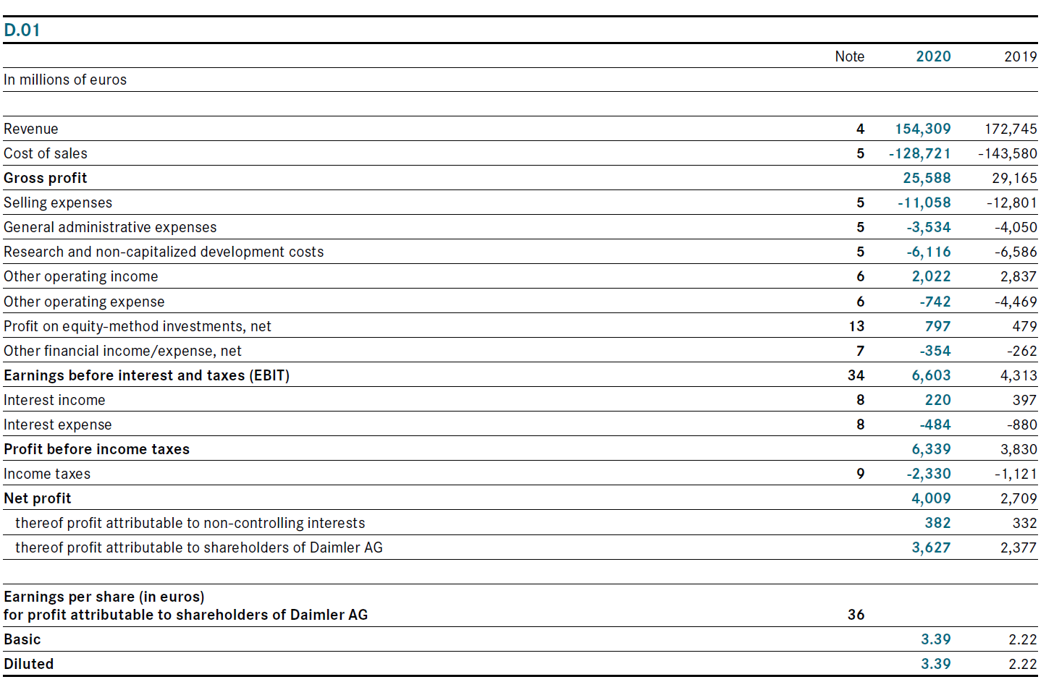











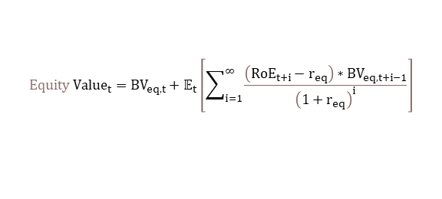


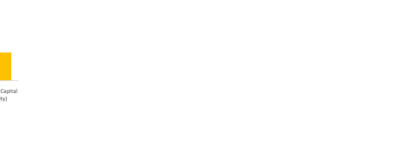





Flow and stock measures.
Why do we often divide by average stock values?
Analyzing means comparing
(In many cases, analyzing is the same as answering a question by making clever comparisons)
Ratios: compare one number to another -> pick the right comparison for the right question
Compare ratios/numbers over time
Compare ratios/numbers to other companies
Compare ratios/numbers to theoretical benchmarks
Analyzing Firm Performance Using Financials
Entity and Equity Perspective of a Firm
Firm is a combination of assets that are cleverly combined to create value
How are these assets financed? -> Who has how much claim on the return on the (net) operating assets?
Crucial for understanding different return on invested capital viewpoints
$$RoE=\frac{net income_{t}}{(Equity_{t}+Equity_{t−1})/2}$$
Net income FY 2020
Assume the goal is to analyze how the firm creates value. This sheet focuses on two things:
Reading financial statements to understand a firm’s business model
Identifying drivers of return on invested capital from various perspectives via ratio analysis
E.g., want to put net income into perspective to the average amount of invested equity in the period
Central importance of Return on equity
Return measure vs corresp. hurdle rate
Equity 31.12.X1
Equity 31.12.X2
$${Equity Value}_{t}=BV_{eq,t}+𝔼_{t}\left[\sum_{i=1}^{∞}{\frac{\left(RoE_{t+i}−r_{eq}\right)∗BV_{eq,t+i−1}}{{\left(1+r_{eq}\right)}^{i}}}\right]$$
RNOA vs r_{WACC}
Often true development unknown → use average
?
RoE vs r_{EQ}
Net income FY 2020
Net income FY 2020
(Oversimplified: $RoE_{t+i}>r_{eq}$ key for value generation)
$$RoE_{t}=\frac{Net Income_{t}}{Avg. BV_{eq.t :t−1 }}$$
Return on Equity
How many $ does a firm earn its owners per $1 of equity put into it?
Form of periodic return on investment
Equity 31.12.X1
Equity 31.12.X2
Equity 31.12.X1
Equity 31.12.X2
Assets not used in operations
Operation’s “built-in” financing
Two sides of the same coin: net operating assets vs the amount of capital needed to run the firm’s operations
Capital provided by external parties (e.g., bank debt)
Capital provided by the firm owners
Reading Financials to Understand a Business
What are the big items on the BS? Indicators of material investments, risks, sources of finance, etc.
What are the big items in the IS? Major sources of revenues, major cost sources
Compare and put different positions into perspective
Conduct a detailed ratio analysis
Framework for Financial Analysis: What determines high return on investment for owners?
If RoE is key, what are its determinants?
Margins, Turnover, Leverage as subcomponents
Analyzing subcomponents to understand how the firm generates returns for its owners
Turnovers
Compares amount of assets/invested capital to the revenues these generate
Key aspect of performance: How much sales can the firm generate per deployed dollar of net operating assets?
Used to analyze “leanness”/ efficiency from an invested capital perspective
Margins
Compares (sub) profits versus revenues
Key aspect of profitability: How much does the firm earn on a dollar of revenues generated?
Used to analyze “which costs eat up most of revenues?” by walking down the income statement
$$RoE=\frac{net income}{average common equity}=\frac{net income}{sales}×\frac{sales}{average total assets}×\frac{average total assets}{average common equity}$$
Standard Balance Sheet Setup
Net working capital
DuPont Rearrangement
$$=net margin × asset turnover × leverage$$
Revenue
Gross Profit
Cost of goods sold
EBITDA
Other operating expenses
EBIT
Depr. & Amort.
EBT
Interest expenses
Net income
Tax expenses
Current (< 1 year in firm)
Net Operating Assets
Invested Capital (Entity)
Detailed margin analysis
Fin. Assets
Op. Liabilities
Net Op. Assets
Net Fin. Oblig.
Detailed turnover analysis
Gross Margin$\frac{Gross Profit}{Revenue}$
Op. Assets
Net Op. Assets
Net Fin. Oblig.
Detailed financing analysis
“Price premium” How much can firm charge over cost of making/buying product?
Fin. Liabilities
Equity
EBITDA Margin$\frac{EBITDA}{Revenue}$
Non-current (> 1 year in firm)
Fin. Assets
Op. Liabilities
Net operating assets (NOA) = op. assets (OA) – op. liabilities (OL)
Equation above does not cleanly separate operating and financing activities of a firm. “Advanced DuPont” decomposition cleaner
EBIT Margin$\frac{EBIT}{Revenue}$
How much Is left per dollar of sales after cost of operations?—ignoring wear and tear
Op. Assets
Fin. Liabilities
Net financial obligations (NFO) = fin. liabilities (FL) – fin. Assets (FA)
$$\text{R}\text{o}\text{E}= \frac{\text{NOI}}{\text{sales}}×\frac{\text{sales}}{\text{NOA}}+\frac{\text{NFO}}{\text{common} \text{equity}}×\left(\frac{\text{NOI}}{\text{NOA}}−\frac{\text{NFE}}{\text{NFO}}\right)=RNOA+leverage×spread$$
Equity
Return on net operating assets
How many $ does a firm earn per $1 of capital invested in the operations, irrespective of who provided the capital
How much Is left per dollar of sales after cost of operations?
(Note: less direct relation with sales depending on variable to fixed costs ratio)
Net Operating Asset Turnover
$$\frac{\text{sales}}{\text{avg}\text{. }\text{net} \text{operating} \text{assets}}$$
Net Margin$\frac{Net Income}{Revenue}$
How much is left per dollar of sales all costs?
How much sales can be generated with $1 of invested capital
Leverage
Leverage increases return to owners by increasing operations using external capital (and paying the external capital less: Spread > 0)
Note on EBITDA as a performance measure:
Some accounting experts don’t like it, but it’s very prevalent (e.g., private equity, M&A, etc.) Common arguments for EBITDA make it sound like “a generalizable (one-size fits all) number that summarizes (1) the firm’s profitability, (2) cash flow, and (3) credit quality (ability to service debt)”. (Bouwens, Jan, Ties De Kok, and Arnt Verriest. "The prevalence and validity of EBITDA as a performance measure." Comptabilité-Contrôle-Audit 25.1 (2019): 55-105. ) That obviously cannot all be true at once. Bouwens et al. have a good discussion. It’s a hybrid, often used for strategic reasons.
The sensible use case seems to be if you are interested in the operating performance before important investment and financing outlays. (e.g., as private equity often is because they often change investment and financing policies.) It is also often advocated as being ”closer to cash flow”. That’s fine. But remember, we do not view cash flow generally good periodic performance measure.
Total assets
160
Equity
80
RoE
RoA
Long-term capital structure / Solvency
Extent of firm‘s long-term credit commitments
Other margins
For specific cost combinations (e.g., cogs + marketing)
For cleaner separation of (core) operations vs. financing or non-recurring items
Often industry or business model specific
Net Working Capital Turnover
$$\frac{\text{sales}}{\text{avg}\text{. }\text{curr}\text{. }\text{operating} \text{assets}\text{ − }\text{avg}\text{. }\text{curr}\text{. }\text{operating} \text{liabilities}}$$
… any non-current sensible non-current turnover
Operating
profit (EBIT) = 24
Net income = 16
$$\frac{16}{80}$$
$$=20\%$$
$$\frac{24}{160}$$
$$=15\%$$
Op. CF to Debt $\frac{Op CF}{Total Debt}$
Working capital efficiency
How much sales can be generated per $1 of net working capital
Debt
80
Interest = 8
Debt to Equity $\frac{Total Debt}{Common Equity}$
NOI Margin$\frac{Net operating income}{Revenue}$
“Cleaner” version of EBI margin
Avg. Days to Collect Receivables
$\frac{\text{365}}{\text{sales}\text{/}\text{avg}\text{. }\text{accounts} \text{receivable}}$
Avg. Days to Sell Inventory
$\frac{\text{365}}{\text{cogs}\text{/}\text{avg}\text{. }\text{inventory}}$
Avg. Days to Pay Payables
$\frac{\text{365}}{\text{purchases}\text{/}\text{avg}\text{. }\text{accounts} \text{payables}}$
*(purchases = cogs + Δinventory)
Leveraging up
Short-term liquidity
Extent of firm‘s long-term credit commitments
Sales Margin$\frac{Gross Profit −sales expense}{Revenue}$
Example of an industry-specific margin
Operating
profit (EBIT) = 48
Total assets
320
Equity 80
Net Income = 24
RoE
RoA
Current Ratio $\frac{Current Assets}{Current Liabilities}$
Debt
240
Interest = 24
$$\frac{24}{80}$$
$$=30\%$$
$$\frac{48}{320}$$
$$=15\%$$
Quick Ratio $\frac{Cash and Equivalent+Receivables}{Current Liabilities}$
Lower receivable collection period implies higher efficiency
Lower inventory holding period implies higher efficiency
How long can you stretch to pay payables. Longer payback time increases working capital efficiency
EBIT interest coverage $\frac{EBIT}{Interest Expense}$
© Harm H. Schütt, version 01/2022
Notes:
Main headings 10pt
Secondary headings 8pt
Normal text 6pt
Comments 5pt

Slide 2
Cash and cash equivalents/ marketable securities
Money due for goods/services delivered but not yet paid for by customers
Accounts Receivables
Money due for goods/services delivered but not yet paid for by customers
Inventory
Goods (produced, in-production, bought) not yet sold
PPE
How profitably can the firm convert sales into profits?
Equity-method Investments / other financial assets
How profitably can the firm convert sales into profits?
Intangibles
How profitably can the firm convert sales into profits?
Deferred tax assets
How profitably can the firm convert sales into profits?
Other Assets
How profitably can the firm convert sales into profits?
Operating lease assets
How profitably can the firm convert sales into profits?

