Slide 1
COMP 791A: Statistical Language Processing
n-gram Models over Sparse Data
Chap. 6

Slide 2
“Shannon Game” (Shannon, 1951)
“I am going to make a collect …”
Predict the next word given the n-1 previous words.
Past behavior is a good guide to what will happen in the future as there is regularity in language.
Determine the probability of different sequences from a training corpus.

Slide 3
Language Modeling
a statistical model of word/character sequences
used to predict the next character/word given the previous ones
applications:
  Speech recognition
  Spelling correction
    He is trying to fine out.
    Hopefully, all with continue smoothly in my absence.
  Optical character recognition / Handwriting recognition
  Statistical Machine Translation
  …

Slide 4
1st approximation
each word has an equal probability to follow any other
  with 100,000 words, the probability of each of them at any given point is .00001
but some words are more frequent then others…
  in Brown corpus:
    “the” appears 69,971 times
    “rabbit” appears 11 times

Slide 5
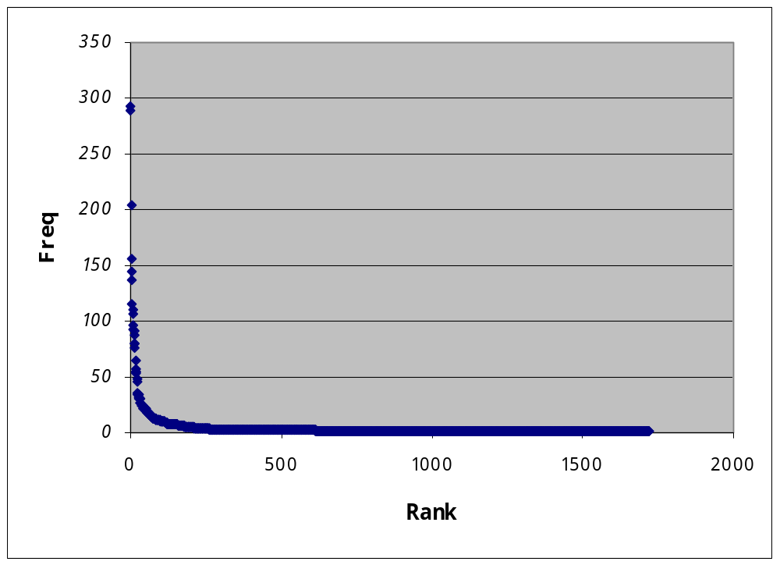
Remember Zipf’s Law
f×r = k

Slide 6
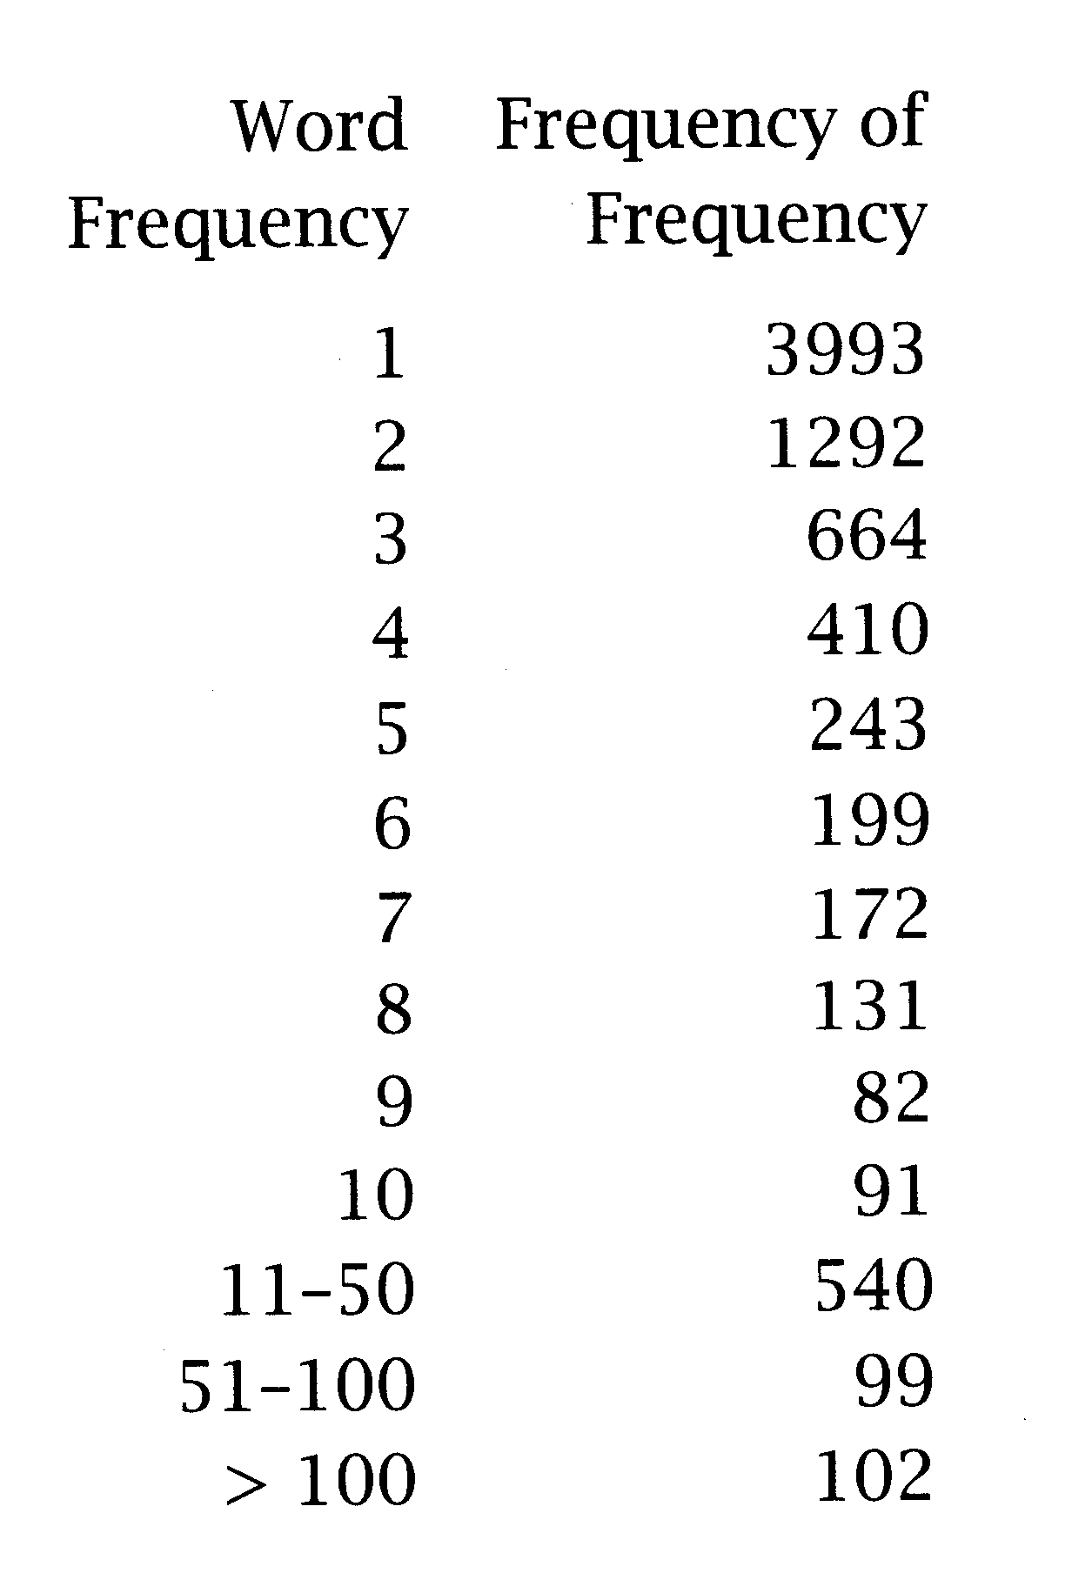
Frequency of frequencies
most words are rare (happax legomena)
but common words are very common

Slide 7
n-grams
take into account the frequency of the word in some training corpus
  at any given point, “the” is more probable than “rabbit”
but bag of word approach…
  “Just then, the white …”
so the probability of a word also depends on the previous words (the history)
P(w_{n} |w₁w₂…w_{n-1})

Slide 8
Problems with n-grams
“the large green ______ .”
  “mountain”? “tree”?
“Sue swallowed the large green ______ .”
  “pill”? “broccoli”?
Knowing that Sue “swallowed” helps narrow down possibilities
But, how far back do we look?

Slide 9
Reliability vs. Discrimination
larger n:
  more information about the context of the specific instance
  greater discrimination
  But:
    too consuming
    ex: for a vocabulary of 20,000 words:
      number of bigrams = 400 million (20 000²)
      number of trigrams = 8 trillion (20 000³)
      number of four-grams = 1.6 x 10¹⁷ (20 000⁴)
    too many chances that the history has never been seen before (data sparseness)
smaller n:
  less precision
  BUT:
    more instances in training data, better statistical estimates
    more reliability
--> Markov approximation: take only the most recent history

Slide 10
Markov assumption
Markov Assumption:
  we can predict the probability of some future item on the basis of a short history
  if (history = last n-1 words) --> (n-1)^{th} order Markov model or n-gram model
Most widely used:
  unigram (n=1)
  bigram (n=2)
  trigram (n=3)

Slide 11
Text generation with n-grams
n-gram model trained on 40 million words from WSJ
Unigram:
  Months the my and issue of year foreign new exchange’s September were recession exchange new endorsed a acquire to six executives.
Bigram:
  Last December through the way to preserve the Hudson corporation N.B.E.C. Taylor would seem to complete the major central planner one point five percent of U.S.E. has already old M. X. corporation of living on information such as more frequently fishing to keep her.
Trigram:
  They also point to ninety point six billion dollars from two hundred four oh six three percent of the rates of interest stores as Mexico and Brazil on market conditions.

Slide 12
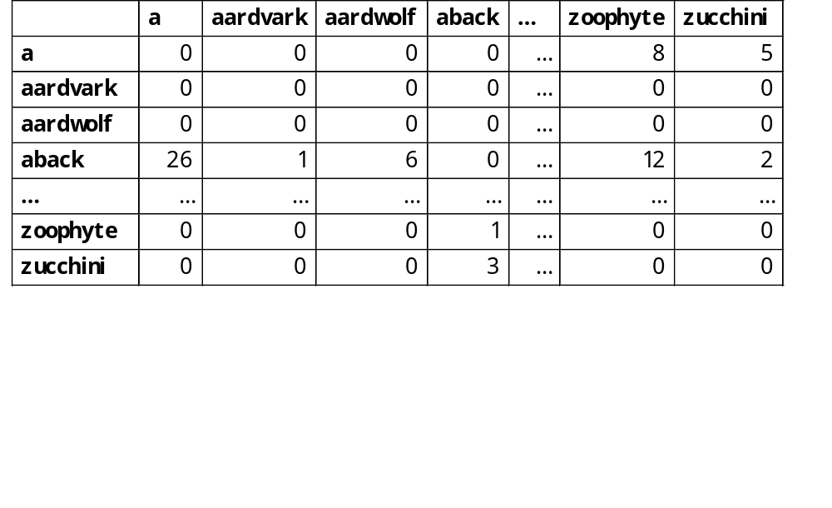
Bigrams
first-order Markov models
N-by-N matrix of probabilities/frequencies
N = size of the vocabulary we are modeling
P(w_{n}|w_{n-1})
2nd word
1st word

Slide 13
Why use only bi- or tri-grams?
Markov approximation is still costly
  with a 20 000 word vocabulary:
  bigram needs to store 400 million parameters
  trigram needs to store 8 trillion parameters
  using a language model > trigram is impractical
to reduce the number of parameters, we can:
  do stemming (use stems instead of word types)
  group words into semantic classes
  seen once --> same as unseen
  ...

Slide 14
Building n-gram Models
Data preparation:
  Decide training corpus
  Clean and tokenize
  How do we deal with sentence boundaries?
    I eat. I sleep.
      (I eat) (eat I) (I sleep)
    <s>I eat <s> I sleep <s>
      (<s> I) (I eat) (eat <s>) (<s> I) (I sleep) (sleep <s>)
Use statistical estimators:
  to derive a good probability estimates based on training data.

Slide 15
Statistical Estimators
Maximum Likelihood Estimation (MLE)
Smoothing
  Add-one -- Laplace
  Add-delta -- Lidstone’s & Jeffreys-Perks’ Laws (ELE)
      ( Validation:
        Held Out Estimation
        Cross Validation )
  Witten-Bell smoothing
  Good-Turing smoothing
Combining Estimators
  Simple Linear Interpolation
  General Linear Interpolation
  Katz’s Backoff

Slide 16
Statistical Estimators
--> Maximum Likelihood Estimation (MLE)
Smoothing
  Add-one -- Laplace
  Add-delta -- Lidstone’s & Jeffreys-Perks’ Laws (ELE)
      ( Validation:
        Held Out Estimation
        Cross Validation )
  Witten-Bell smoothing
  Good-Turing smoothing
Combining Estimators
  Simple Linear Interpolation
  General Linear Interpolation
  Katz’s Backoff

Slide 17
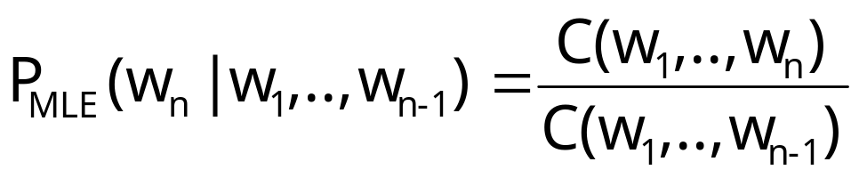
Maximum Likelihood Estimation
Choose the parameter values which gives the highest probability on the training corpus
Let C(w₁,..,w_{n}) be the frequency of n-gram w₁,..,w_{n}

Slide 18
Example 1: P(event)
in a training corpus, we have 10 instances of “come across”
  8 times, followed by “as”
  1 time, followed by “more”
  1 time, followed by “a”
with MLE, we have:
  P(as | come across) = 0.8
  P(more | come across) = 0.1
  P(a | come across) = 0.1
  P(X | come across) = 0 where X ≠ “as”, “more”, “a”

Slide 19
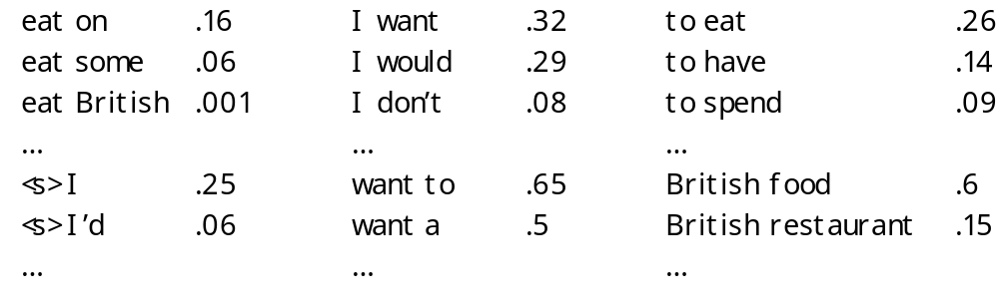
Example 2: P(sequence of events)
P(I want to eat British food)
= P(I|<s>) x P(want|I) x P(to|want) x P(eat|to) x P(British|eat) x P(food|British)
= .25 x .32 x .65 x .26 x .001 x .6
= .000008

Slide 20
Some adjustments
product of probabilities… numerical underflow for long sentences
so instead of multiplying the probs, we add the log of the probs
P(I want to eat British food)
= log(P(I|<s>)) + log(P(want|I)) + log(P(to|want)) + log(P(eat|to)) + log(P(British|eat)) + log(P(food|British))
= log(.25) + log(.32) + log(.65) + log (.26) + log(.001) + log(.6)
= -11.722

Slide 21
Problem with MLE: data sparseness
What if a sequence never appears in training corpus? P(X)=0
  “come across the men” --> prob = 0
  “come across some men” --> prob = 0
  “come across 3 men” --> prob = 0
MLE assigns a probability of zero to unseen events …
probability of an n-gram involving unseen words will be zero!
but… most words are rare (Zipf’s Law).
so n-grams involving rare words are even more rare… data sparseness

Slide 22
Problem with MLE: data sparseness (con’t)
in (Balh et al 83)
  training with 1.5 million words
  23% of the trigrams from another part of the same corpus were previously unseen.
in Shakespeare’s work
  out of 844 000 possible bigrams
  99.96% were not used
So MLE alone is not good enough estimator
Solution: smoothing
  decrease the probability of previously seen events
  so that there is a little bit of probability mass left over for previously unseen events
  also called discounting

Slide 23
Discounting or Smoothing
MLE is usually unsuitable for NLP because of the sparseness of the data
We need to allow for possibility of seeing events not seen in training
Must use a Discounting or Smoothing technique
Decrease the probability of previously seen events to leave a little bit of probability for previously unseen events

Slide 24
Statistical Estimators
Maximum Likelihood Estimation (MLE)
--> Smoothing
  --> Add-one -- Laplace
  Add-delta -- Lidstone’s & Jeffreys-Perks’ Laws (ELE)
      ( Validation:
        Held Out Estimation
        Cross Validation )
  Witten-Bell smoothing
  Good-Turing smoothing
Combining Estimators
  Simple Linear Interpolation
  General Linear Interpolation
  Katz’s Backoff

Slide 25
Many smoothing techniques
Add-one
Add-delta
Witten-Bell smoothing
Good-Turing smoothing
Church-Gale smoothing
Absolute-discounting
Kneser-Ney smoothing
...

Slide 26
Add-one Smoothing (Laplace’s law)
Pretend we have seen every n-gram at least once
Intuitively:
  new_count(n-gram) = old_count(n-gram) + 1
The idea is to give a little bit of the probability space to unseen events

Slide 27
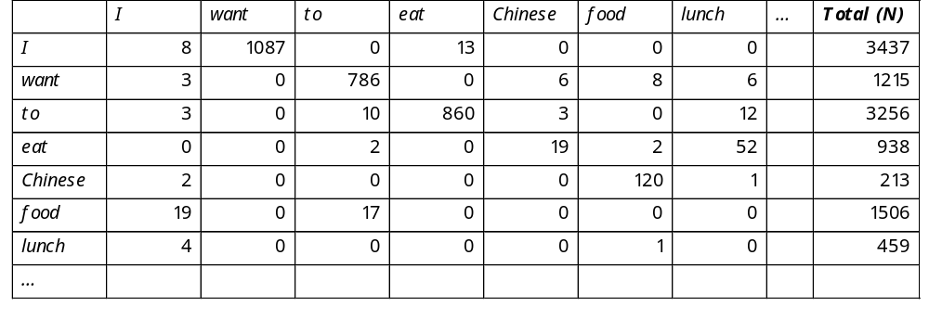
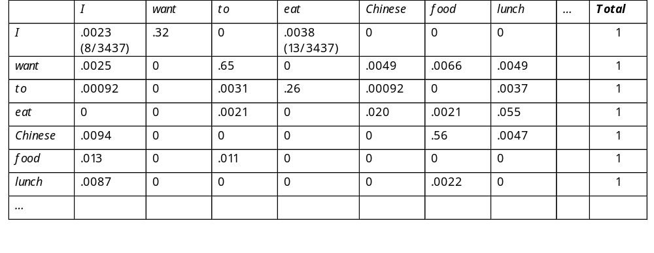
Add-one: Example
unsmoothed bigram counts:
2nd word
1st word
unsmoothed normalized bigram probabilities:

Slide 28
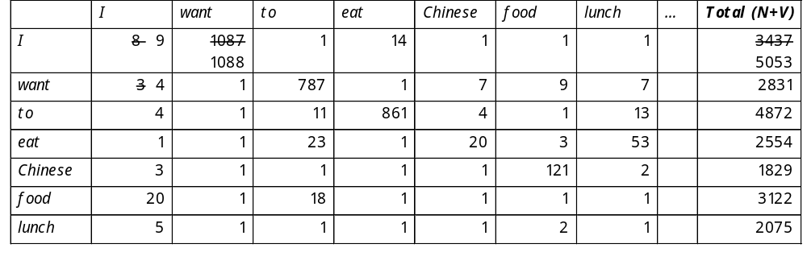
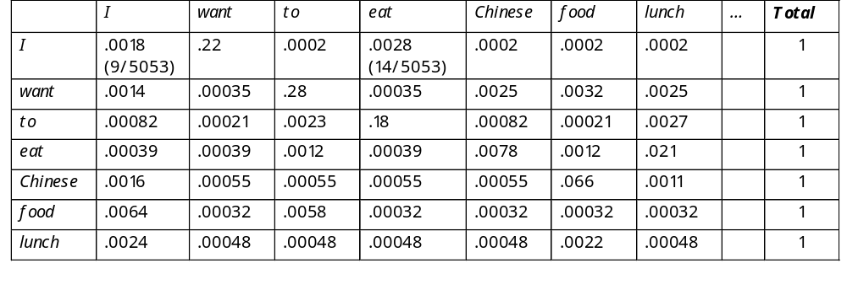
Add-one: Example (con’t)
add-one smoothed bigram counts:
add-one normalized bigram probabilities:

Slide 29
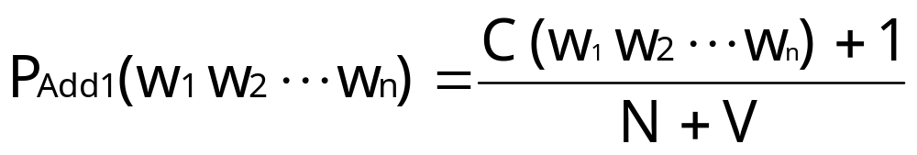
Add-one, more formally
N: nb of n-grams in training corpus starting with w₁…w_{n-1}
V: size of vocabulary
i.e. nb of possible different n-grams starting with w₁…w_{n-1}
i.e. nb of word types

Slide 30
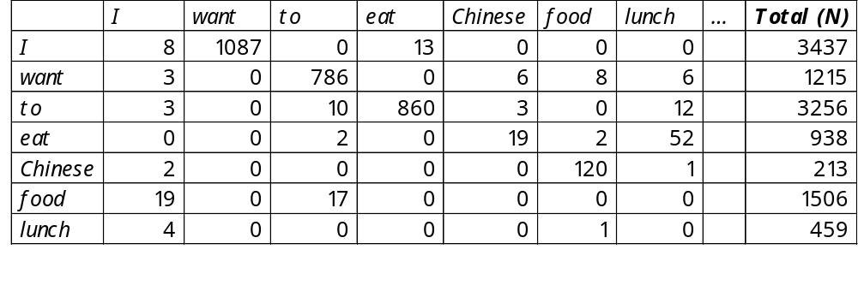
The example again
unsmoothed bigram counts:
V= 1616 word types
V= 1616
P(I eat)
= C(I eat) + 1 / (nb bigrams starting with “I” + nb of possible bigrams starting with “I”)
= 13 + 1 / 3437 + 1616
= 0.0028

Slide 31
Problem with add-one smoothing
every previously unseen n-gram is given a low probability
but there are so many of them that too much probability mass is given to unseen events
adding 1 to frequent bigram, does not change much
but adding 1 to low bigrams (including unseen ones) boosts them too much !
In NLP applications that are very sparse, Laplace’s Law actually gives far too much of the probability space to unseen events.

Slide 32
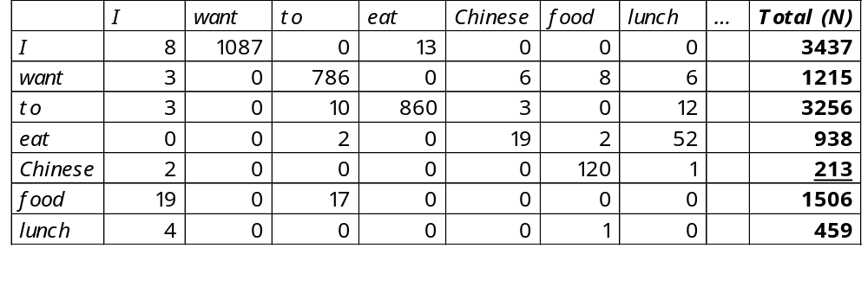
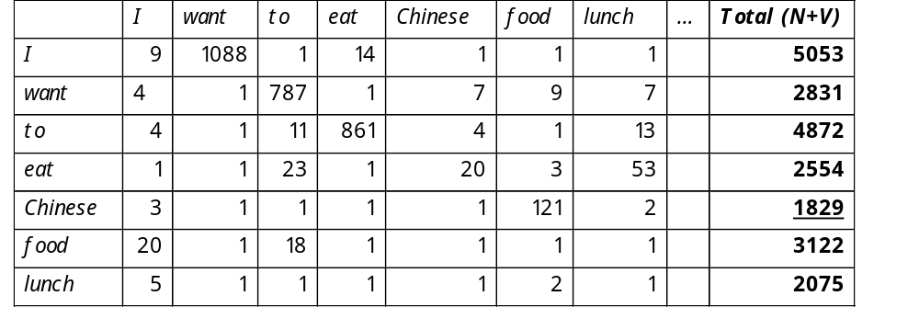
Problem with add-one smoothing
bigrams starting with Chinese are boosted by a factor of 8 ! (1829 / 213)
unsmoothed bigram counts:
1st word
add-one smoothed bigram counts:
1st word

Slide 33
Problem with add-one smoothing (con’t)
Data from the AP from (Church and Gale, 1991)
  Corpus of 22,000,000 bigrams
  Vocabulary of 273,266 words (i.e. 74,674,306,760 possible bigrams - or bins)
  74,671,100,000 bigrams were unseen
  And each unseen bigram was given a frequency of 0.000295
Add-one smoothed freq.
Freq. from training data
f_{MLE} | f_{empirical} | f_{add-one}
0 | 0.000027 | 0.000295
1 | 0.448 | 0.000274
2 | 1.25 | 0.000411
3 | 2.24 | 0.000548
4 | 3.23 | 0.000685
5 | 4.21 | 0.000822
Freq. from held-out data
too high
too low
Total probability mass given to unseen bigrams =
  (74,671,100,000 x 0.000295) / 22,000,000 ~99.96 !!!!

Slide 34
Statistical Estimators
Maximum Likelihood Estimation (MLE)
Smoothing
  Add-one -- Laplace
  --> Add-delta -- Lidstone’s & Jeffreys-Perks’ Laws (ELE)
      Validation:
        Held Out Estimation
        Cross Validation
  Witten-Bell smoothing
  Good-Turing smoothing
Combining Estimators
  Simple Linear Interpolation
  General Linear Interpolation
  Katz’s Backoff

Slide 35
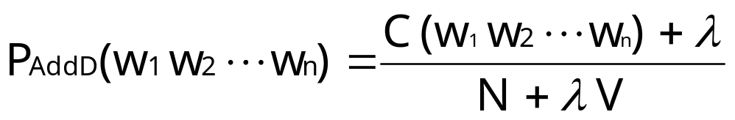
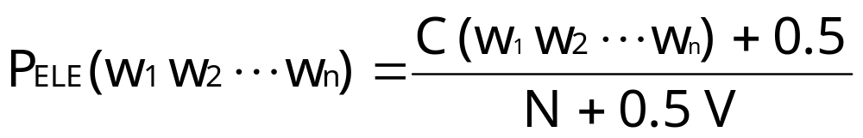
Add-delta smoothing (Lidstone’s law)
instead of adding 1, add some other (smaller) positive value λ
most widely used value for λ = 0.5
if λ=0.5, Lidstone’s Law is called:
  the Expected Likelihood Estimation (ELE)
  or the Jeffreys-Perks Law
better than add-one, but still…

Slide 36
Statistical Estimators
Maximum Likelihood Estimation (MLE)
Smoothing
  Add-one -- Laplace
  Add-delta -- Lidstone’s & Jeffreys-Perks’ Laws (ELE)
      --> ( Validation:
        Held Out Estimation
        Cross Validation )
  Witten-Bell smoothing
  Good-Turing smoothing
Combining Estimators
  Simple Linear Interpolation
  General Linear Interpolation
  Katz’s Backoff

Slide 37
Validation / Held-out Estimation
How do we know how much of the probability space to “hold out” for unseen events?
ie. We need a good way to guess λ in advance
Held-out data:
  We can divide the training data into two parts:
    the training set: used to build initial estimates by counting
    the held out data: used to refine the initial estimates (i.e. see how often the bigrams that appeared r times in the training text occur in the held-out text)

Slide 38
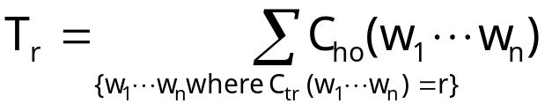
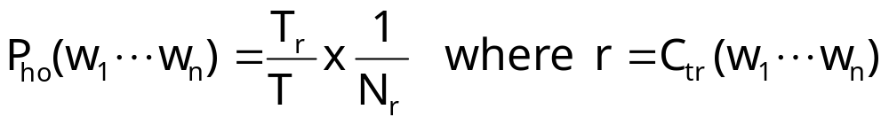
Held Out Estimation
For each n-gram w₁...w_{n} we compute:
  C_{tr}(w₁...w_{n}) the frequency of w₁...w_{n} in the training data
  C_{ho}(w₁...w_{n}) the frequency of w₁...w_{n} in the held out data
Let:
  r = the frequency of an n-gram in the training data
  N_{r} = the number of different n-grams with frequency r in the training data
  T_{r} = the sum of the counts of all n-grams in the held-out data that appeared r times in the training data
  T = total number of n-gram in the held out data
So:

Slide 39
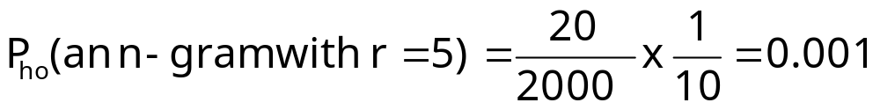
Some explanation…
probability in held-out data for all n-grams appearing r times in the training data
since we have N_{r} different n-grams in the training data that occurred r times, let's share this probability mass equality among them
ex: assume
  if r=5 and 10 different n-grams (types) occur 5 times in training
  --> N₅ = 10
  if all the n-grams (types) that occurred 5 times in training, occurred in total (n-gram tokens) 20 times in the held-out data
  --> T₅ = 20
  assume the held-out data contains 2000 n-grams (tokens)

Slide 40
Cross-Validation
Held Out estimation is useful if there is a lot of data available
If not, we can use each part of the data both as training data and as held out data.
Main methods:
  Deleted Estimation (two-way cross validation)
    Divide data into part 0 and part 1
    In one model use 0 as the training data and 1 as the held out data
    In another model use 1 as training and 0 as held out data.
    Do a weighted average of the two models
  Leave-One-Out
    Divide data into N parts (N = nb of tokens)
    Leave 1 token out each time
    Train N language models

Slide 41
Dividing the corpus
Training:
  Training data (80% of total data)
    To build initial estimates (frequency counts)
  Held out data (10% of total data)
    To refine initial estimates (smoothed estimates)
Testing:
  Development test data (5% of total data)
    To test while developing
  Final test data (5% of total data)
    To test at the end
But how do we divide?
  Randomly select data (ex. sentences, n-grams)
    Advantage: Test data is very similar to training data
  Cut large chunks of consecutive data
    Advantage: Results are lower, but more realistic

Slide 42
Developing and Testing Models
Write an algorithm
Train it
  With training set & held-out data
Test it
  With development set
Note things it does wrong & revise it
Repeat 1-5 until satisfied
Only then, evaluate and publish results
  With final test set
  Better to give final results by testing on n smaller samples of the test data and averaging

Slide 43
Factors of training corpus
Size:
  the more, the better
  but after a while, not much improvement…
    bigrams (characters) after 100’s million words (IBM)
    trigrams (characters) after some billions of words (IBM)
Nature (adaptation):
  training on WSJ and testing on AP??

Slide 44
Statistical Estimators
Maximum Likelihood Estimation (MLE)
Smoothing
  Add-one -- Laplace
  Add-delta -- Lidstone’s & Jeffreys-Perks’ Laws (ELE)
      ( Validation:
        Held Out Estimation
        Cross Validation )
  --> Witten-Bell smoothing
  Good-Turing smoothing
Combining Estimators
  Simple Linear Interpolation
  General Linear Interpolation
  Katz’s Backoff

Slide 45
Witten-Bell smoothing
intuition:
  An unseen n-gram is one that just did not occur yet
  When it does happen, it will be its first occurrence
  So give to unseen n-grams the probability of seeing a new n-gram

Slide 46
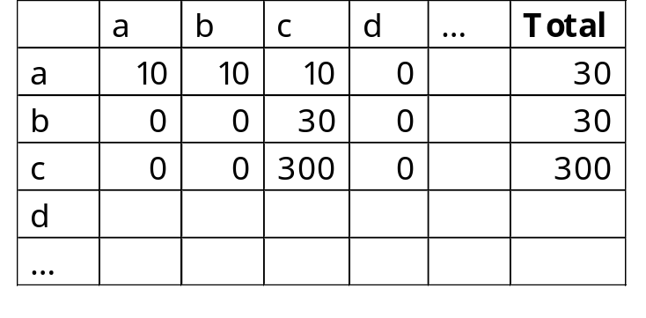
Some intuition
Assume these counts:
Observations:
  a seems more promiscuous than b…
    b has always been followed by c,
    but a seems to be followed by a wider range of words
  c seems more stubborn than b…
    c and b have same distribution
    but we have seen 300 instances of bigrams starting with c, so there seems to be less chances that a new bigram starting with c will be new, compared to b
2nd word
1st word

Slide 47
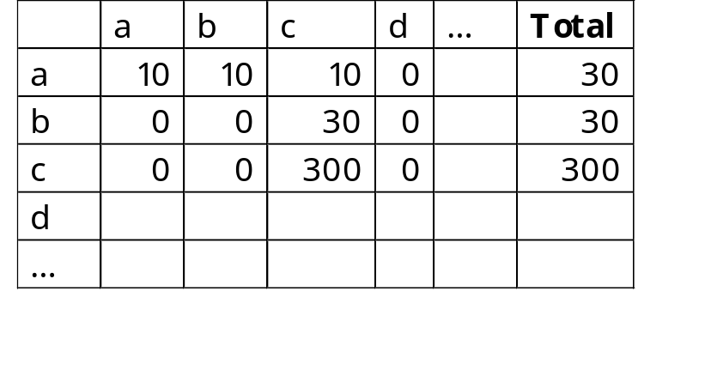
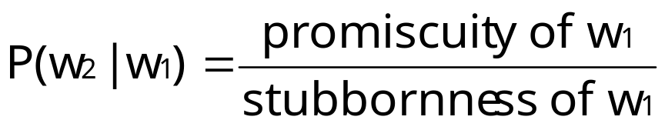
Some intuition (con’t)
intuitively,
  ad should be more probable than bd
  bd should be more probable than cd
  P(d|a) > P(d|b) > P(d|c)

Slide 48
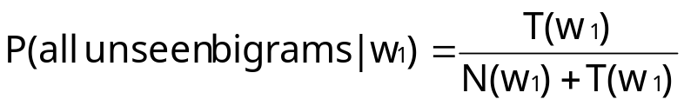
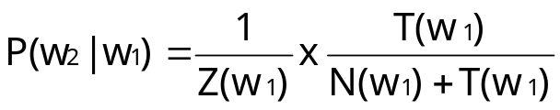
Witten-Bell smoothing
to compute the probability of a bigram w₁w₂ we have never seen, we use:
  promiscuity T(w₁)
    = the probability of seeing a new bigram starting with w₁
    = number of different n-grams (types) starting with w₁
  stubbornness N(w₁)
    = number of n-gram tokens starting with w₁
the following total probability mass will be given to all (not each) unseen bigrams
  for all unseen events
this probability mass, must be distributed in equal parts over all unseen bigrams
  Z (w₁) : number of unseen n-grams starting with w₁
  for each unseen event

Slide 49
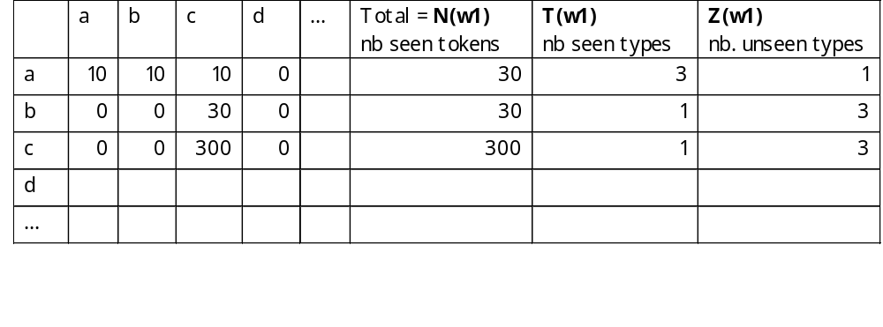
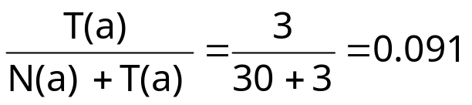
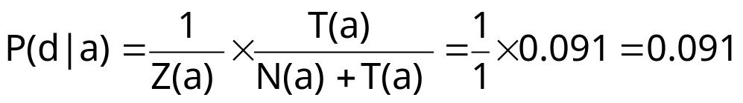
Small example
all unseen bigrams starting with a will share a probability mass of
each unseen bigrams starting with a will have an equal part of this

Slide 50
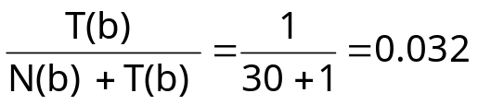
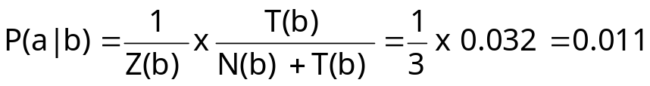
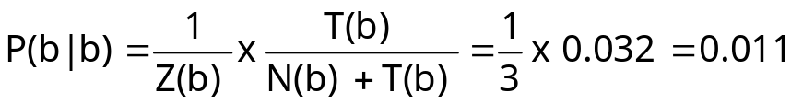
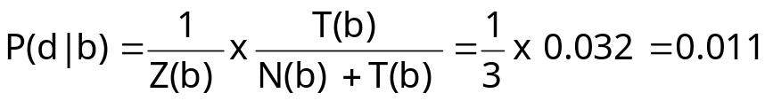
Small example (con’t)
all unseen bigrams starting with b will share a probability mass of
each unseen bigrams starting with b will have an equal part of this

Slide 51
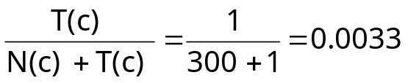
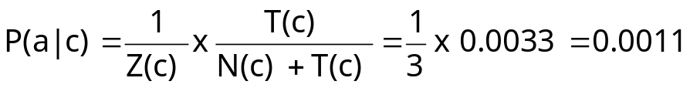


Small example (con’t)
all unseen bigrams starting with c will share a probability mass of
each unseen bigrams starting with c will have an equal part of this

Slide 52
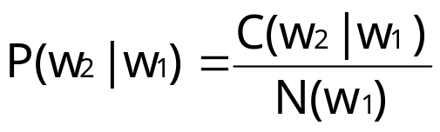
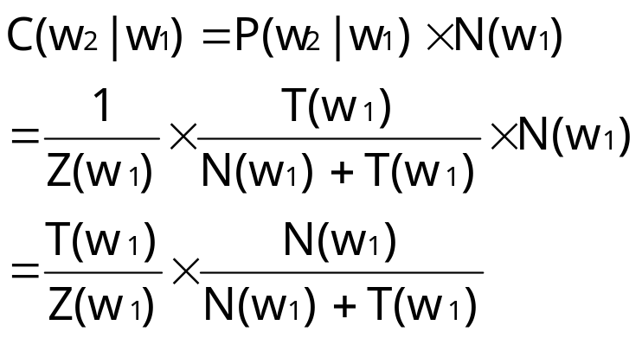
More formally
Unseen bigrams:
  To get from the probabilities back to the counts, we know that:
    // N (w₁) = nb of tokens starting with w₁
  so we get:

Slide 53
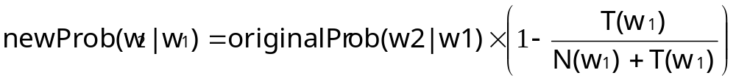
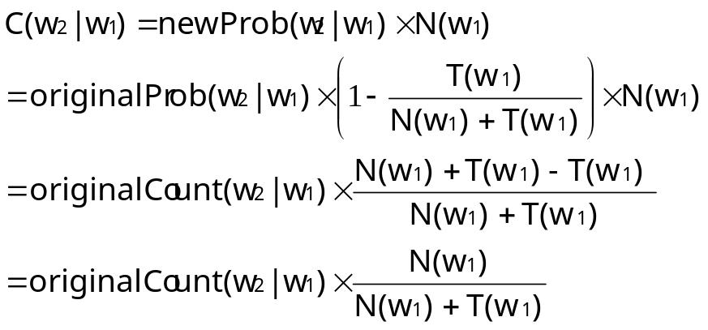
More formally (con’t)
Seen bigrams :
  since we added probability mass to unseen bigrams, we must decrease (discount) the probability mass of seen event (so that total = 1)
  we increased prob mass of unseen event by a factor of T(w₁) / N(w₁) + T(w₁) , so we must discount by the same factor
  so we get:

Slide 54
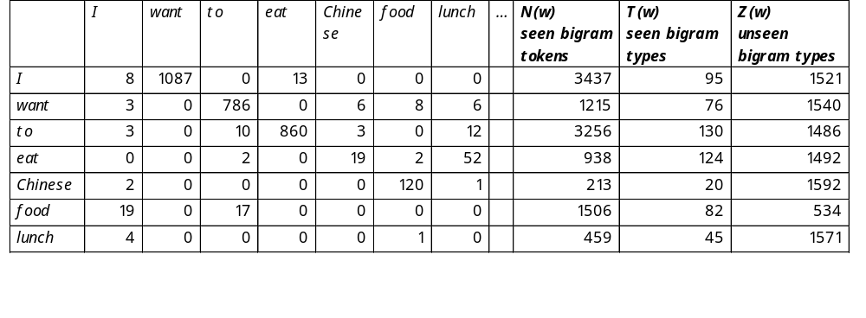
The restaurant example
The original counts were:
T(w)= number of different seen bigrams types starting with w
we have a vocabulary of 1616 words, so we can compute
Z(w)= number of unseen bigrams types starting with w
  Z(w) = 1616 - T(w)
N(w) = number of bigrams tokens starting with w

Slide 55
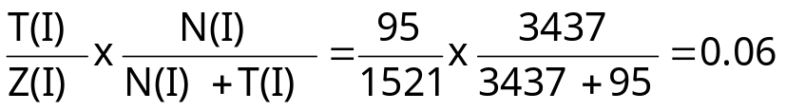
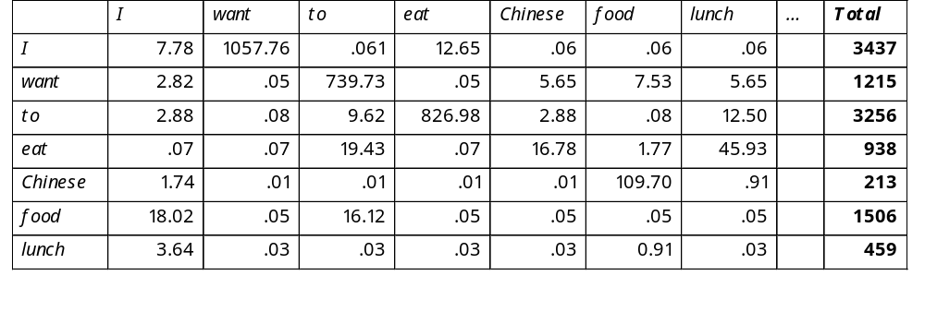
Witten-Bell smoothed count
the count of the unseen bigram “I lunch”
the count of the seen bigram “want to”
Witten-Bell smoothed bigram counts:

Slide 56
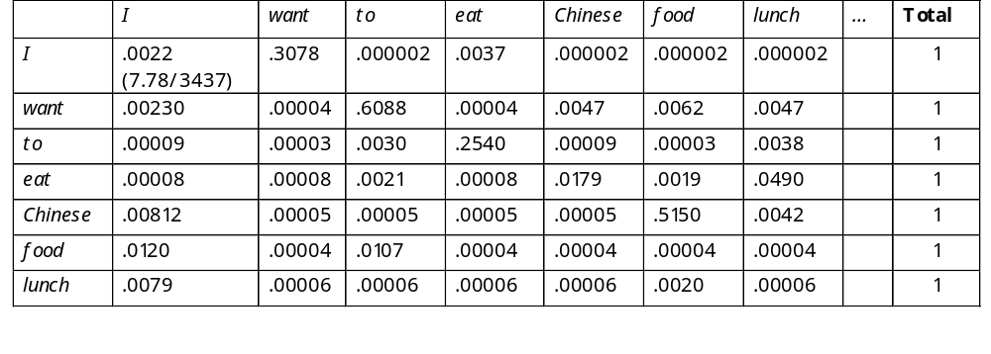
Witten-Bell smoothed probabilities
Witten-Bell normalized bigram probabilities:

Slide 57
Statistical Estimators
Maximum Likelihood Estimation (MLE)
Smoothing
  Add-one -- Laplace
  Add-delta -- Lidstone’s & Jeffreys-Perks’ Laws (ELE)
      Validation:
        Held Out Estimation
        Cross Validation
  Witten-Bell smoothing
  --> Good-Turing smoothing
Combining Estimators
  Simple Linear Interpolation
  General Linear Interpolation
  Katz’s Backoff

Slide 58
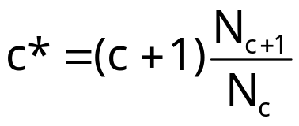
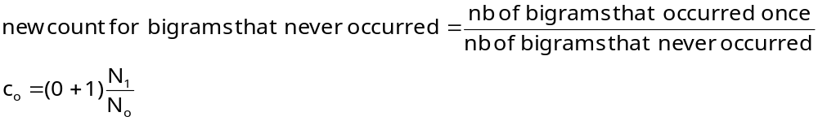
Good-Turing Estimator
Based on the assumption that words have a binomial distribution
Works well in practice (with large corpora)
Idea:
  Re-estimate the probability mass of n-grams with zero (or low) counts by looking at the number of n-grams with higher counts
  Ex:
Nb of ngrams that occur c+1 times
Nb of ngrams that occur c times

Slide 59
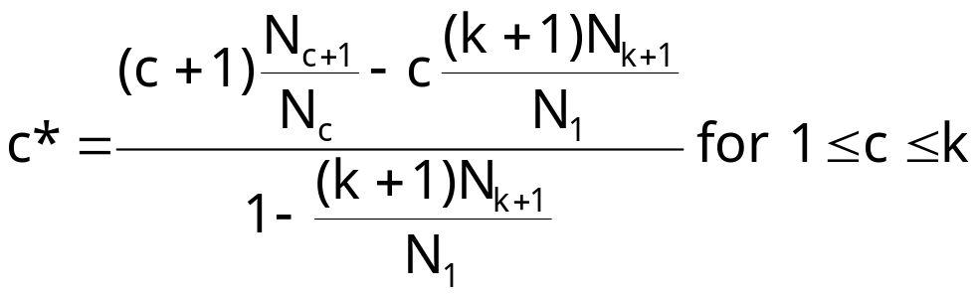
Good-Turing Estimator (con’t)
In practice c* is not used for all counts c
large counts (> a threshold k) are assumed to be reliable
If c > k (usually k = 5)
  c* = c
If c <= k

Slide 60
Statistical Estimators
Maximum Likelihood Estimation (MLE)
Smoothing
  Add-one -- Laplace
  Add-delta -- Lidstone’s & Jeffreys-Perks’ Laws (ELE)
      ( Validation:
        Held Out Estimation
        Cross Validation )
  Witten-Bell smoothing
  Good-Turing smoothing
--> Combining Estimators
  Simple Linear Interpolation
  General Linear Interpolation
  Katz’s Backoff

Slide 61
Combining Estimators
so far, we gave the same probability to all unseen n-grams
  we have never seen the bigrams
    journal of P_{unsmoothed}(of |journal) = 0
    journal from P_{unsmoothed}(from |journal) = 0
    journal never P_{unsmoothed}(never |journal) = 0
  all models so far will give the same probability to all 3 bigrams
but intuitively, “journal of” is more probable because...
  “of” is more frequent than “from” & “never”
  unigram probability P(of) > P(from) > P(never)

Slide 62
Combining Estimators (con’t)
observation:
  unigram model suffers less from data sparseness than bigram model
  bigram model suffers less from data sparseness than trigram model
  …
so use a lower model estimate, to estimate probability of unseen n-grams
if we have several models of how the history predicts what comes next, we can combine them in the hope of producing an even better model

Slide 63
Statistical Estimators
Maximum Likelihood Estimation (MLE)
Smoothing
  Add-one -- Laplace
  Add-delta -- Lidstone’s & Jeffreys-Perks’ Laws (ELE)
      Validation:
        Held Out Estimation
        Cross Validation
  Witten-Bell smoothing
  Good-Turing smoothing
Combining Estimators
  --> Simple Linear Interpolation
  General Linear Interpolation
  Katz’s Backoff

Slide 64
Simple Linear Interpolation
Solve the sparseness in a trigram model by mixing with bigram and unigram models
Also called:
  linear interpolation,
  finite mixture models
  deleted interpolation
Combine linearly
  P_{li}(w_{n}|w_{n-2},w_{n-1}) = λ₁P(w_{n}) + λ₂P(w_{n}|w_{n-1}) + λ₃P(w_{n}|w_{n-2},w_{n-1})
  where 0≤ λ_{i} ≤1 and Σ_{i} λ_{i} =1

Slide 65
Statistical Estimators
Maximum Likelihood Estimation (MLE)
Smoothing
  Add-one -- Laplace
  Add-delta -- Lidstone’s & Jeffreys-Perks’ Laws (ELE)
      Validation:
        Held Out Estimation
        Cross Validation
  Witten-Bell smoothing
  Good-Turing smoothing
Combining Estimators
  Simple Linear Interpolation
  --> General Linear Interpolation
  Katz’s Backoff

Slide 66
General Linear Interpolation
In simple linear interpolation, the weights λ_{i} are constant
So the unigram estimate is always combined with the same weight, regardless of whether the trigram is accurate (because there is lots of data) or poor
We can have a more general and powerful model where λ_{i} are a function of the history h
  where 0≤ λ_{i}(h) ≤1 and Σ_{i} λ_{i}(h) =1
Having a specific λ(h) per n-gram is not a good idea, but we can set a λ(h) according to the frequency of the n-gram

Slide 67
Statistical Estimators
Maximum Likelihood Estimation (MLE)
Smoothing
  Add-one -- Laplace
  Add-delta -- Lidstone’s & Jeffreys-Perks’ Laws (ELE)
      Validation:
        Held Out Estimation
        Cross Validation
  Witten-Bell smoothing
  Good-Turing smoothing
Combining Estimators
  Simple Linear Interpolation
  General Linear Interpolation
  --> Katz’s Backoff

Slide 68
Katz’s Backing Off Model
higher-order model are more reliable
so use lower-order model only if necessary
P_{bo}(w_{n}|w_{n-2}, w_{n-1}) =
P_{disc}(w_{n}|w_{n-2}, w_{n-1} ) if c(w_{n-2}w_{n-1} w_{n} ) > k // if trigram was seen enough
α₁ P_{disc}(w_{n} |w_{n-1}) if c(w_{n-1} w_{n}) > k // if bigram was seen enough
α₂ P_{disc}(w_{n}) otherwise
α₁ and α₂ make sure the probability mass is 1 when backing-off to lower-order model
discounted probabilities (with Good-Turing, add-one, …)

Slide 69
Other applications of LM
Author / Language identification
hypothesis: texts that resemble each other (same author, same language) share similar characteristics
  In English character sequence “ing” is more probable than in French
Training phase:
  construction of the language model
  with pre-classified documents (known language/author)
Testing phase:
  evaluation of unknown text (comparison with language model)

Slide 70
Example: Language identification
bigram of characters
  characters = 26 letters (case insensitive)
  possible variations: case sensitivity, punctuation, beginning/end of sentence marker, …

Slide 71
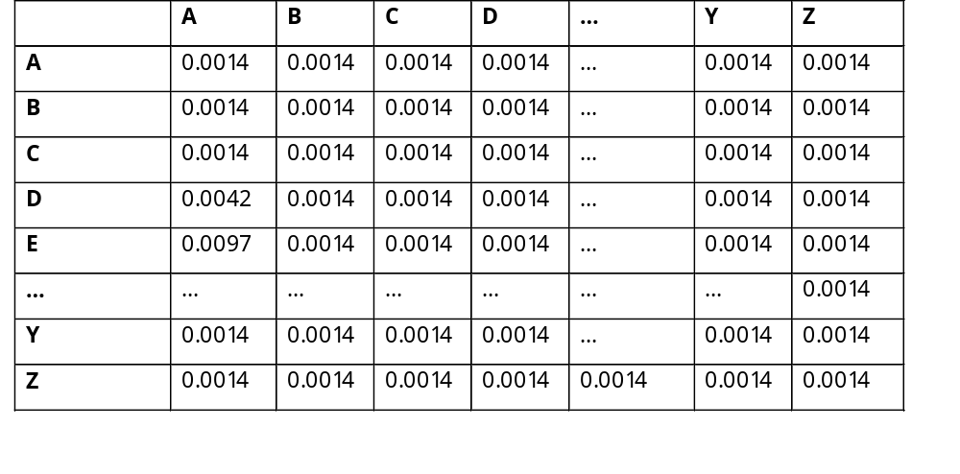
1. Train an language model for English:
2. Train a language model for French
3. Evaluate probability of a sentence with LM-English & LM-French
4. Highest probability -->language of sentence

