Slide 1
Predicting In-hospital Mortality of Patients in the Paediatric ICU
Shenda Hong
Jun 14, 2020

Slide 2
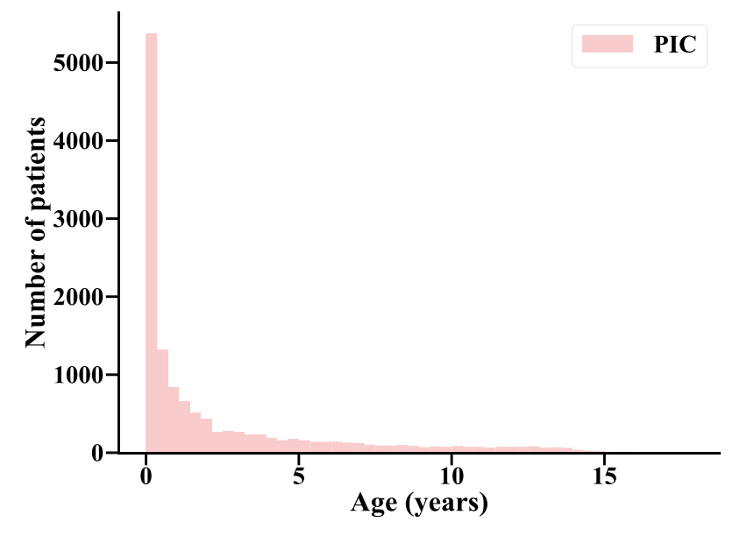

Data
PIC (Paediatric Intensive Care) database is a large, single-center database comprising information relating to patients admitted to critical care units at the Children's Hospital of Zhejiang University School of Medicine. It is a supplement to the well-known MIMIC database which provided a real clinical database for many data science researchers and supported many research projects. We hope this open paediatric intensive care database will also help improve the quality of intensive care for children.
http://pic.nbscn.org
Xian Zeng#, Gang Yu#, Yang Lu#,Linhua Tan, Xiujing Wu, Shanshan Shi, Huilong Duan, Qiang Shu* and Haomin Li*. PIC, a paediatric-specific intensive care database. Scientific Data 2020 7:14 DOI:doi.org/10.1038/s41597-020-0355-4. Available from: https://www.nature.com/articles/s41597-020-0355-4

Slide 3
Data
Task：Predicting In-hospital Mortality of Patients in the Paediatric ICU， in the first 24 hours after admission
Tables
ADMISSIONS
CHARTEVENTS
LABEVENTS
Extract min/max values in the first 24 hours after admission
1109 featrues
Impute missing values with 0

Slide 4
1109 features
Feature Selection by Machine Learning Model
Random Forest, 5 fold cross validation
Average feature importance score
Select top ranked features
64 features
?? features
Grouping
Feature Selection and Grouping by Pediatrician
Feature set 1
Feature set 2
Feature set 3
......
Model 1
Model 2
Model 3
......
Framework of Predicting In-hospital Mortality of Patients in the Paediatric ICU
Ensemble
Final Model

Slide 5
步骤及创新点
使用机器学习模型从1109个特征中初步筛选出64个特征【Joint feature selection】；
领域专家：1）从上述64个特征中进一步筛选，去除无临床意义的特征【Joint feature selection】；2）把剩余的特征，按照临床的“常规化验操作”分组；
对于每组特征建立可解释的机器学习模型（如线性模型、决策树等，具体未定），并进行模型集成ensemble得到最终的预测结果：1）模型可解释，临床实践中简单可用【Interpretation】；2）在缺失部分化验结果时（表现为特征成组缺失），也能够给出预测结果【Handle missing values via Feature grouping】。

Slide 6
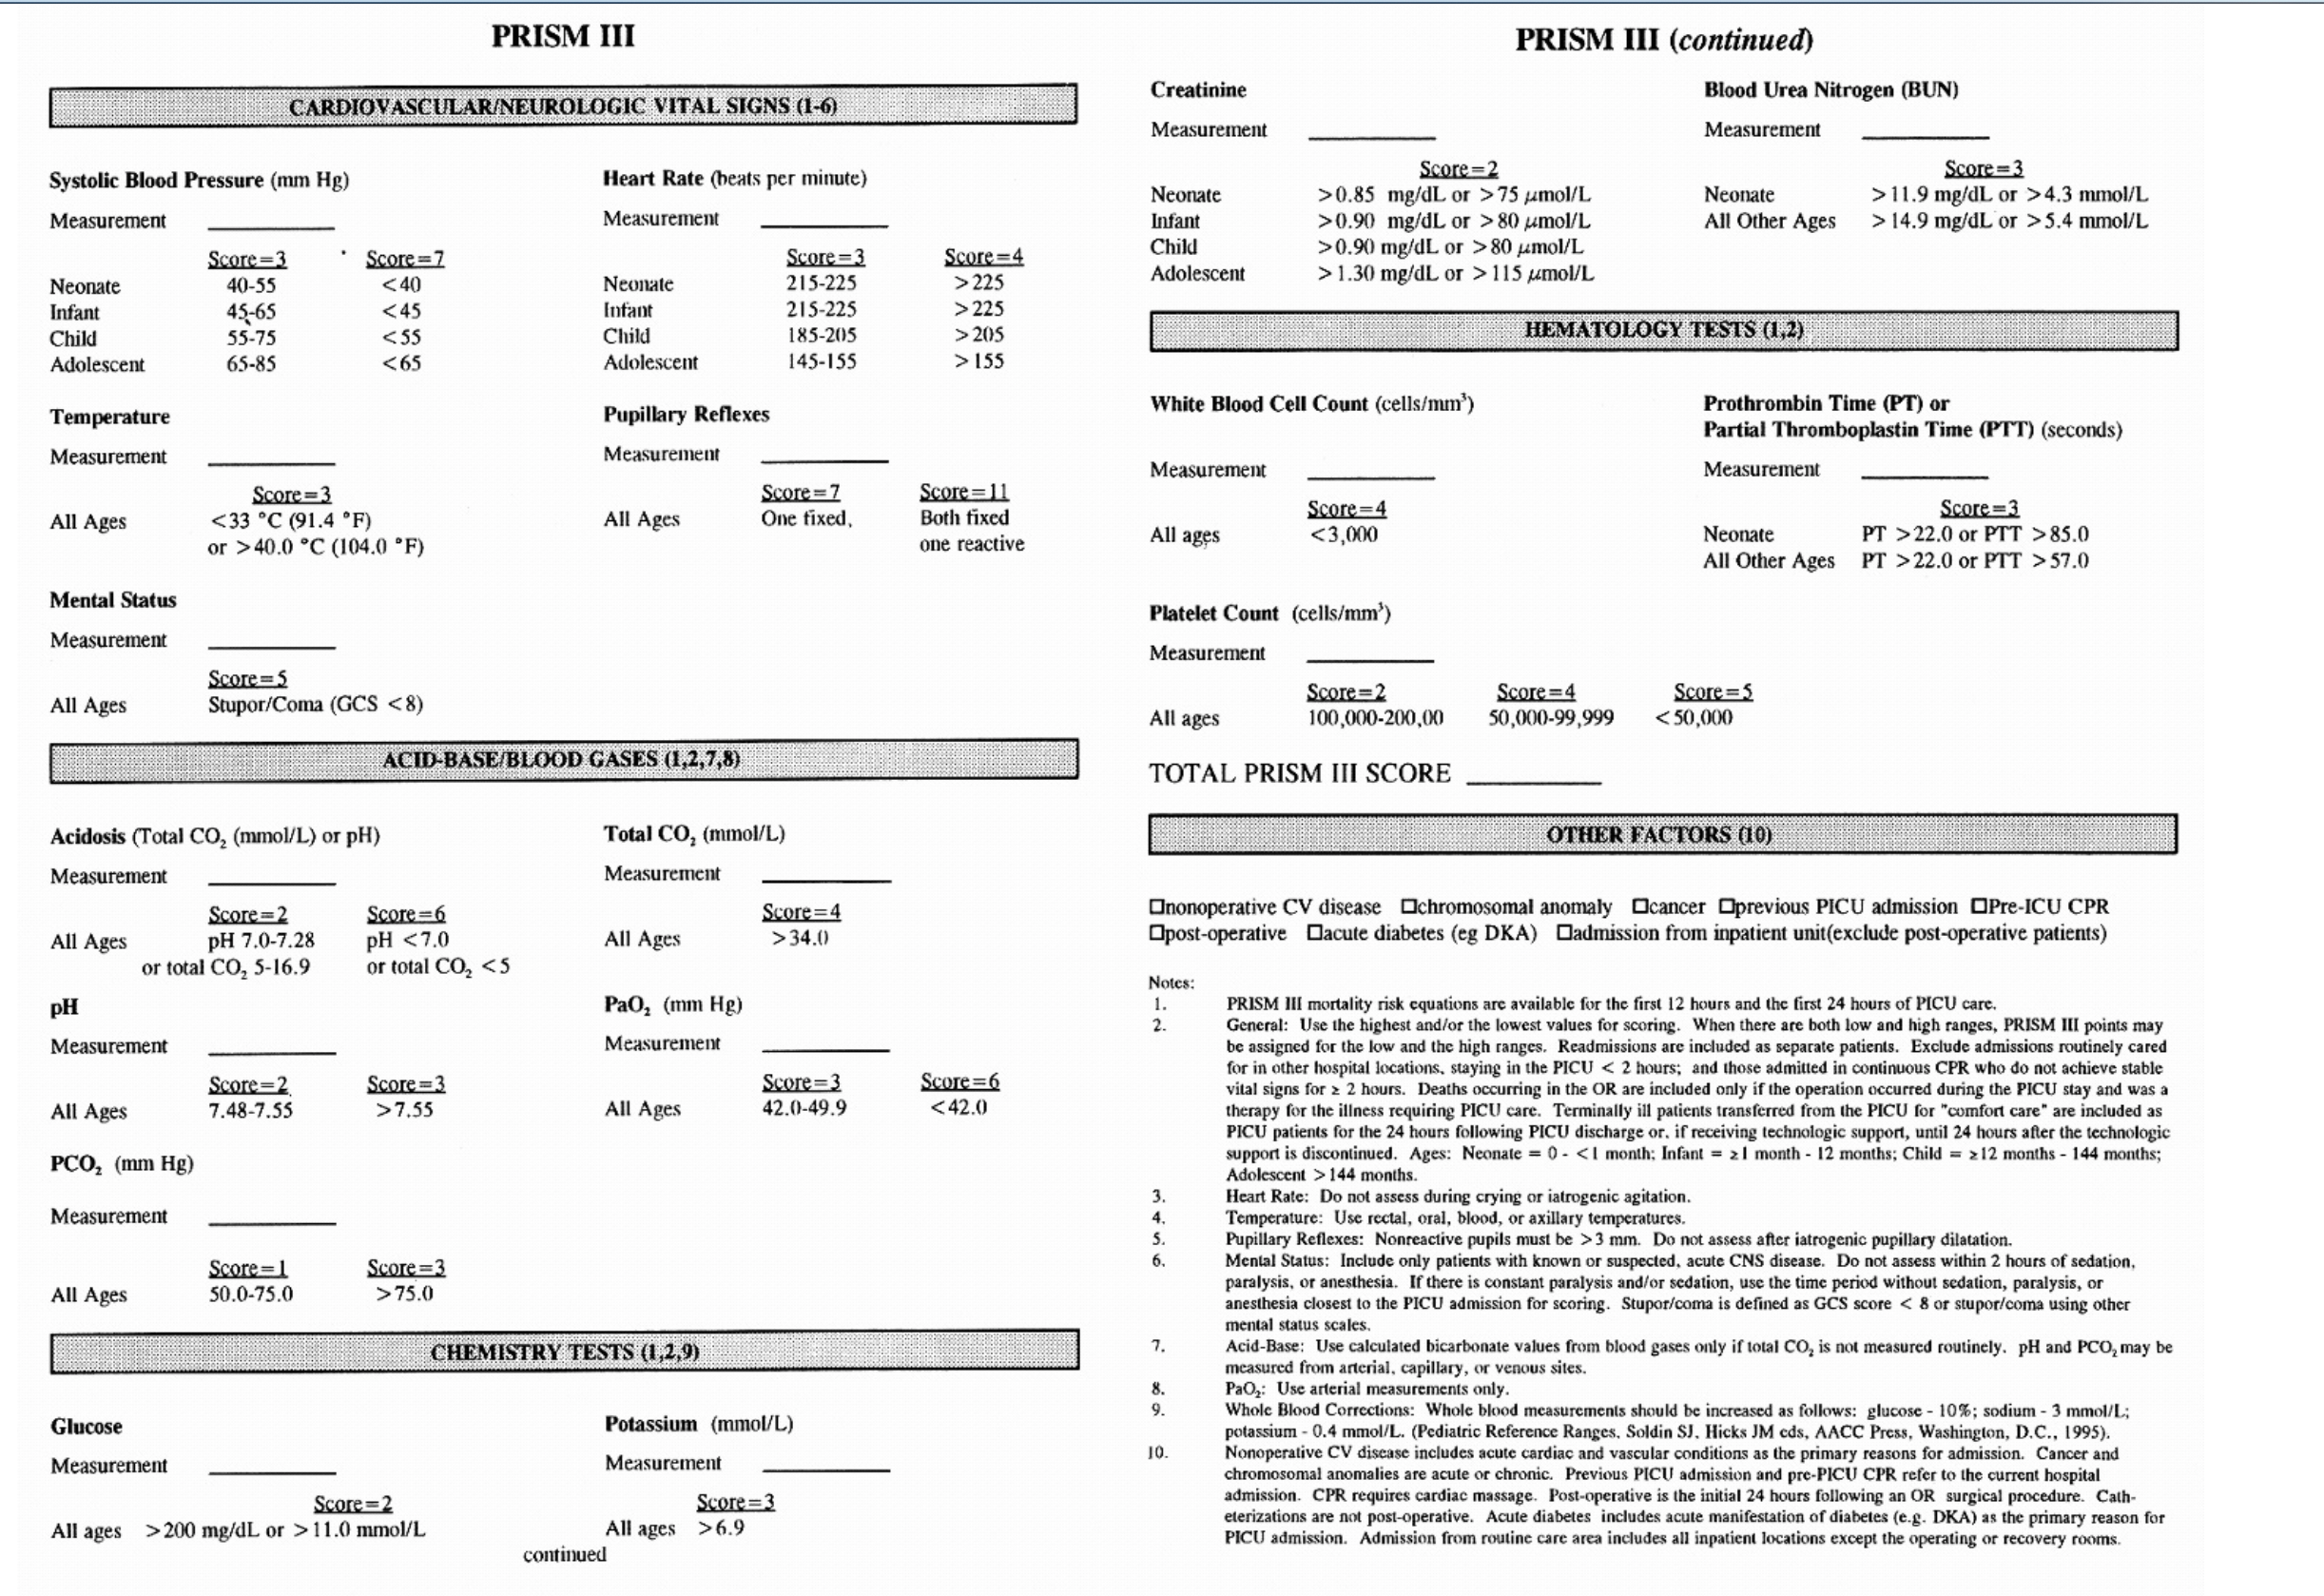
Baseline Model：
PRISM III

Slide 7
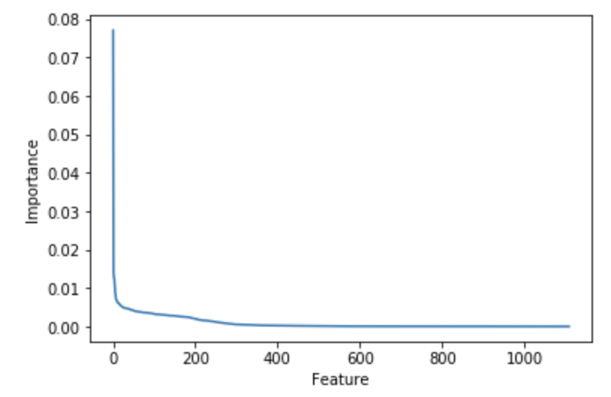
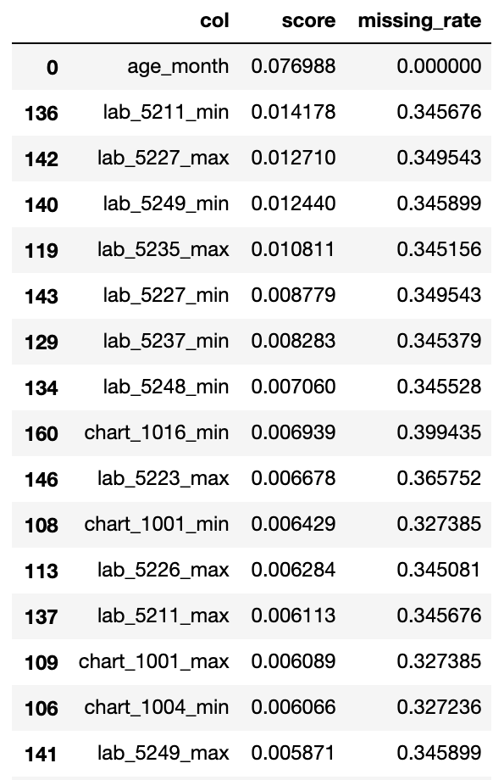

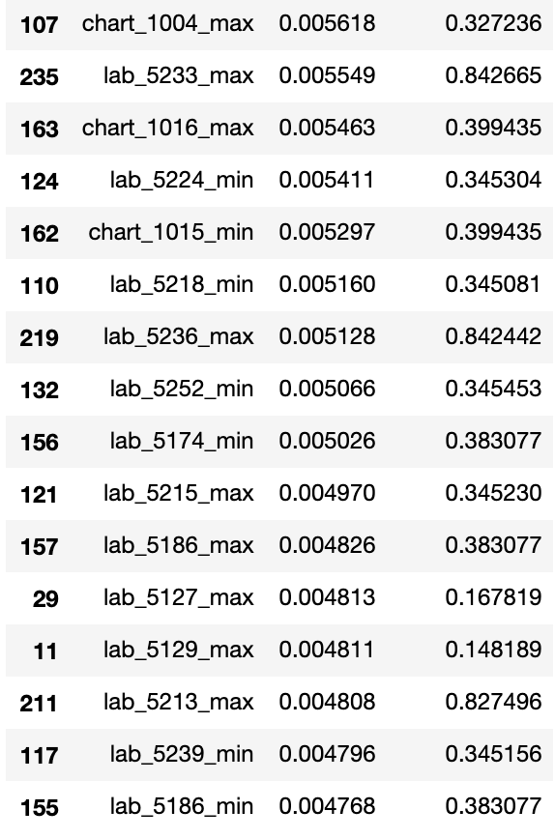
Results: Feature Importance from RF
排序
1
2
3
4
5
6
7
8
9
10
11
12
13
14
15
16
年龄（月）
实际碱剩余
乳酸
标准碱剩余
二氧化碳分压
乳酸
酸碱度
标准碳酸氢根
收缩压
血糖
体温
钾
实际碱剩余
体温
呼吸
标准碱剩余
17
18
19
20
21
22
23
24
25
26
27
28
29
30
31
32
呼吸
p50(T)
收缩压
碳酸氢根HCO3-
舒张压
氯 Cl-
二氧化碳分压 pCO2(T)
氧饱和度 sO2
INR(PT)
钙（离子） Ca2+
凝血酶原时间(PT)
血小板压积
血小板计数
阴离子间隙 Anion Gap(K+)
氧分压 pO2
凝血酶原时间(PT)

Slide 8
Results: Compare
AUROC (mean, std)
#Features | defined by model | all | 128 | 64 | 32 | 16 | 8 | 4
PRISM_III | 0.5949, 0.0000
LR |  | 0.7100, 0.0157 | 0.7612,0.0132 | 0.7806,0.0168 | 0.8054,0.0090 | 0.7964,0.0143 | 0.6832,0.0079 | 0.6552,0.0128
RF |  | 0.8277, 0.0142 | 0.8307,0.0156 | 0.8232,0.0076 | 0.8146,0.0177 | 0.7729,0.0211 | 0.6649,0.0198 | 0.6424,0.0192
AUPRC (mean, std)
#Features | defined by model | all | 128 | 64 | 32 | 16 | 8 | 4
PRISM_III | 0.1534, 0.0000
LR |  | 0.1730, 0.0076 | 0.1958,0.0219 | 0.2208,0.0220 | 0.3226,0.0148 | 0.3129,0.0142 | 0.2659,0.0175 | 0.2428,0.0210
RF |  | 0.2930, 0.0095 | 0.2986,0.0131 | 0.2994,0.0071 | 0.3045,0.0115 | 0.2722,0.0109 | 0.2401,0.0132 | 0.2029,0.0208

Slide 9
Conclusion
LR and RF can perform better than PRISM_III
Feature selection can promote both LR and RF
RF with 128 features performs the best
The recommended model is LR with 32 features

Slide 10
TODO
除了PRISM_III是否有别的被广泛使用的方法？
我查了SAPS II等适用于16岁以上的人，所以就没有对比，是否合理？
P6是使用随机森林建模全部1109个特征后，得到了最重要的32个特征的排序，请问模型选出的特征是否真的重要？是否有错选？是否有漏选？
合适的目标期刊

Slide 11
Thanks!

