Slide 1
Presentation on the topic “Analysis of the impact of coronavirus on the global economic situation”
Made by Iakovlev Evgenii, Panasiuk Ivan, Redikultsev Vladislav

Slide 2
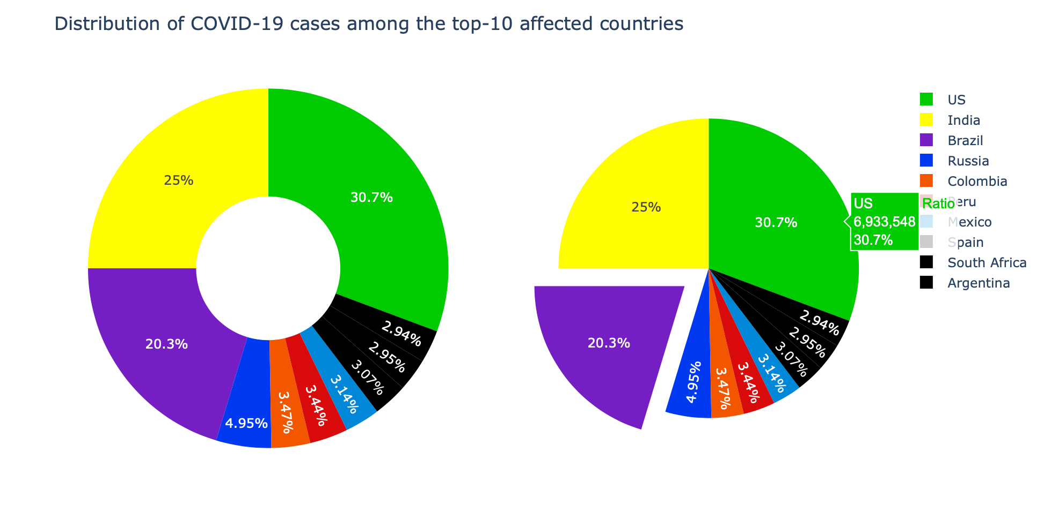
What is coronavirus pandemic and how it connected with economy
Coronavirus was discovered on 31, December, 2019 in China
Then followed rapid spread
Lockdowns globally led to economic slowdown in the whole world
–Coronavirus had a crucial impact on major economy – US
–Pandemic greatly affected major developing economies – India, Brazil
–These resulted in turbulence in the Global Economy

Slide 3
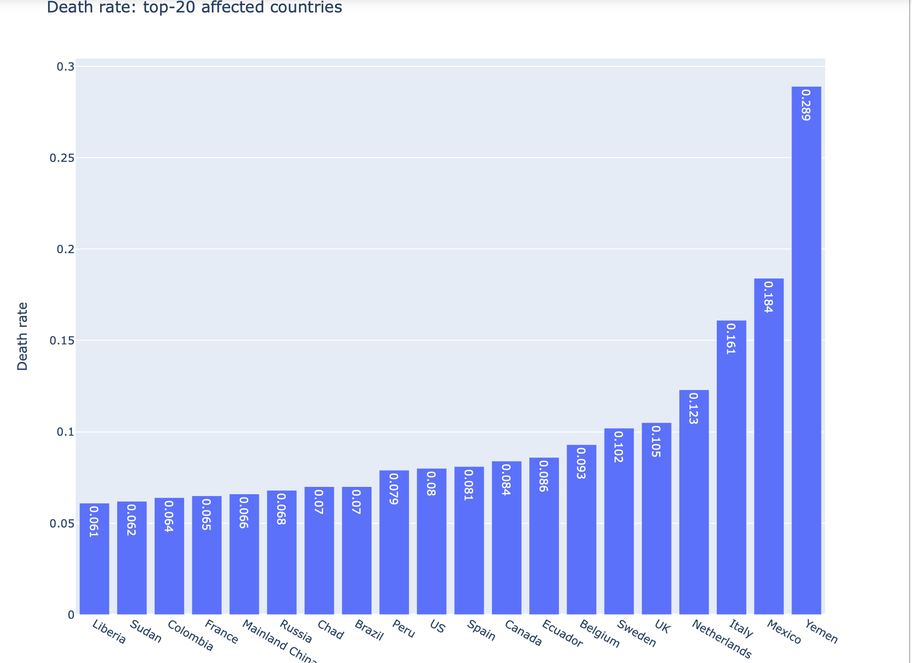
Tightening lockdowns ubiquitous
Death rate provokes quarantine measures,
consequently pressures business and leads to unemployment
Every government tried to do anything to decrease mortality rate
Including eliminating small business...

Slide 4
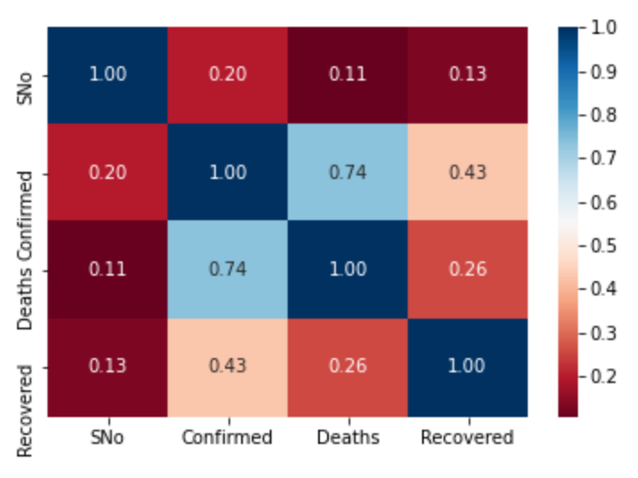
What are your chances in fighting the disease?
-Represents correlation between cases, death and recovery rates
-Strong correlation between confirmed cases and deaths
-Not only correlation in this case, but also causation

Slide 5
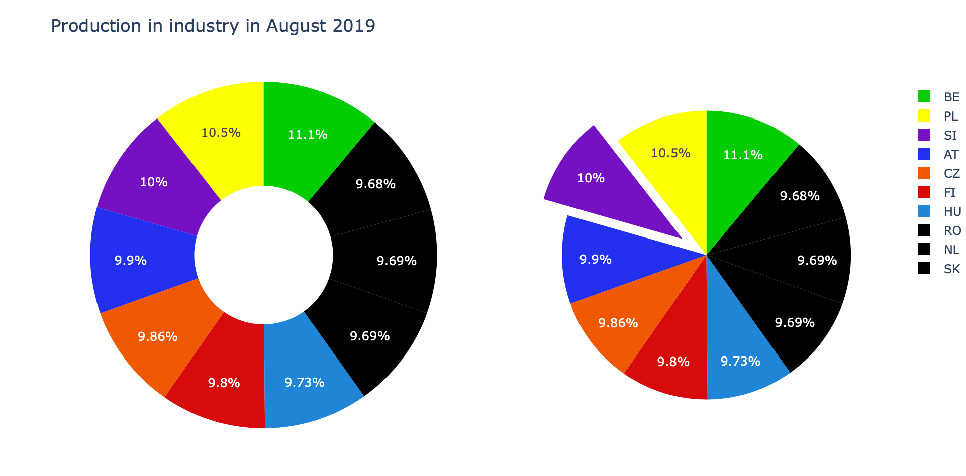
Before it all began
-Before pandemic states possessed from 9.68% of the market to 11.1%(relative equality of production)
-Belgium was the leader, followed by Poland and Switzerland

Slide 6
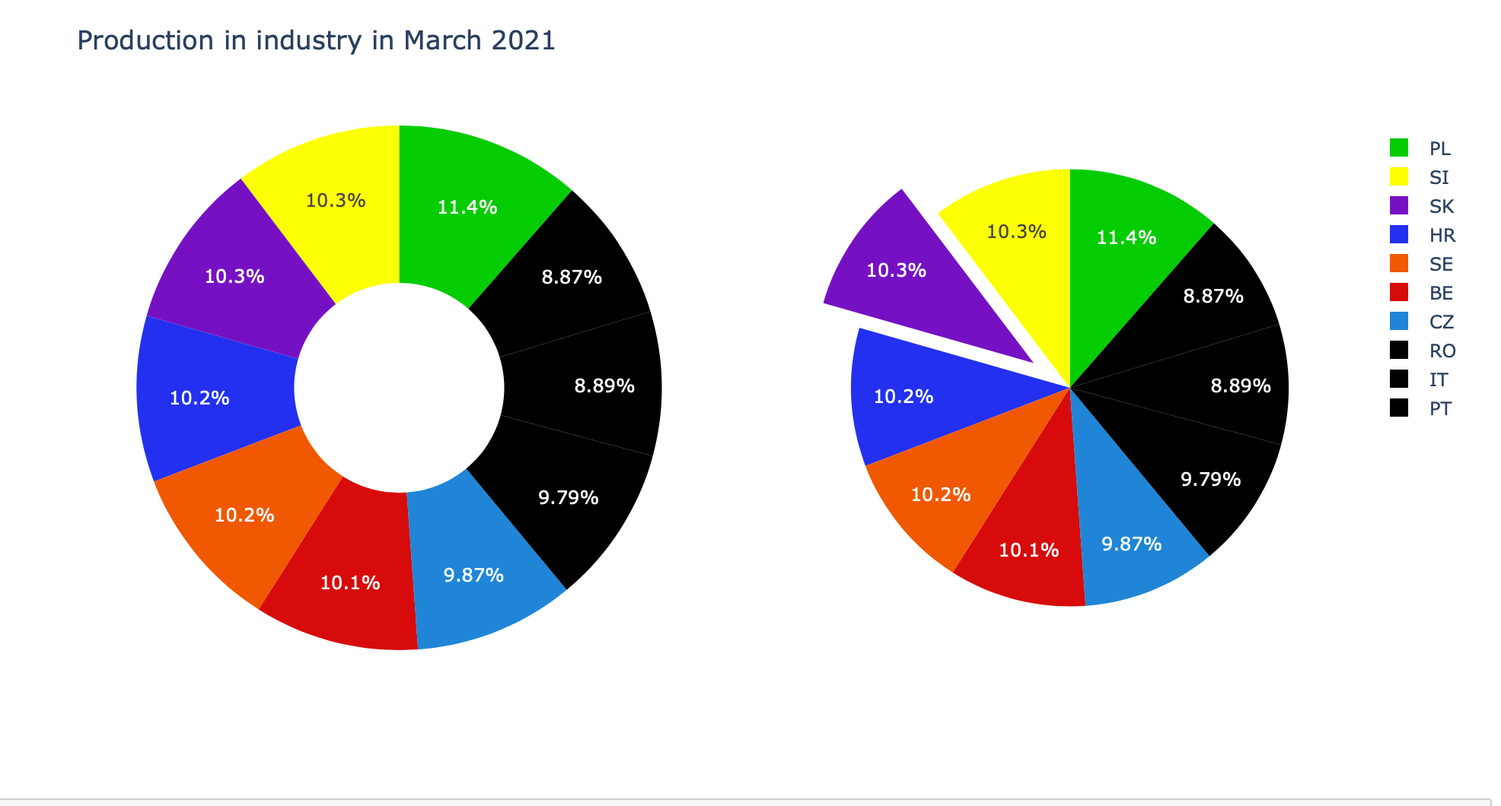
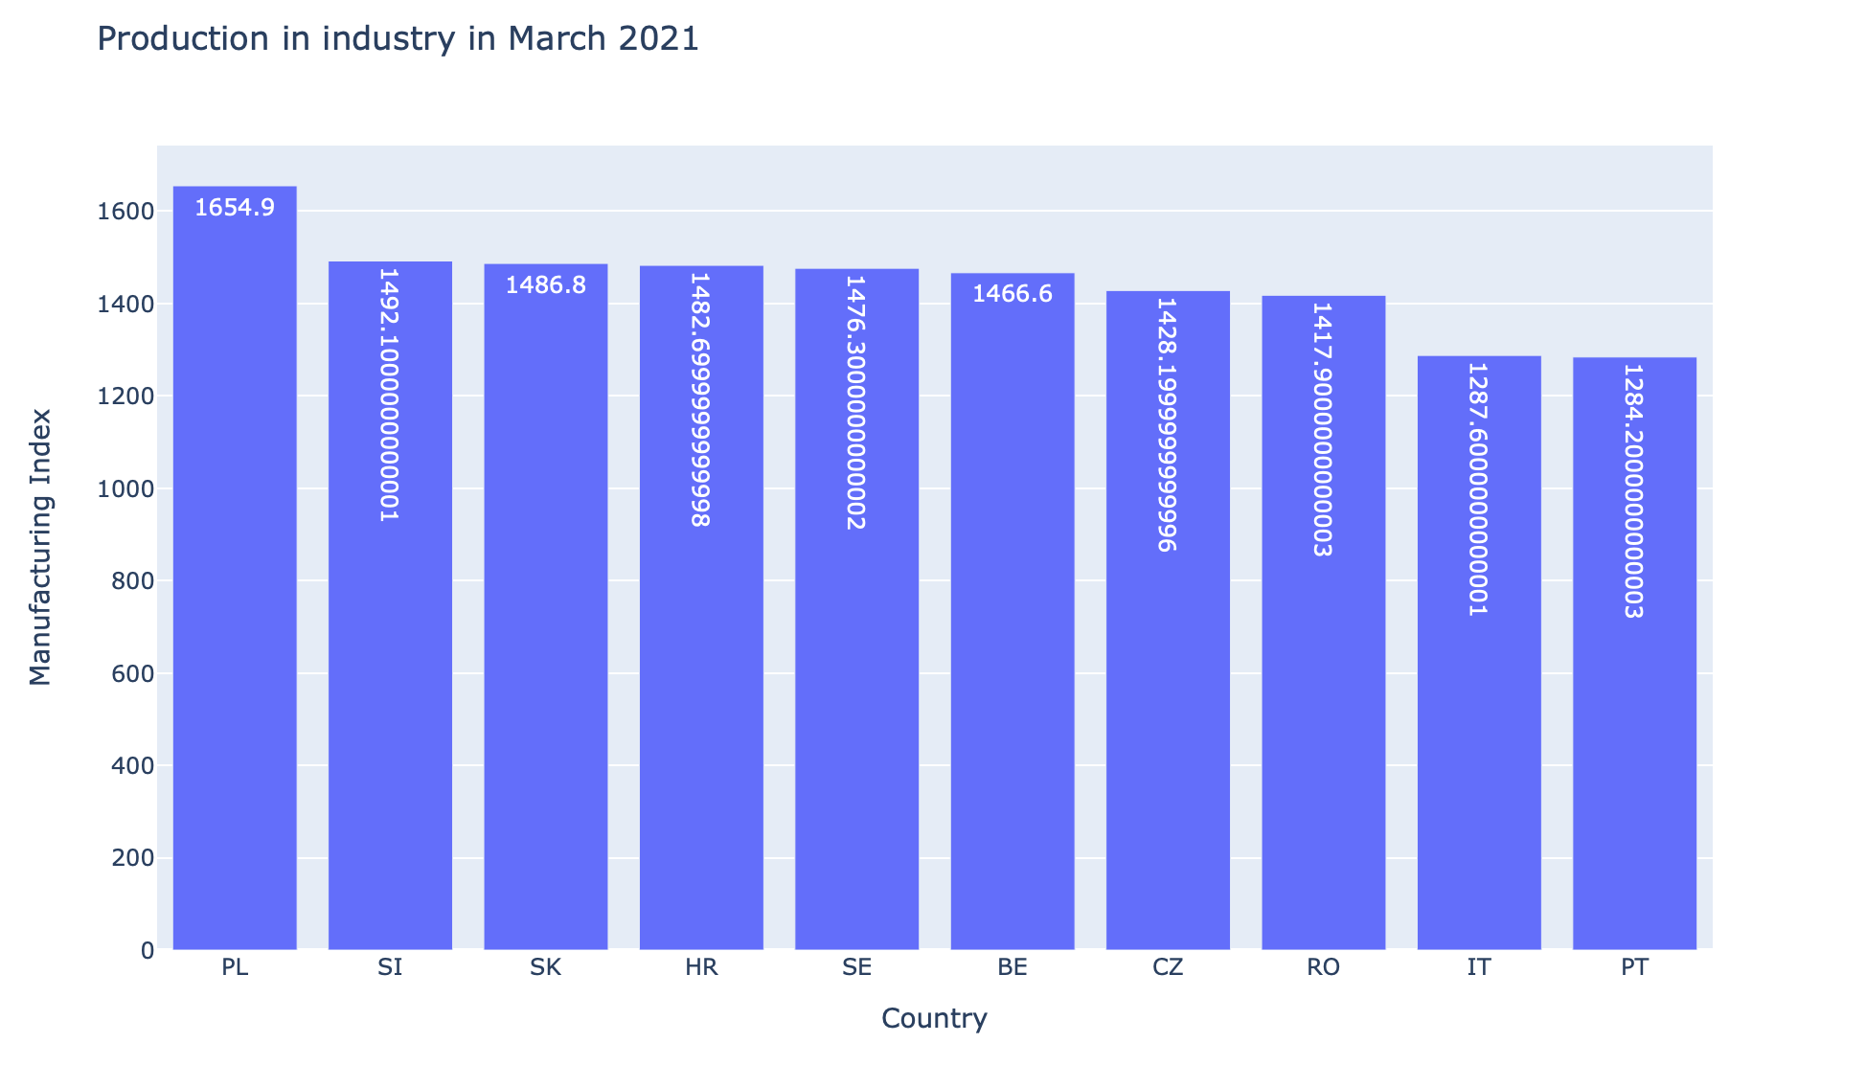
After a year of Covid-19
-Poland took the first place
-Switzerland stayed behind it, (but Slovakia has almost same percentage)
-Belgium has fallen on the 5th place
-Due to statistics given above(about deaths)

Slide 7
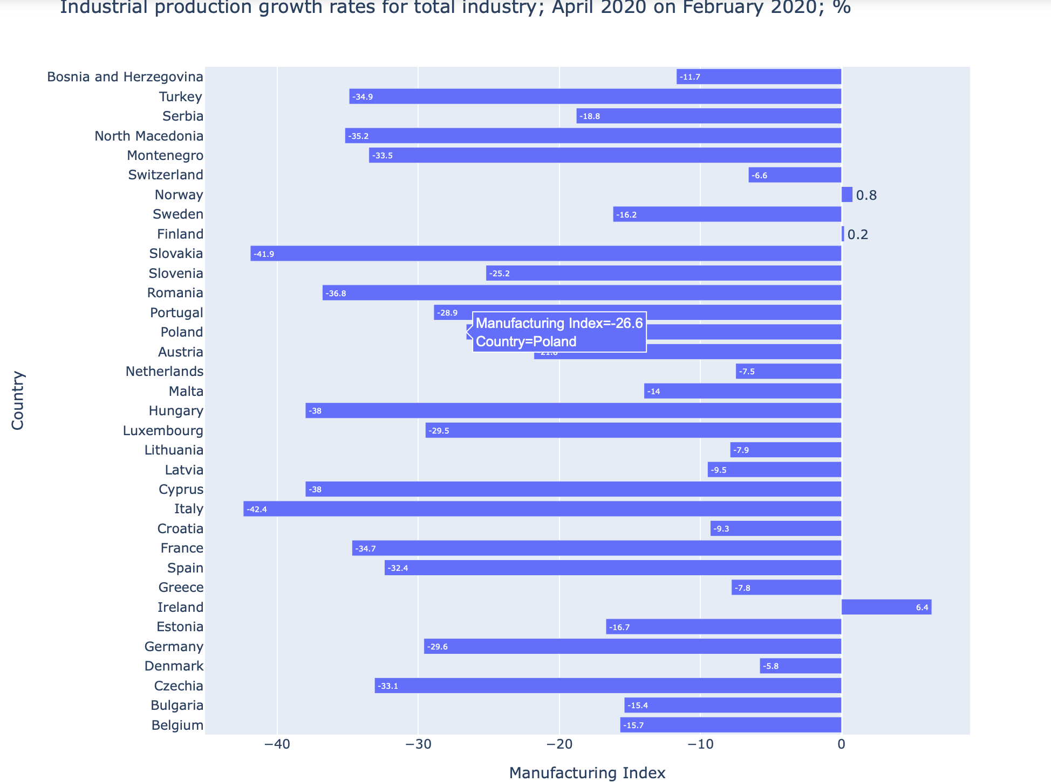
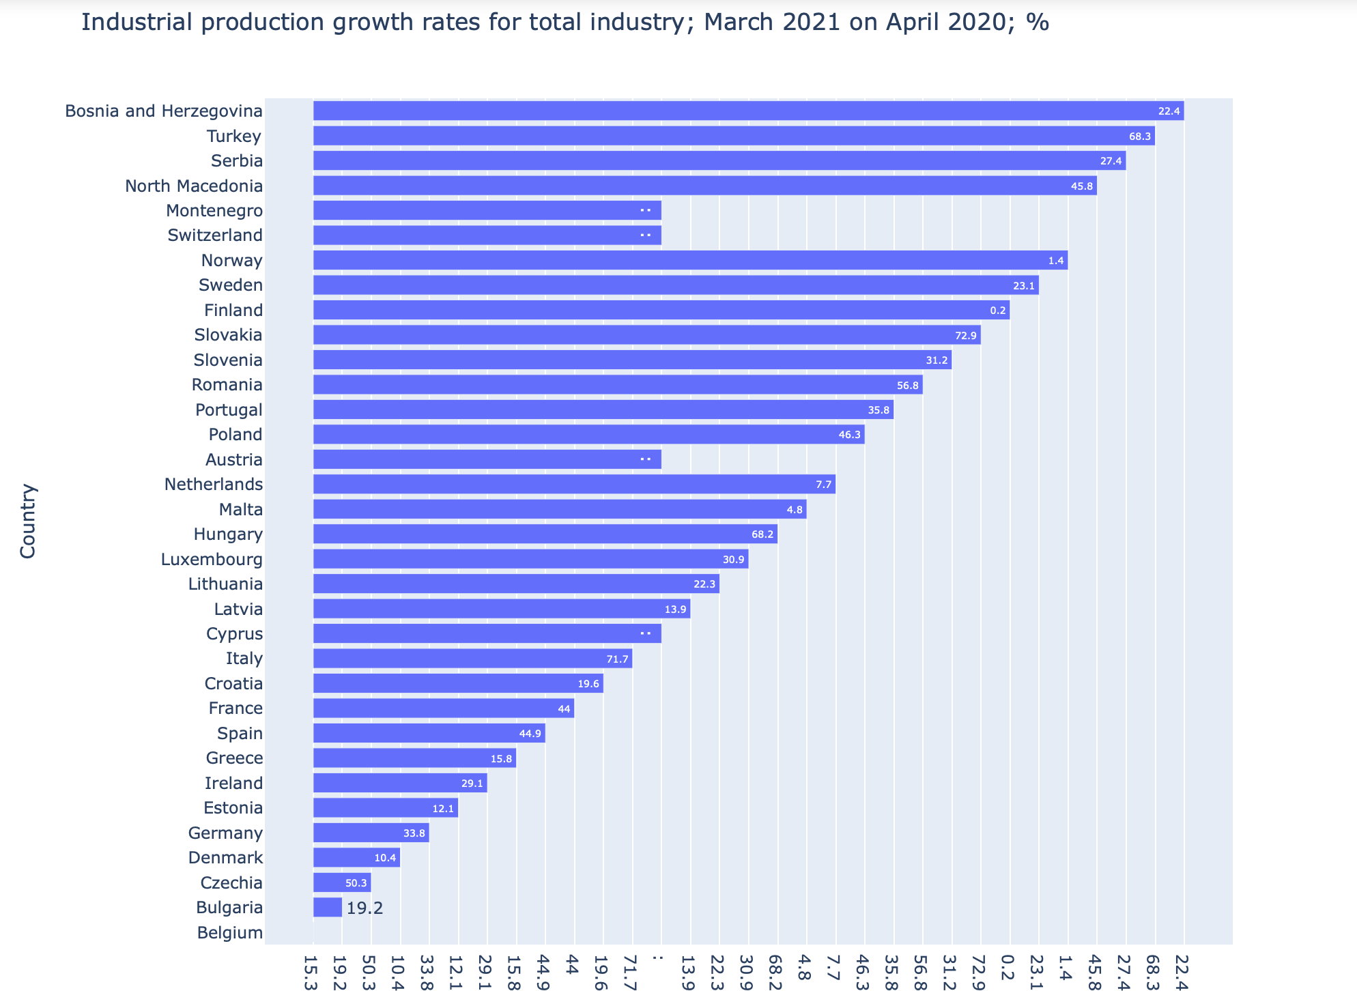
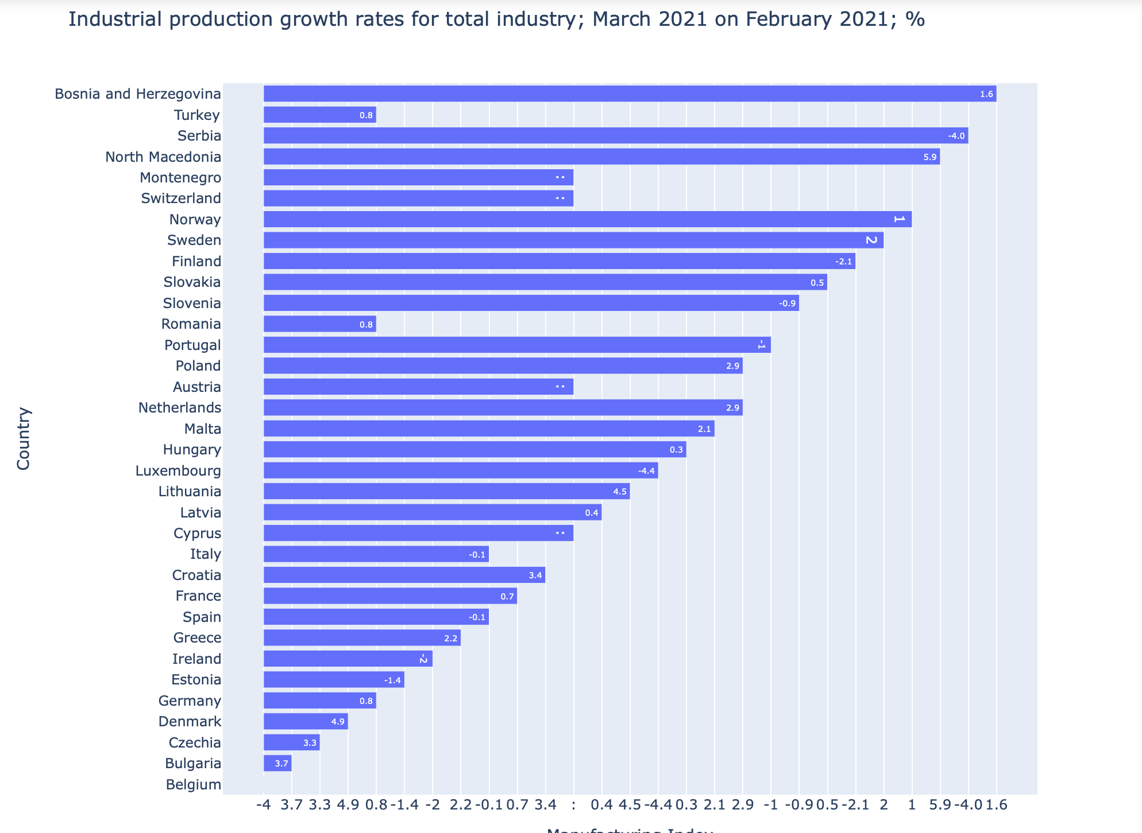
Effect on industry
-Italy suffered the most during the first wave, this explains low growth rate in comparison with other states.
-Finland and Norway managed to increase production during April 2020
-Consequently, little capital loss and steady growth.

Slide 8
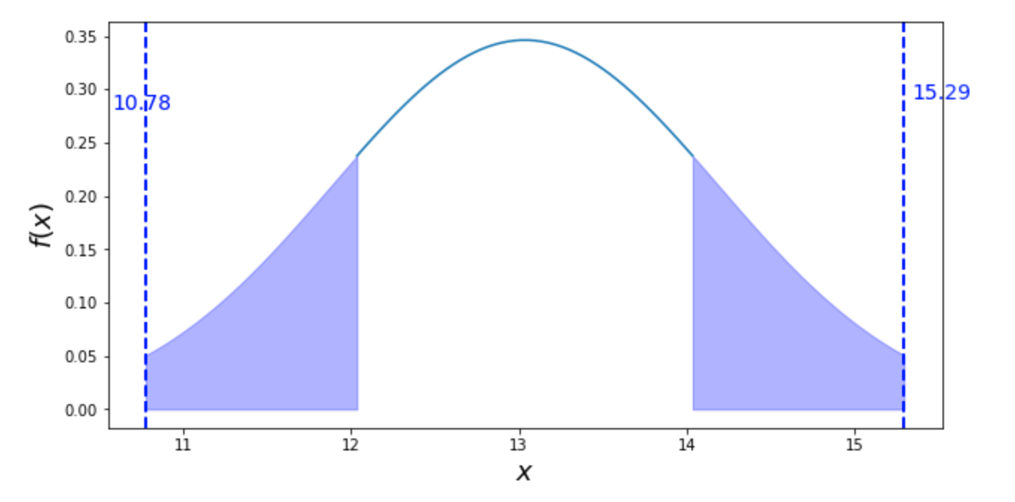
Test of hypothesis
Firstly, by t-test:
H0: there is no statistically significant difference in the average industrial production before and after covid, while H1 there is.
From the results H0 is rejected
Secondly, by f-test: H0: there is no difference in the variance between the indexes before and after covid and H1: there is. H0 here also proved to be false.

Slide 9
Conclusion
Coronavirus has impacted global economy massively. That is underlined by the statistics of global economic performance since the beginning of the pandemic. In addition, the research demonstrated that the states that were damaged more by the virus, decreased their temps of growth.

