Slide 1
QT UI
To make the GUI, make changes in pclviewer.ui file
Each object added corresponds to certain xml code
            Evokes QT 4 Designer
            Give object name :
              qvtkWidget for the visualizer for instance
              ProgressBar

Slide 2
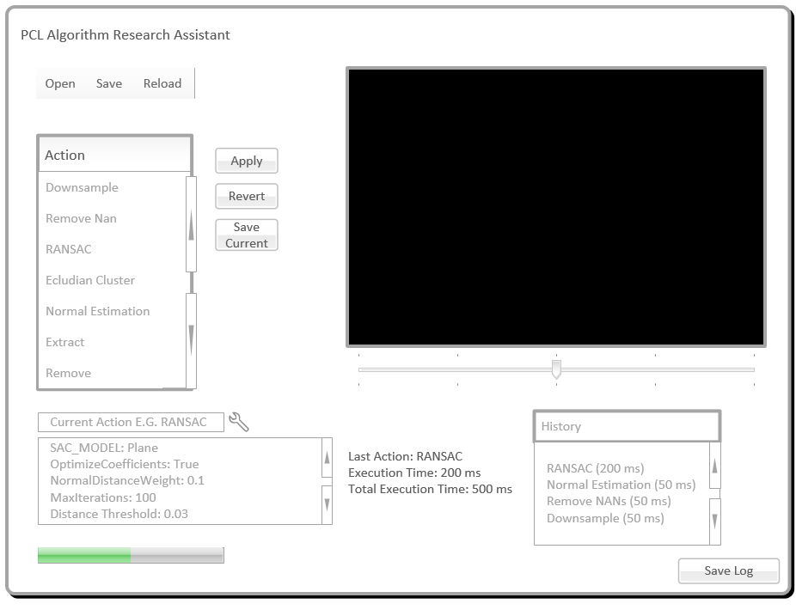
Reference Design

Slide 3
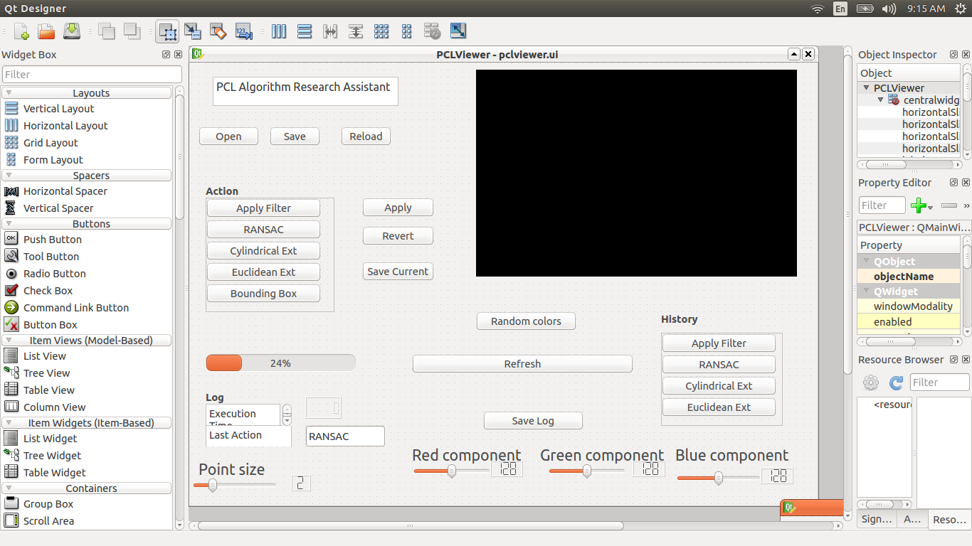
QT Designer

