Slide 1
Unit 1 Linux Background and Open Source Joe Oakes Penn State

Slide 2
Linux: Overview
What is Linux?
Kernel
Distros
GPL: General Public License
Software and Standards
Hierarchical File system

Slide 3
What is Linux?
Linux is a product of the Internet
Linux is a free operating system
All the source code is free
You can study the source code, modify it, and redistribute it
The original Kernel was developed by a Finnish student Linus Torvalds – .01 released 1991

Slide 4
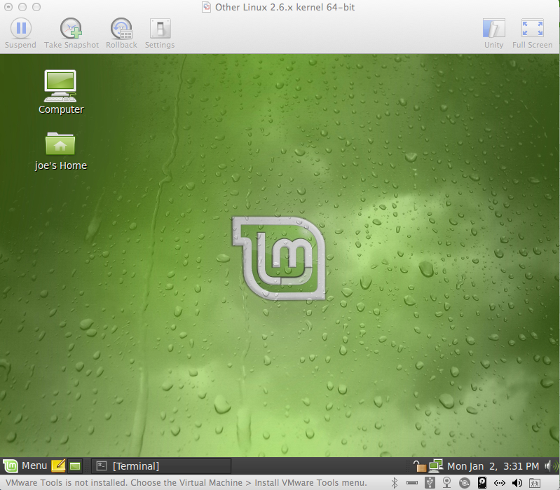
What is Linux?
There are many distributions - distros
Gentoo
Fedora
Ubuntu
Debian
CentOS
Mandriva
OpenSuse
Linux Mint

Slide 5
What is Linux?
There are many bundled OS packages
WAMP: Windows (OS), Apache (Web Server), MySQL (Database), PHP (Web Server Dynamic Programming Language) or Perl or Python (scripting programming languages)
MAMP: Mac (OS), Apache (Web Server), MySQL (Database), PHP (Web Server Dynamic Programming Language) or Perl or Python (scripting programming languages)
LAMP: Linux (OS), Apache (Web Server), MySQL, PHP (Web Server Dynamic Programming Language) or Perl or Python (scripting programming languages)

Slide 6
What is Linux?
An operating system
Schedules tasks
Allocates storage
Handles peripheral interfaces
Printers
Disk drives
Screen
Keyboard
mouse

Slide 7
What is Linux?
An operating system: has two main parts
Kernel: allocates machine resources
memory
disk space
CPU cycles
System programs
Handles higher level functions
Servers

Slide 8
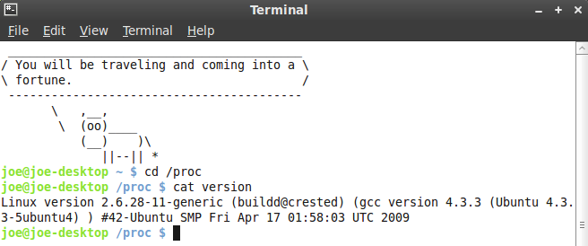
What is Linux?
Technology Timeout: proc directory
Contains files about Linux
$ cd /proc
$cat version

Slide 9
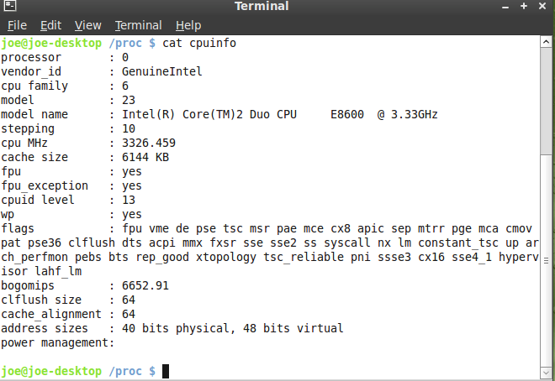
What is Linux?
Technology Timeout: proc directory
$ cd /proc
$cat cpuinfo

Slide 10
What is Linux?
GPL: General Public License
The GPL says you have the right to copy, modify, and redistribute the code covered by the agreement
When you redistribute the code you must also distribute the same license with the code
Works different than copyright – gives rights instead of limiting them – termed copyleft

Slide 11
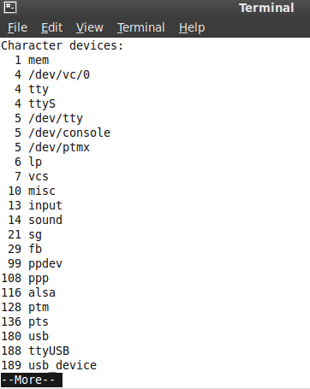
What is Linux?
Technology Timeout
Less is more
Linux replaced the more UNIX screen paging utility with a more improved utility named less
$cat devices | less

Slide 12
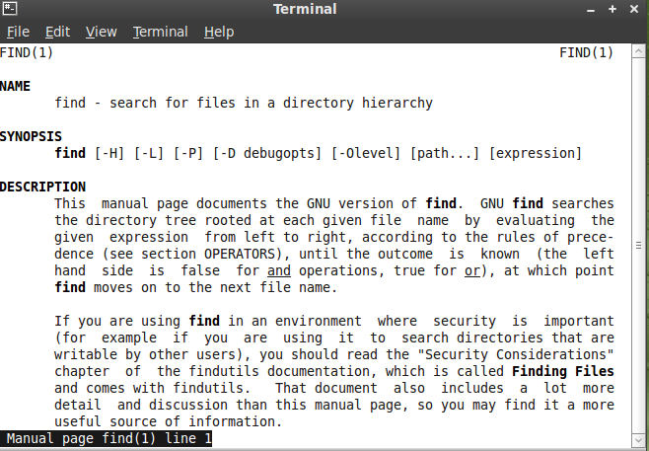
What is Linux?
Technology Timeout
Getting help
$man find

Slide 13
What is Linux?
Technology Timeout
Ghostscript
The utility to view PostScript documents is ghostscript
Text Editors
Vim, gEdit, Nano, Emacs
Elvis
One of the many vi file editor replacements is elvis

Slide 14
What is Linux?
Standards
POSIX: Portable Operating System Interface
Applications
Companies: IBM, GNU, KDE, Apache, gnome
www.ibm.com/linux
www.gnu.org
www.kde.org
www.gnome.org
www.apache.org

Slide 15
What is Linux?
Software
Mozilla – www.mozilla.org
Firefox: Web Browser
Thunderbird: Email Client
Lightning: calendar for Thunderbird
Bugzilla: server software designed to help you manage software development.
Sea Monkey: All-in one internet application suite
Fennec: Browser for Mobile devices

Slide 16
What is Linux?
Platforms
Emulators
Allows you to run some DOS, Windows, Mac programs under Linux
www.winehq.com
Virtual Machines
www.virtualbox.org - Sun
Parallels
Vmware
Xen - Citrix
QEMU

Slide 17
What is Linux?
Linux has a Kernel Programming Interface
Programs interact with the Kernel using system calls
System calls are special functions with well known names
Linux Can Support Many Users
It is a multiuser operating system that allows many people to use all the system resources

Slide 18
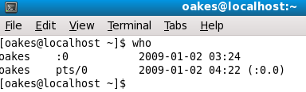
What is Linux?
Technology Timeout: Showing users on the system
Who
The who command will display who is logged on to the system
Shows which terminal they logged into
Shows what time they logged into the system
Shows the name of the host from which they have logged in
pts: pseudo-terminal slave

Slide 19
What is Linux?
Linux Can Run Many Tasks
Linux is a fully protected multitasking operating system
It allows each user to run more than job at a time
Processes can communicate with each other but remain fully protected from one another

Slide 20
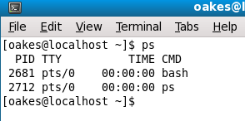
What is Linux?
Technology Timeout: Tasks
ps command - report on active processes
Shows the Process ID # – PID
TTY: Teletype terminal
CMD: command

Slide 21
What is Linux?
Linux Provides a Secure Hierarchical File system
The Linux file system provides a structure where files are arranged under directories
Each directory can hold files or other directories
The structure is like a treelike organization
Each user has one primary directory

Slide 22
What is Linux?: Filesystem
/
Root
bin
boot
dev
etc
home
lib
tmp
usr
var
joe
jim
john
Desktop
Documents
Download
$ cd /bin
Contains commands that are used by both the system administrator as well as non-privileged users

Slide 23
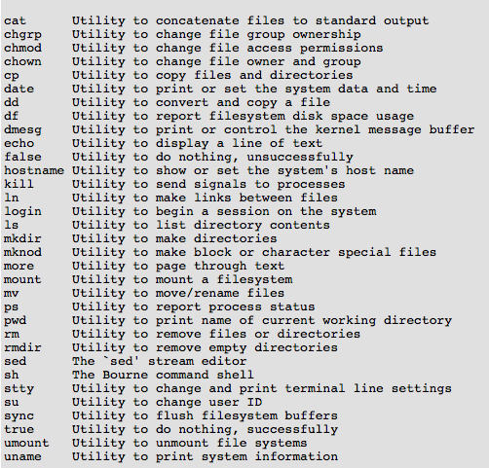
$ cd /bin

Slide 24
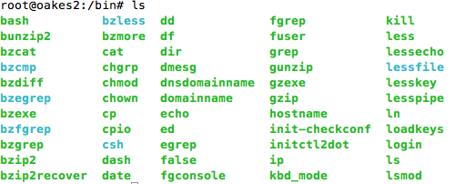
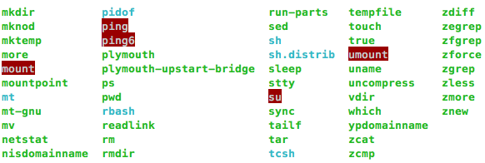

Slide 25
What is Linux?
/
Root
bin
boot
dev
etc
home
lib
tmp
usr
var
joe
jim
john
Desktop
Documents
Download
/boot contains everything required for the boot process except for configuration files
/dev is the location of special or device files.

Slide 26
What is Linux?
/
Root
bin
boot
dev
etc
home
lib
tmp
usr
var
joe
jim
john
Desktop
Documents
Download
/etc contains all system related configuration files
/home is the user assigned specific directory

Slide 27
What is Linux?
/
Root
bin
boot
dev
etc
home
lib
tmp
usr
var
joe
jim
john
Desktop
Documents
Download
/lib directory contains kernel modules and those shared library images
/tmp temporary files

Slide 28
What is Linux?
/
Root
bin
boot
dev
etc
home
lib
tmp
usr
var
joe
jim
john
Desktop
Documents
Download
/usr usually contains the largest share of data – user system resources
/var contains variable data like system logging files, mail and printer spool directories, and transient and temporary files

Slide 29
What is Linux?
/
Root
bin
boot
dev
etc
home
lib
tmp
usr
var
joe
jim
john
Desktop
Documents
Download
$ cd /home/joe/Desktop

Slide 30

What is Linux?
Linux Provides a Secure Hierarchical File system
Links: A link allows a given file to be accessed by means of two or more names
The alternate name can be located in the original file directory or a another directory
Using a long listing $ ls –l will show the l in the first position

