Slide 1
Unit 2 Linux - Bash Shell Joe Oakes Penn State

Slide 2
What is Bash (Unix Shell)?
Bash is a Unix shell
Written for the GNU Project as a free software replace for the Bourne shell (sh)
There are other shells: csh – c shell, K korn shell
Default shell on Linux and Mac OS X
Available on Windows using Cygwin and MinGW
Bash is a command processor
User types in commands which causes actions

Slide 3
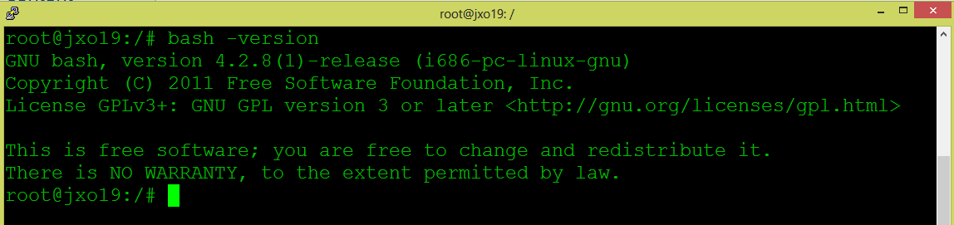

Bash Shell: Version
Run bash with the –version option
Environment Variable SHELL
Use the echo command to display the contents

Slide 4
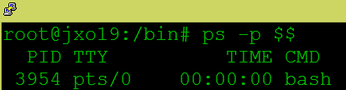
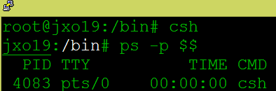
Bash Shell: Version
ps – show running processes –p option select by process ID - $ returns the PID process identification
Notice the c shell is running

Slide 5
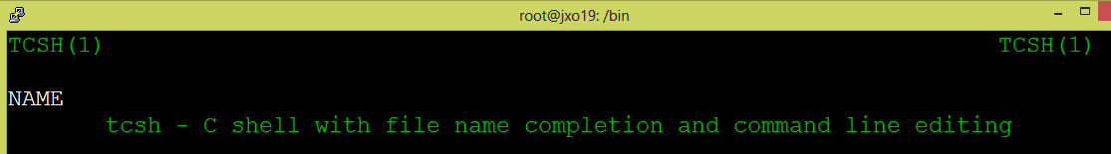
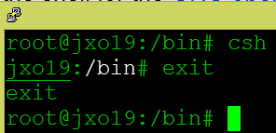
Bash Shell: csh shell
Manual page for C shell csh
Symbolic Link
C shell start up
Use Exit to exit

Slide 6
What is Bash (Unix Shell)?
Bash Supports the following features
Wildcarding: using ? *
Piping: chaining the output of a process (stdout) to the input feed (stdin) of another process
Here documents: Content of a document is redirected to stdin (standard input)
Command substitution
Variables: a storage location with an identifier
Control structures for condition testing and iteration

Slide 7
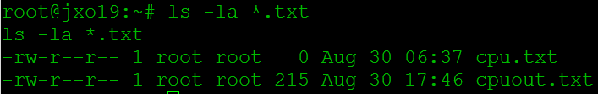
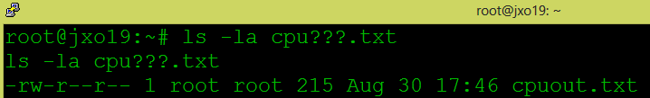
Bash Shell: Wildcards
cd – change directory to your home using cd ~ tilda
Long directory file listing showing all files (ls –la) with the * wildcard
Character wildcard ? Using question mark – it will look for three characters

Slide 8

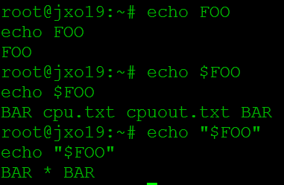
Bash Shell: Wildcards
Create an environment variable FOO with the contents that hold a wildcard character
Notice echo without the $ will just echo the literal characters FOO
Using $FOO doesn’t seem to work since it contains the * wildcard
Use “” double quotes around the variable

Slide 9

Bash Shell: Piping
Long directory file listing showing all files (ls –la) stdout is piped into stdin of the grep command
This is a hidden file notice the . character in the file name. It is located in the users home directory and used to configure the shell

Slide 10
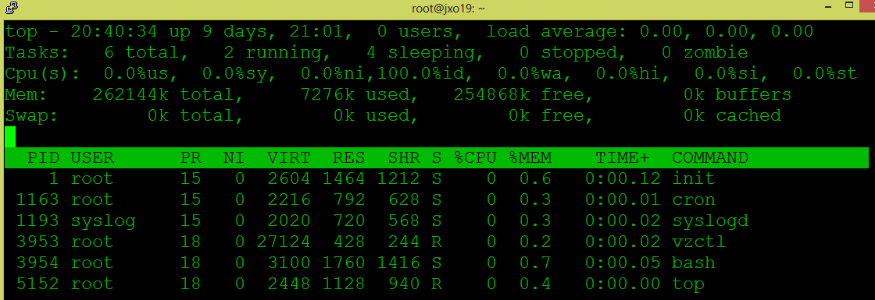
Bash Shell: Top Command
System running time
Processes IDs
Priority of the task
Nice Value: processes that will run at a lower priority – value higher, + lower priority

Slide 11
Bash Shell: Top Command
Shared Mem size: the amount of shared memory used by a task.
Virtual Image: virtual memory used by the task VIRT = SWAP + RES
Resident size (kb) non-swapped physical memory a task has used
Process status: D = uninterruptible sleep
R = running
S = sleeping
T = traced or stopped
Z = zombie

Slide 12
%CPU -- CPU usage The task's share of the elapsed CPU time since the last screen update, expressed as a percentage of total CPU time.
TIME -- CPU Time Total CPU time the task has used since it started.
%MEM -- Memory usage (RES) A task's currently used share of available physical memory
Enter q to quit

Slide 13


What is Bash (Unix Shell)?
Bash Supports the following features
Command Line completion: to match partly typed program names, filenames and variable names – use the tab key
Show the contents of the environment variable $PIPESTATUS
Enter Tab

Slide 14


What is Bash (Unix Shell)?
Bash can perform integer calculations
declare
let

Slide 15


Bash Shell Script File
cd – change directory to your home
Use the vim editor to create a new shell script file script1.sh
Go into Insert mode using I key
Add the following to the file
Vim editor
Insert mode using I key

Slide 16
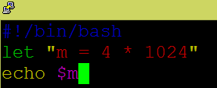

Bash Shell Script File
For the file to execute it must know where the bash shell is located #!/bin/bash
To get out of Insert mode hit the escape key
Enter : colon then enter w (write) and q(quit)
Write from buffer memory to hard drive and quit

Slide 17
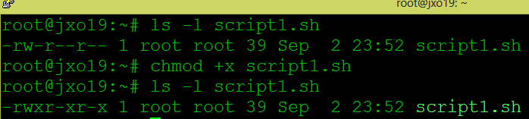
Bash Shell Script File
List out the file: ls –l script1.sh
Notice it needs execute permissions to run
Use chmod +x script1.sh
Now it has execute permissions
Missing execute permissions
Has execute permissions

Slide 18

Bash Shell Script File
To execute the script
./script1.sh
Execute the script

