Slide 1
Unit 3 Linux File and Folder Permissions Joe Oakes Penn State

Slide 2
Linux: File and Folder Permissions
File and Folder permissions are a good security feature
But if the assigned permission were not correctly performed that could be a vulnerability
Each file and directory has three user based permission groups: Owner, Group, All users

Slide 3
Linux: File and Folder Permissions
owner - The Owner permissions apply only the owner of the file or directory, they will not impact the actions of other users.
group - The Group permissions apply only to the group that has been assigned to the file or directory, they will not effect the actions of other users.
all users - The All Users permissions apply to all other users on the system, this is the permission group that you want to watch the most.

Slide 4
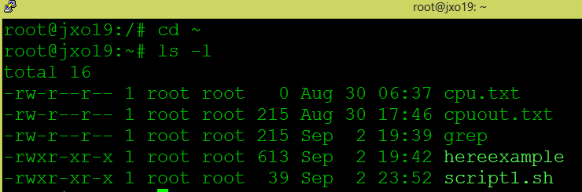
Linux: File and Folder Permissions
Number of hardlinks to the file
Owner permissions
Read
Write
execute
Group
Permissions
Read
execute

Slide 5
Linux: File and Folder Permissions
inodes (index node) it stores basic information about a regular file, directory, or other file system object.
With hard links it is possible to associate multiple directory entries with a single inode
Hard links cannot link directories
Cannot cross file system boundaries
Soft or symbolic links are just like hard links
Soft allows to associate multiple filenames with a single file

Slide 6
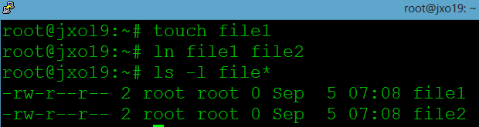
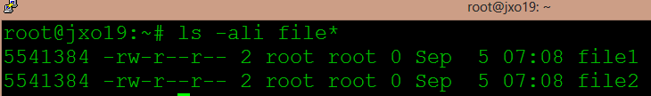
Linux: File and Folder Permissions
touch will create an empty file
Hard link file1 to file2
Two hard links
New file2 created after ln command
inode number

Slide 7
Linux: File and Folder Permissions
Soft or symbolic links are just like hard links
Soft allows to associate multiple filenames with a single file
You can create links between directories.
Can cross file system boundaries.
When the source of the link is moved or removed
Symbolic links are not updated.
Hard links always refer to the source, even if moved or removed

Slide 8
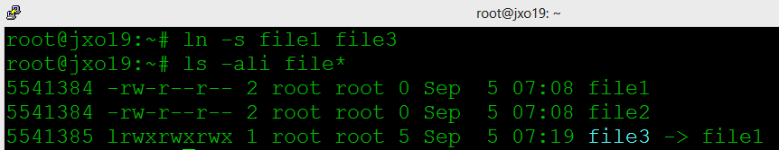
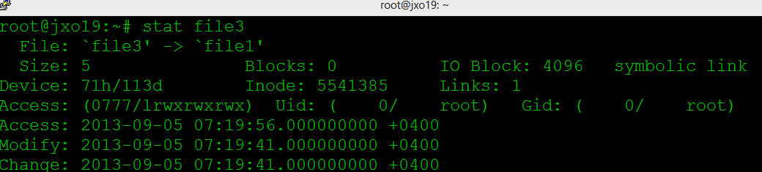
Linux: File and Folder Permissions
Symbolic Link option
l means it is soft link
file3 (it doesn’t really exist) it just points to file1

Slide 9
Linux: File and Folder Permissions
All users
Permissions
Read
execute
Owner
Group

Slide 10
Linux: File and Folder Permissions
Each file or directory has three basic permission types:
read - The Read permission refers to a user's capability to read the contents of the file.
write - The Write permissions refer to a user's capability to write or modify a file or directory.
execute - The Execute permission affects a user's capability to execute a file or view the contents of a directory.

Slide 11
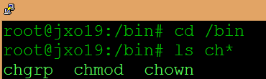
Linux: File and Folder Permissions
Three commands that work with ownership and permissions
chgrp: change group for a file or directory
chmod: change file mode bits
chown: change ownership for a file or directory

Slide 12
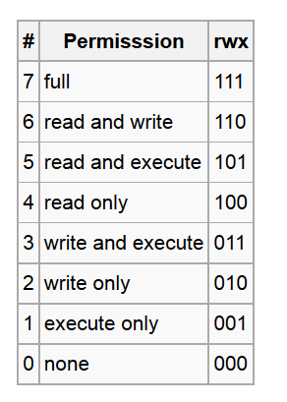
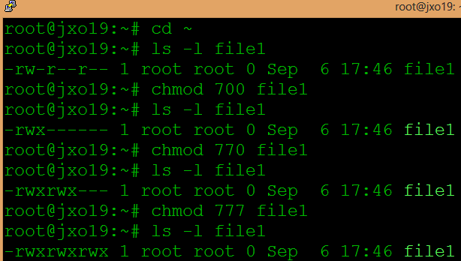
Linux: File and Folder Permissions
The chmod numeric format accepts up to four octal digits.
The rightmost three refer to permissions for the file owner, the group, and other users

Slide 13
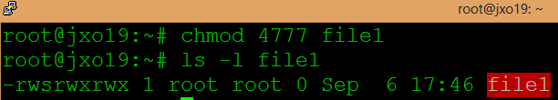
Linux: File and Folder Permissions
The chmod numeric format accepts up to four octal digits.
The next digit (fourth from the right) specifies special setuid, setgid, and sticky flags.
When set-user identification (setuid) permission is set on an executable file, a process that runs this file is granted access based on the owner of the file (usually root), rather than the user who is running the executable file.

Slide 14
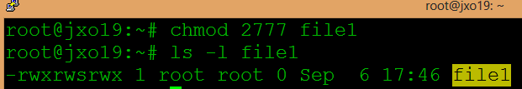
Linux: File and Folder Permissions
The set-group identification (setgid) permission is similar to setuid, except that the process's effective group ID (GID) is changed to the group owner of the file, and a user is granted access based on permissions granted to that group.

Slide 15
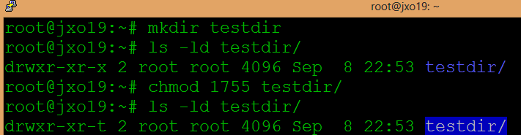
Linux: File and Folder Permissions
The sticky bit is a permission bit that protects the files within a directory. If the directory has the sticky bit set, a file can be deleted only by the owner of the file, the owner of the directory, or by root

Slide 16
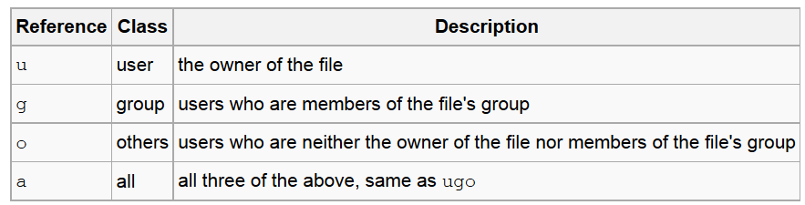
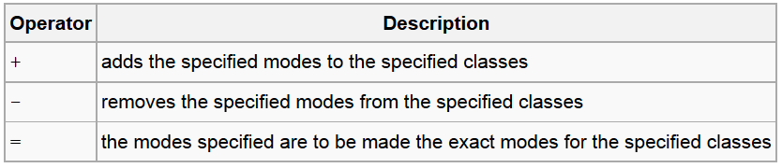
Linux: File and Folder Permissions
Symbolic Notation of File system permissions

Slide 17
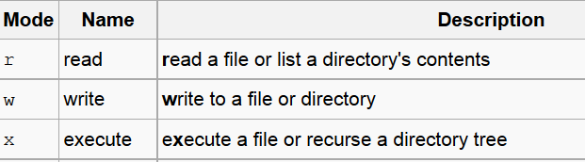
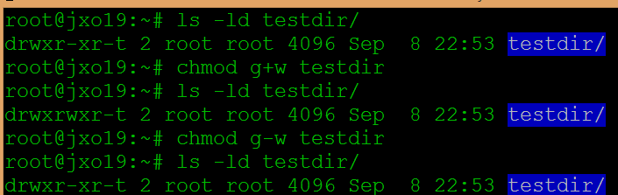
Linux: File and Folder Permissions
Symbolic Notation of File system permissions

Slide 18
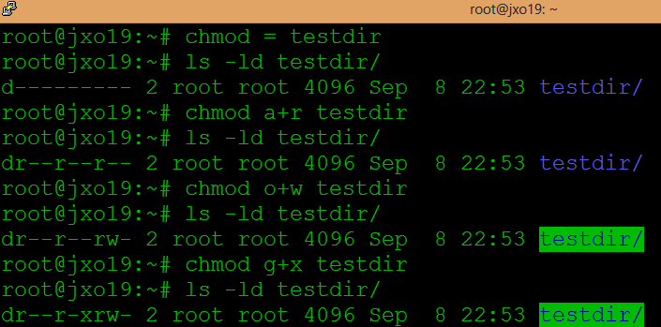
Linux: File and Folder Permissions
Symbolic Notation of File system permissions

