Slide 1
Unit 4 Linux Editors Joe Oakes Penn State

Slide 2
Linux: Editors
VIM: Based on the vi editor on from Unix
VI Improved contains additional features
Designed for use both command line and use in a GUI environment - gVim
VIM is free and open source software
License is compatible with the GNU GPL
Contains a tutor - vimtutor

Slide 3
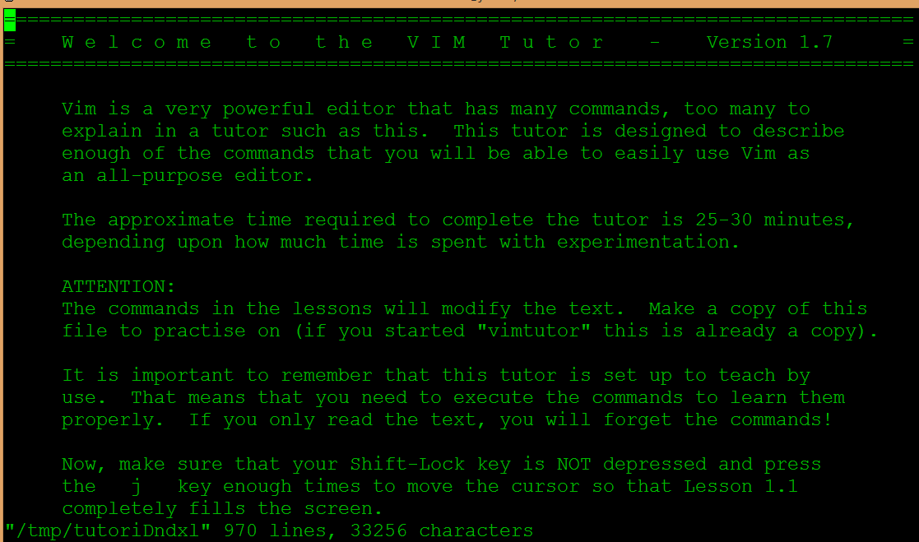
Linux: Editors

Slide 4
Linux: Editors
To move the cursor you have two options
Arrow keys or h,j,k,l keys
h moves left, l moves right, k moves up, j moves down
<ESC> key will place you in normal mode
:q! <ENTER> discards any changes you have made
Text Editing – Deletion
Press x to delete the character under the cursor
Learn by usage

Slide 5
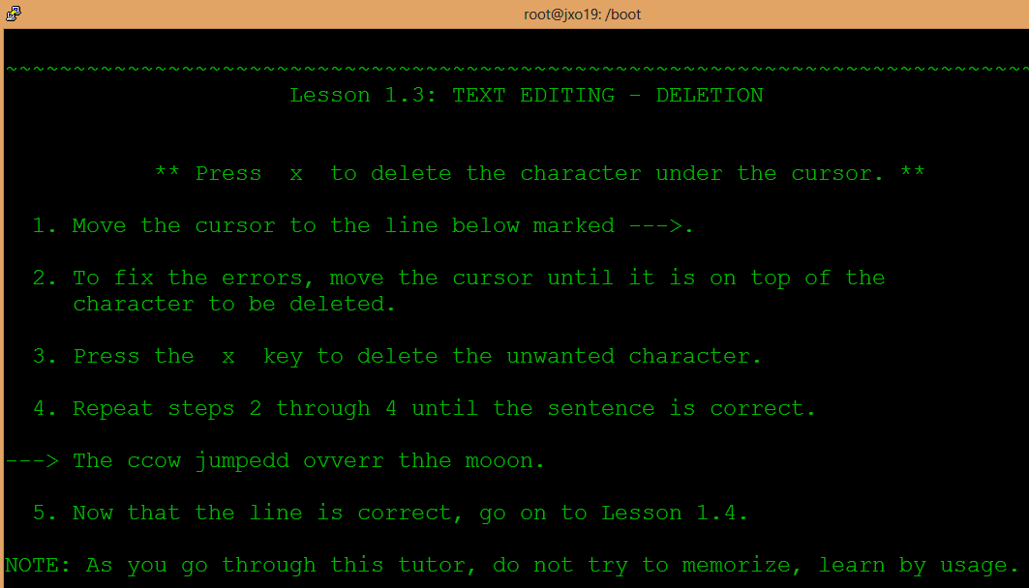
Linux: Editors

Slide 6
Linux: Editors
Text Editing – Insertion
Position the cursor
Enter i to enter insert mode
<ESC> to return to Normal mode
When in insert mode you can still use the arrow keys to move arround

Slide 7
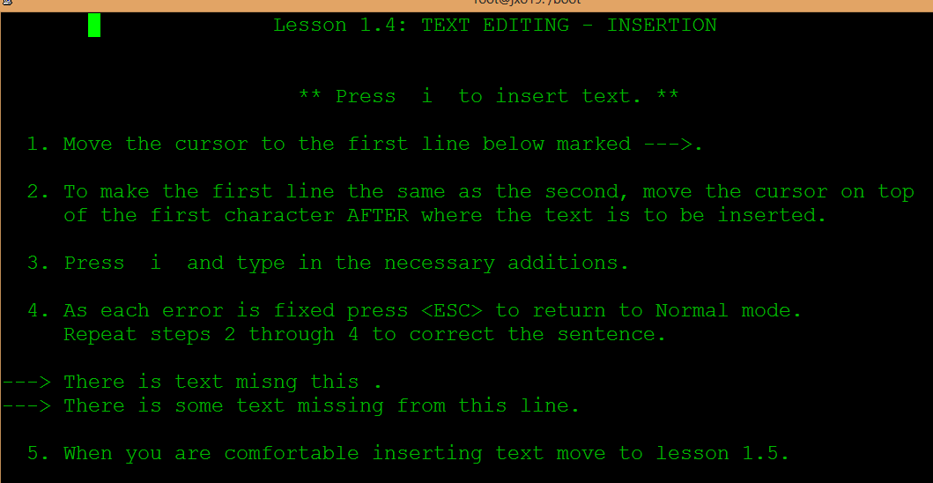
Linux: Editors

Slide 8
Linux: Editors
Text Editing – Appending
Position the cursor
Press A and type in additions
<ESC> to return to Normal mode
When in insert mode you can still use the arrow keys to move around

Slide 9
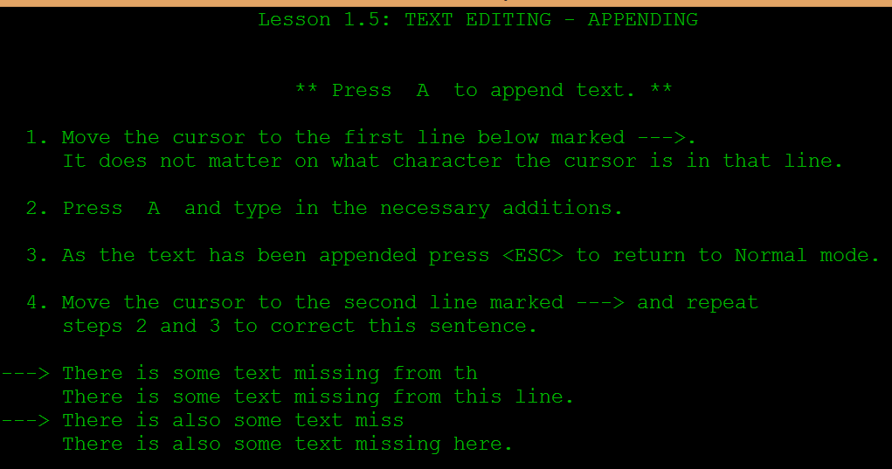
Linux: Editors

Slide 10

Linux: Editors
To view the Tutor file and work in the Editor open two terminal screens
Change directory to your home area
Start the vim editor with a new file called tutor

Slide 11
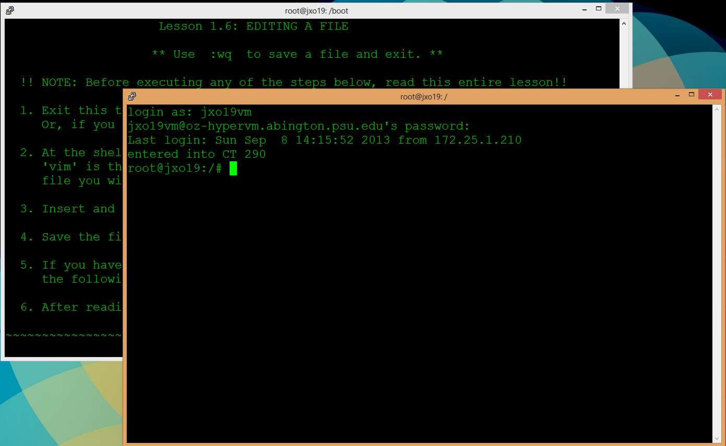
Linux: Editors

Slide 12
Linux: Editors
Type dw to delete a word
Position the cursor to the beginning word to be deleted
Type dd to delete a whole line

Slide 13
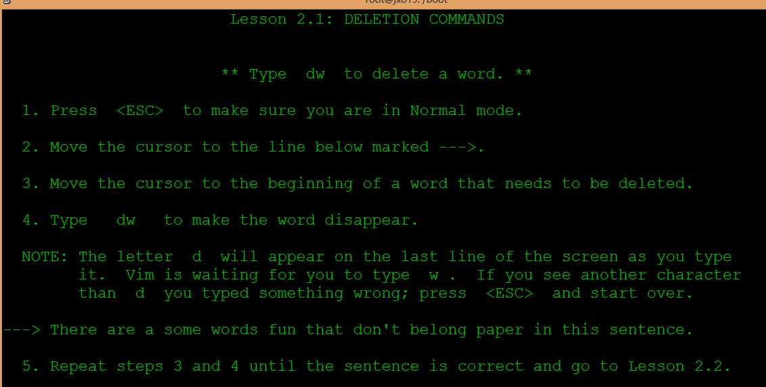
Linux: Editors

Slide 14
Linux: Editors
Type d$ - delete until the end of line
Position the cursor to the beginning word to be deleted

Slide 15
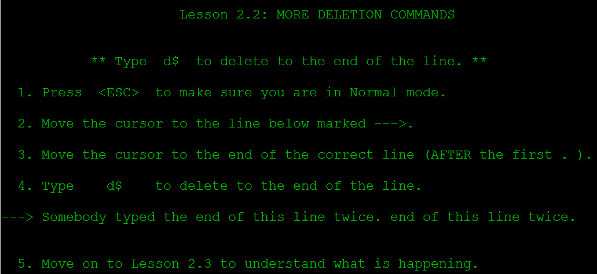
Linux: Editors

Slide 16
Linux: Editors
Type d motion
Position the cursor
de – will delete a word
dw – until the start of the next word
d$ - end of line

Slide 17
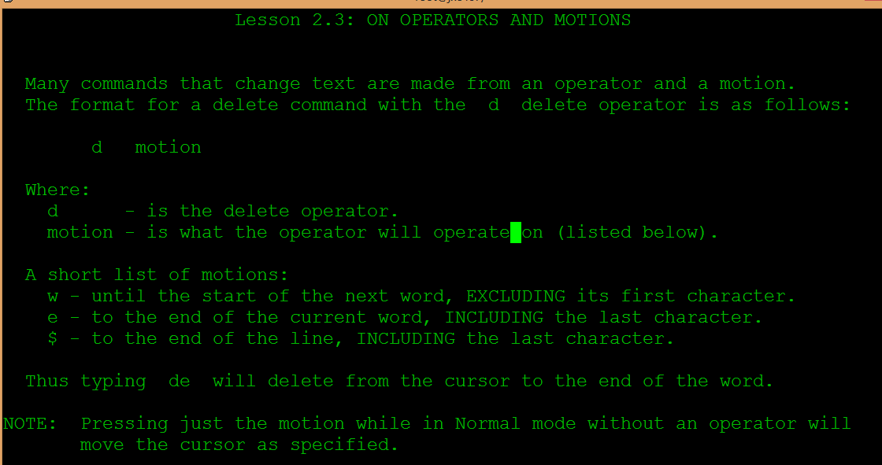
Linux: Editors

Slide 18
Linux: Editors
Type a number before a motion repeats it that many times
2w to move the cursor two words forward
3e to move the cursor to the end of the third word forward
0 to move to the start of the line

Slide 19
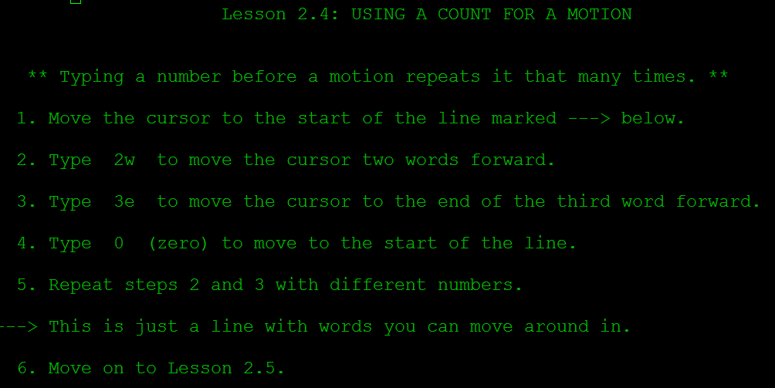
Linux: Editors

Slide 20
Linux: Editors
Using a count to Delete
D number motion
Position the cursor
Type d2w to delete two UPPER case words

Slide 21
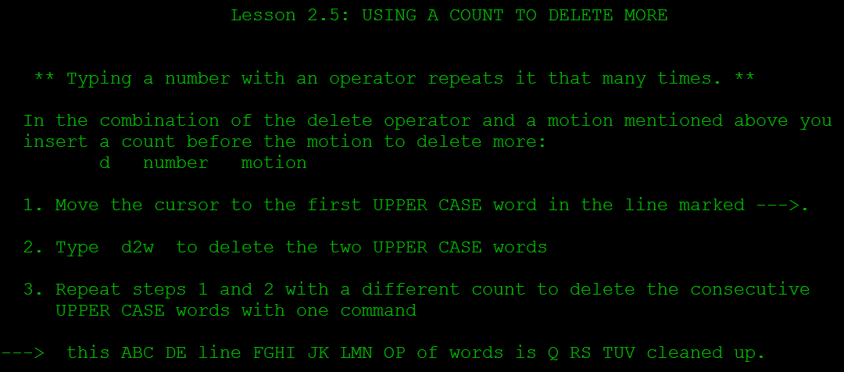
Linux: Editors

Slide 22
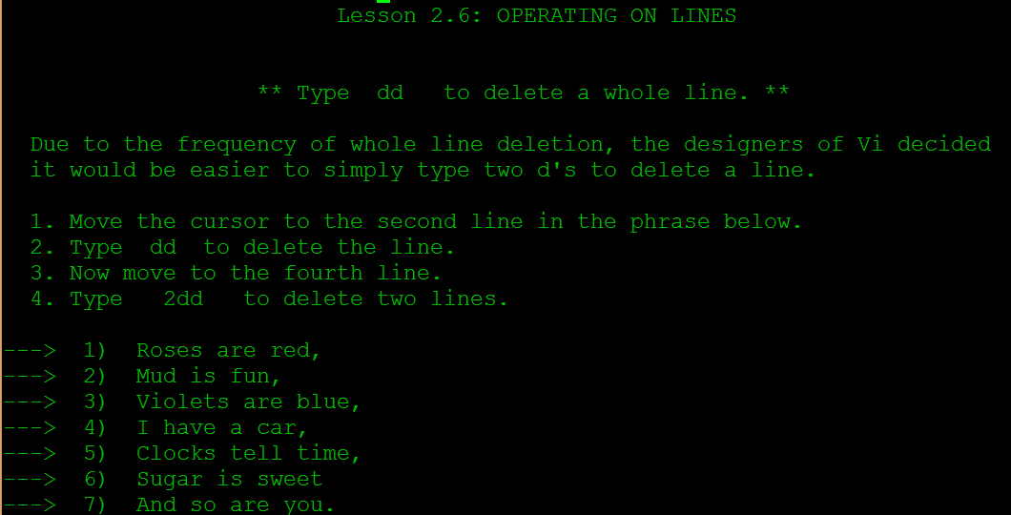
Linux: Editors

Slide 23
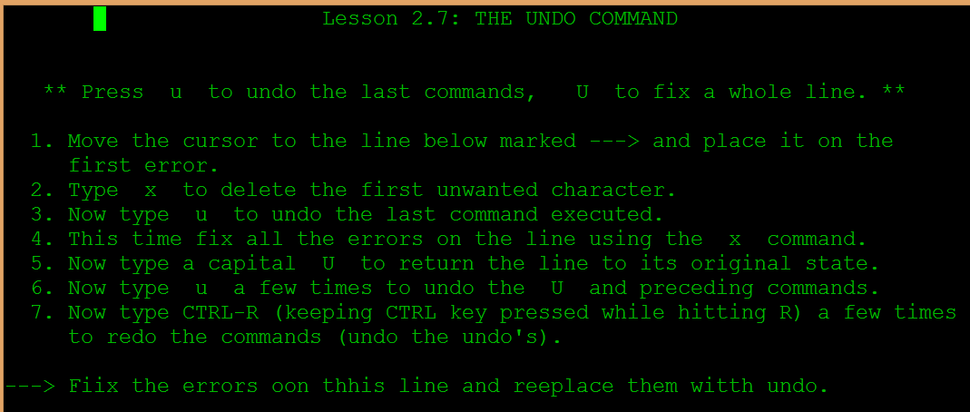
Linux: Editors

Slide 24
Linux: Editors
Cursor location and file Status
CNTRL-g – location and file status
G – go to bottom of file
gg – go to start of file
Motion G go to the line number - 503G

Slide 25
Linux: Editors
Searching
Use the / forward slash character at the : colon
Search for the next phrase again type n forward direction
Search backward N
Search backward direction using ? instead of /
Ctrl-O go back to where you came from
Find a match use % percent character

Slide 26
Linux: Editors
Scrolling
Control f page forward
Control b page back

