Slide 1
Unit 5 Linux Matrix Screen Joe Oakes Penn State

Slide 2
Linux: Matrix Screen
Matrix screen display Bash shell script
Main learning components
Setting and using colors
Working with String arrays
Flow Control: if and case
Command Line input arguments
Cursor positioning
Iteration: while, for do loops
Random environment variable
Handling Signals

Slide 3
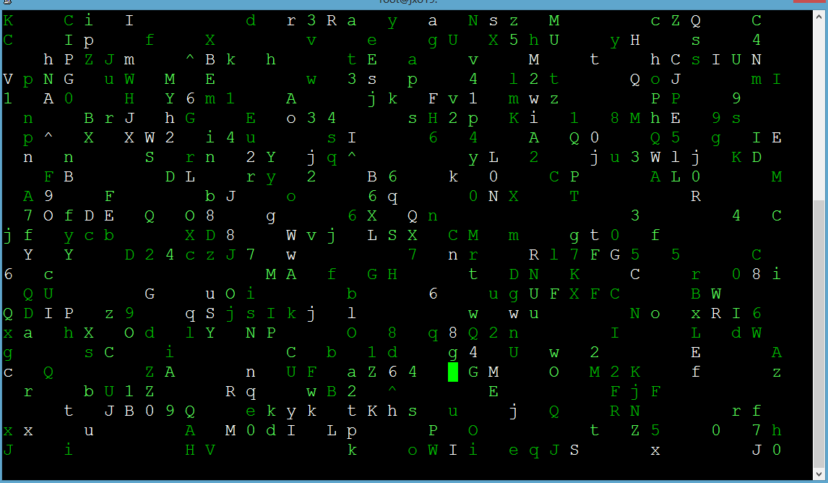
Linux: Matrix Screen

Slide 4
Linux: Matrix Screen
Step 1 create a color.sh script
vim color.sh
Go into insert mode and add the bash command
#!/bin/bash
Type in the following colors
blue="\033[0;34m"
brightblue="\033[1;34m"
cyan="\033[0;36m"
brightcyan="\033[1;36m"
green="\033[0;32m"
brightgreen="\033[1;32m“

Slide 5
Linux: Matrix Screen
red="\033[0;31m"
brightred="\033[1;31m"
white="\033[1;37m"
black="\033[0;30m"
grey="\033[0;37m"
darkgrey="\033[1;30m“
Now lets use the color
Use the printf command
printf”$red Hello World”

Slide 6
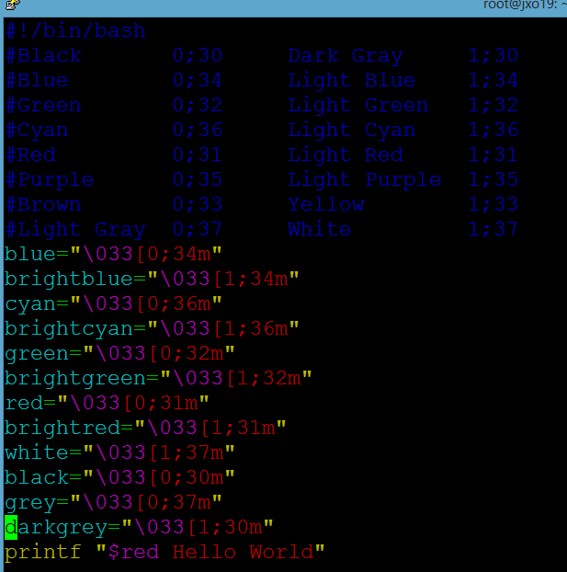
Linux: Matrix Screen

Slide 7
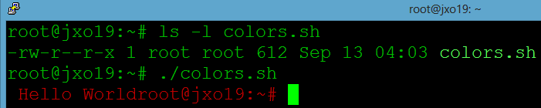
Linux: Matrix Screen
Exit back to normal mode
Save and exit
Set permissions so only the owner has execute using symbolic notation permissions
Run the script

Slide 8
Linux: Matrix Screen
Step 2 create a strings.sh script
vim strings.sh
Go into insert mode and add the bash command
#!/bin/bash
Type in the following string array
chars=(a b c d e f g h i j k l m n o p q r s t u v w x y z A B C D E F G H I J K L M N O P Q R S T U V W X Y Z 0 1 2 3 4 5 6 7 8 9 ^)

Slide 9
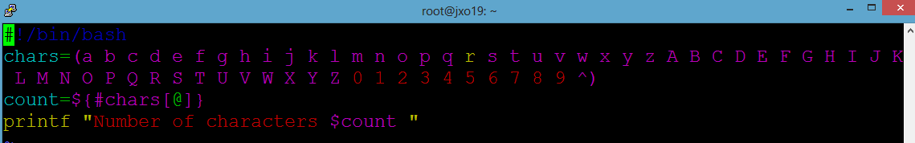

Linux: Matrix Screen
Determine the array length
count=${#chars[@]}
printf “Number of characters $count ”
Save and quit
Set permissions so you can execute it

Slide 10
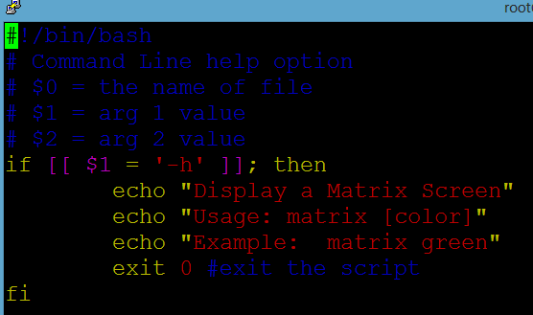
Linux: Matrix Screen
Step 3 & 4 create a cmdLine.sh script
vim cmdLine.sh
Go into insert mode and add the bash command
#!/bin/bash
Type in the following conditional array

Slide 11
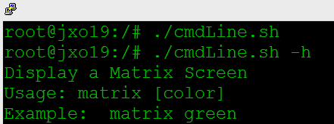
Linux: Matrix Screen
Save and quit
Set permissions so you can execute it
Run it

Slide 12
Linux: Matrix Screen
Case Statement – flow control syntax
case expression in
pattern 1)
statements ;;
pattern 2)
statements ;;
esac
Create a caseTest.sh

Slide 13
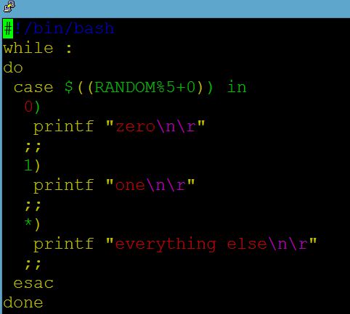
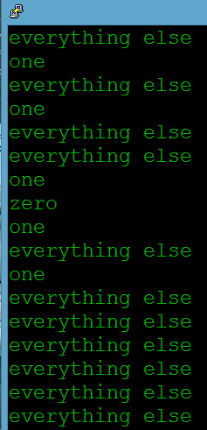
Linux: Matrix Screen
Case Statement – flow control syntax

Slide 14
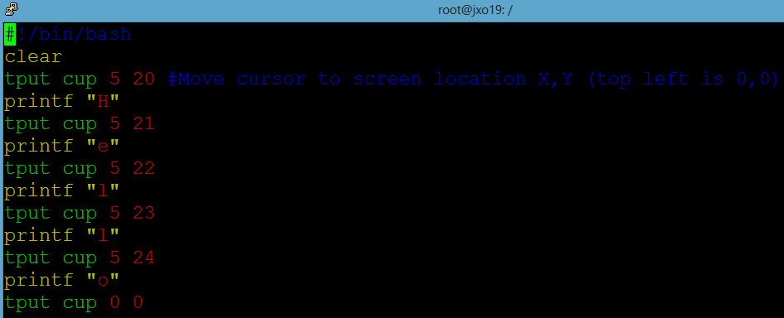
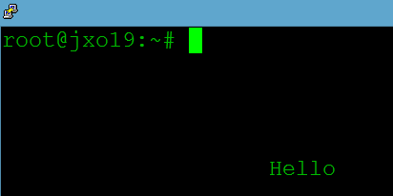
Linux: Matrix Screen
Step 5 create a curPos.sh script
vim curPos.sh
Go into insert mode and add the bash command

Slide 15
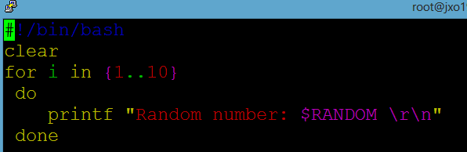
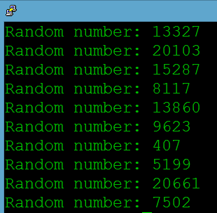
Linux: Matrix Screen
Step 6 & 7 For loop and Random variable
create a rand.sh script
vim rand.sh
Go into insert mode and add the bash command

Slide 16
Linux: Matrix Screen
Step 8 Handle error conditions
The trap command will execute commands when a signal is received
Ctrl+C The interrupt signal, sends SIGINT to the job running in foreground.
Kill signal values
SIGHUP 1 Hangup
SIGINT 2 Interrupt from keyboard
SIGKILL 9 Kill signal
SIGTERM 15 Termination signal
SIGSTOP 17,19,23 Stop the process
SIGKILL and SIGSTOP can not be caught, blocked or ignored

Slide 17
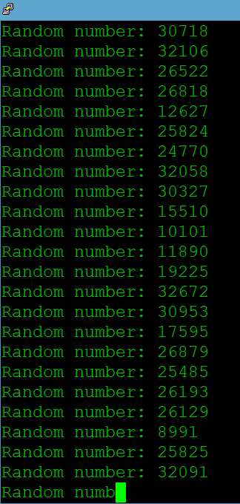
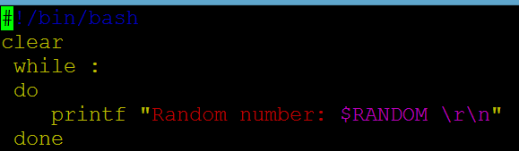
Linux: Matrix Screen
Step 8 Handle error conditions
# tput can be used to move the cursor, get back information
# tput sgr0 Turn off all attributes
trap "tput sgr0; clear; exit" SIGTERM SIGINT
Endless loop program

Slide 18
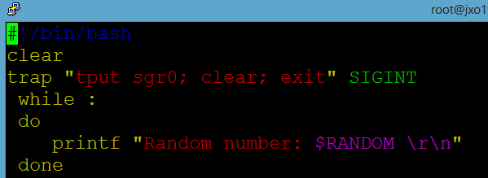
Linux: Matrix Screen
Step 8 Handle error conditions
Modified to handle Control+C
Clears attributes, clears screen, exits shell

