Slide 1
Unit 5 Linux Web Server Joe Oakes Penn State

Slide 2
Linux: Web Server
Objectives for this Lab
Learn how to install a Web Server
Learn how to configure a Web Server
Learn how to start and stop the Web Server
Learn how to customize a Web Server
Learn how to check the status of the Web Server

Slide 3
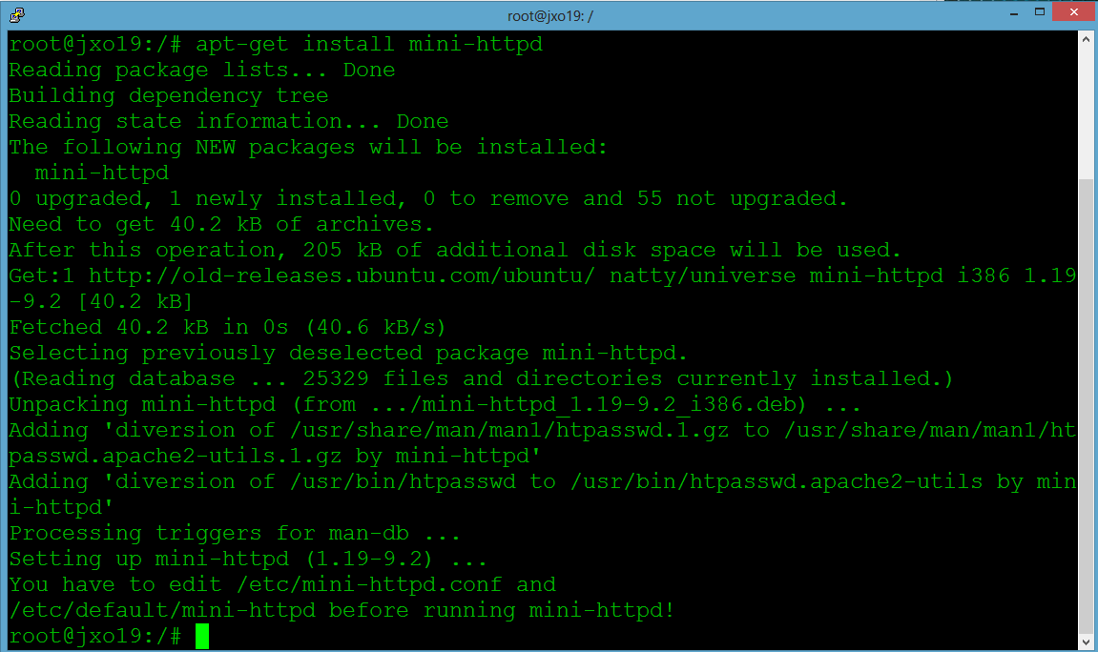
Linux: Matrix Screen
Step 1: Install the mini-httpd Web Server
# apt-get install mini-httpd

Slide 4
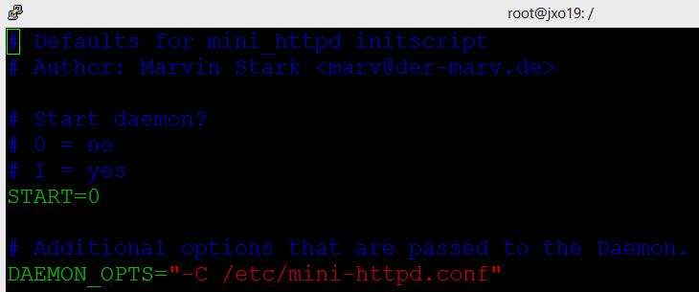
Linux: Web Server
Step 2. Configure mini-httpd Web Server using the vi editor
Use the vim editor to modify the configuration file /etc/default/mini-httpd. Change START value to be 1
# vim /etc/default/mini-httpd
START=1

Slide 5
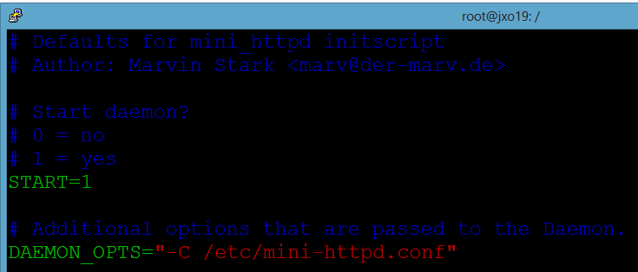
Linux: Web Server
Notice the configuration location
/etc/mini-httpd.conf
httpd – hyperTransport Protocol Daemon
Daemon – computer program service that runs background without user interactive user
syslogd is the daemon that implements the system logging

Slide 6
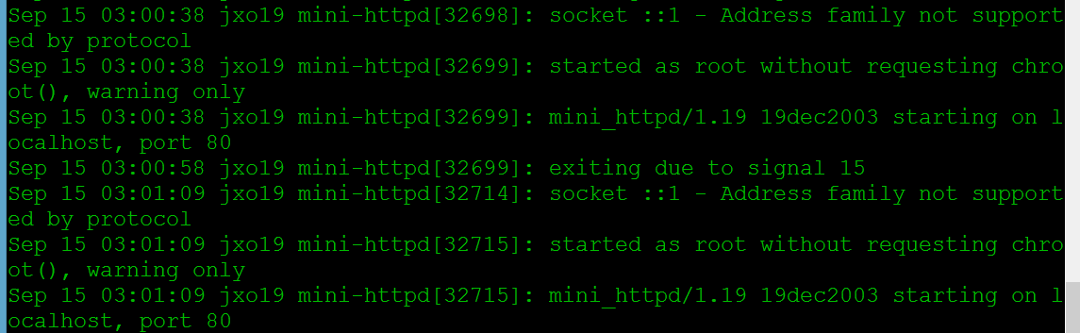
Linux: Web Server
Print out the syslog file
# cat /var/log/syslog
Messages showing mini_httpd startup info

Slide 7
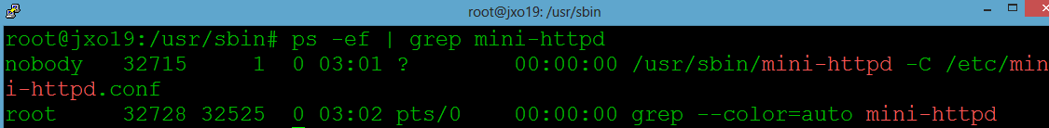
Linux: Web Server
Step 3: Start the mini-httpd Web Server
# service mini-httpd start
Check the process id for the mini-httpd Web server.
# ps -ef | grep mini-httpd
Process ID 32715
Is the mini Web Server

Slide 8
Linux: Web Server
Step 4. Check the Web Server Listening Port
Check the networking status of the port for the Web Server. Look for port 80 using grep :80.
# netstat -an | grep :80
Transmission Control Protocol
127.0.0.1 – Localhost’s IP address
Listening on Port 80

Slide 9
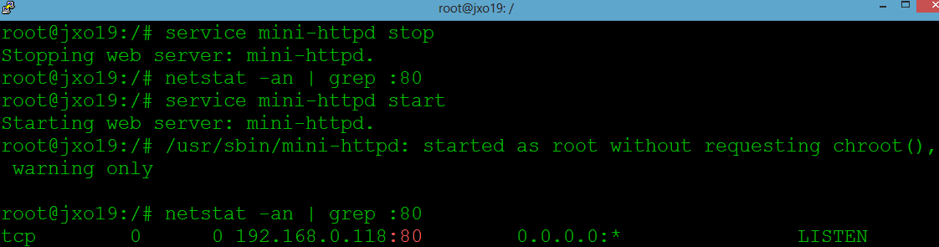
Linux: Web Server
Stop and start the mini_httpd service
# service mini-httpd stop
# netstat -an | grep :80
# service mini-httpd start
# netstat -an | grep :80
Most services you can – stop, start, reset and get status

Slide 10
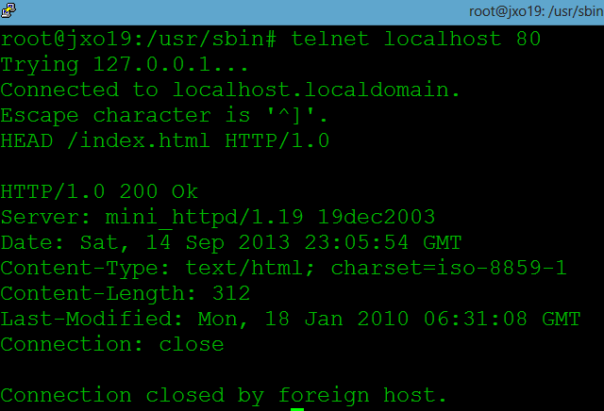
Linux: Web Server
Telnet to local machine check port 80 listening
Step 5. Telnet Port 80 Web Server
Use telnet to make a connection and request a head method message from the server.
After you type in the command full HEAD line you need to enter the return key twice.
# telnet localhost 80
It will show a blank screen - type in the following to request the index http header.
HEAD /index.html HTTP/1.0
Web Server response
HTTP: Hypertext Transfer Protocol 200 is okay

Slide 11
Linux: Web Server
HTTP Codes
1XX range informational
2XX Success
3XX Redirection
4XX Client Error
5XX Server Error
Common HTTP Methods
G ET: retrieve data
HEAD: no response body
POST: Requests that the server accept the entity enclosed
PUT: Resquests the enclosed entity be stored under the supplied URI
DELETE: Deletes the specified resource

Slide 12
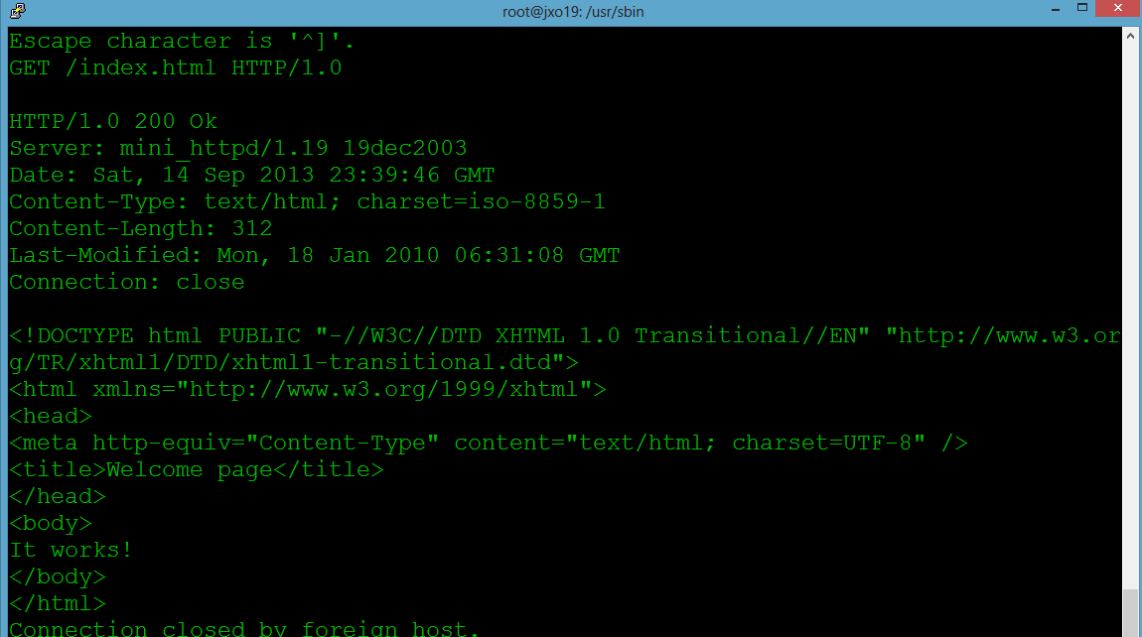
Linux: Web Server
Telnet again to port 80
Type in GET /index.html HTTP/1.0
Using the GET method
Notice it sent the index.html HTML markup back

Slide 13
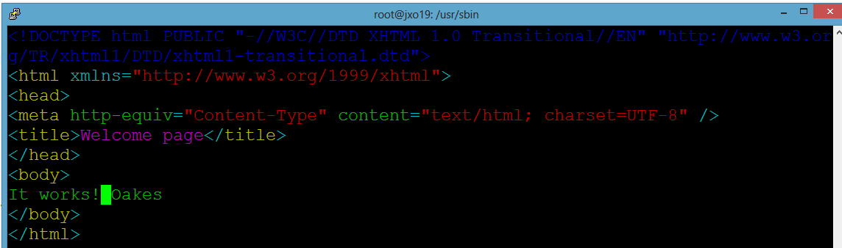
Linux: Web Server
Step 7. Find the Web Server data_dir HTML Document Location
Look for the parameter setting in the mini-httpd.conf file.
# cat /etc/mini-httpd.conf | grep data_dir
Use vim to modify the index.html file on the server and add your last name to the html
<body>It works! Oakes</body>
HTML root file Linux Web Servers use index.html

Slide 14

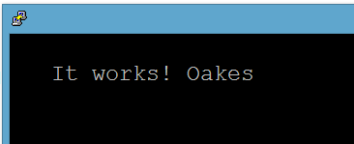
Linux: Web Server
Step 8. Web Browser Web Server Test
Open the lynx browser and hit the local Web server
URL http://localhost/index.html or http://localhost
# lynx localhost
The lynx browser is a text type browser

Slide 15
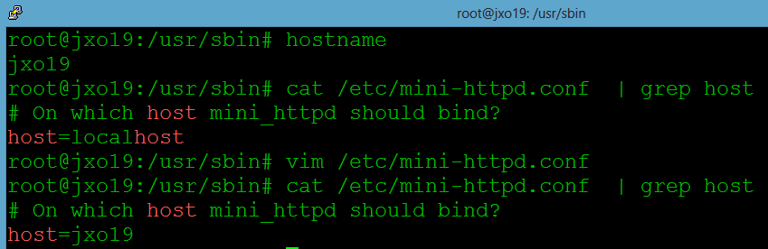
Linux: Web Server
Change the listening IP address to use your hostname.
Edit the mini_httpd config file - change the host value to use your hostname.
Use the hostname command to determine your hostname
# hostname
# cat /etc/mini-httpd.conf | grep host
We are changing the Web server from using IP address 127.0.01 (localhost) to use the assigned IP address to the (hostname)

Slide 16
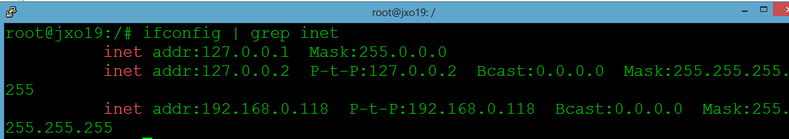
Linux: Web Server
Determine your machine’s assigned IP address
# ifconfig | grep inet
Use the lynx browser to connect to your local IP address
# lynx yourIPaddress
Ask a classmate their IP address and try and connect
# lynx classmateIPaddress
Networking IP address of the host
192.168.0.118

Slide 17
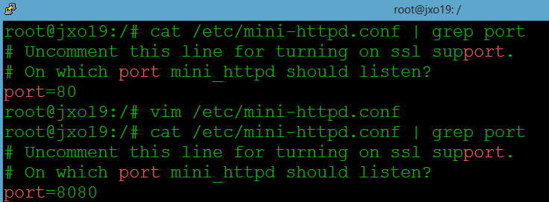
Linux: Web Server
Step 9. Web Server Port Listen Change
Edit the mini-httpd configuration file and look for the Listen port 80 parameter and change it to be port 8080.
# cat /etc/mini-httpd.conf | grep port
# vim /etc/mini-httpd.conf
# cat /etc/mini-httpd.conf | grep port
Port 8080 is another common internal Port number for Web development

Slide 18
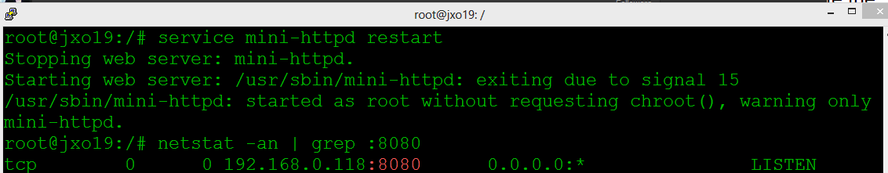
Linux: Web Server
Restart the web server
# service mini-httpd restart
Make sure Port 8080 is listening
# netstat -an | grep :8080
Notice IP address and Port #
It is listening for requests from the browser

Slide 19
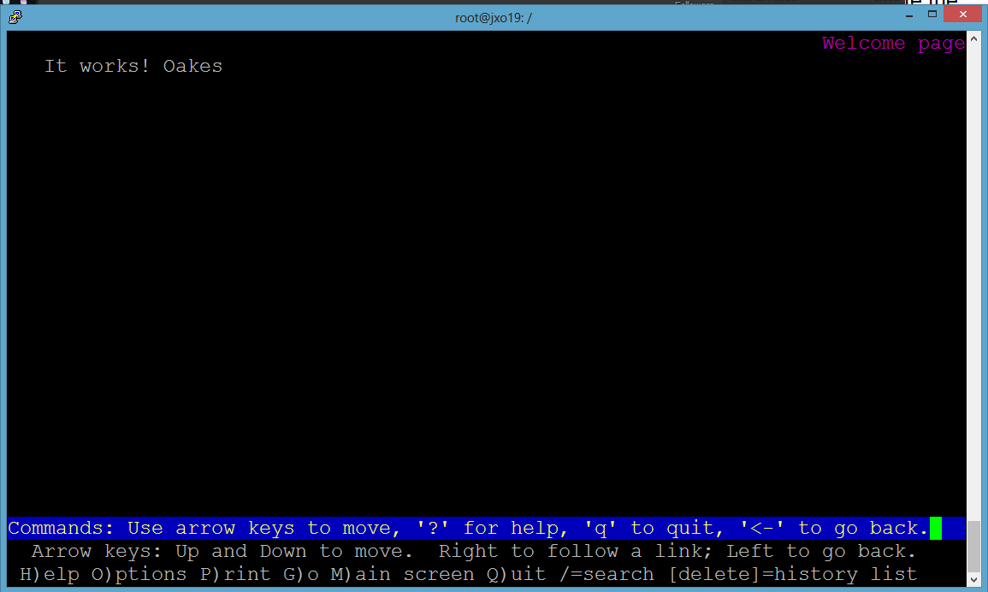
Linux: Web Server
Test using the Lynx browser using the hostname and port
# lynx jxo19:8080
Control+c to exit browser

Slide 20
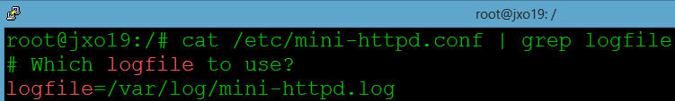
Linux: Web Server
Step 10. Log File View
View the mini-httpd config file and find where the log file is stored.
# cat /etc/mini-httpd.conf | grep logfile
Log files mostly have the file extension .log

Slide 21
Linux: Web Server
Open another Putty session so you have two running.
Use the tail command to look at the tail end of the Web Server's log file real time. Control-C will stop it running.
The –f option will continue the show the file real time as new log entries are added
# tail -f /var/log/mini-httpd.log
In the other Putty window hit the web server using lynx browser
# lynx jxo19:8080

Slide 22
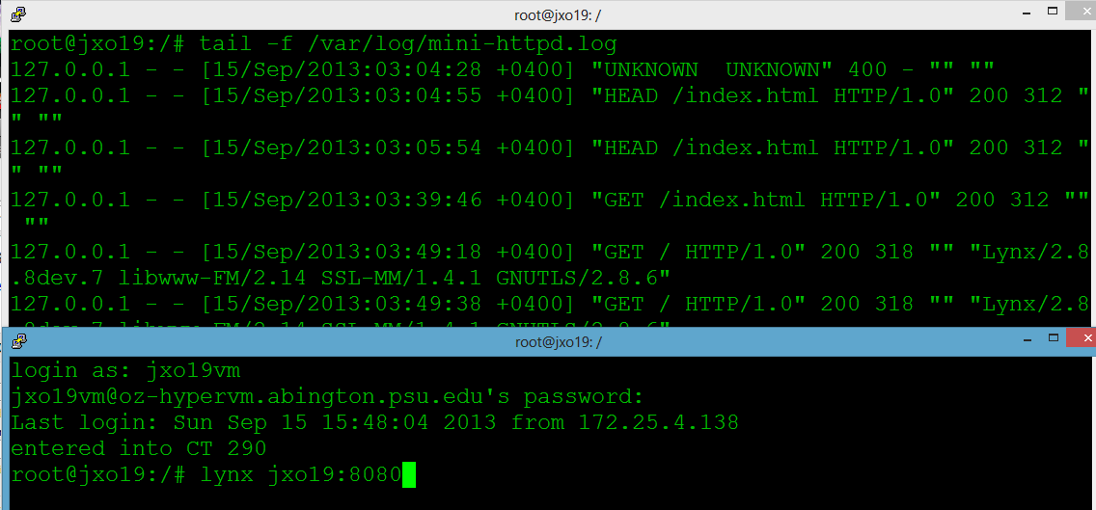
8080 Port # to make the request

Slide 23
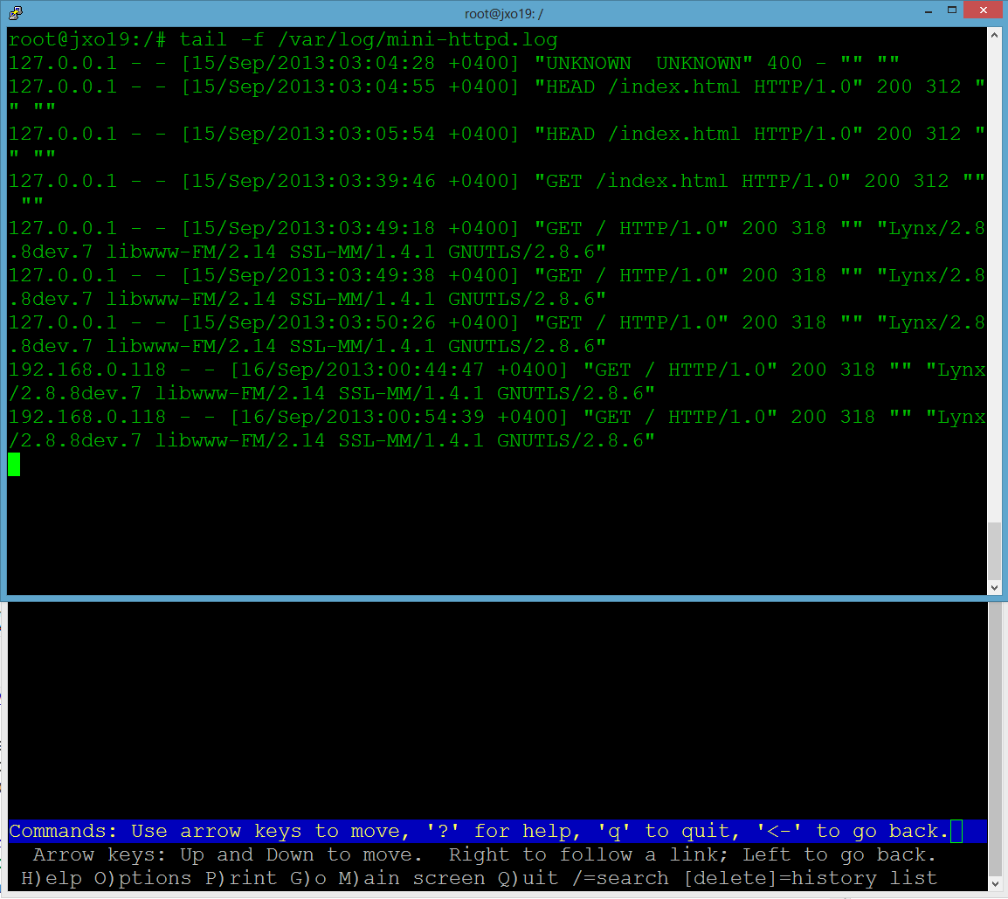
Notice the GET request , browser type, and the response code

