Slide 1
Unit 7 Linux Commands
Joe Oakes
Penn State

Slide 2
Linux Commands
What are commands?
There can be four different kinds of commands
Executable program /usr/bin
Command built into the shell – e.g. cd built in
A shell function
Alias These are commands that you can define yourselves, built from other commands

Slide 3
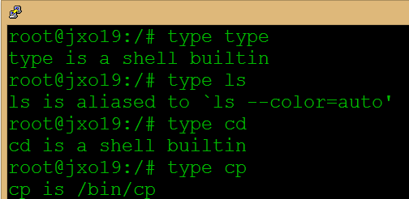
Linux Commands
type – Display information about command type

Slide 4

Linux Commands
which – shows the exact location of a given executable. There could be more than one version

Slide 5
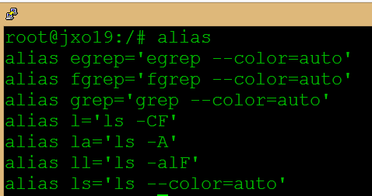
Linux Commands
alias – Display information about set aliases
Can be used to set aliases

Slide 6
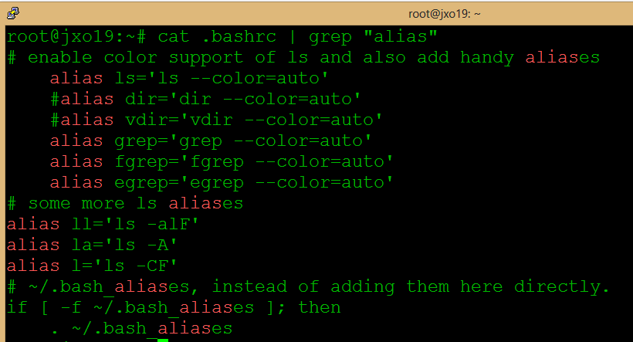
Linux Commands
.bashrc file (hidden file type see . prefix)
Configuration (rc – runtime configuration)

Slide 7
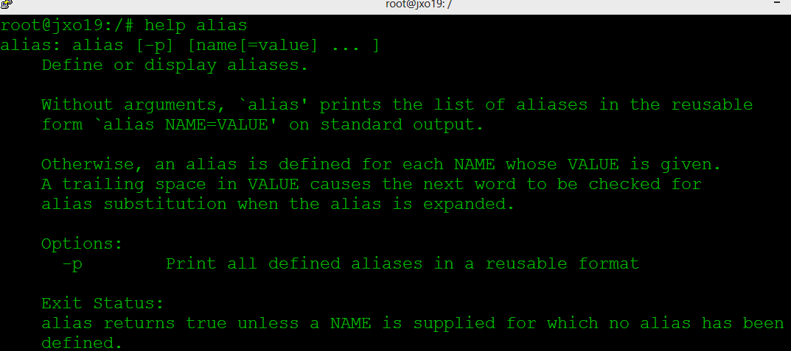
Linux Commands
help – display help information for shell builtins
There might be a man page and –h available

Slide 8
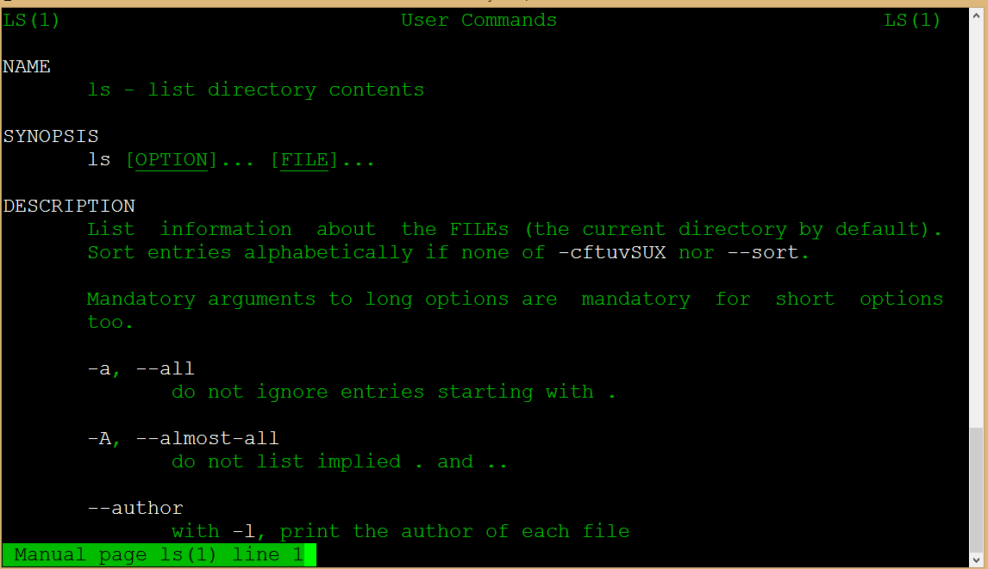
Linux Commands
man program - Most executable programs intended for command line use provide a formal piece of documentation called a manual page

Slide 9
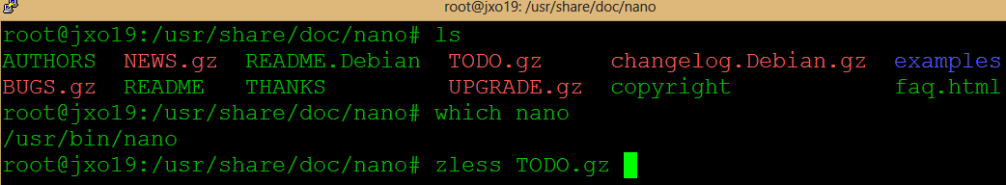
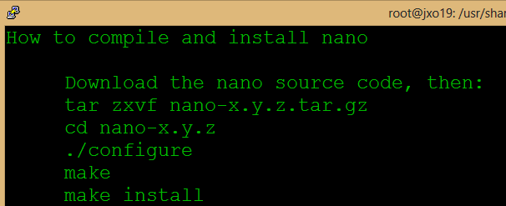
Linux Commands
README – documentation files for software
check /usr/share/doc directory
Use less to view in plain text
If they are compressed .gz then use zless

Slide 10
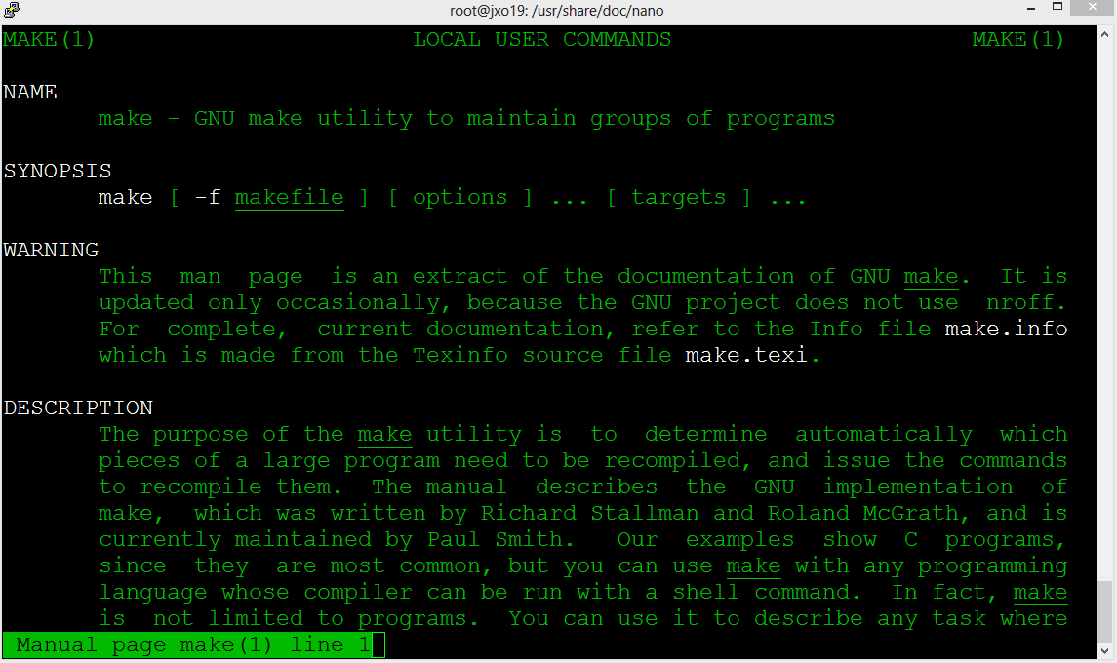
Linux Commands
make – utility to maintain groups of programs

Slide 11

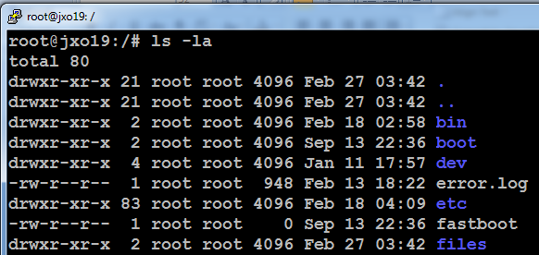
Linux Commands
mkdir – make a directory
rmdir – remove a directory

Slide 12
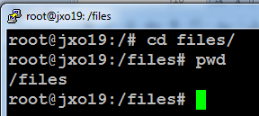
Linux Commands
cd – change to a directory
pwd – print working directory

Slide 13
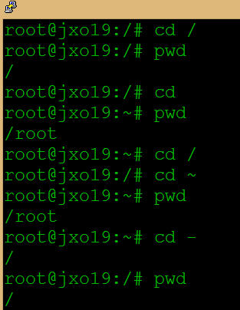
Linux Commands
cd followed by nothing will change the working directory to your home directory
cd ~ will change the working directory to the home directory of the specified user
cd - changes the working directory to the previous one

Slide 14
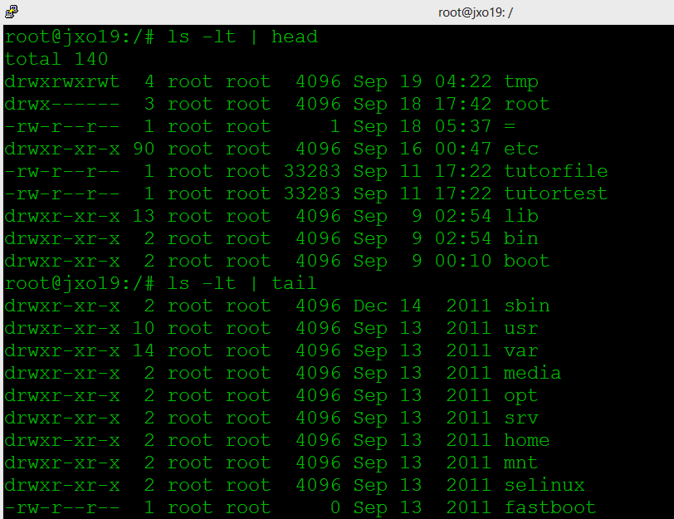
Linux Commands
head – shows the top 10 in the results
tail – shows the top 10 from the bottom

Slide 15
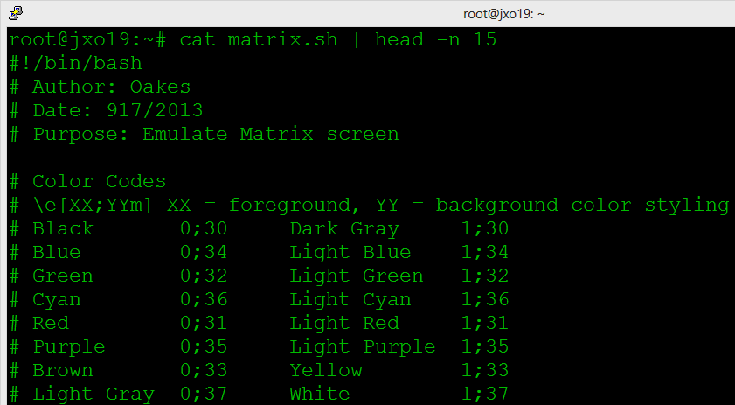
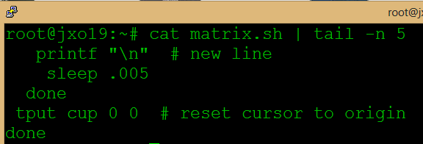
Linux Commands
head and tail
Use –n option to select number of lines returned

Slide 16

Linux Commands
find – search for files in a directory hierarchy
For example this will display the total number of files in the current working directory and all subdirectories
find . –type f –print | wc -l

Slide 17
Linux Commands
Linux really does use file extensions but applications running on Linux might
File names that begin with a period character are hidden.
File names in Linux, like Unix, are case sensitive

Slide 18

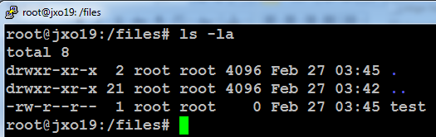
Linux Commands
touch – make an empty file

Slide 19
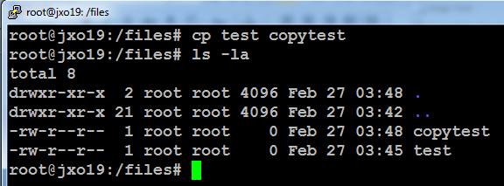
Linux Commands
cp – copy a file source -> destination

Slide 20

Linux Commands
cp – copy a file source -> destination
Use the –i option interactive mode

Slide 21

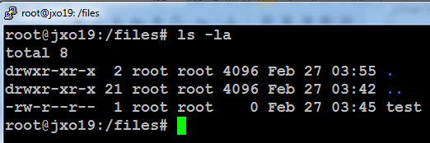
Linux Commands
rm – remove a file with -i interactive mode

Slide 22
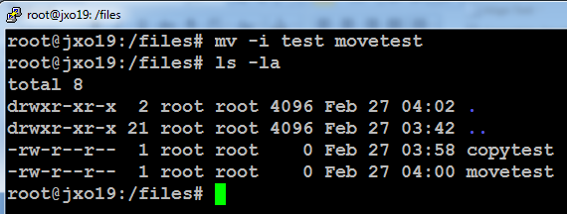
Linux Commands
mv – move a file with -i interactive mode
Can also be used to perform a file rename operation

Slide 23
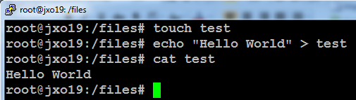
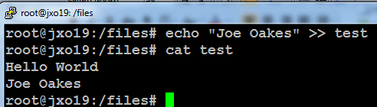
Linux Commands
echo - can be used to write to a file
> overwrite the destination file
>> append to the exisiting file
cat – concatenate or show the contents of a file

Slide 24
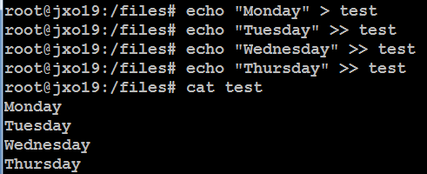
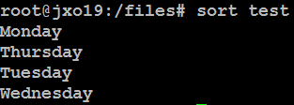
Linux Commands
sort – displays a file in order

Slide 25
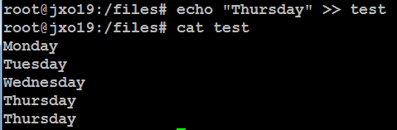
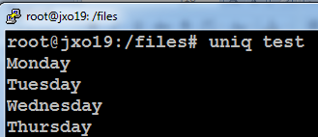
Linux Commands
sort –u remove duplicate lines from a file
uniq - remove duplicate lines from a file

Slide 26
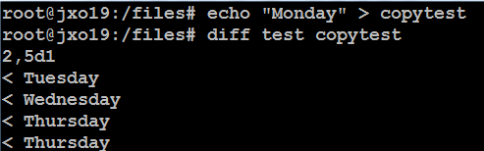
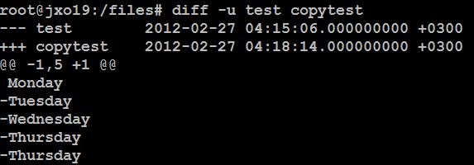
Linux Commands
diff – compares two files

Slide 27
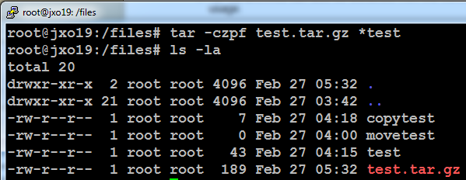
Linux Commands
tar – tape archive
Can be used to gzip compress or uncompress and archive many files into one
tar –options <filename> files to add

Slide 28
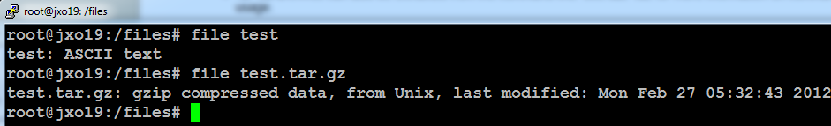
Linux Commands
file – identifies the contents of a file

Slide 29

Linux Commands
Wildcard characters * and ?

