Slide 1
Linux Unit 8 SQLite Database
Joe Oakes
Penn State

Slide 2
Linux: What is SQLite?
SQLite is an embedded SQL database engine. Unlike most other SQL databases, SQLite does not have a separate server process.
SQLite reads and writes directly to ordinary disk files.
A complete SQL database with multiple tables, indices, triggers, and views, is contained in a single disk file.
http://www.sqlite.org/

Slide 3
Linux: What is SQLite?
SQLite uses dynamic typing. Content can be stored as INTEGER, REAL, TEXT, BLOB, or as NULL.
A column declared INTEGER PRIMARY KEY will autoincrement.
SQLite is in the public domain. No claim of ownership is made to any part of the code.

Slide 4
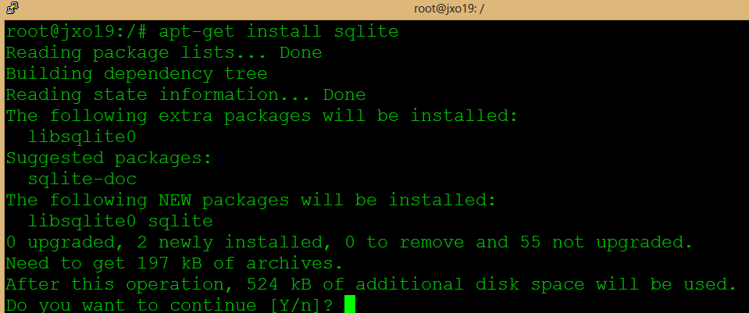
Linux: SQLite
Install sqlite database
# apt-get install sqlite

Slide 5
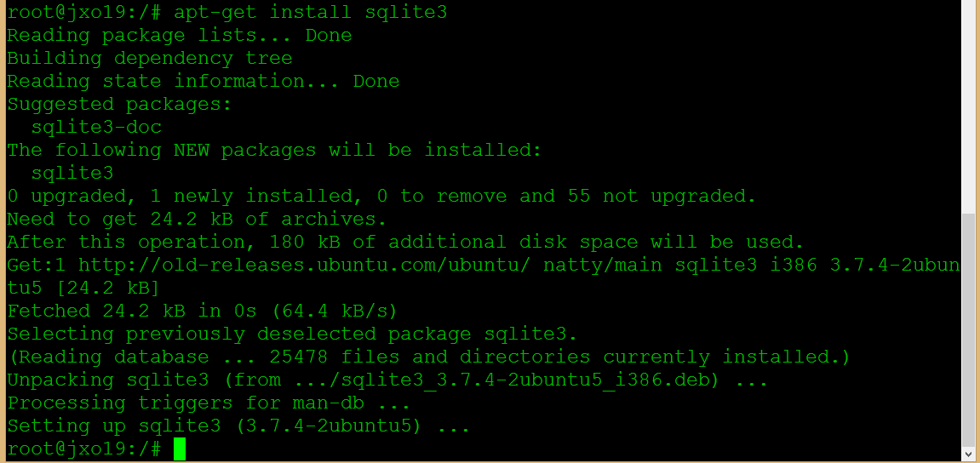
Linux: SQLite
Install the Command Line Shell For SQLite
# apt-get install sqlite3

Slide 6
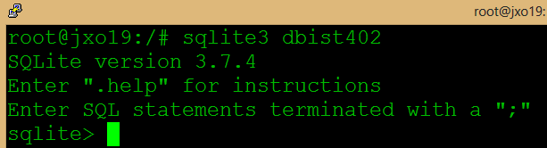
Linux: SQLite?
Start the sqlite3 program followed by the file that holds the SQLite database.
It will create a new one if it does not exist.
# sqlite3 dbist402

Slide 7
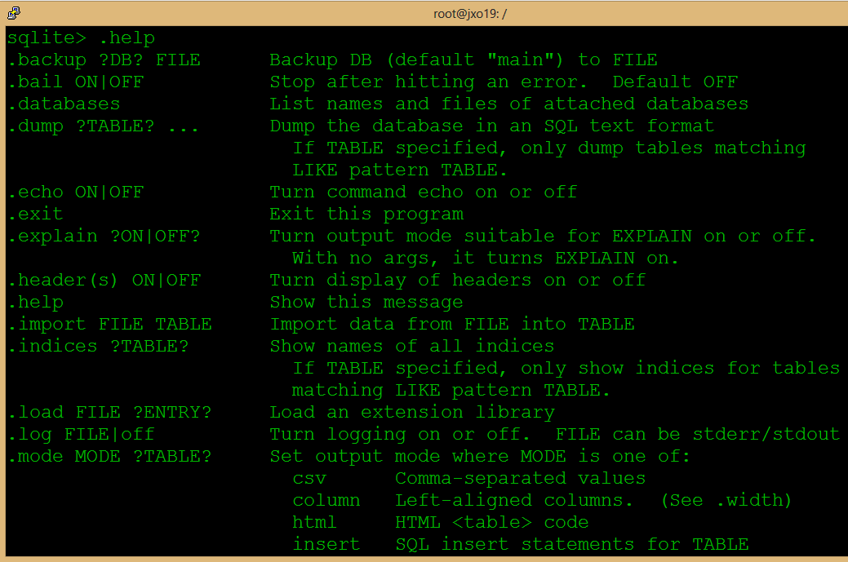
Linux: SQLite
To get help on the commands use .help
sqlite> .help
sqlite> .quit

Slide 8
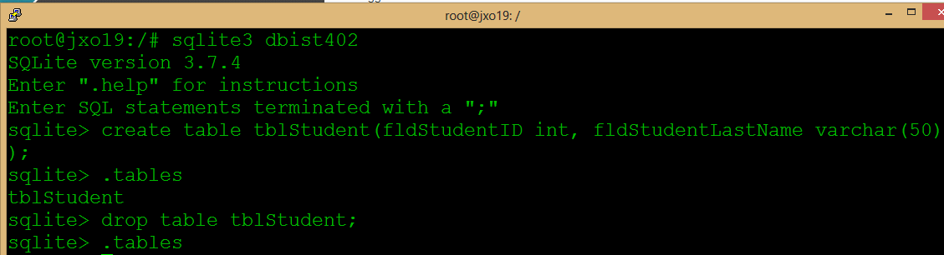
Linux: SQLite
Create a new table tblStudent
fldStudentID integer
fldStudentLastName varchar 50 characters
sqlite> create table tblStudent(fldStudentID int, fldStudentLastName varchar(50));
sqlite> .tables
sqlite> drop table tblStudent;

Slide 9
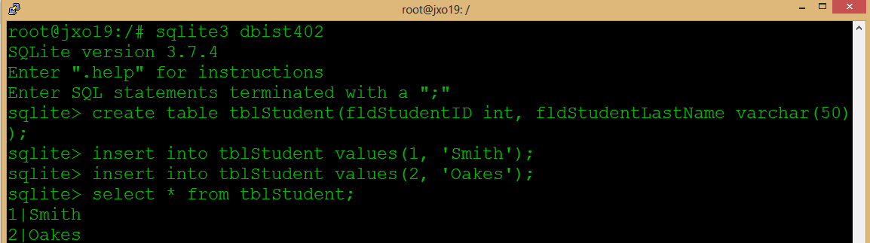
Linux: SQLite
Insert two records into the tblStudent
Show the records in the tblStudent table
sqlite> insert into tblStudent values(1, 'Smith');
sqlite> insert into tblStudent values(2, 'Oakes');
sqlite> select * from tblStudent;

Slide 10
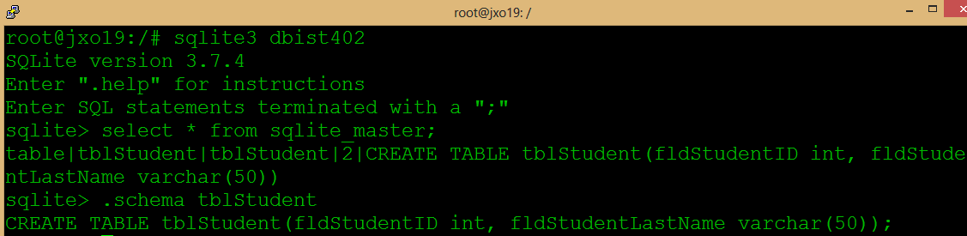
Linux: SQLite
Querying the SQLITE_MASTER table
Showing the table schema
sqlite> select * from sqlite_master;
sqlite> .schema tblStudent

Slide 11
Linux: SQLite
Update a record in the table tblStudent
sqlite> update tblStudent set fldStudentLastName ='Oaks' where fldStudentID =2;
sqlite> select * from tblStudent;

Slide 12
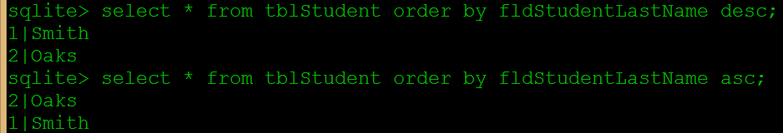
Linux: SQLite
Querying the tblStudent with Order By descending
Querying the tblStudent with Order By ascending
sqlite> select * from tblStudent order by fldStudentLastName desc;
sqlite> select * from tblStudent order by fldStudentLastName asc;

Slide 13
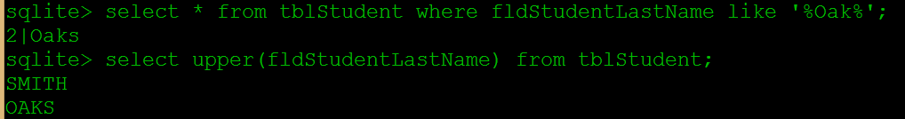
Linux: SQLite
Querying the tblStudent finding matches with wildcard
Querying the tblStudent table using a uppercase function upper()
sqlite> select * from tblStudent where fldStudentLastName like '%Oak%';
sqlite> select upper(fldStudentLastName) from tblStudent;

Slide 14
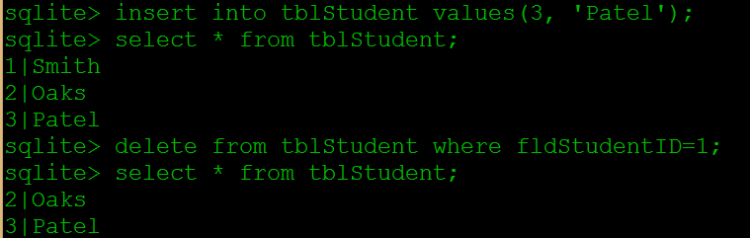
Linux: SQLite
Insert and Delete a record into the tblStudent
sqlite> insert into tblStudent values(3, 'Patel');
sqlite> select * from tblStudent;
sqlite> delete from tblStudent where fldStudentID=1;
sqlite> select * from tblStudent;

Slide 15
Linux: SQLite
Primary Key
sqlite> insert into tblStudent values(3, 'Patel');
sqlite> select * from tblStudent;
sqlite> delete from tblStudent where fldStudentID=1;
sqlite> select * from tblStudent;

Slide 16
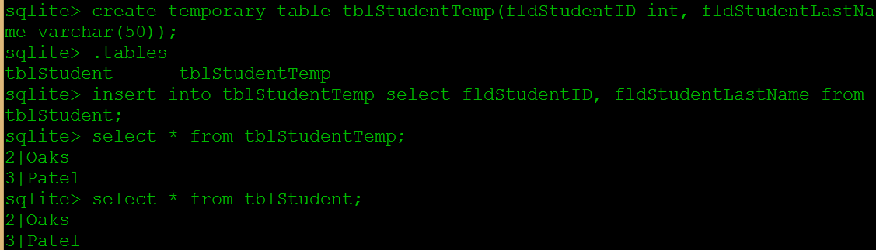
Linux: SQLite
Copy records from one table into a temp table
sqlite> create temporary table tblStudentTemp(fldStudentID int, fldStudentLastName varchar(50));
sqlite> .tables
sqlite> insert into tblStudentTemp select fldStudentID, fldStudentLastName from tblStudent;
sqlite> select * from tblStudentTemp

Slide 17
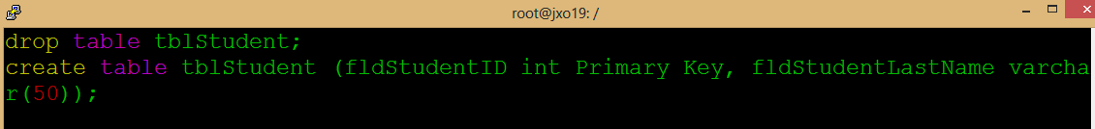

Linux: SQLite
Try to create a database script
Use vim editor to create a new file student.sql script
drop table tblStudent;
create table tblStudent (fldStudentID int Primary Key, fldStudentLastName varchar(50));
# sqlite3 dbist402 < student.sql

Slide 18
Linux: SQLite
How to create transactions
sqlite> begin transaction;
sqlite> create temporary table tblStudentTemp(fldStudentID int primary key, fldStudentLastName varchar(50));
sqlite> insert into tblStudentTemp select fldStudentID, fldStudentLastName from tblStudent;
sqlite> drop table tblStudent;
sqlite> create table tblStudent (fldStudentID int Primary Key, fldStudentLastName varchar(50));
sqlite> insert into tblStudent select fldStudentID, fldStudentLastName from tblStudentTemp;
sqlite> drop table tblStudentTemp;
sqlite> commit;

