Slide 1

IST 402 Network Security TLS 1.3 LM7
Joe Oakes
Penn State Abington

Slide 2

TLS 1.3 Differences
The main differences between TLS 1.2 and TLS 1.3 are:
TLS 1.3 offers better performance and stronger security than TLS 1.2, and it is recommended that organizations transition to TLS 1.3 wherever possible.
Handshake process: Once the handshake is complete, the client and server can exchange encrypted application data over the established secure connection. The TLS 1.3 handshake process has been optimized to reduce the number of round trips required, which improves performance.
Cipher suites: deprecated weaker cipher suites and support for latest versions of the AES and ChaCha20 ciphers.
Security: provides stronger security than TLS 1.2 by using forward secrecy as a default feature
Resumption: faster connections between the client and server

Slide 3
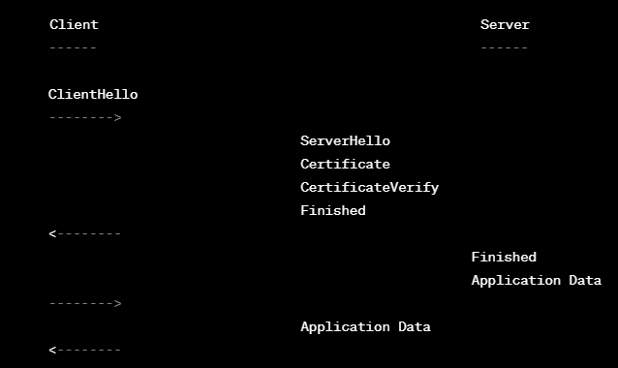
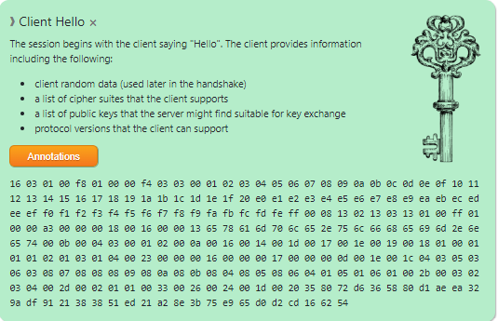
TLS 1.3 Differences: Handshaking Process
The main differences between TLS 1.2 and TLS 1.3 are:
Handshake process: In TLS 1.2, the handshake process involves multiple round trips between the client and server to establish a secure connection. In TLS 1.3, the handshake process has been optimized to reduce the number of round trips required, which improves performance.

Slide 4
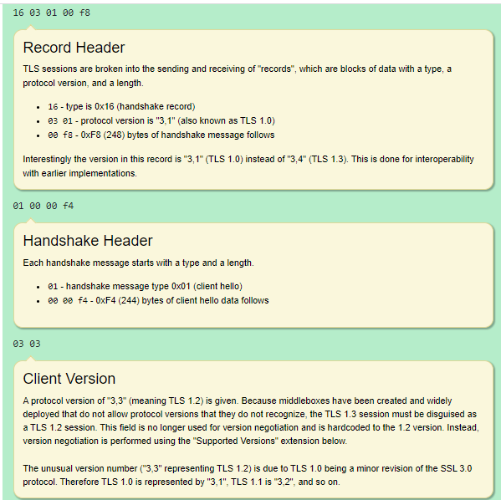
TLS 1.3 Handshaking Process
ClientHello: The TLS client initiates the handshake by sending a ClientHello message to the server, which includes the highest version of TLS it supports, a list of cipher suites it supports, and a random value called the client nonce.

Slide 5
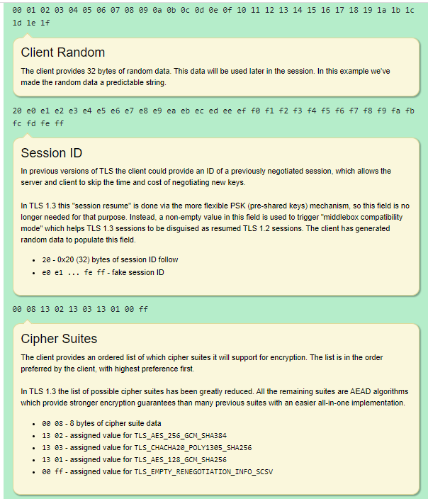
TLS 1.3 Handshaking Process
ClientHello: The TLS client initiates the handshake by sending a ClientHello message to the server, which includes the highest version of TLS it supports, a list of cipher suites it supports, and a random value called the client nonce.

Slide 6
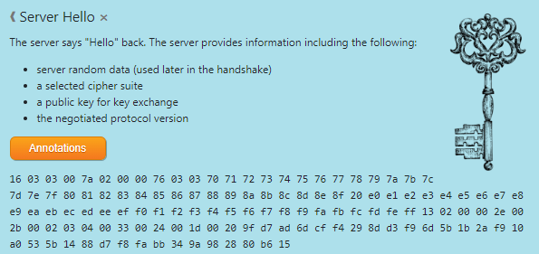
TLS 1.3 Handshaking Process: Server Hello
2. ServerHello: The TLS server responds with a ServerHello message, which includes the TLS version and cipher suite selected for the connection, a random value called the server nonce, and a session ID.

Slide 7
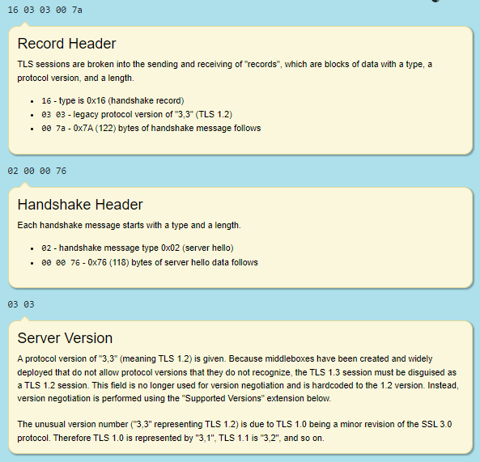
TLS 1.3 Handshaking Process ServerHello
2. ServerHello: The TLS server responds with a ServerHello message, which includes the TLS version and cipher suite selected for the connection, a random value called the server nonce, and a session ID.

Slide 8
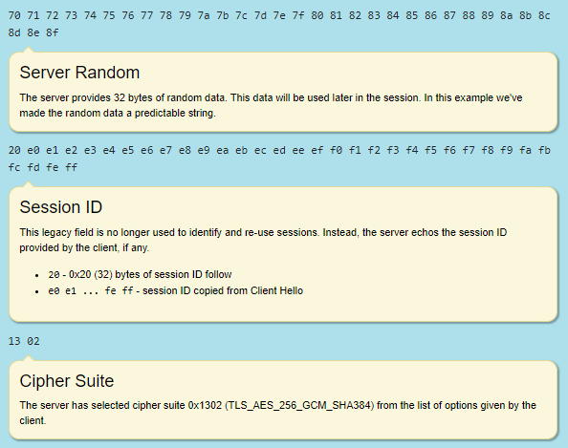
TLS 1.3 Handshaking Process: ServerHello
Handshaking
2. ServerHello: The TLS server responds with a ServerHello message, which includes the TLS version and cipher suite selected for the connection, a random value called the server nonce, and a session ID.

Slide 9
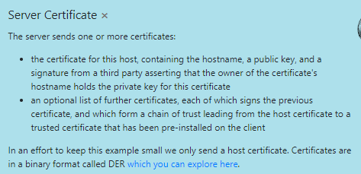
TLS 1.3 Handshaking Process: Certificate
3. Certificate: The server sends its certificate to the client to establish its identity. The certificate includes the server's public key and is used to encrypt the shared secret that will be used to establish the secure connection.

Slide 10
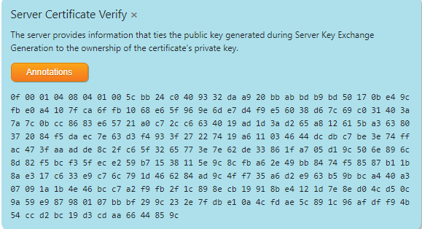
TLS 1.3 Handshaking Process: CertificateVerify
4. CertificateVerify: The server sends a digital signature of the previous handshake messages to the client to prove that it owns the private key corresponding to the certificate.

Slide 11
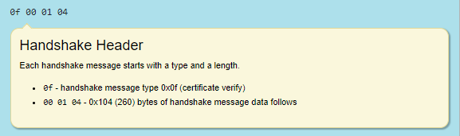
TLS 1.3 Handshaking Process: CertificateVerify
Handshaking
4. CertificateVerify: The server sends a digital signature of the previous handshake messages to the client to prove that it owns the private key corresponding to the certificate.

Slide 12
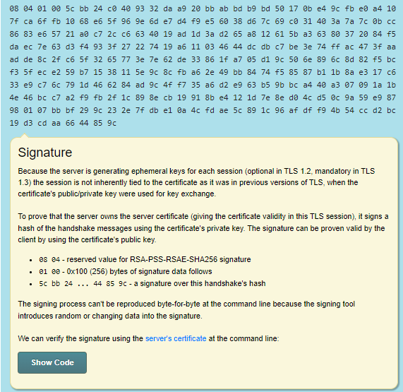
TLS 1.3 Handshaking Process: CertificateVerify
Handshaking
4. CertificateVerify: The server sends a digital signature of the previous handshake messages to the client to prove that it owns the private key corresponding to the certificate.

Slide 13
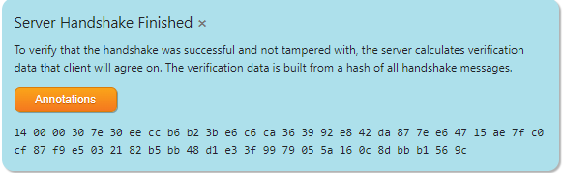
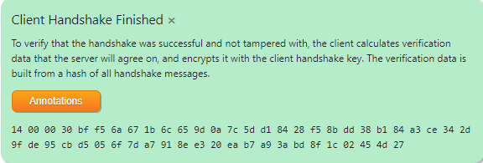
TLS 1.3 Handshaking Process: Finished
5. Finished: Both the client and server send Finished messages to each other, which contain a hash of all the previous handshake messages, including the shared secret. This verifies that both parties have the same shared secret and that the connection has been established securely.

Slide 14
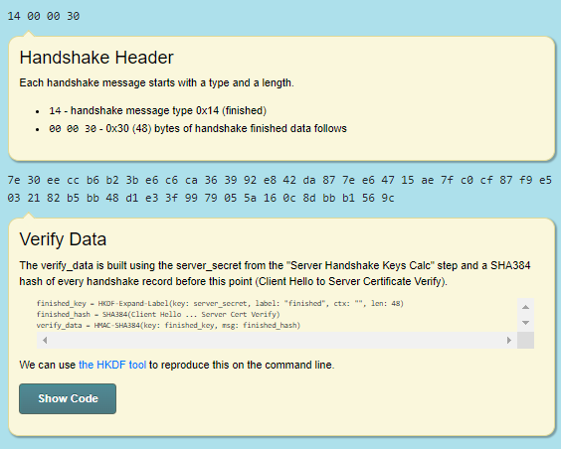
TLS 1.3 Handshaking Process: Finished
5. Finished: Both the client and server send Finished messages to each other, which contain a hash of all the previous handshake messages, including the shared secret. This verifies that both parties have the same shared secret and that the connection has been established securely.

Slide 15
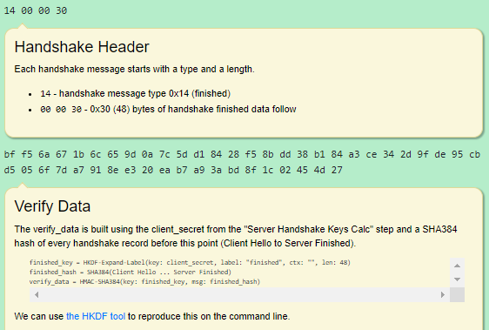
TLS 1.3 Handshaking Process: Finished
5. Finished: Both the client and server send Finished messages to each other, which contain a hash of all the previous handshake messages, including the shared secret. This verifies that both parties have the same shared secret and that the connection has been established securely.

Slide 16
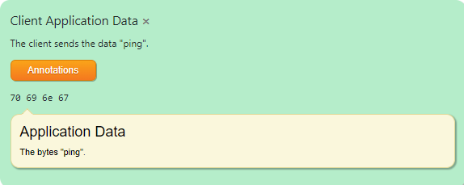
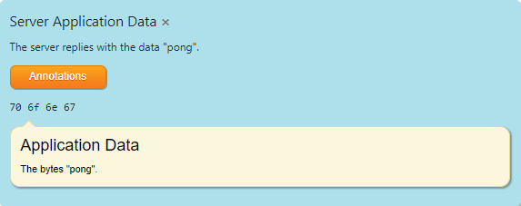
TLS 1.3 Handshaking Process: Application Data
6. Encrypted application data: Once the handshake is complete, the client and server can exchange encrypted application data over the established secure connection.

Slide 17
TLS 1.3 Handshaking Process
Handshaking
ClientHello: The TLS client initiates the handshake by sending a ClientHello message to the server, which includes the highest version of TLS it supports, a list of cipher suites it supports, and a random value called the client nonce.
ServerHello: The TLS server responds with a ServerHello message, which includes the TLS version and cipher suite selected for the connection, a random value called the server nonce, and a session ID.
Certificate: The server sends its certificate to the client to establish its identity. The certificate includes the server's public key and is used to encrypt the shared secret that will be used to establish the secure connection.
CertificateVerify: The server sends a digital signature of the previous handshake messages to the client to prove that it owns the private key corresponding to the certificate.
Finished: Both the client and server send Finished messages to each other, which contain a hash of all the previous handshake messages, including the shared secret. This verifies that both parties have the same shared secret and that the connection has been established securely.
Encrypted application data: Once the handshake is complete, the client and server can exchange encrypted application data over the established secure connection.

Slide 18
TLS 1.3 Differences: Cipher Suites
The main differences between TLS 1.2 and TLS 1.3 are:
Cipher suites: TLS 1.3 has deprecated weaker cipher suites that were present in TLS 1.2, such as those that use RC4 or SHA-1. TLS 1.3 also supports only the latest versions of the AES and ChaCha20 ciphers.
TLS_AES_128_GCM_SHA256
TLS_AES_256_GCM_SHA384
TLS_CHACHA20_POLY1305_SHA256
All three cipher suites use authenticated encryption with associated data (AEAD) algorithms for confidentiality, integrity, and authenticity. They differ in the key size and the underlying encryption algorithm used.
TLS_AES_128_GCM_SHA256 and TLS_AES_256_GCM_SHA384 use the AES encryption algorithm with 128-bit and 256-bit keys, respectively, and the Galois/Counter Mode (GCM) of operation for authenticated encryption.
TLS_CHACHA20_POLY1305_SHA256 uses the ChaCha20 stream cipher for encryption and the Poly1305 message authentication code (MAC) for authentication.

Slide 19
TLS 1.3 Differences: Security
The main differences between TLS 1.2 and TLS 1.3 are:
Security: TLS 1.3 provides stronger security than TLS 1.2 by using forward secrecy (also known as perfect forward secrecy) as a default feature. This means that even if an attacker is able to obtain the private key used in the connection, they cannot use it to decrypt past or future sessions.
In a system that uses forward secrecy, the keys used to encrypt a communication session are ephemeral and are not stored or reused in the future. Instead, new keys are generated for each session, and the old keys are discarded. If the long-term private key of a party is later compromised, the previously encrypted sessions cannot be decrypted, even if the attacker gains access to the corresponding public key and the encrypted data.
TLS 1.3 provides forward secrecy by using a key exchange algorithm that generates a new set of keys for each session, based on the Diffie-Hellman (DH) key exchange or Elliptic Curve Diffie-Hellman (ECDH) key exchange. The keys are then used to derive a shared secret, which is used for symmetric encryption of the communication. This ensures that even if the long-term private key of a party is compromised in the future, past communications remain confidential.

Slide 20
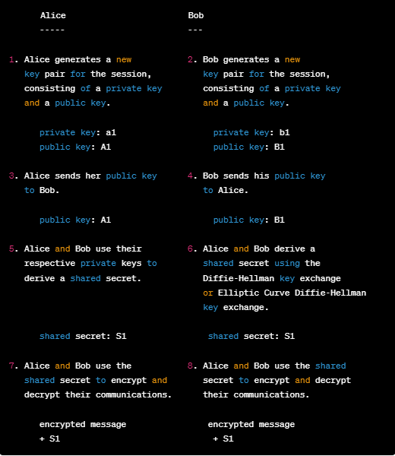
TLS 1.3 Differences: Security
Forward Secrecy
In this diagram, Alice and Bob want to communicate securely and privately. They each generate a new key pair for the session, consisting of a private key and a public key. They exchange their public keys and use them to derive a shared secret using a key exchange algorithm such as Diffie-Hellman or Elliptic Curve Diffie-Hellman.
The shared secret is then used to encrypt and decrypt their communications. Because the keys used for each session are ephemeral and are not reused in the future, the confidentiality of past communications remains protected even if the long-term private key of a party is compromised in the future. This provides forward secrecy.

Slide 21
TLS 1.3 Differences: Resumption
Client Server
------ ------
1. Client initiates a TLS 1.3 connection with the server.
ClientHello ------------->
2. Server responds with a ServerHello that includes a new session ticket and the selected cipher suite.
<-------------- ServerHello, NewSessionTicket
3. Client sends encrypted application data to the server.
Encrypted Application Data ------------->
4. Client and server exchange additional encrypted application data.
Encrypted Application Data <------------->
Encrypted Application Data <------------->
Encrypted Application Data <------------->
5. Client and server exchange a series of messages to gracefully close the connection.
CloseNotify ------------->
6. Client stores the session ticket for potential future use.
7. Client initiates a new connection to the server and presents the session ticket.
ClientHello, SessionTicket ------------->
8. Server validates the session ticket and resumes the previous session.
<-------------- ServerHello, EncryptedApplicationData
The main differences between TLS 1.2 and TLS 1.3 are:
Resumption: TLS 1.3 introduces a new session resumption mechanism that allows for faster connections between the client and server, without compromising security.
When the client decides to close the connection, it sends a CloseNotify message, and the server responds with its own CloseNotify message.
If the client decides to initiate a new connection with the server and wants to resume the previous session, it includes the session ticket in the ClientHello message. The server validates the session ticket and resumes the previous session by sending a ServerHello message that includes encrypted application data.
Session resumption allows clients to reuse previously established session parameters, reducing the latency and computational overhead of establishing a new session.

Slide 22
TLS 1.3: Works Cited
https://tls13.xargs.org/

