Slide 1



IMPACT OF 5G
ON CONSUMER MARKET
TLIQ-o
Image by pikisuperstar on Freepik

Slide 2
TOPICS
PROBLEM STATEMENT
APPROACH
RESULTS
RECOMMENDATION
TLIQ-o

Slide 3

PROBLEM STATEMENT
ATLIQO LAUNCHED 5G PLANS IN VARIOUS CITIES IN INDIA IN MAY 2022 among other competitors.
MANAGEMENT NOTICES
IN THEIR REVENUE AND ACTIVE USERS
IS KEEN TO COMPARE PRE AND POST 5G PERFORMANCE TO MAKE INFORMED DECISIONS
TLIQ-o

Slide 4
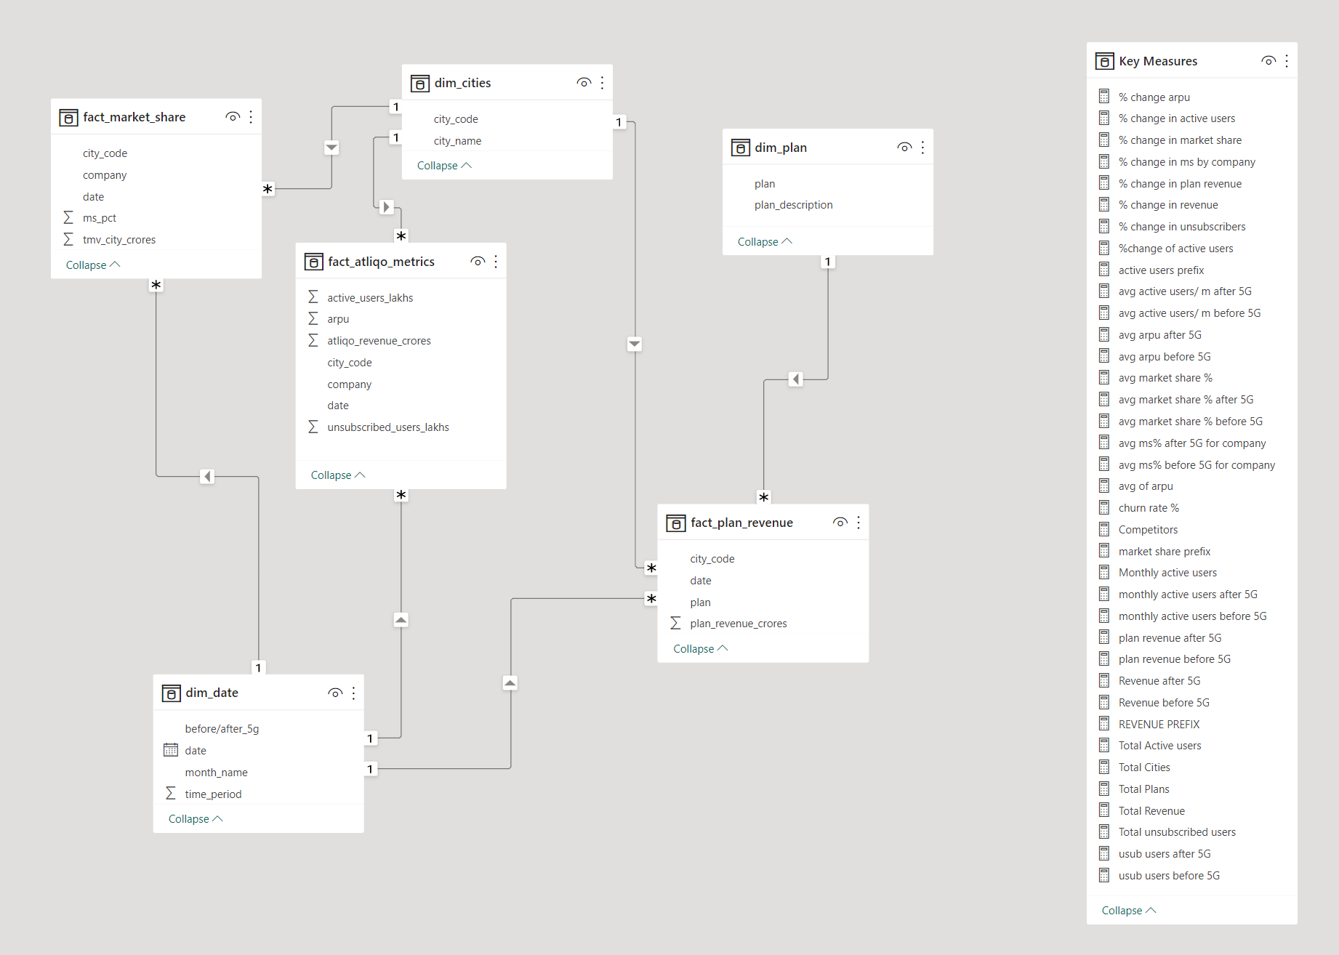
APPROACH
DATA MODELING
CREATING MEASURES
DATA VISUALIZATION
AND GETTING INSIGHTS
TLIQ-o

Slide 5


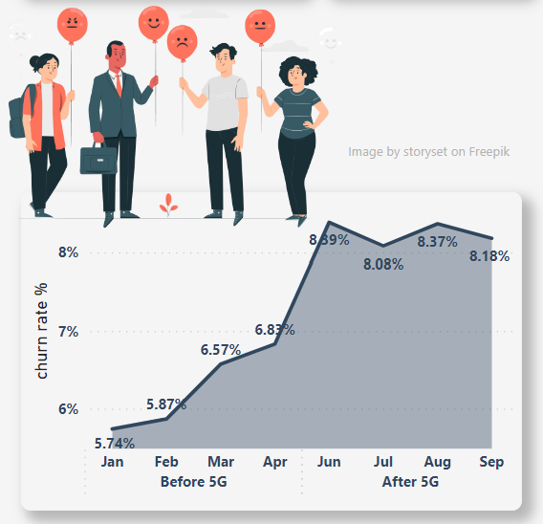
RESULTS - OVERVIEW
0.5%
23.5%
Revenue drop
Rise in unsubscribers
8.3%
ACTIVE USERS drop
1.4%
CHURN RATE AVERAGES ABOVE 8% AFTER 5G
MARKET SHARE drop
TLIQ-o

Slide 6
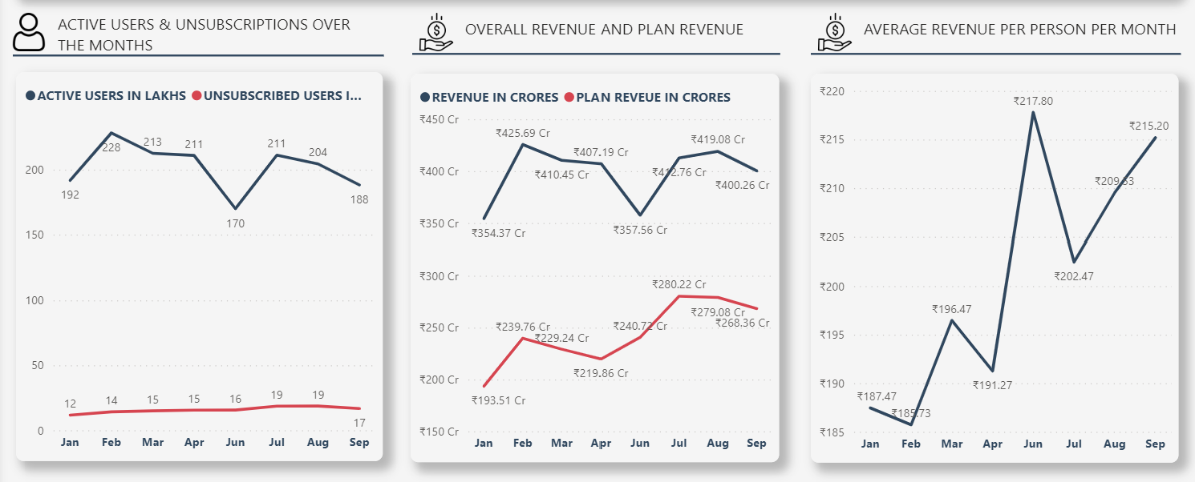
RESULTS – USER BASE
Arpu increased by ₹21 following the 5g launch.
Despite a decline of 20% active users, atliqo saw a 22% rise in plan revenue through may and June.
40.93 Lakh users became inactive through may and June dropping the overall revenue.
TLIQ-o

Slide 7
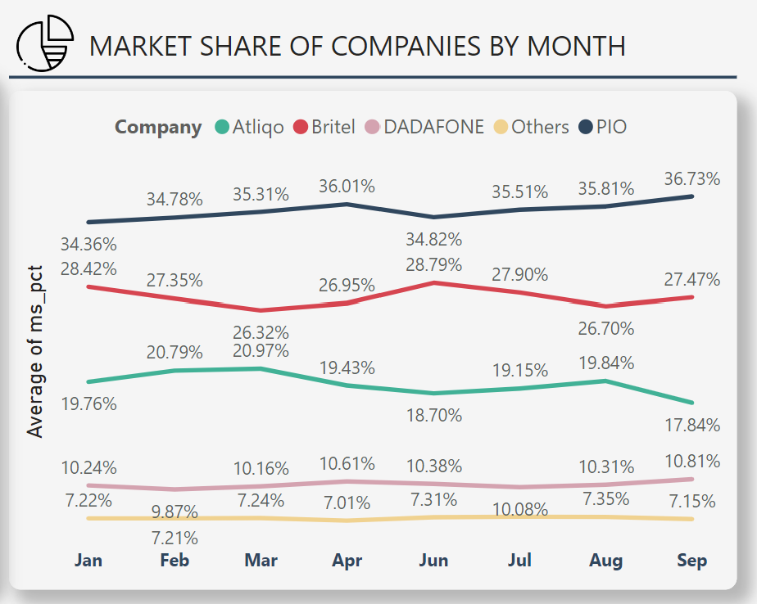
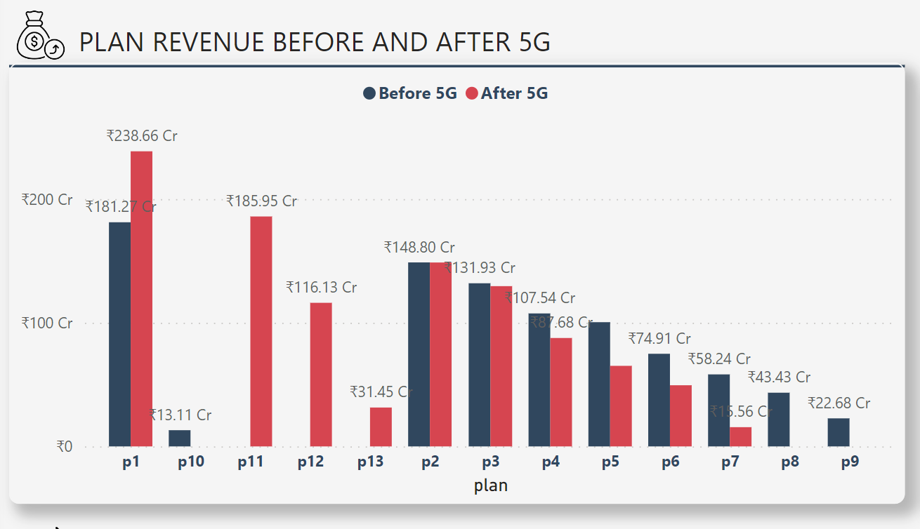
RESULTS – MARKET SHARE / PLANS
Newly added plans p11, p12, p13 after 5g, Helped to increase plan revenue.
Plans p8, p9, p10 are probably discontinued after 5g launch due to lower revenue prior to 5g or the revenue is so small to be compared.
BRITEL AND ATLIQO ARE SHOWING VERY OPPOSITE TRENDS IN MARKET SHARE %. It is possible that most of the unsubscribed users are leaving for britel. britel could be atliqo’s fierce competitor.
P5. p6 and p7 plans are performing very poorly post 5g launch.
TLIQ-o

Slide 8
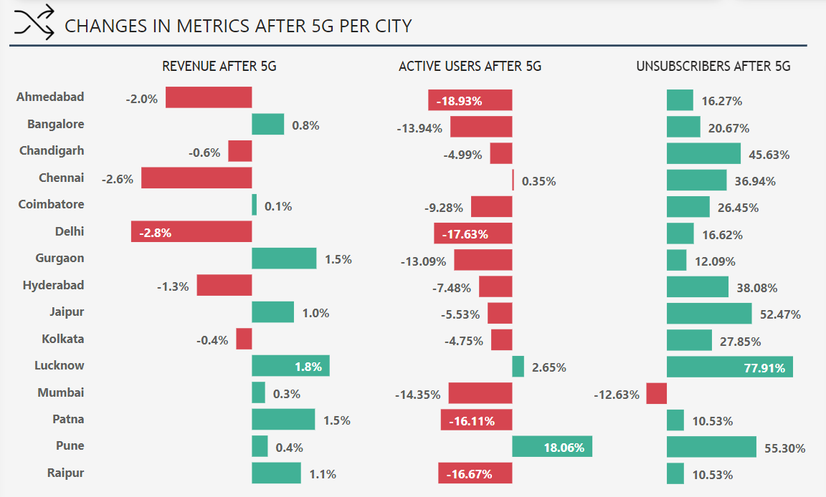
RESULTS- CITY INSIGHTS
Mumbai is the only city where number of unsubscribers dropped after 5G launch.
Pune saw an increase in active users after 5g, FOLLOWED BY LUCKNOW AND CHENNAI
Pune saw an increase in active users after 5g
TLIQ-o

Slide 9





RECOMMENDATIONS
Inactive users add cost to the company and hence they should be terminated with 60 days notice.
Focus on customer retention in cities like DELHI, CHENNAI, HYDERABAD, PUNE. Reduce the churn rate by providing excellent customer service and flexible plans.
Customers prefer to have high validity as well as per day data usage plans rather than a bundle of data pack. Plans P5, P6 and P7 can be revised keeping this in mind and separate plan can be created for users who prefer low validity and bundle data pack.
Plan revenue is better post 5G, however the overall revenue has not seen significant change except the month of June. This could be due to the cost of operating 5G connections, installations, maintaining services, etc.
Find new ways to advertise and promote 5G to compete the market share with competitors. BRITEL is the closest competitor and AtliQO should consider to build strategies accordingly.
TLIQ-o

