Slide 1
ATLIQ HARDWARE
Sales Insights FROM ad-hoc requests
By HARDIK SEJU
February 2nd, 2023

Slide 2
AGENDA
Introduction
Insights
Conclusion
Queries
Appendix

Slide 3
INTRODUCTION
Atliq Hardware, one of the leading computer hardware producers in India with customers from across the globe, want to get insights on company products sales to make data-informed decisions.

Slide 4
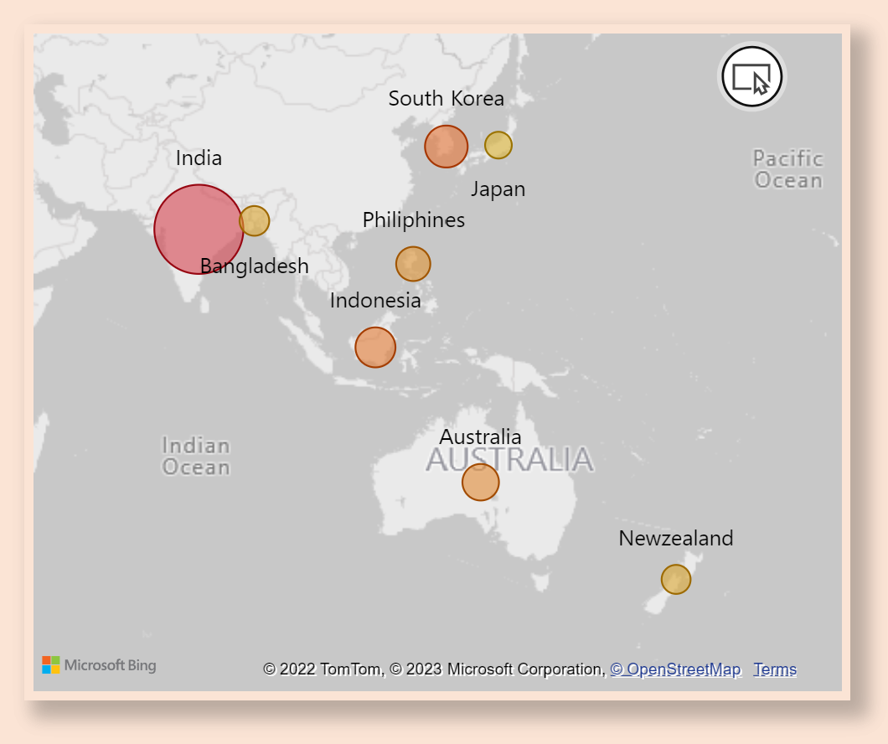
INSIGHTS
Q1. LIST OF MARKETS WHERE CUSTOMER “ATLIQ EXCLUSIVE” OPERATES BUSINESS IN “ASIA PACIFIC” REGION for Fiscal year 2020-2021
India is a leading market in terms of Gross Sales for Atliq Exclusive in Asia Pacific region out of 8 countries, followed by South Korea, Indonesia, Australia and others.

Slide 5
INSIGHTS
Q2. Change in NUMBER OF unique products
Q3. unique products in each segment
44%
232
Common unique products
We observe a 44% rise in number of unique products from 2020 to 2021.
Atliq hardware can research on current trends as well as needs and introduce some new products in Networking and Storage segments.

Slide 6
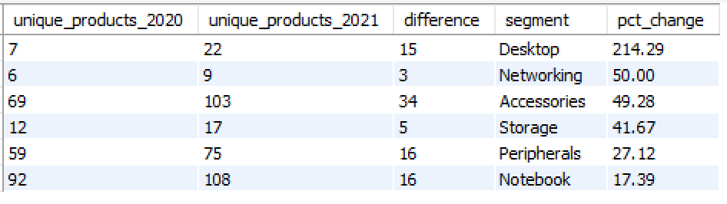
INSIGHTS
Q4. % CHANGE OF UNIQUE PRODUCTS IN EACH SEGMENT FROM PREVIOUS YEAR
For Atliq hardware, Desktop segment saw highest comparative increase in its products in year 2021.

Slide 7
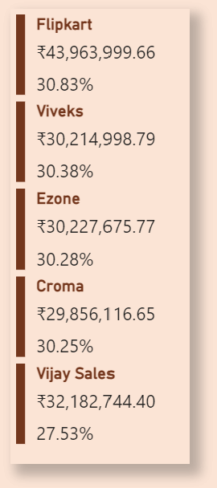


INSIGHTS
Q5. Top 5 customers with highest average pct discount for fiscal year 2021 in Indian market
FlipKart with highest average discount brings in the highest sales. This strategy of discount with customers is working well for the company.
Q6. Product with Max Manufacturing cost
- AQ Home Allin1 Gen2
Q6. Product with Min Manufacturing cost
- AQ Master Wired X1 MS
Computer icons created by Freepik - Flaticon

Slide 8
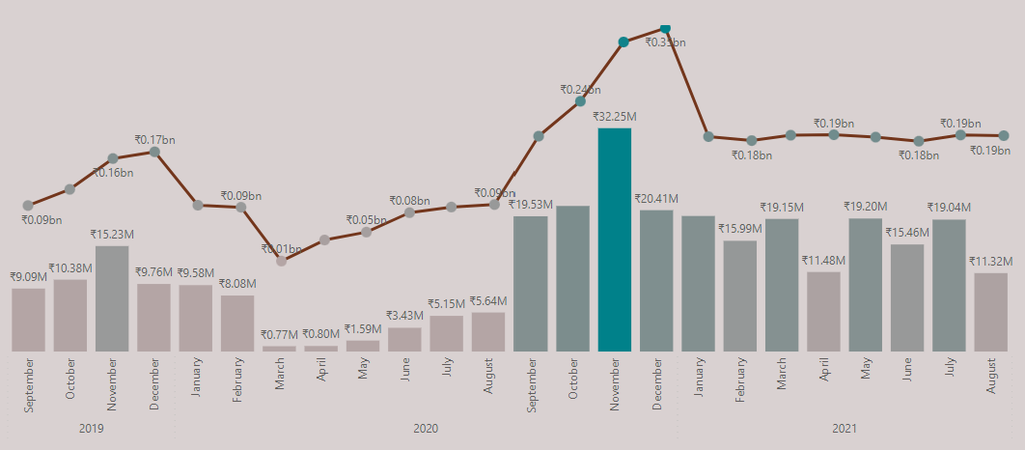
INSIGHTS
Q7. Gross sales for CUSTOMER “atliq exclusive” for each month
GROSS SALES ALL CUSTOMERS
GROSS SALES ATLIQ EXCLUSIVE
Atliq hardware can introduce some products to increase sales in summer. Overall the sales have increased after pandemic and have remained consistently high then pre pandemic year.

Slide 9
INSIGHTS
Q8. Quarter with max quantities sold for fiscal year 2020
Quarters FOR FISCAL YEAR 2020
For fiscal year 2020, Q3 was with the least products sold. In summer the computer hardware demand decreases and Atliq Hardware can come up with some outdoor products like waterproof speakers to hike up the sales.
Q1
SEP’19
OCT’19
NOV’19
7M
Q2
DEC’19
JAN’20
FEB’20
6.6M
Q3
MAR’20
APR’20
MAY’20
2M
Q4
JUN’20
JUL’20
AUG’20
5M
Computer icons created by Freepik - Flaticon

Slide 10
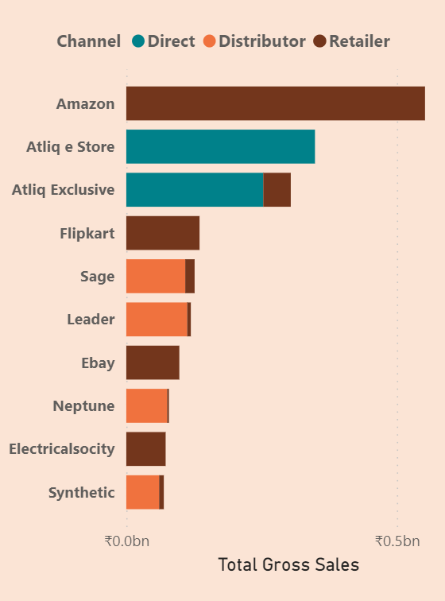



INSIGHTS
Q9. Channels with gross sales and its Percentage contribution
retailer
direct
distributor
₹ 1.92 bn (73.22 %)
₹ 0.40 bn (15.47 %)
₹ 0.29 bn (11.31 %)
Top ten customers with
Highest gross sales
Retail icons created by pojok d - Flaticon
Retail icons created by pojok d - Flaticon
B2c icons created by Uniconlabs - Flaticon

Slide 11
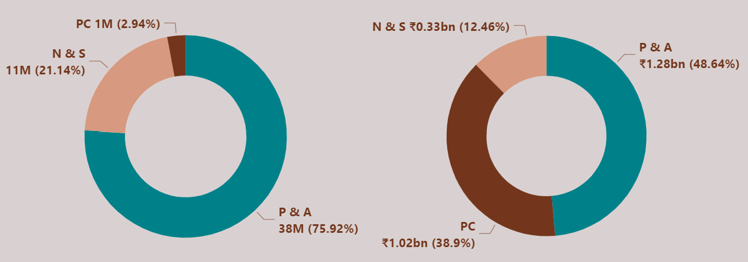
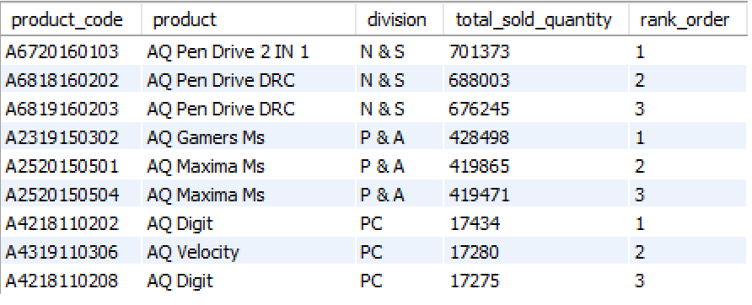
INSIGHTS
Q10. Top 3 products in each division with highest quantity sold in fiscal year 2021
Total products sold
Total gross sales
Even though P & A accounts for the division with maximum quantities sold, the products with highest quantities sold belongs to N & S. Quantities sold in PC division are significantly lower than other two divisions but still accounts for 38.9% of all gross sales.

Slide 12
PUTTING IT ALL TOGETHER
Atliq Hardware has performed well in year 2021 introducing 102 new products with Peripherals and Accessories bringing in the highest revenue followed by PC.
PC is the strongest performing division, generating 39% of total sales while accounting for only 3% of overall quantities of products sold.
Try to tweak discounts rates such that the customers bring in more gross sales for the company.
Space to increase e-commerce sales by partnering with new e-commerce platforms with competitive discounts.

Slide 13
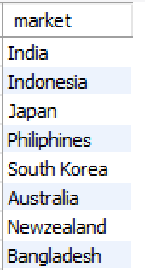
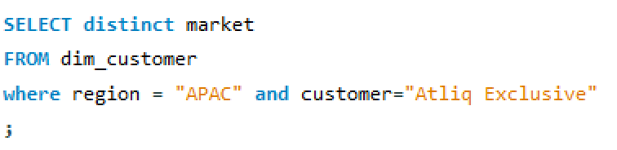
QUERIES
1. Provide the list of markets in which customer "Atliq Exclusive" operates its business in the APAC region.

Slide 14
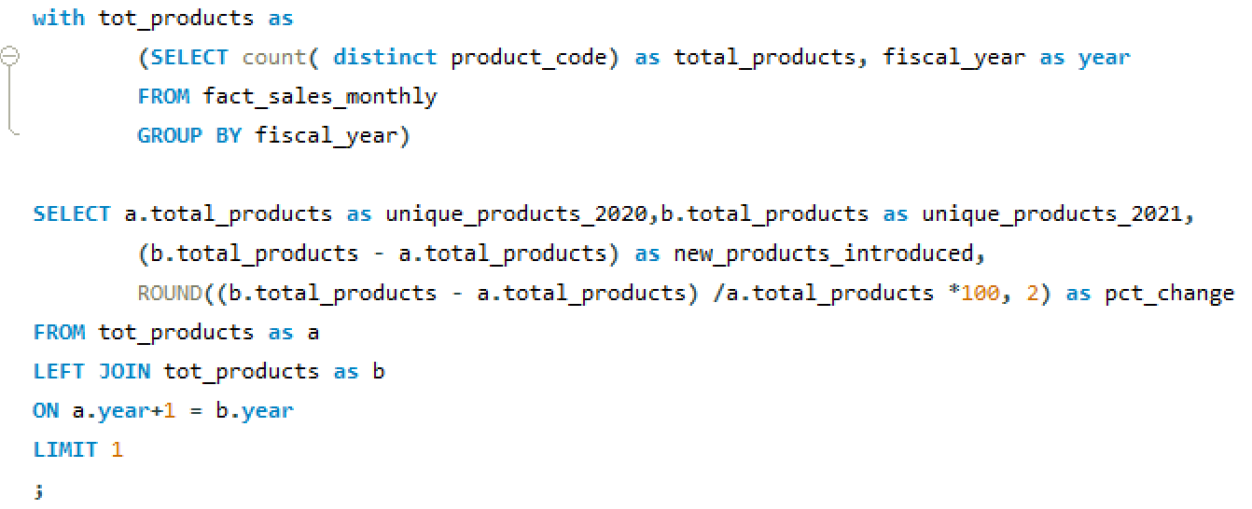
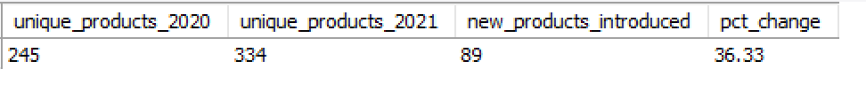
QUERIES
2. What is the percentage of unique product increase in 2021 vs. 2020?

Slide 15
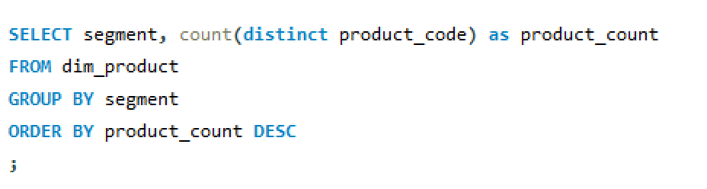
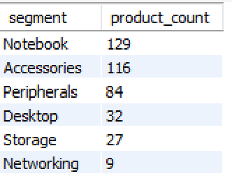
QUERIES
3. Provide a report with all the unique product counts for each segment and sort them in descending order of product counts

Slide 16
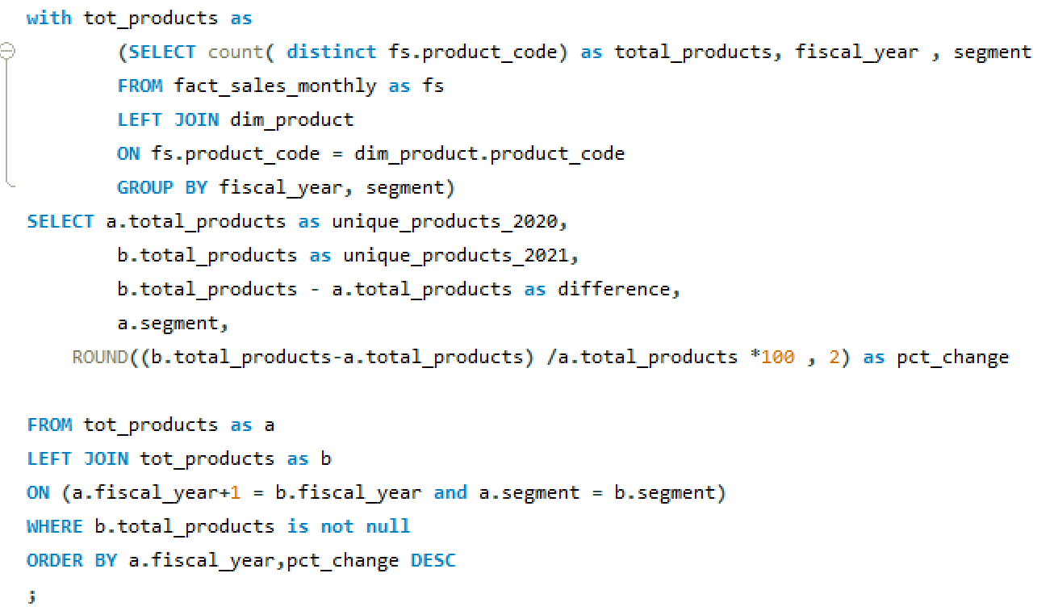
QUERIES
4. Follow-up: Which segment had the most increase in unique products in 2021 vs 2020?

Slide 17
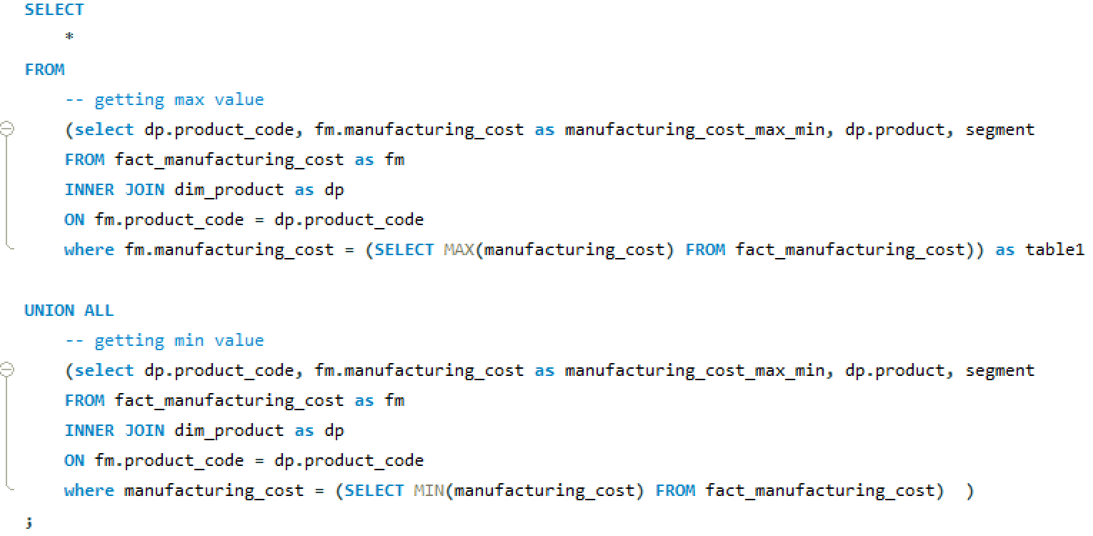
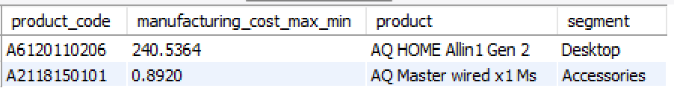
QUERIES
5. Get the products that have the highest and lowest manufacturing costs.

Slide 18
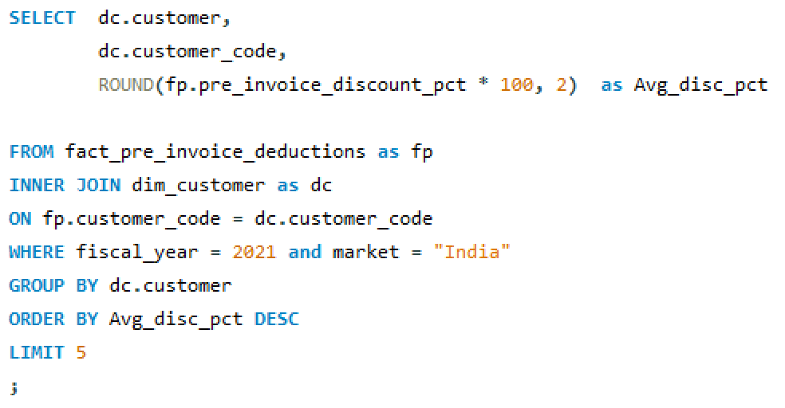
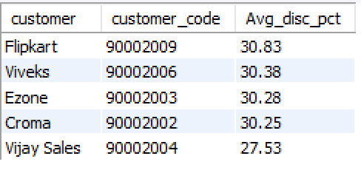
QUERIES
6. Generate a report which contains the top 5 customers who received an average high pre_invoice_discount_pct for the fiscal year 2021 and in the Indian market.

Slide 19
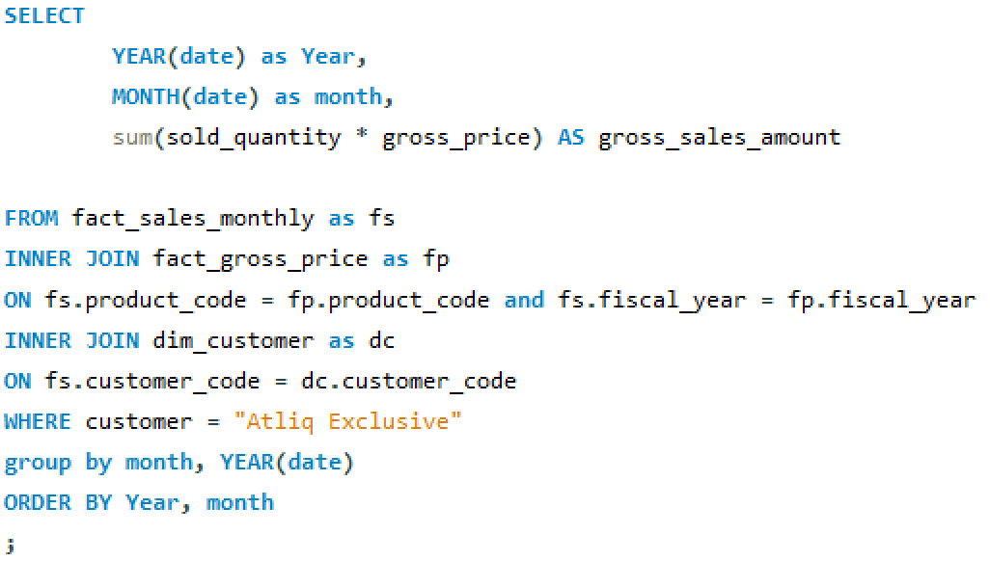
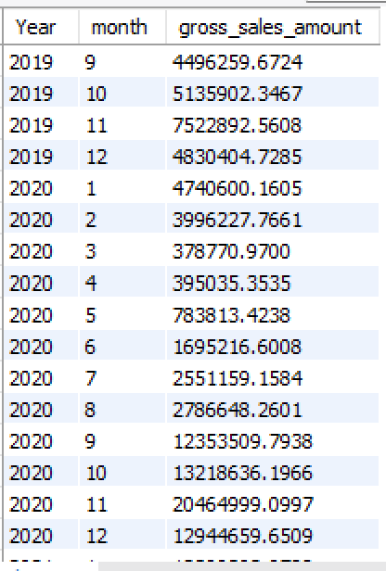
QUERIES
7. Get the complete report of the Gross sales amount for the customer “Atliq Exclusive” for each month.

Slide 20
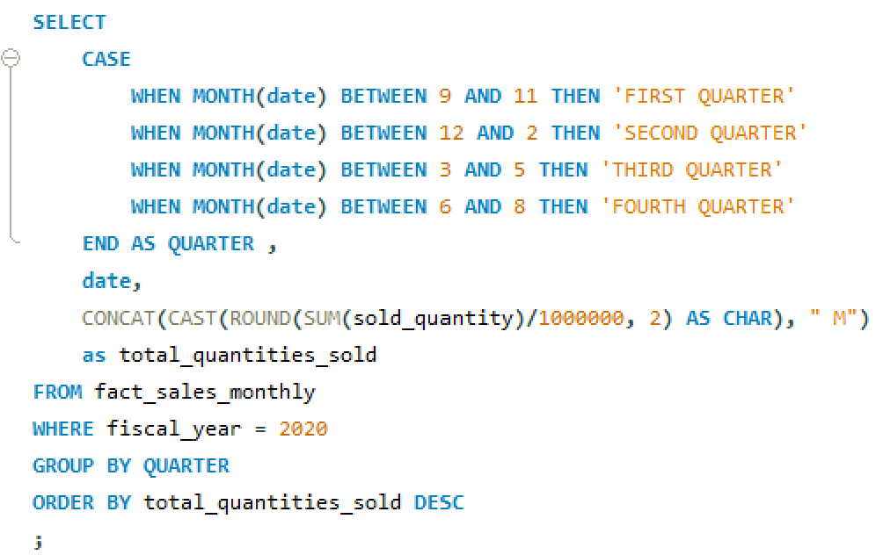
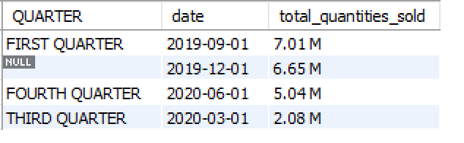
QUERIES
8. In which quarter of 2020, got the maximum total_sold_quantity?

Slide 21
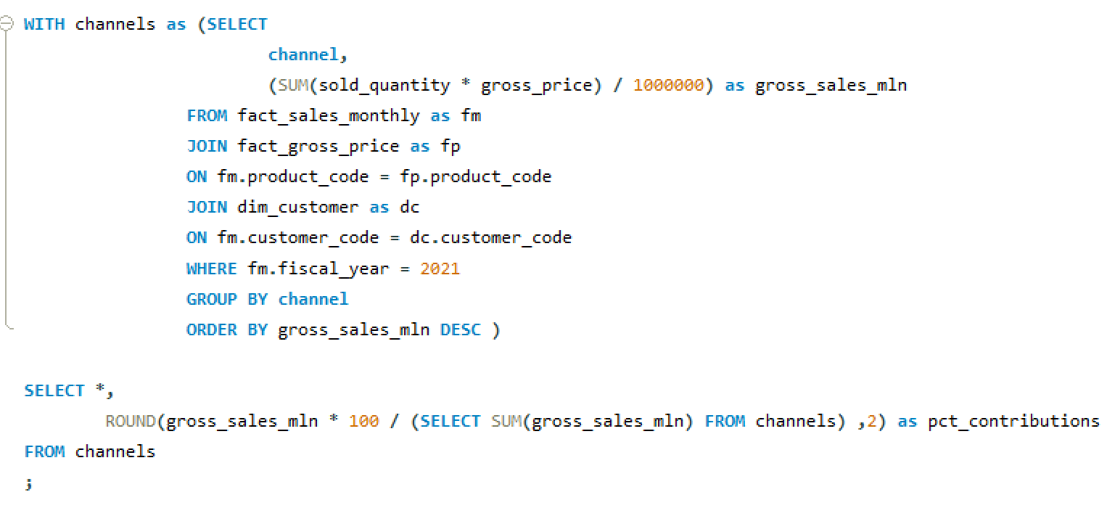
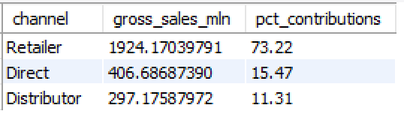
QUERIES
9. Which channel helped to bring more gross sales in the fiscal year 2021 and the percentage of contribution?

Slide 22
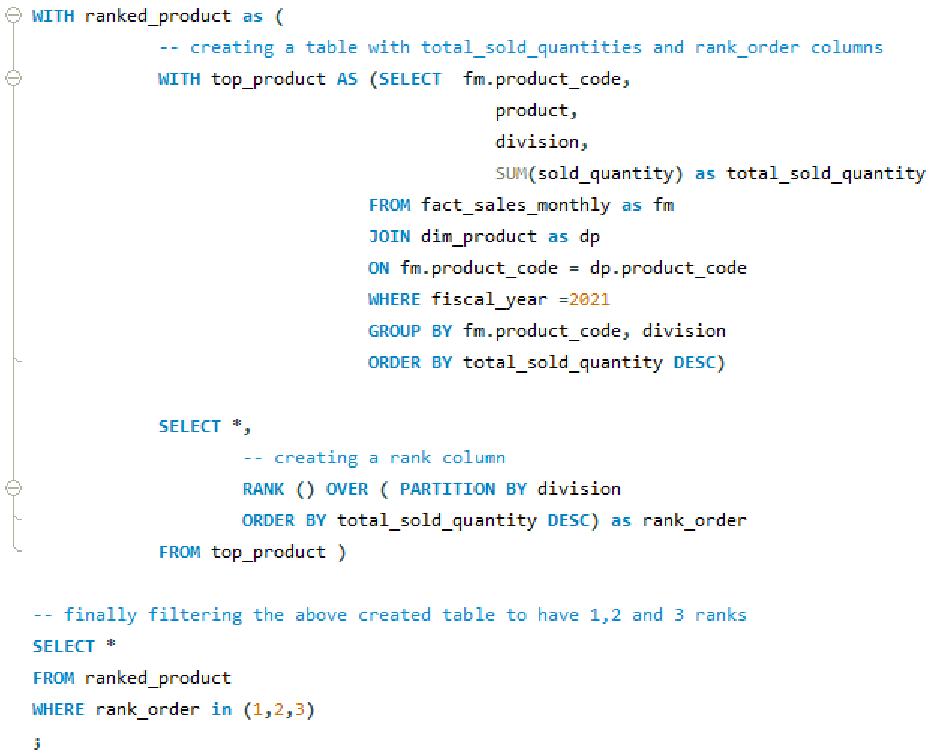
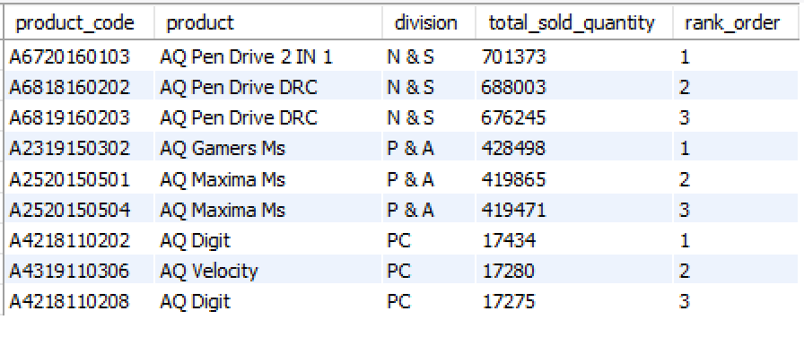
QUERIES
10. Get the Top 3 products in each division that have a high total_sold_quantity in the fiscal_year 2021?

Slide 23
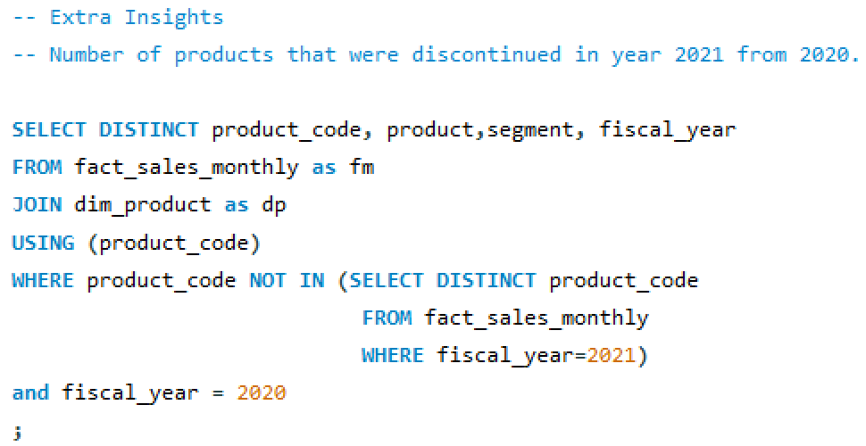
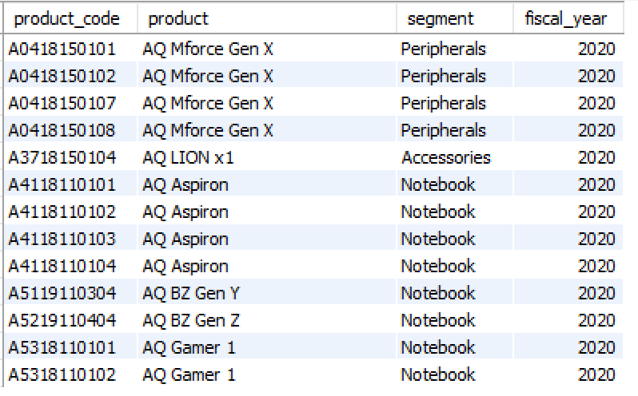
QUERIES
Extra: Number of unique products that were discontinued in year 2021 from year 2020.

Slide 24
APPENDIX
Project on GitHub:
https://github.com/hseju/Consumer-Goods-Insights-SQL
Codebasics challenge #4:
https://codebasics.io/event/codebasics-resume-project-challenge

Slide 25
THANK YOU
HARDIK SEJU

