Slide 1

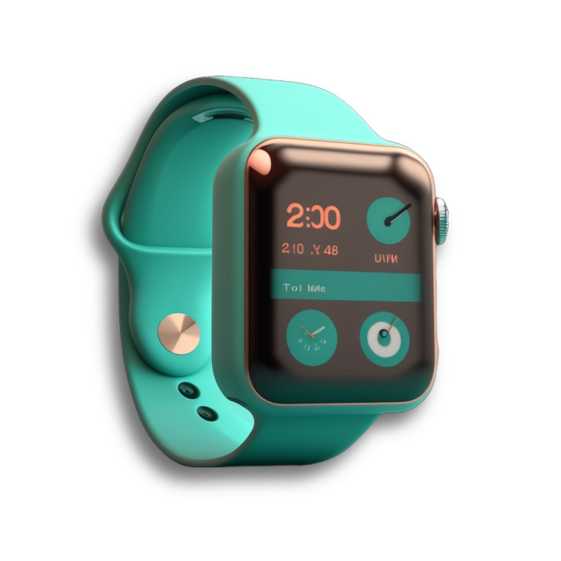

BELLABEAT
Physical Activity Insights
In 24 hours
Users are spending on average
Bellabeat is a high-tech manufacturer of health-focused products for women. It’s Co-founder Urška Sršen wants to focus on new growth opportunities by analyzing smart fitness data. The trends and insights gathered from this data can help guide the marketing strategy for the company.
21 mins
14 mins
3h 13 mins
On Intense
Activities
On Moderate
Activities
On Light
Activities
30 participants consented to provide their fitness data from 12th April 2016 to 12th May 2016 on a survey about their Sleep, Physical Activity and Heart Rate.
So when are users more active during a day?
Sleep Patterns
Nearly half of the users did not track their sleep, meaning they did not prefer to wear the tracker or the device did not support sleep tracking.
With daily average of
High activity levels are noticed between 4 PM to 8 PM. This could be the most preferable time to workout for users considering when they are done with work. Though different timings were notices for different users where they performed high intensity activities.
8K
Steps
Steps
Recommendations
Belleat has several products including Bellabeat App, Time, and Leaf which can be worn as a Bracelet, necklace or a clip.
Users can be prompted to enter data about their regular activity time to better serve them with data regarding their intensity level and time performing that activity.
Users should be notified to have their watch on while sleeping to track and to keep informed about their sleeping habits.
Users should also be notified about their time lying in bed awake in order to keep them active or fall asleep faster.
A reward system could be implemented to keep users motivated with regards to activities like number of steps.

