Slide 1

Plato’s Pizza is a Greek inspired Pizza restaurant In New Jersey.
The Business wants to get insight from its transactional Data and find more opportunities to drive sales and improve efficiency.

Slide 2
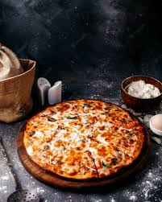
Stakeholder Expectations
What days and times do we tend to be busiest?
How many pizzas are we making during peak periods?
What are our best and worst selling pizzas?
What's our average order value?
How well are we utilizing our seating capacity? (we have 15 tables and 60 seats)

Slide 3
Process
EDA in BigQuery
Report Findings
Data Cleaning
Data Visualization

Slide 4
Data Cleaning

