Slide 1
Packet Inspection to detect attacks using machine learning models
By: Hussein Salloum
Supervised by:
Dr – Sameeh Jammoul
Dr- Mohammad Bashar Dasouki

Slide 2
Project Objective

Slide 3
Project Requirements

Slide 4
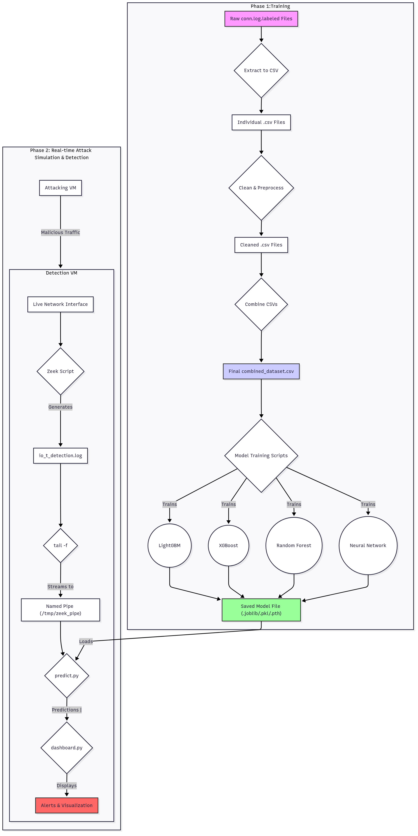
System Block Diagram

Slide 5
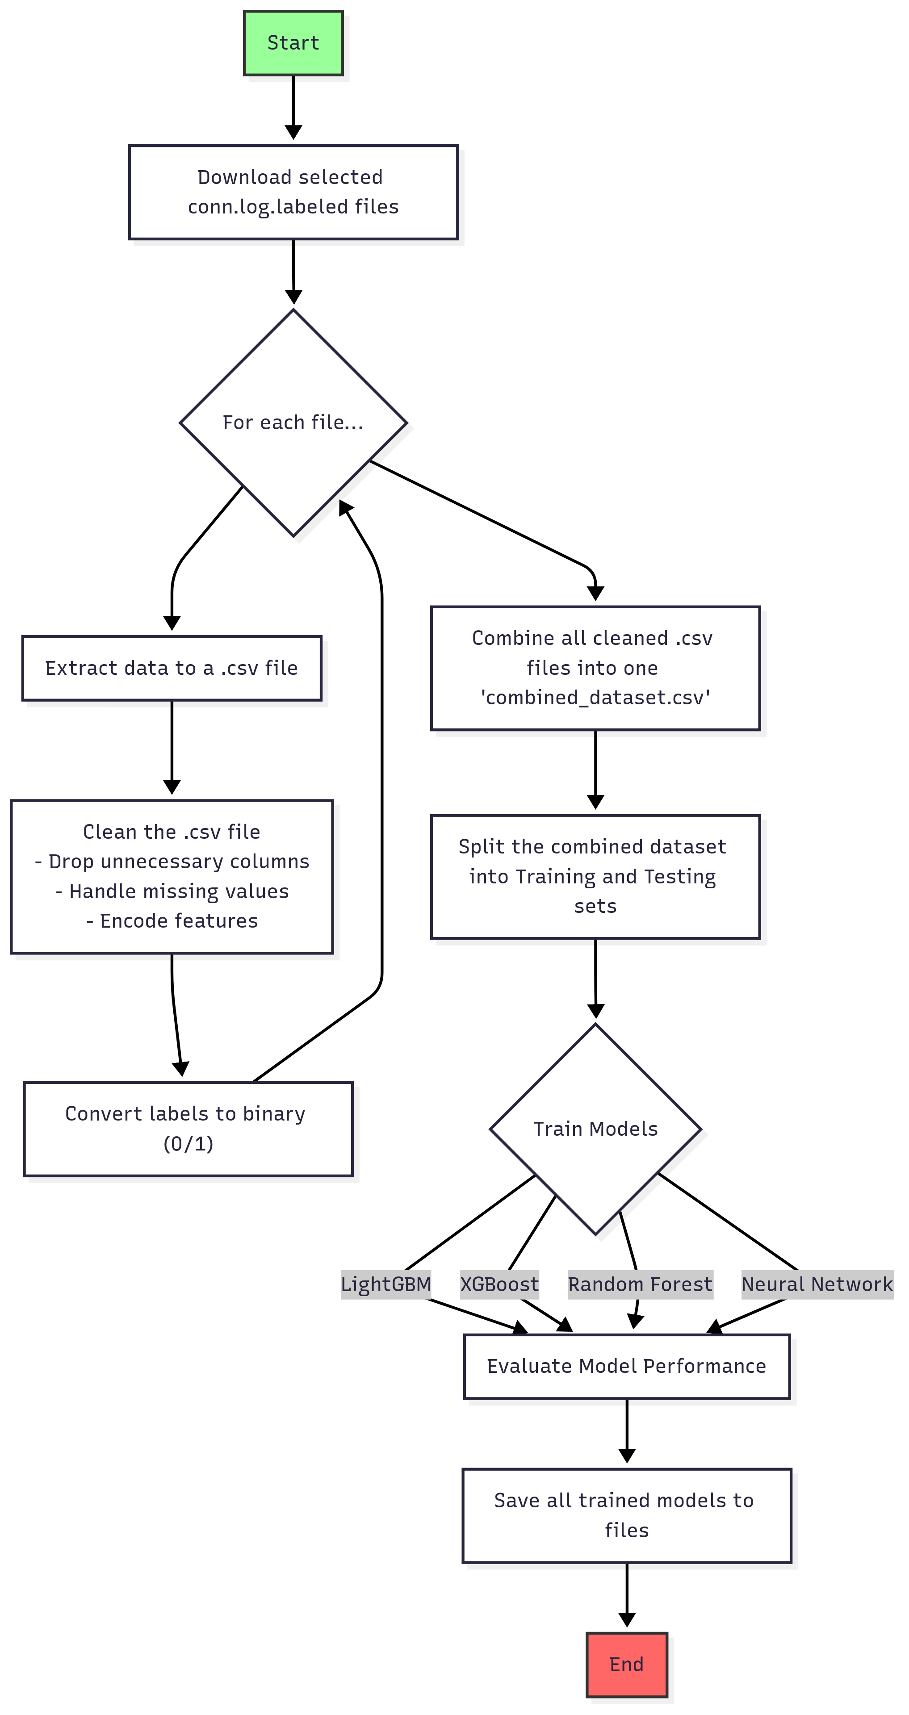
Training Flow Chart

Slide 6
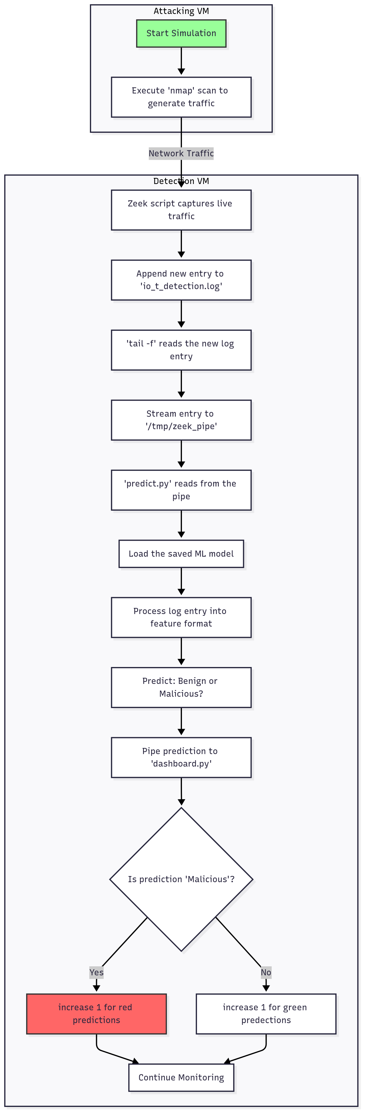
Attacking Flow Chart

Slide 7
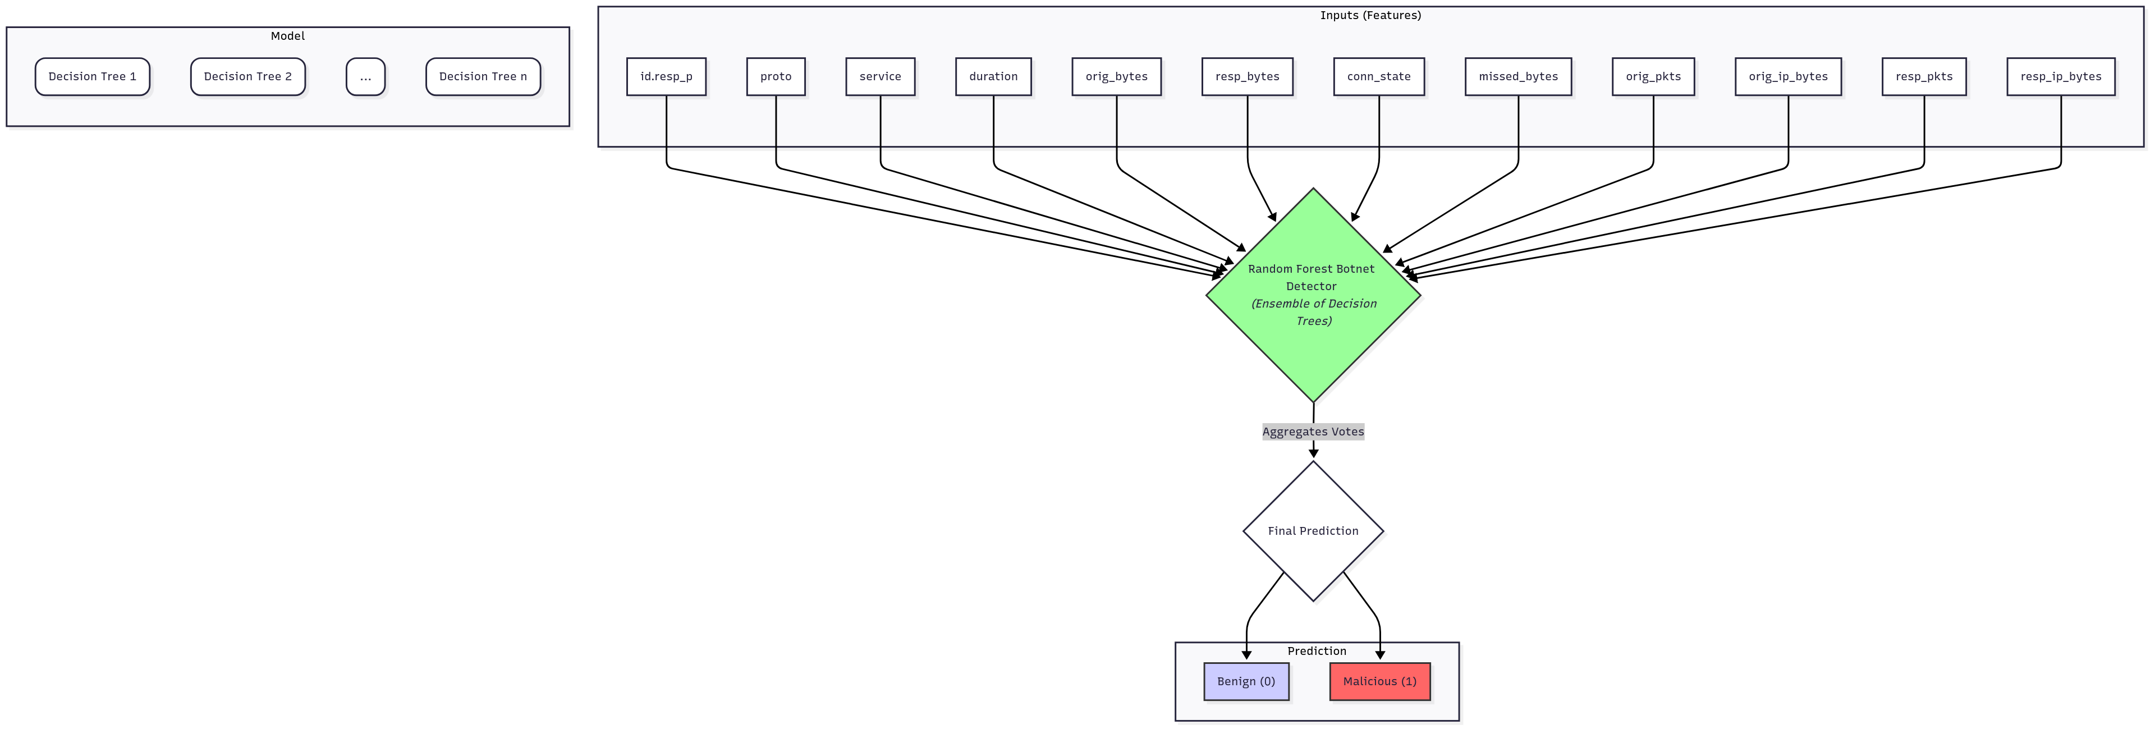
Random Forest

Slide 8
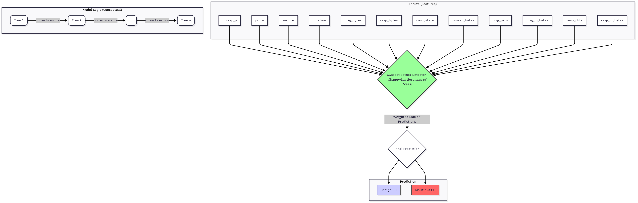
Xgboost

Slide 9
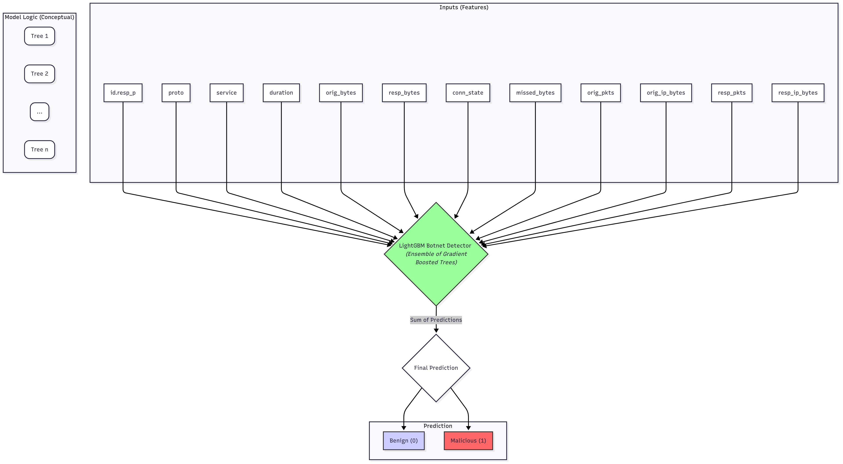
lightgbm

Slide 10
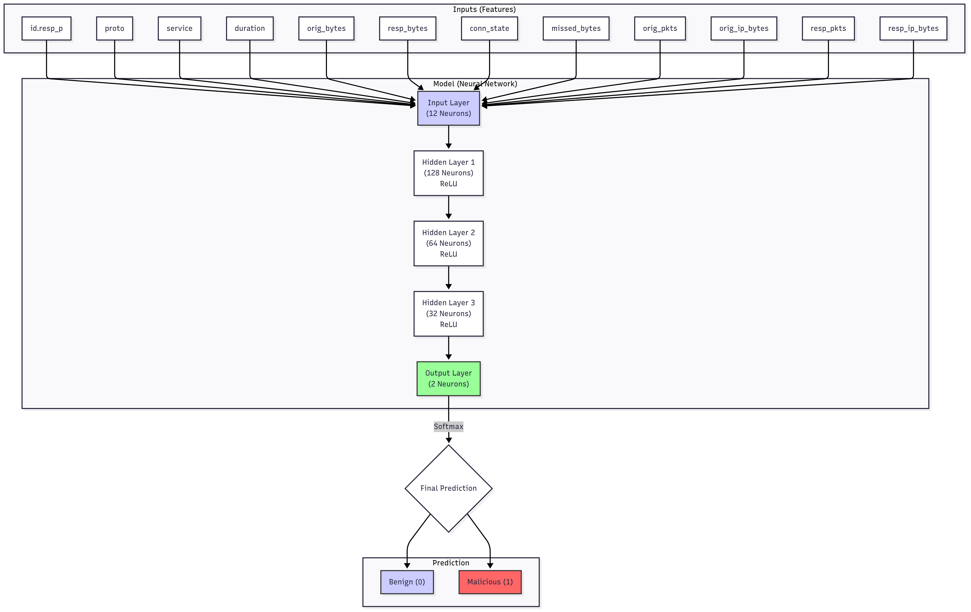
Neural Network

Slide 11
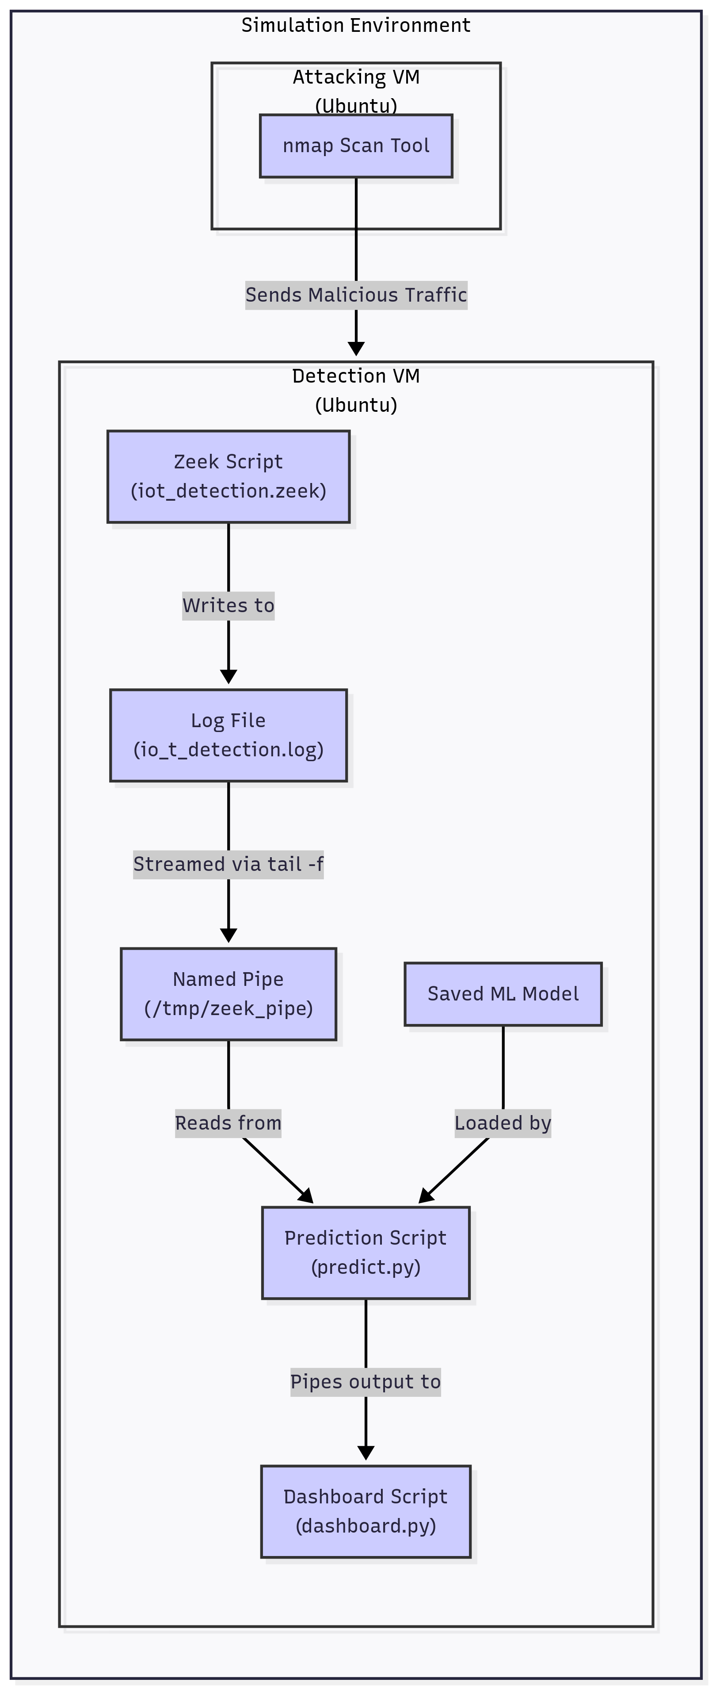
Deployment Diagram

Slide 12




Tools Used

Slide 13
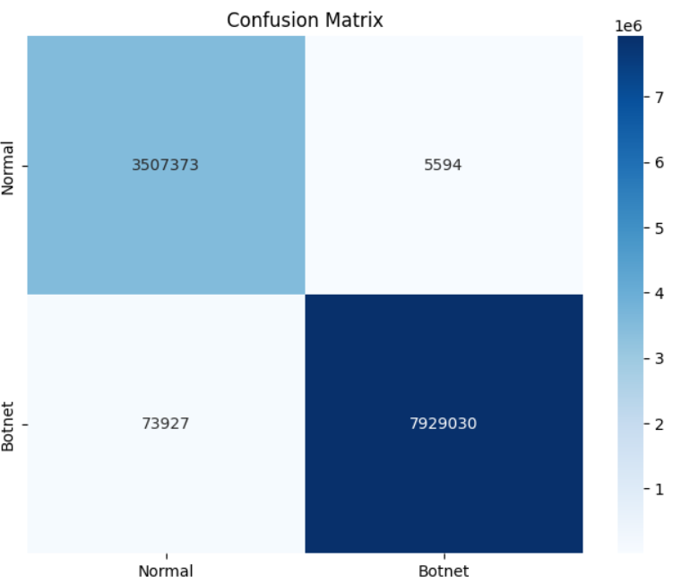
Xgboost confusion matrix

Slide 14
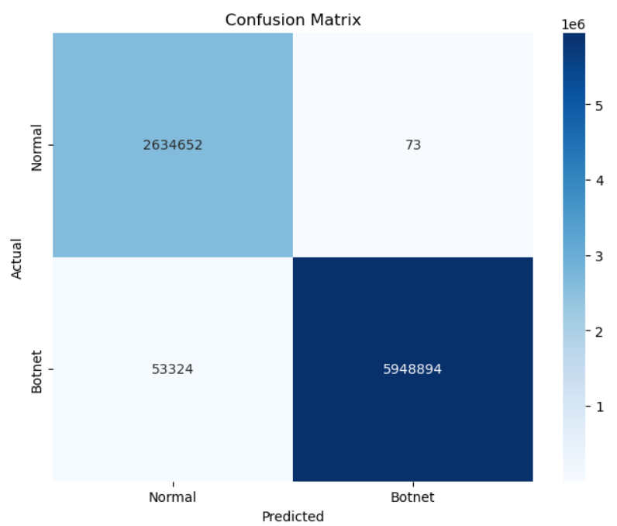
Random forest confusion matrix

Slide 15
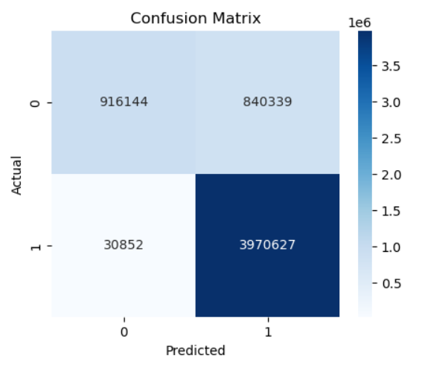
Neural network confusion matrix

Slide 16
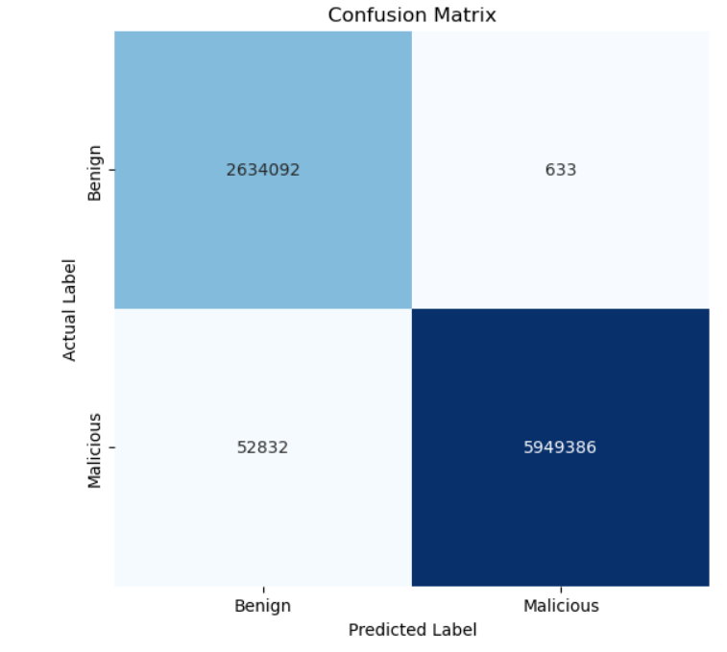
Light gbm confusion matrix

Slide 17
Conclusion

