Slide 1
Hardware implementation of genetic algorithm
Paper by: Matti Tommiska & Jarkko Vuori
Presentation by: Huseyin Sert
Notes:
Hello and welcome to my presentation
1. As you can see from the title of my presentation, my research topic was Hardware Implementation of Genetic Algorithms.
2. The study was carried out by Matti Tommiska and Jarko Vuori in 1996.
3. The paper claims that hardware based GAs are faster than software based GAs and that they offer huge parallelism and extreme efficiency.
4. First, lets understand what genetic algorithms ARE.

Slide 2
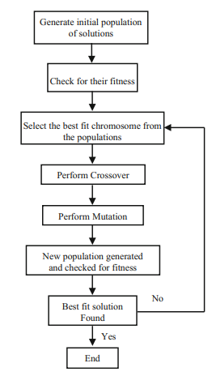
Background: What is genetic algorithm(GA)?
GA is a heuristic search method used in artificial intelligence and computing.
GA makes uses of techniques inspired from evolutionary biology such as selection, crossover and mutation to solve a problem.
The algorithm reflects the process of natural selection where the fittest individuals are selected for reproduction in order to produce offspring of the next generation.
Notes:
1. To shortly describe it, GA is a heuristic search method used in artificial intelligence and computing.
2. GA makes uses of techniques inspired from evolutionary biology such as selection, crossover and mutation to solve a problem.
3. The algorithm reflects the process of natural selection where the fittest individuals are selected for reproduction in order to produce offspring of the next generation.

Slide 3
Background: How does ga work?
Initial population: Algorithm starts by creating random initial population.
Fitness Evaluation: Individuals are given a fitness score.
Selection: Fittest individuals are selected and they are allowed to pass their genes on to next generations.
Crossover: Parents begin exchanging genes with each other until the crossover point is reached.
Mutation: Starts by introducing random changes or mutations to child chromosomes.
Replacement: Best offsprings are placed back into the population.
Population converged: Algorithm stops when the fitness criteria is met.
Notes:
So how does it work?
The algorithm starts by creating a random initial population.
This score can then determine the probability of that individuals’ selection for reproduction.
Selection phase. The fittest individuals are selected and they are allowed to pass their genes to the next generation.
This creates new offspring which is then added to the population.
This maintains diversity within population and prevents premature convergence.
Best offsprings created are placed back into the population.
The algorithm stops when newer generations do not produce offspring which is significantly different from previous generations i.e. fitness criteria is met.

Slide 4

Introduction: Interest in Genetic Algorithms
What is so special about genetic algorithms?
GAs arouse interest because of their flexibility in solving problems which traditional optimisation methods and machine learning find difficult to do so.
Is there any problems?
Due to their iterative problem solving, they require a lot of power
Traditional microprocessors are not very efficient in running genetic algorithms. This is because genetic algorithms need large memory banks to store population.
Also, by using traditional microprocessors, it is difficult to exploit the inherent parallelism in GAs
Notes:
Now lets get back to paper!
NOTE: THIS STUDY TAKES PLACE IN 1996
1. Study starts by stating that GAs arouse interest because of their flexibility in solving problems which traditional optimisation methods and machine learning find difficult to do so.
2. However there are some problems:
2.1. Due to their iterative problem solving, they require a lot of power
2.2. Traditional microprocessors are not very efficient in running genetic algorithms. This is because genetic algorithms need large memory banks to store population.
2.3. Also, by using traditional microprocessors, it is difficult to exploit the inherent parallelism in GAs
2.4. Good high-speed random number generation has also been difficult to implement.

Slide 5
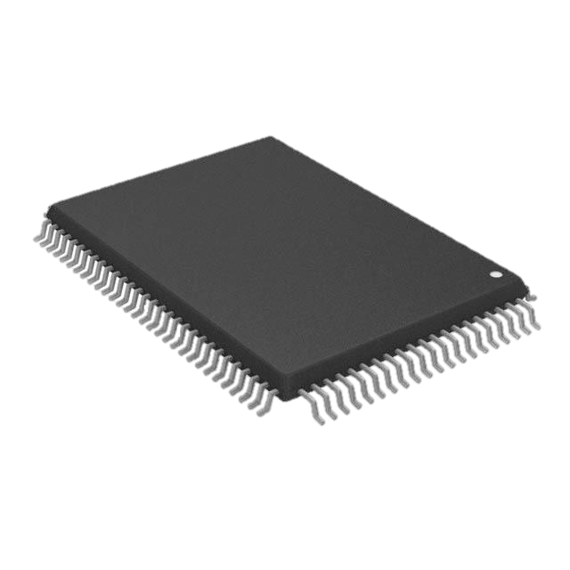
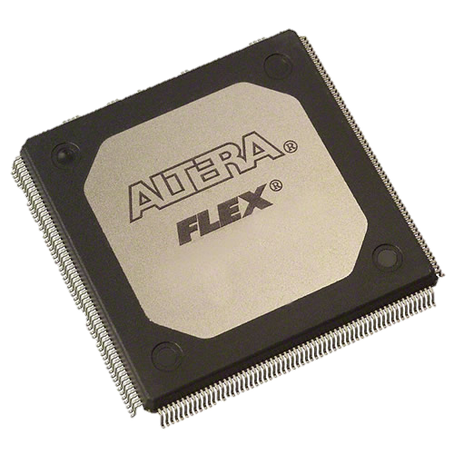
Introduction: Improvements on programmable hardware
Xilinx XC4003E
Complexity of programmable hardware has been evolving to the phase where large high-speed digital systems can be implemented on a single programmable chip.
Several FPGA families like XC4000E family from Xilinx and 10k family from ALTERA, now allow users to implement blocks of SRAM to their FPGA designs.
Altera Flex 10k50
Notes:
However, things GOT better!!!
1. Complexity of programmable hardware has been evolving to the phase where large high-speed digital systems can be implemented on a single programmable chip.
2. Several FPGA families like XC4000E family from Xilinx and 10k family from ALTERA, now allow users to implement blocks of SRAM to their FPGA designs.

Slide 6
Introduction: why should we use it?
Great parallelism & extreme efficiency:
The potential benefit of using genetic algorithm hardware is that it allows both the great parallelism and extremely efficient atomic operations just suited for random number generation, crossover, mutation and fitness evaluation.
On population level parallelism (random number generation), GA may be parallelised by dividing the original population into many subpopulations.
Subpopulations will exchange the fittest individuals between each other.
This means you can run multiple GA algorithms at the same time.
Population may be the same for all processes, meaning solution is searched among many separate processes for the same problem. (Hämäläinen et al., 1996)
Notes:
As mentioned previously, the potential benefit of using genetic algorithm hardware is that it allows both the GREAT PARALLELISM and EXTREMELY EFFICIENT ATOMIC OPERATIONS just suited for random number generation, crossover, mutation and fitness evaluation.
On population level parallelism (random number generation), GA may be parallelised by dividing the original population into many subpopulations.
Subpopulations will exchange the fittest individuals between each other.
This means you can run multiple GA algorithms at the same time.
Population may be the same for all processes, meaning solution is searched among many separate processes for the same problem
On phase level parallelism, the fitness evaluation test… fitness of an individual is not dependent on the fitness of other individuals, all individuals can be evaluated in a truly parallel fashion – you can perform tasks simultaneously!
We can improve performance a little by adjusting algorithm and software, but for significant performance gains / time reductions we need to improve hardware.

Slide 7
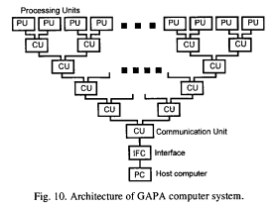
related work: Accelerating genetic algorithm computation in tree shaped parallel computer
First, experiments and realisations of GA were performed in sequential computers, in which genetic operations were repeated multiple times in sequential loops.
Why they are not good for parallelisation?
Search times could be very long which is not ideal for large problems or real-time applications
Parallel nature of GAs cannot be fully utilised in sequential computers.
Genetic Algorithm Parallel Accelerator (GAPA)
Multi processor system with programmable processing units.
Their results show that special hardware accelerate GA computation and significant speedups can be obtained by use of GAPA.
(Hämäläinen et al., 1996)
Notes:
These systems are still used because of
Established programming tools
Good cost / performance ratio
Ease of use
They use Genetic Algorithm Parallel Accelerator system – multi processor system with programmable processing units
Very good cost / performance ratio is gained by use of Digital Signal Processors and FPGA chips
Their results show that special hardware accelerate GA computation, and significant speedups can be obtained by GAPA.

Slide 8
Hardware Choice for implementation
Research paper has selected the ALTERA’s 10k (FLEX 10K50) family for their implementation because of their good availability.
Design efficiency of 10k family seems to be better than standard gate arrays or other RAM based FPGA families.
Altera Flex 10k50
Notes:
Research paper has selected the ALTERA’s 10k (FLEX 10K50) family for their implementation because of their good availability.
Design efficiency of 10k family seems to be better than standard gate arrays or other RAM based FPGA families.
Their hardware consists of a Pentium microprocessor based base unit which has four high speed Peripheral Component Interconnect (PCI) bus slot available.
Which is good for parallelism.

Slide 9
How does the program work?
A GA is designed using Altera Hardware Description Language (AHDL).
Design has been simulated and implemented with Altera’s Flex 10k FPGA family.
The GA is run on a PC card, which is connected to the central processing unit (CPU) through high-performance Peripheral Component Interconnect (PCI) bus.
Due to the easy reconfigurability of programmable logic devices, experimenting with variable population size and various fitness functions are made extremely easy.
This was accomplished by rewriting AHDL code on the host computer then reprogramming the chip on the fly through PCI bus.
Notes:
Due to the easy reconfigurability of programmable logic devices, experimenting with variable population size and various fitness functions are made extremely easy.
(crossover point, mutation rate)
This is done by rewriting AHDL code on the host computer then reprogramming the chip on the fly through PCI bus.

Slide 10
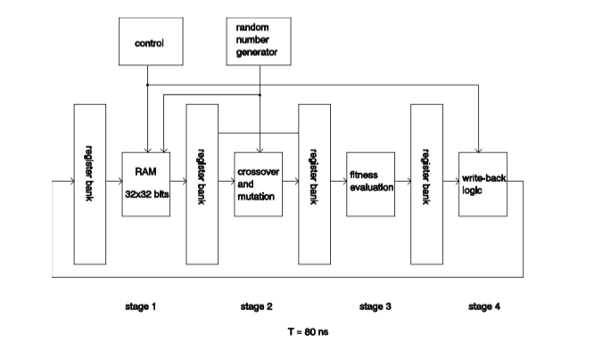
Hardware Implementation Four stages: Operation of pipeline
1. Genetic algorithm is run in a pipelined fashion.
2. The pipeline is made up of four stages which are separated by register banks.
3. Register banks are necessary for the synchronisation of the pipeline and they preserve the addresses of the chromosomes.
4. This guarantees that the same RAM addresses which the chromosomes were read from are ALSO written to AFTER the pipeline has processed AND evaluated the chromosomes and their offsprings (their fitness).
Notes:
1. You can see that the genetic algorithm is run in a pipelined fashion.
2. The pipeline is made up of FOUR stages which are SEPERATED by REGISTER BANKS.
3. Register banks are necessary for the synchronisation of the pipeline and they preserve the addresses of the chromosomes.
4. This guarantees that the same RAM addresses which the chromosomes were read from are ALSO written to AFTER the pipeline has processed AND evaluated the chromosomes and their offsprings (their fitness).
FIRST STAGE:
At first stage of the pipeline, two chromosome are selected randomly from the 32x32 RAM block.
The RAM is implemented as a synchronous memory with separate read and write ports.
SECOND STAGE:
Selected chromosomes from the first stage are subjected to crossover and mutation.
The selected chromosomes are also passed over to the next stage in their original unchanged form.
Crossover point between the two chromosomes is selected at random and the produced offsprings are subjected to mutation.
This is implemented as an inversion of a randomly selected bit in the 32-bit long chromosome.
In this design, chromosomes were subjected to mutation with a probability of 3.1%.
THIRD STAGE:
At the third stage, the four chromosomes, original two and their offsprings are evaluated.
Chromosomes are compared with each other.
The best two chromosomes are selected for write-back in the next stage of the pipeline.
Flexibility of ALTERA’s 10k internal architecture allows the updating of the fitness function without seriously affecting the operation speed of the pipeline.
FOURTH STAGE:
At the fourth and last stage of the pipeline, the best two chromosomes from stage 3 are written back to the same address from which either the chromosomes themselves or their parents were read from four clock cycles earlier.
The paper states that chromosome are selected at random on the selection phase… is there any problem with this?
Overlapping. When you are selecting parents at random, you could overwrite already fit offsprings you already produced which would ultimately slow down convergence.
Anyone want to guess how you would resolve this issues?
Locking. You could lock the parents after you selected them and keep them locked whilst they are in the pipeline. This would ensure that other process do not
The pipeline is active four consecutive cycles and inactive during next four clock cycles, giving it efficiency of 50%.

Slide 11
Hardware Implementation First Stage: Operation of pipeline
At first stage of the pipeline, two chromosome are selected randomly from the 32x32 RAM block.
The RAM is implemented as a synchronous memory with separate read and write ports.
Notes:
FIRST STAGE:
At first stage of the pipeline, two chromosome are selected randomly from the 32x32 RAM block.
The RAM is implemented as a synchronous memory with separate read and write ports.

Slide 12
Hardware Implementation Second Stage: Operation of pipeline
Crossover point between the two chromosomes is selected at random and the produced offsprings are subjected to mutation.
This is implemented as an inversion of a randomly selected bit in the 32-bit long chromosome.
In this design, chromosomes were subjected to mutation with a probability of 3.1%.
Notes:
SECOND STAGE:
Selected chromosomes from the first stage are subjected to crossover and mutation.
The selected chromosomes are also passed over to the next stage in their original unchanged form.
Crossover point between the two chromosomes is selected at random and the produced offsprings are subjected to mutation.
This is implemented as an inversion of a randomly selected bit in the 32-bit long chromosome.
In this design, chromosomes were subjected to mutation with a probability of 3.1%.

Slide 13
Hardware Implementation Third Stage: Operation of pipeline
At the third stage, the four chromosomes, original two and their offsprings are evaluated.
Chromosomes are compared with each other.
The best two chromosomes are selected for write-back in the next stage of the pipeline.
Flexibility of ALTERA’s 10k internal architecture allows the updating of the fitness function without seriously affecting the operation speed of the pipeline.
Notes:
THIRD STAGE:
At the third stage, the four chromosomes, original two and their offsprings are evaluated.
Chromosomes are compared with each other.
The best two chromosomes are selected for write-back in the next stage of the pipeline.
Flexibility of ALTERA’s 10k internal architecture allows the updating of the fitness function without seriously affecting the operation speed of the pipeline.

Slide 14
Hardware Implementation Fourth Stage: Operation of pipeline
At the fourth and last stage of the pipeline, the best two chromosomes from stage 3 are written back to the same address from which either the chromosomes themselves or their parents were read from four clock cycles earlier.
The paper states that chromosome are selected at random on the selection phase… is there any problem with this?
Notes:
FOURTH STAGE:
At the fourth and last stage of the pipeline, the best two chromosomes from stage 3 are written back to the same address from which either the chromosomes themselves or their parents were read from four clock cycles earlier.
The paper states that chromosome are selected at random on the selection phase… is there any problem with this?
Overlapping. When you are selecting parents at random, you could overwrite already fit offsprings you already produced which would ultimately slow down convergence.
Anyone want to guess how you would resolve this issues?
Locking. You could lock the parents after you selected them and keep them locked whilst they are in the pipeline. This would ensure that other processes running in parallel do not select the same parent.
The pipeline is active four consecutive cycles and inactive during next four clock cycles, giving it efficiency of 50%.

Slide 15
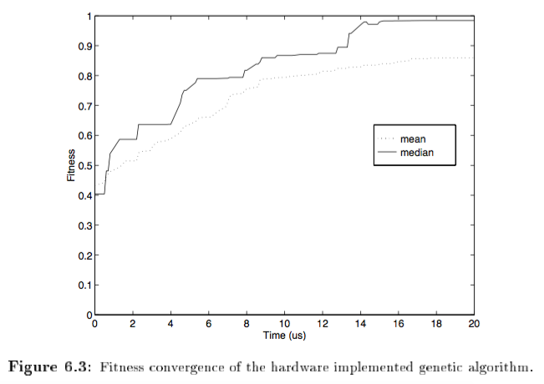
Performance
Both the mean and the median values of the population increased steadily during the first 20μs (microseconds) of simulation.
The simulation results demonstrated both rapid convergence and robust overall performance.
The most remarkable feature of the pipeline was its speed when compared to software-based genetic algorithms.
Notes:
Simulations were performed!
1. Both the mean and the median values of the population increased steadily during the first 20μs (microseconds) of simulation.
2. The simulation results demonstrated both rapid convergence and robust overall performance.
3. The most remarkable feature of the pipeline was its speed when compared to software-based genetic algorithms.

Slide 16
Performance
The largest achievable operation speed was 12.5MHz, which gives the design cycle a time of 80ns (nanoseconds).
Since the pipeline was designed to operate at 50% efficiency, the selection of two chromosomes, their crossover operation and mutation, fitness evaluation and write-back requires 160ns of processing time.
Notes:
The design was simulated using Altera’s Max+Plus II software simulator.
Algorithm was targeted on the Altera Flex 10k50

Slide 17
Performance: Hardware
The same algorithm was coded in C and run on Linux system with 120MHz processor.
This time the selection, crossover, mutation fitness evaluation cycle took 34μs (microseconds) to complete.
This means that the hardware was (34/0.160) 212 times faster than software solution.

Slide 18
Findings & Conclusion
The paper has demonstrated the feasibility of using modern FPGA chips to speed up the operation of genetic algorithms.
In this case an improvement over 200x was achieved compared to software solution.
These results can easily be improved by a factor of four by adding three additional parallel operating calculation units to the same FPGA chip.
In addition, there can be four calculation machines of this kind on the same PCI bus.
Total speed-up compared to software solution would then be 3200x more than software-based solution. More improvements can be made
Different and more complicated fitness functions can be used
Larger populations with longer chromosomes
Non-overlapping generations (which is done by not selecting chromosomes at random)
Notes:
The paper has demonstrated the feasibility of using modern FPGA chips to speed up the operation of genetic algorithms.
In this case an improvement over 200x was achieved compared to software solution.
These results can easily be improved by a factor of four by adding three additional parallel operating calculation units to the same FPGA chip.
In addition, there can be four calculation machines of this kind on the same PCI bus.
Total speed-up compared to software solution would then be 3200x more than software-based solution.
More improvements can be made
Different and more complicated fitness functions can be used
Larger populations with longer chromosomes
Non-overlapping generations (which is done by not selecting chromosomes at random)

Slide 19
Paper References & Useful sources
Tommiska, M and Vuori, J (1996) Hardware Implementation of GA. Proceedings of the Second Nordic Workshop on Genetic Algorithms and Their Applications., pp. 71-78.
Hämäläinen, T, Klapuri, H, Saarinen, J, Ojala, P and Kaski, K (1996) Accelerating Genetic Algorithm Computation in Tree Shaped Parallel Computer. Journal of Systems Architecture. 42 (1), pp.19-36.
Mallawaarachchi, V. (2017) Introduction to Genetic Algorithms — Including Example Code [Online]. Available from: https://towardsdatascience.com/introduction-to-genetic-algorithms-including-example-code-e396e98d8bf3 [Accessed 15 November 2018].

Slide 20
Questions

