Slide 1
EE655 — COURSE PROJECT
SKETCH → IMAGE
Novel Approaches in
Sketch-to-Image Generation
Exploring CLIP-Guided Diffusion and GAN-based methods
for bridging sparse sketches and photorealistic synthesis
Daksh Pratap Singh · Harshvardhan Agarwal · Sarvesh Bharambe · Vrushabh D Undri
Mentor: Prof. Koteswar Jerripothula
01

Slide 2
PROBLEM STATEMENT
Why is Sketch-to-Image Hard?
Abstract Input
One-to-Many Mapping
Dataset Scarcity
Sketches are sparse, lack color and texture, models must infer rich visual content from minimal structural cues.
A single sketch could map to many plausible images. The model must make semantic choices without ambiguity in input.
Paired (sketch, image) datasets are rare across most domains, forcing novel data synthesis strategies.
Applications:
▸ Game & Entertainment Design
▸ Forensics (Face Reconstruction)
▸ Fashion & Product Prototyping
▸ Historical Sketch Reconstruction
▸ Architecture & E-commerce
▸ Human-AI Creative Collaboration
02

Slide 3
LITERATURE REVIEW
Prior Work & Our Contributions
Prior Work
Our Novelty
Pix2Pix
Automated Sketch → Prompt
Paired image-to-image GAN — requires matched sketch/image pairs
CLIP extracts semantic descriptions from sketches — no manual prompting
CycleGAN
Dual Conditioning
Unpaired translation via cycle-consistency loss
Textual (CLIP) + structural (ControlNet) cues combined in one pipeline
SketchyGAN
Data Bootstrapping
Sketch diversity — limited generalization beyond training domain
Canny edge detection + inverse GAN mapping to generate training pairs
S2FGAN
Paradigm Comparison
Semantically interactive sketch-to-face; narrow domain focus
Systematic evaluation of diffusion vs. GAN on the same problem
CLIPasso
Domain-Agnostic
Semantically-aware sketch generation (not synthesis)
CLIP + ControlNet works across object classes without retraining
03

Slide 4
APPROACH 1
CLIP-Guided Conditioned Stable Diffusion
STEP 01
STEP 02
STEP 03
CLIP Interrogator
Prompt Refinement
ControlNet + Stable Diffusion
The sketch is encoded by CLIP's visual encoder into a high-dimensional embedding. Cosine similarity with candidate text descriptions identifies the most semantically relevant prompt.
The initial CLIP prompt is enhanced with style tokens, composition cues (depth of field, lighting, shadows), and quality boosters. Literal sketch references ("drawing", "lines") are removed.
ControlNet (pretrained on Canny Edge, Scribble, Soft-Noise) enforces structural fidelity from the sketch. Stable Diffusion fills in photorealistic texture and lighting from the refined prompt.
Output: a base text description of the sketch content
Output: vivid, scene-coherent prompt for diffusion
Output: high-fidelity image respecting sketch layout
04

Slide 5
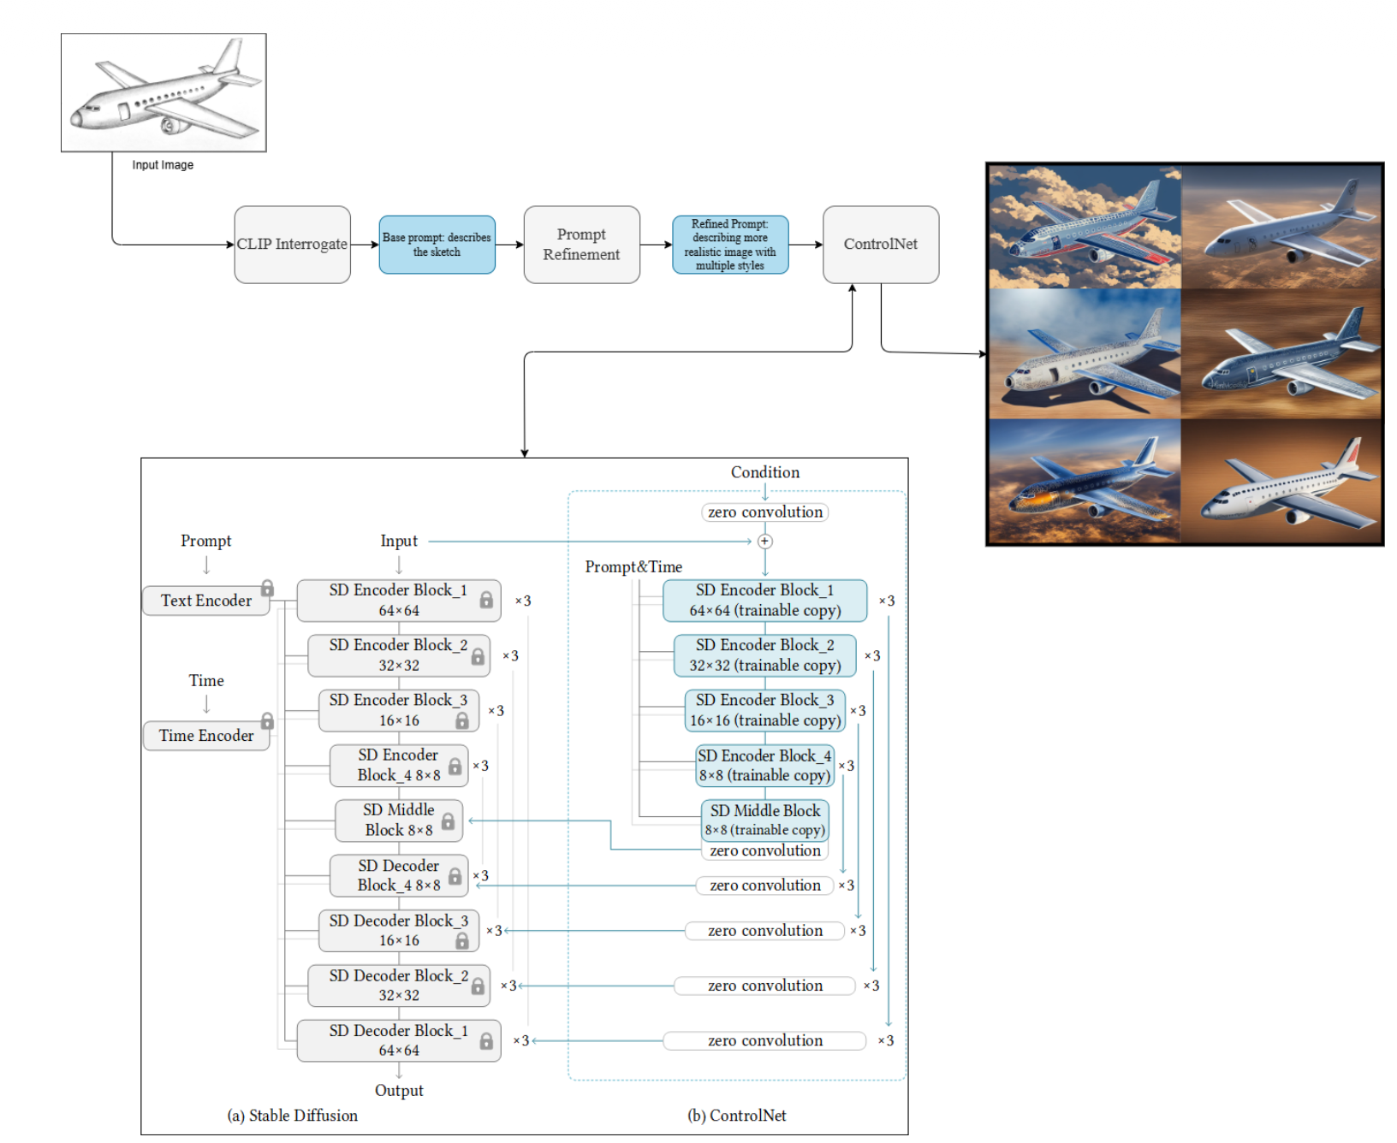
APPROACH 1
CLIP-Guided Conditioned Stable Diffusion :- Architecture
05

Slide 6
APPROACH 2
GAN-Based Translation: Dataset Strategy & Architecture
Dataset Strategy
Model Architecture
Problem — Most domains lack paired (sketch, image) datasets, a fundamental bottleneck for GAN training.
Generator (U-Net)
Conv2D downsample + Conv2DTranspose upsample blocks. Skip connections preserve spatial detail. Final tanh activation scales output to [−1, 1].
Canny Edge Detection — Applied to real images to generate synthetic sketches retaining edge details and outlines.
Discriminator (PatchGAN)
Takes sketch + generated/real image pair. Outputs patch-level real/fake probabilities via binary cross-entropy.
Photoshop Filters — Used to simulate realistic sketch textures, preserving stylistic variety in training pairs.
Loss Function
CycleGAN Augmentation — Trained for image→sketch (simpler direction). Generated synthetic pairs used to bootstrap sketch→image training.
Adversarial loss (fool discriminator) + L1 pixel-wise loss (penalize pixel difference from ground truth).
Datasets — ~7,300 human face images (Kaggle) + Sketchy Database from Georgia Tech.
Training Config
Batch=4 · 128×128 px · 10 epochs · Adam lr=2×10⁻⁴ · ~1,800 steps/epoch · 15+ hrs per run.
06

Slide 7
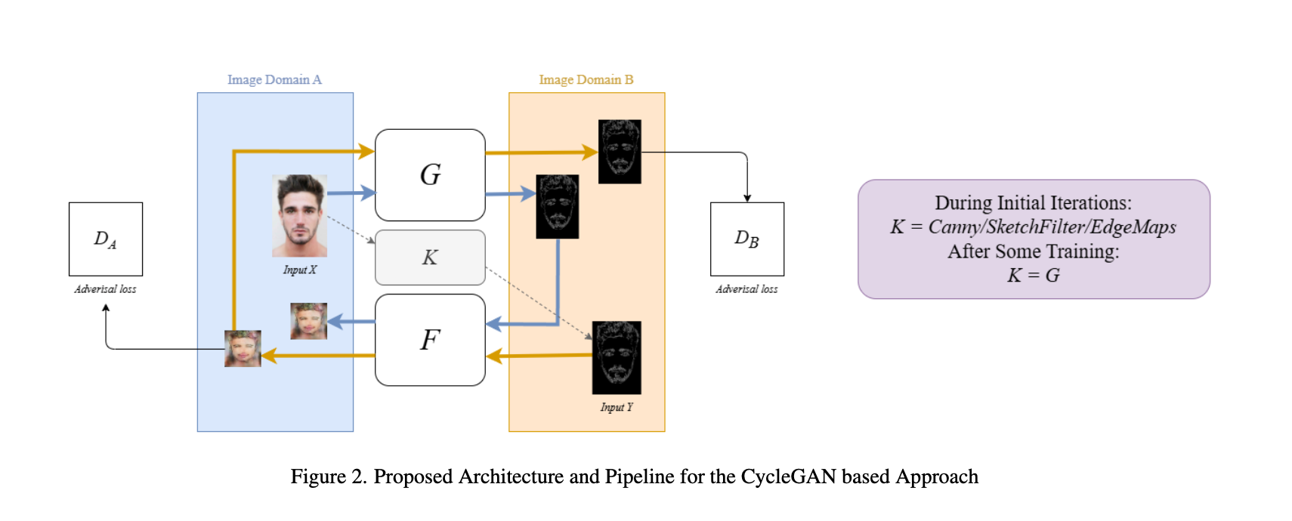
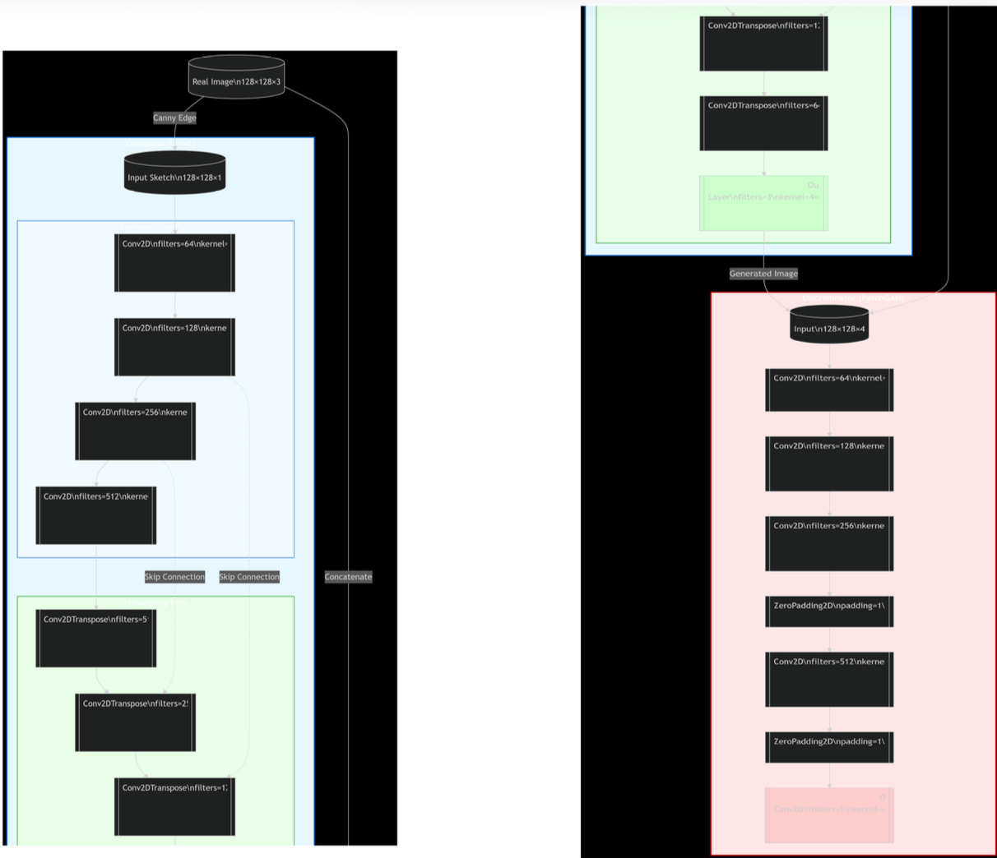
APPROACH 2
GAN-Based Translation: Dataset Strategy & Architecture
07

Slide 8
CYCLEGAN — DEEP DIVE
Unpaired Translation + Data Augmentation Role
Why CycleGAN?
How It Fed Into Custom GAN Training
Designed for unpaired image-to-image translation, no requirement for matched sketch-image pairs. Learns to translate between domains using cycle-consistency loss.
1
Train CycleGAN on real images (human faces)
2
Use trained image→sketch generator to produce synthetic sketch-image pairs
Hypothesis
Image→sketch mapping is simpler than sketch→image (images lose color, depth, detail). A smaller dataset can train the inverse direction effectively.
3
Combine with Canny-derived pairs to form augmented training set
4
Train custom Pix2Pix-style GAN on augmented dataset
Augmentation Strategy
During initial iterations: K = Canny/SketchFilter/EdgeMaps. After training: K = G (the trained generator produces synthetic sketches for bootstrapping).
5
Iterate: better GAN → better synthetic pairs → retrain
08

Slide 9
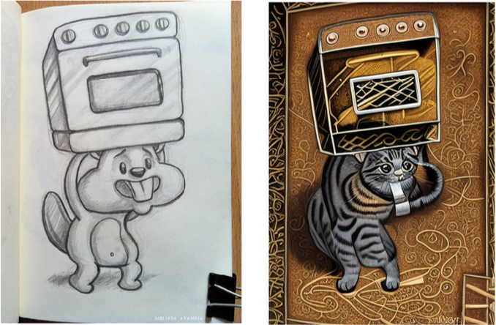
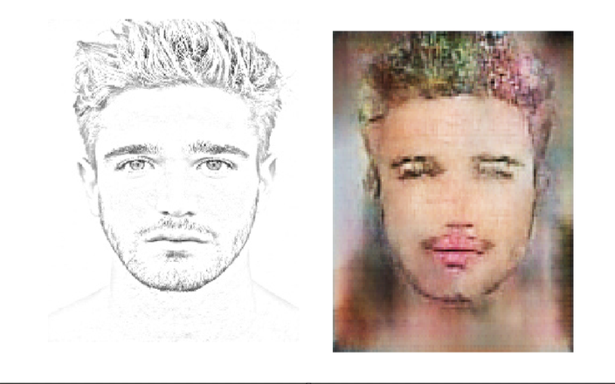
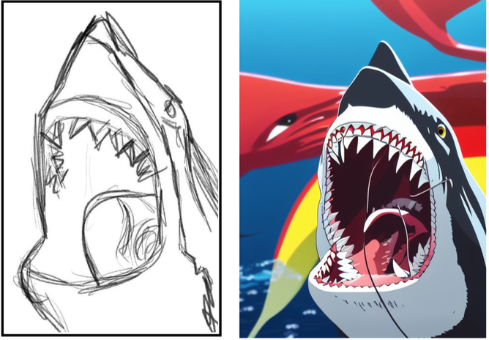
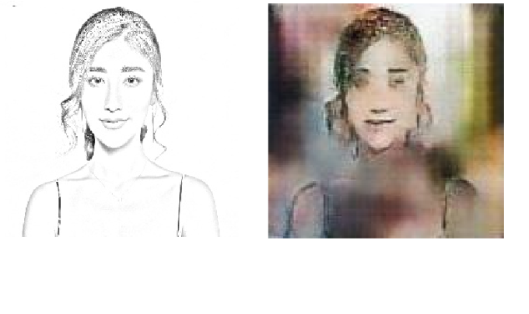
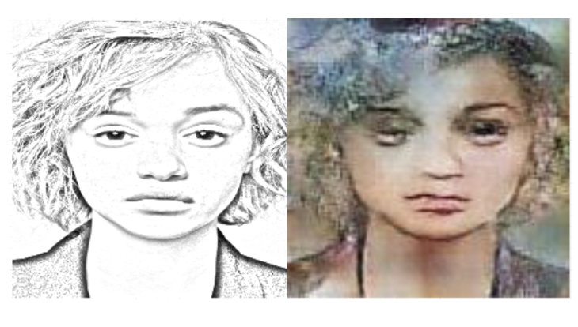
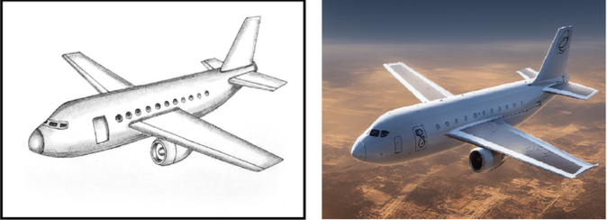
RESULTS & COMPARISON
ControlNet (Diffusion) vs. Custom GAN
CLIP-Guided Conditioned Stable Diffusion
Custom GAN-based Input Output
09

Slide 10
RESULTS & COMPARISON
ControlNet (Diffusion) vs. Custom GAN — Head to Head
Criteria
ControlNet / Diffusion
Custom GAN
Training Required
No, uses pretrained models
Yes, from scratch, 15+ hrs/run
Data Requirement
Small fine-tuning dataset sufficient
Needs large paired dataset
Output Quality
High fidelity, rich detail
Sharp but less consistent
Style Control
Via text prompt — highly flexible
Requires architecture changes
Domain Flexibility
Any domain without retraining
Domain-specific only
Inference Speed
Slower, iterative denoising
Fast, single forward pass
Modularity
Highly modular, easy to swap control
Less modular, needs new training
Best Use Case
Creative synthesis, concept art
Real-time, domain-specific tasks
10

Slide 11
EXPERIMENTAL OBSERVATIONS
What We Learned From Running Both Approaches
Diffusion: Superior Generalization
Diffusion: Controllable via Text
CLIP + ControlNet successfully synthesized images across sketches of diverse object classes, airplanes, animals, faces, without any task-specific retraining. The model generalizes from massive pretrained representations.
Style, composition, and scene context could be steered purely through prompt engineering. Prompts including lighting, depth-of-field, and material descriptors significantly improved output realism.
Diffusion: Occasional Misclassification
GAN: Domain-Specific Sharpness
CLIP can misidentify the sketch subject, leading to incorrect base prompts. This was partially mitigated via prompt refinement, but remains a weakness in highly ambiguous or abstract sketches.
Custom GAN outputs showed sharper edges and higher domain consistency for human faces, the training domain, compared to diffusion outputs for the same class.
GAN: Hardware Bottleneck
Data Bootstrapping: Effective
Training required 15+ hours per iteration on constrained hardware for just 7,300 images at 128×128 resolution. This significantly limited our ability to tune hyperparameters and experiment at scale.
Canny-derived synthetic sketch-image pairs were effective training data. The edge maps preserved the structural features (outlines, proportions) typical of real sketches.
11

Slide 12
CONCLUSION
Takeaways & Future Directions
01
03
Diffusion wins on quality & flexibility
Data bootstrapping is viable
CLIP + ControlNet delivers superior visual fidelity and domain-agnostic generalization. Ideal for creative synthesis, concept art, and varied domains.
Synthetic sketch-image pairs from Canny edge detection and CycleGAN augmentation are effective substitutes when real paired datasets don't exist.
02
04
GANs win on speed & fine-grained control
The fundamental trade-off
With sufficient training data and compute, GANs produce domain-specific, consistent results faster. Better suited for real-time, constrained applications.
Flexibility vs. controllability, neither approach dominates universally. The right choice is use-case dependent. Future work: combine both in a hybrid pipeline.
12

