Slide 2
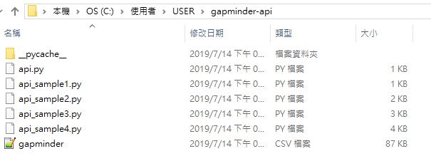

Slide 4
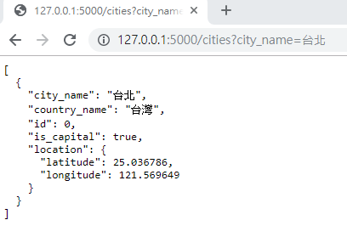
http://127.0.0.1:5000/cities?city_name=台北

Slide 5
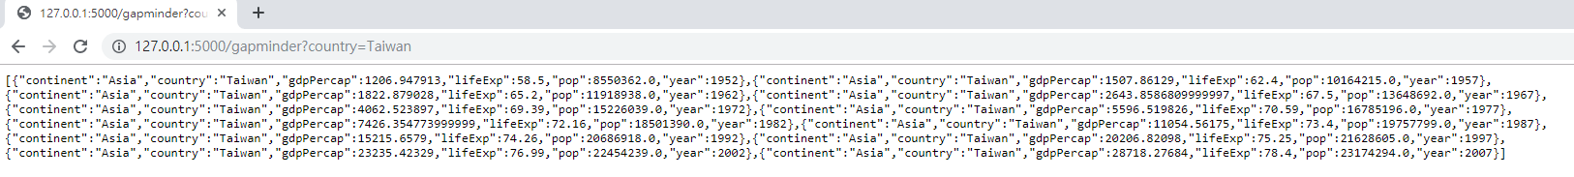
http://127.0.0.1:5000/gapminder?country=Taiwan

