Slide 1

Improved Orbit Estimation Using GPS Measurements for Conjunction Analysis
Gabriel Hugh Elkaim, Assistant Professor
Alana Rose Muldoon
Computer Engineering, UC Santa Cruz
ION GNSS 2008
Savannah, Georgia, 16-19.September.2008

Slide 2
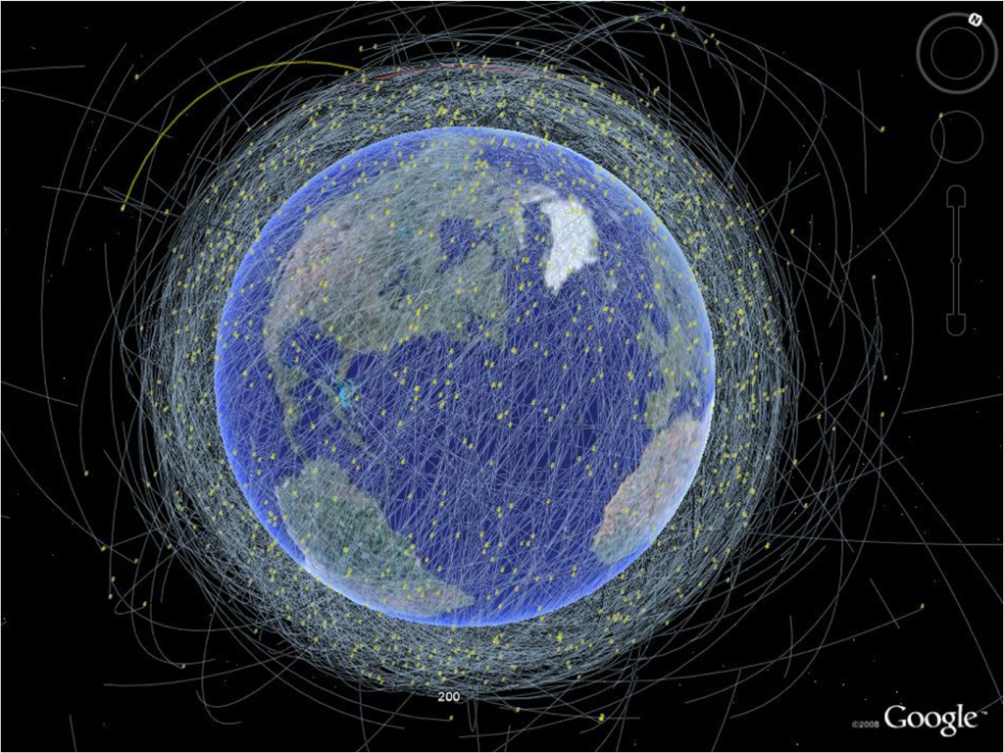
Background
There's a lot of stuff up there.
In general, we don't know position with great precision.
In LEO, only objects greater than 10 cm are tracked

Slide 3
The Problem
Over 12,000 tracked space objects in orbit
Only available data to do conjunction analysis are the North American Aerospace Defense (NORAD) Two Line Elements (TLE’s)
  No error estimates or guarantees at all with this data.

Slide 4
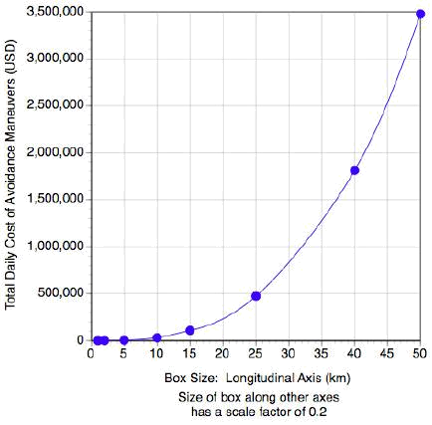
Cost of Position Uncertainty
Uncertainty error in position causes:
  Higher collision probability
  More maneuvers that need to be carried out
  More fuel to move
  Higher Cost
  Lower lifetime of satellite
Too many false alarms
Courtesy of ISU

Slide 5
Two Line Elements (TLE)
1 22829U 93061G 08181.90415536 .00000057 00000-0 38148-4 0 9814
2 22829 98.3648 143.4549 0009649 186.0812 174.0247 14.30192331769944
Description of the orbital parameters at a specific time
No error estimates
Decent long term accuracy
Generated from more complex algorithms
  Exact algorithms are unknown
  Have changed through the data record

Slide 6
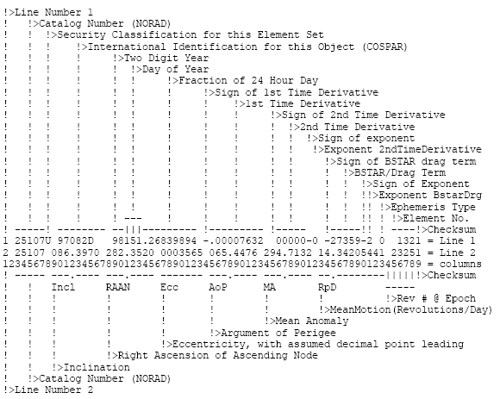
http://www.satobs.org/element.html

Slide 7
TLE issues
Strange coordinate system
  Not using WGS-84
  Using TEME coordinate frame
    Temporal equinox?
    Uniform equinox?
  Holdover from 1950’s computational abilities
Small orbit perturbations removed
  Better long term accuracy
  Worse conjunction analysis performance
  Just what do they throw away?

Slide 8
How Well Do we Know TEME?
TEME: Temporal Equator Mean Equinox
TLE’s are defined in the TEME frame
  Official documentation is hard to find
  Holdover from 1950’s computational abilities
All definitions of coordinate transforms from TEME to a more well-known frame are the same regardless of the TLE or the orbit
  There is evidence that a better coordinate transform exists based on orbital data
Notes:
TEME = True Equator Mean Equinox

Slide 9
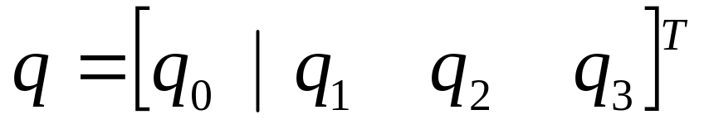
Finding the True Quaternion
Use GPS precise ephemerides for ECEF position data at 15 minute intervals
Propagate TLE data using method of Vallado et. al. in “Revisiting SpaceTrack Report #3”
Use a least squares method for matching the two sets of data points
Extract true quaternion using Horn’s method

Slide 10
Error Analysis of TLE’s using GPS
Using GPS Precise Ephemerides, find the best possible conversion from TEME to ECEF (PEF) for each GPS satellite, representing this as a quaternion.
  A quaternion represents an axis and an amount of rotation.
Found a consistent bias among all GPS TLE’s
  Corresponds to a yaw between ECEF and TEME of -0.2 mrad
Six groupings of different biases for GPS TLE’s
  A different bias for each TLE, specific correction (pitch and roll).
Notes:
PEF is pseudo earth fixed, includes polar motion

Slide 11
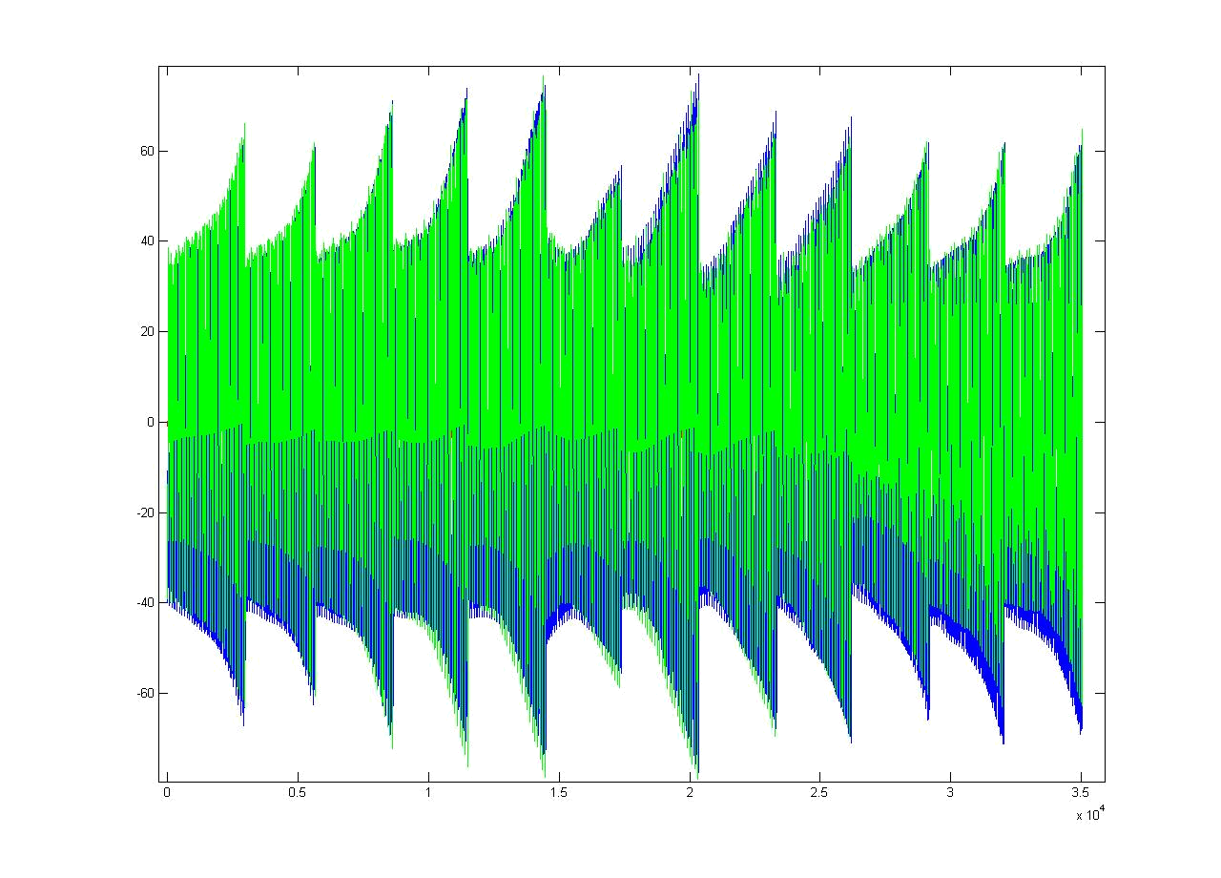
Error in Direct Conversion
GPS converted to TEME frame via PEF
Converted to RIC to compare
2006 data, new TLE each month
Error in Km, time in 15 minute increments
PRN2 2006 No corrections
Notes:
Would normally use the prediction out a month to determine if I had a conjunction and needed to move

Slide 12
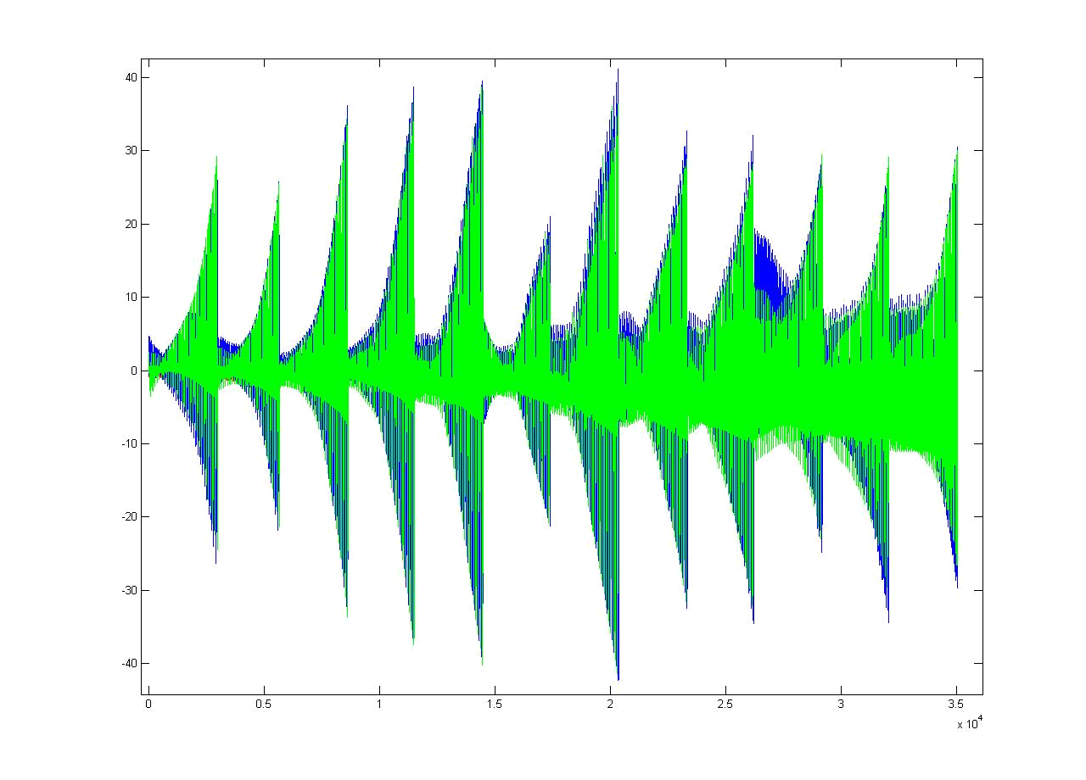
Applying Consistent Bias
Same satellite, corrected using optimal rotation matrix found using data from January 2006
Note smaller scale
PRN2 2006 R(2006) Correction

Slide 13
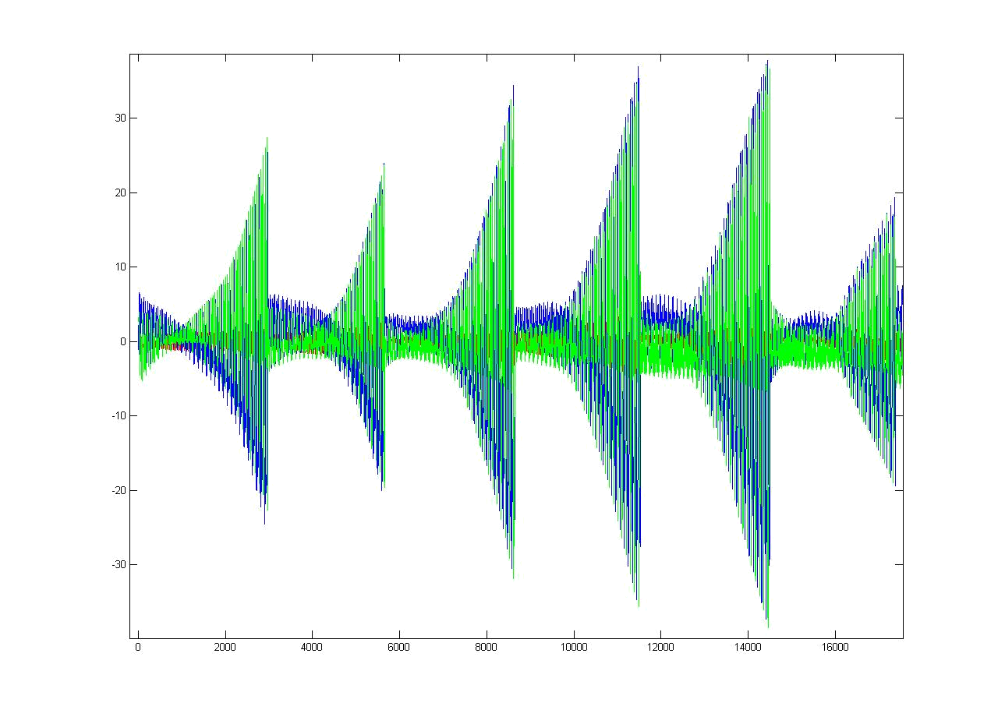
Applying specific bias
Use the true quaternion found from Jan 06 for all GPS satellites
Use the specific quaternion from Jan 06 for this PRN
2006 data, new TLE each month
Error in Km, time in 15 minute increments
PRN2 2006 R(2006) and S(2006) Correction
Notes:
Would normally use the prediction out a month to determine if I had a conjunction and needed to move. Red bars are at +/- 60 KM

Slide 14
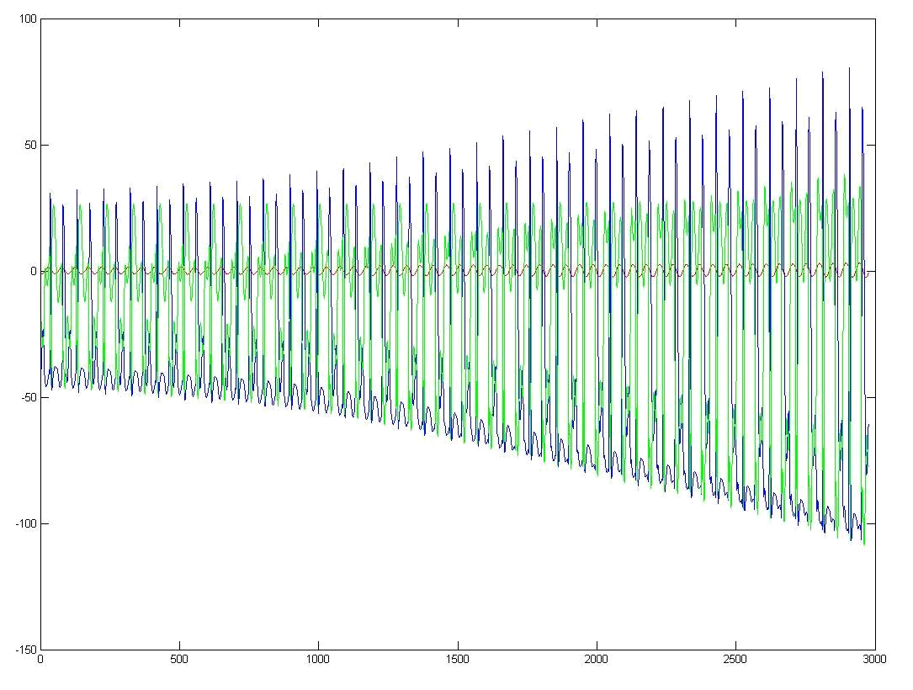
Two Years Later
No correction
Errors in RIC coordinate frame
Errors in Km, time in 15 minute intervals
One month of data plotted
PRN2 2008 No Correction

Slide 15
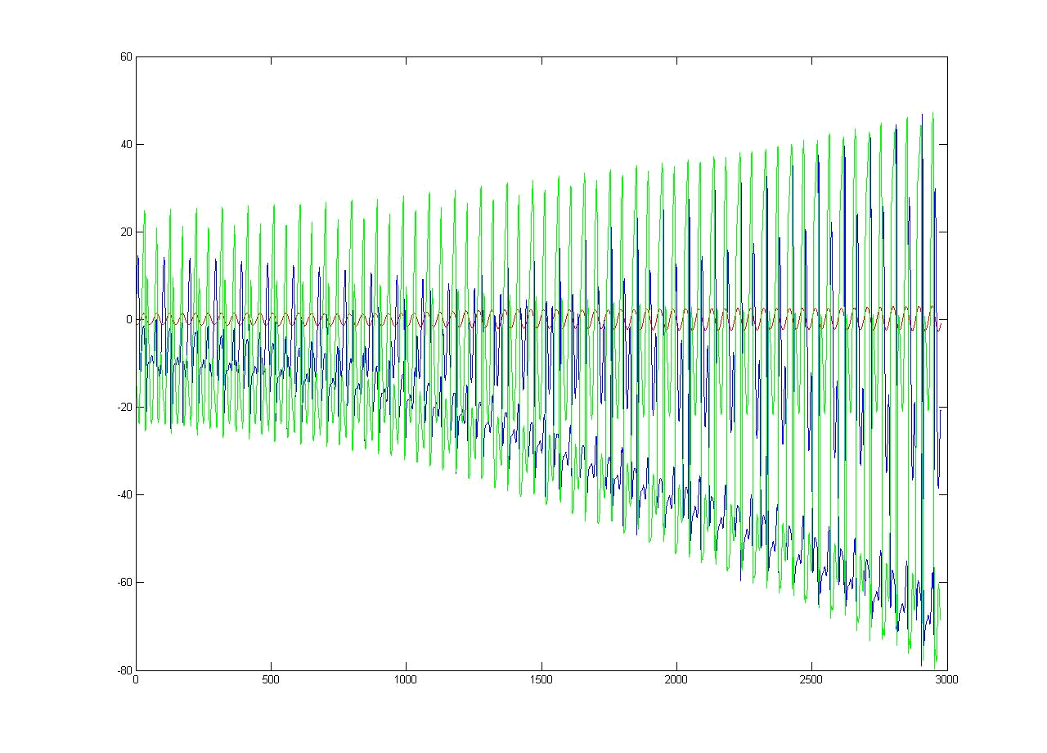
Two Years Later (improved)
2006 General and Specific corrections
Errors in RIC coordinate frame
Errors in Km, time in 15 minute intervals
One month of data plotted
PRN2 2008 R(2006) and S(2006) Correction

Slide 16
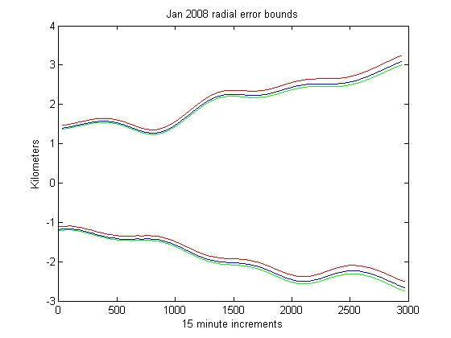
Radial Error Bound Improvement
Error bounds in radial, in plane, and out of track for Jan 2008 for PRN2
Red corresponds to error that has not been corrected by any method
Blue to error that has been corrected using the best rotation found in 2006
Green to error that has been corrected using the best rotation found in 2008
Correction on a per TLE basis improves error
PRN2 2008 No Correction
PRN2 2008 R(2006) Correction
PRN2 2008 R(2008) Correction

Slide 17
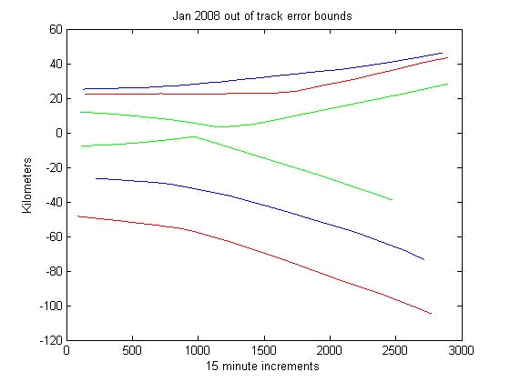
Out of Track Error Bound Improvement
Error bounds in radial, in plane, and out of track for Jan 2008 for PRN2
Red corresponds to error that has not been corrected by any method
Blue to error that has been corrected using the best rotation found in 2006
Green to error that has been corrected using the best rotation found in 2008
Correction on a per TLE basis improves error
PRN2 2008 No Correction
PRN2 2008 R(2008) Correction
PRN2 2008 R(2006) Correction

Slide 18
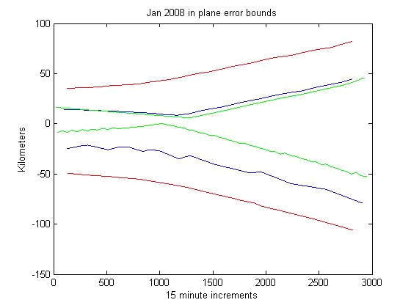
In Plane Error Bound Improvement
Error bounds in radial, in plane, and out of track for Jan 2008 for PRN2
Red corresponds to error that has not been corrected by any method
Blue to error that has been corrected using the best rotation found in 2006
Green to error that has been corrected using the best rotation found in 2008
Correction on a per TLE basis improves error
PRN2 2008 No Correction
PRN2 2008 R(2008) Correction
PRN2 2008 R(2006) Correction

Slide 19
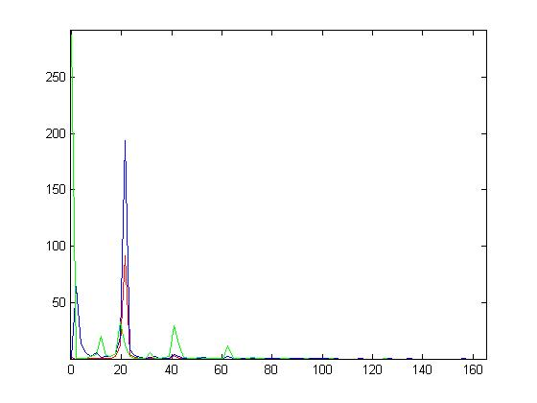
Fast Fourier Transform Analysis
Looking at FFT of RIC error in one satellite over a month
There is definite predictable structure in the TLE orbit data.
All three components show a spike that corresponds to one full orbit of the satellites.
Indicates TLEs may have a frame misalignment
Possible orbital element mis-modeling.

Slide 20
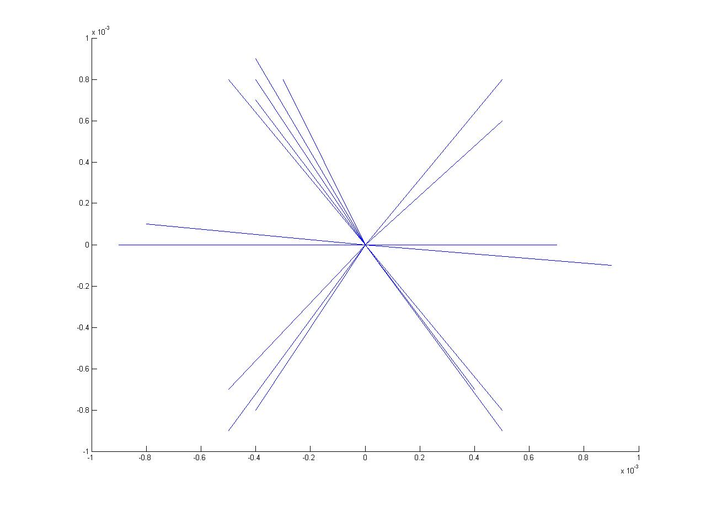
Quaternions
The per TLE rotation frames are not random
The GPS satellites are in six bands around the earth
There is a better conversion from the TEME frame to a more well understood frame based on orbital data
Rotation axis from quaternions computed using GPS satellites from Jan 2006

Slide 21
Conclusions
Using GPS precise ephemerides can track error in TLEs over time
Consistent rotation bias between TEME and ECEF coordinate frame
Bias “slips” over time ~ 0.15 mrad/year
Bias still useful in correcting TLE 2 years later
Specific correction for each Satellite determined from TLE and ephemeris data
Specific correction improves error prediction in TLEs
Errors have much structure to be exploited

Slide 22
Caveats
GPS are in MEO orbits
  Very little atmospheric drag
  Small gravitational disturbances
Do these conclusions generalize out to LEO, Sun Synchronous, and GEO orbits?
  Unknown at current time
  Need to validate with LEO or SunSync satellite data
Can quaternions be estimated directly from the TLEs?

Slide 23
Future Research
Use more precise orbit parameters to improve prediction error from TLEs
Apply same techniques to LEO satellite
Use TLEs directly as input to filter/estimator
Least squares using sparse measurements instead of one week blocks
Better propagation algorithms that take into account known orbit perturbations

Slide 24
Questions?

