Slide 1
TEAM BRIEF
How to use AI agents without wasting cycles
Use Codex, Claude Code, REPLs, AGENTS.md, and SKILLS.md as an engineering system: read the truth, change the repo, prove the result.
Repo proof, not AI hype
A practical brief for new users
Neutron 2 AI agent workflow
01

Slide 2
The shift is that agents can now work inside the system
A few months ago, AI mostly explained code. Now it can inspect a repo, edit files, run builds, read logs, package releases, and leave a handoff.
01
Local context
The agent sees the real checkout, docs, scripts, and branch state.
02
Tool use
It can run commands, inspect artifacts, and verify outputs instead of guessing.
03
Memory and instructions
Project rules persist through AGENTS.md, skills, runbooks, and handoff notes.
04
Proof loops
Claims are useful only after validation: build, test, GDS, receiver, viewer, hash, or hardware evidence.
Grounded in this repo's Neutron 2 MVP workflow and archived HIL/release notes.
Neutron 2 AI agent workflow
02

Slide 3
Think of an AI agent as a fast junior engineer with tools
The agent is valuable because it can do the tedious loop quickly. It is dangerous when treated like an authority.
01
Ask it to inspect
Start from the repo, not from memory or generic F Prime advice.
02
Ask it to act
Give a narrow file, component, runbook, or validation target.
03
Ask it to prove
Require the exact command, screenshot, event, or artifact that shows success.
04
Keep judgment human
Humans own hardware safety, mission decisions, merge approval, and demo acceptance.
Simple operating rule: no proof, no claim.
Neutron 2 AI agent workflow
03

Slide 4
Each AI surface has a different job
Tool
Best use
Bad use
Team rule
Codex
Repo edits, builds, tests, docs, Git handoff, artifact creation.
Blind strategy answers without reading the checkout.
Use for implementation and verification.
Claude Code
Parallel code reading, refactors, review passes, long-context reasoning.
Diverging from repo rules or creating a second source of truth.
Point it at AGENTS.md and shared skills.
REPL
Fast scratchpad for data inspection, scripts, API checks, and browser automation.
Silent one-off logic that never lands in the repo.
Promote durable work into scripts or docs.
Chat
Briefs, explanations, tradeoffs, prompt drafting, and planning.
Unverified claims about live hardware or current files.
Convert advice into a checkable task.
Neutron 2 AI agent workflow
04

Slide 5
Context engineering is how you make the agent useful
1
2
3
4
5
Goal
Ground truth
Boundaries
Proof
Handoff
What should change, and why does it matter?
Which files, docs, branch, hardware, or logs are authoritative?
What should it not touch or overclaim?
What must pass before the work is accepted?
What should the next person know?
A strong prompt is not long. It is specific about sources, scope, and acceptance.
Neutron 2 AI agent workflow
05

Slide 6
AGENTS.md is the operating contract for the repo
It tells every agent how to behave before it starts changing things.
01
Current branch first
Check branch and submodules before assuming state.
02
Repo-local docs first
Use the checked-out F Prime docs before live web docs.
03
Demo-first scope
Prefer the smallest change that supports the FlatSat story.
04
Student-safe defaults
macOS examples first, Windows through WSL2 for F Prime development.
In this repo: AGENTS.md routes architecture to docs/SYSTEM_ARCHITECTURE.md and current status to docs/agents_notes.md.
Neutron 2 AI agent workflow
06

Slide 7
SKILLS.md-style folders turn lessons into reusable workflows
A skill is a small local instruction pack: when to use it, what to read, what commands matter, and what mistakes to avoid.
01
fprime-swe
Component, topology, build, and F Prime workflow.
02
fprime-docs-search
Search the repo-pinned F Prime docs before the web.
03
fprime-hil-testing
Staged hardware bring-up, serial identity, GDS, payload receiver, viewer proof.
04
student-git-handoff
Plain-language feature branch, commit, push, and PR workflow.
Shared skills live under .agents/skills and .claude/skills so different agent surfaces inherit the same rules.
Neutron 2 AI agent workflow
07

Slide 8
The best agent loop is read, plan, change, verify, hand off
1
2
3
4
5
Read
Plan
Change
Verify
Handoff
Inspect source files, docs, branch, logs, and hardware map.
Name the narrow change and validation target.
Edit only the files needed for the task.
Run the relevant gate and capture evidence.
Summarize files changed, proof, and residual risk.
Most wasted AI time comes from skipping the first or fourth step.
Neutron 2 AI agent workflow
08

Slide 9
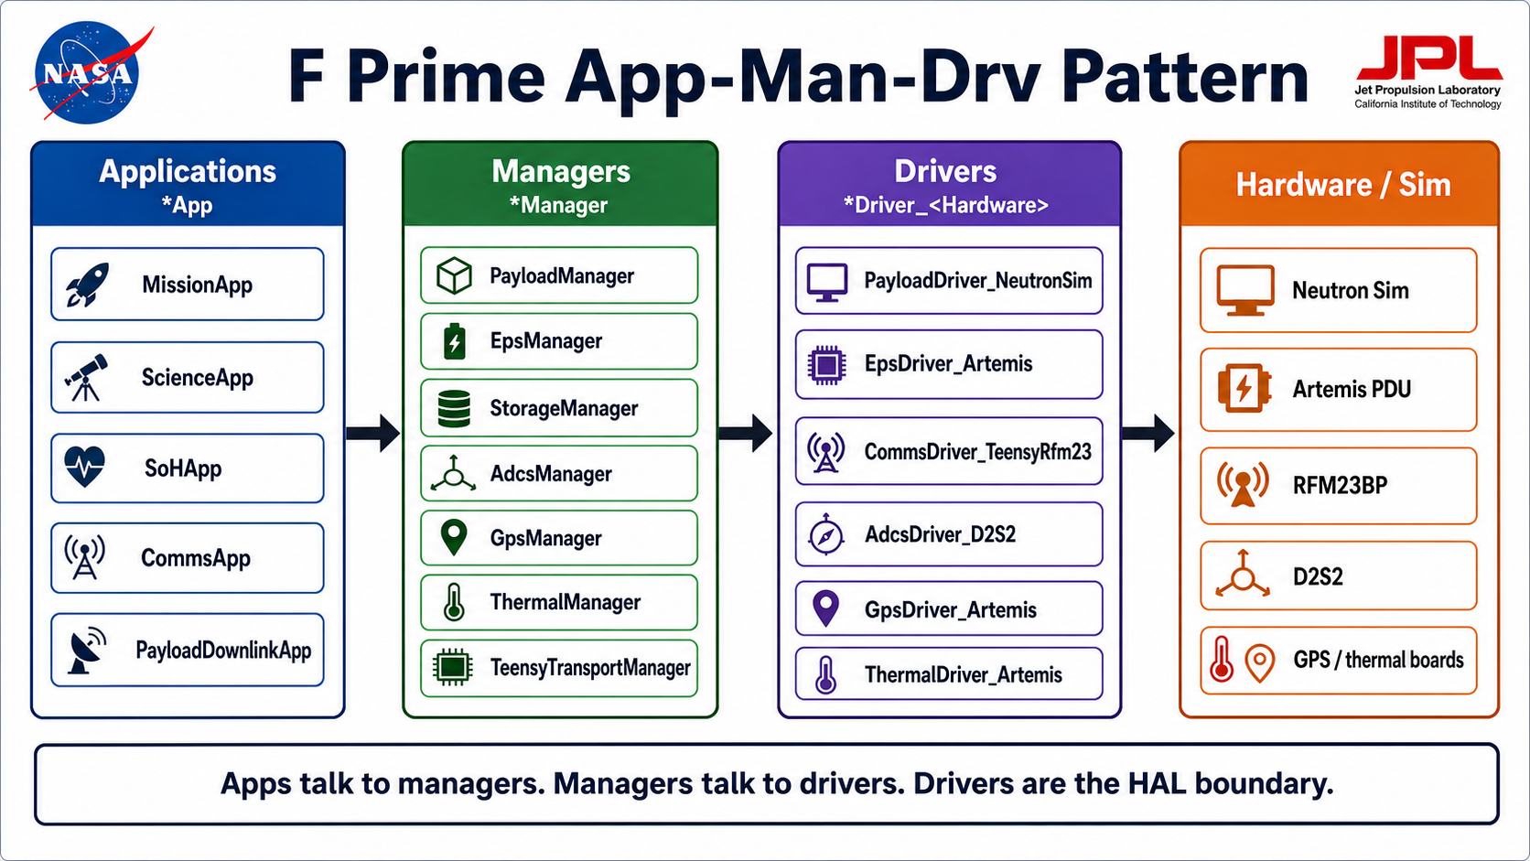
This repo shows what proof-oriented agents can produce
The point is not that AI “knew” the architecture.
The point is that agents helped turn scattered conversations, code, HIL findings, and docs into a usable Application -> Manager -> Driver system with runbooks, validation gates, and handoff material.
Evidence pattern
Architecture claims live in docs, implementation lives in code, and proof lives in tests or HIL outputs.
Source: docs/SYSTEM_ARCHITECTURE.md
Neutron 2 AI agent workflow
09

Slide 10
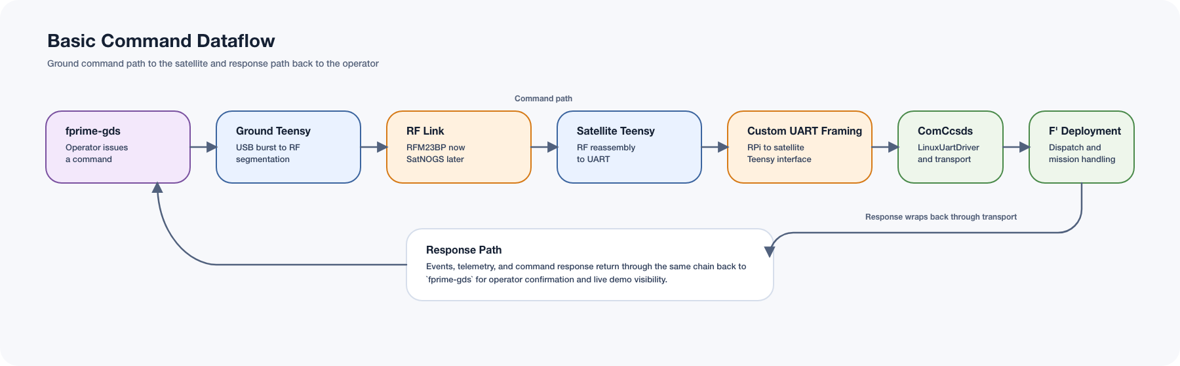
For hardware work, logs are useful but proof is visible
GDS
Command, event, telemetry visible to operator
Receiver
Channel-1 payload file reconstructed
Viewer
Science data opens and parses
Hash
Ground file matches Pi latest payload
Counters
Both Teensys agree packets moved
Agent rule: never claim HIL success from local validation alone.
Neutron 2 AI agent workflow
10

Slide 11
A good task prompt sounds like an engineering ticket
Pass the agent enough context to start correctly, then make success measurable.
01
Start here
Read AGENTS.md, README.md, SYSTEM_ARCHITECTURE.md, and agents_notes.md.
02
Task
Fix or explain one concrete behavior, file, component, or runbook.
03
Constraints
KISS, demo-first, preserve Application -> Manager -> Driver.
04
Acceptance
Run the gate, show the artifact, or report why it could not be verified.
Reusable prompt pattern: context + task + boundaries + proof.
Neutron 2 AI agent workflow
11

Slide 12
Use agents like a team habit, not a magic button
1
2
3
4
5
One source
Small PRs
Proof first
Write back
Review
Keep rules in AGENTS.md and detailed truth in docs.
Ask for narrow changes and organized commits.
Require validation before merge or demo claims.
Turn hard-won fixes into runbooks or skills.
Humans accept risk, hardware actions, and final design.
The compounding gain is not one impressive answer. It is a repo that teaches the next agent and the next teammate what already works.
Neutron 2 AI agent workflow
12

