Slide 1

Lesson 5 Assignment: tax bracket CALCULATOR

Slide 2
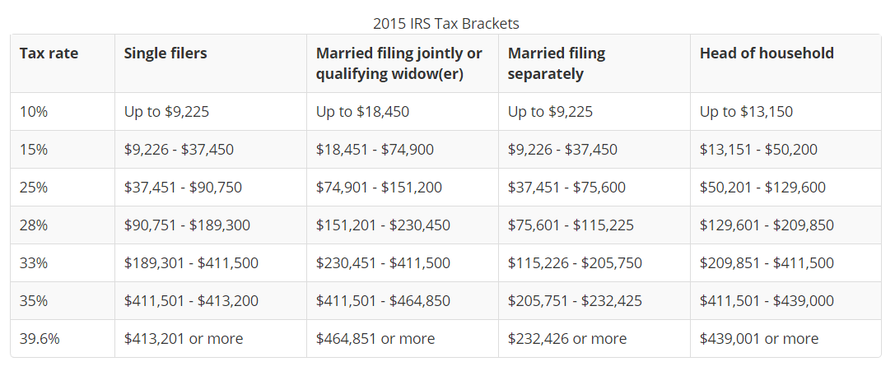
Lesson 5 Assignment: Estimate Tax Rate and Tax Amount
The US federal personal income tax is calculated based on the filing status and taxable income. There are four filing statuses: single filers, married filing jointly, married filing separately, and head of household. The tax rates for each are shown below.

Slide 3
Lesson 5 Assignment: Estimate Tax Rate and Tax Amount

Slide 4
Lesson 5 Assignment: Estimate Tax Rate and Tax Amount
Algorithm:
Request that the user selects filing status (Dropdown Menu)
0 – Single;
1 – Married filing jointly or qualifying widow(er);
2 – Married filing separately;
3 – Head of household
Prompt user to enter Taxable Income (Textbox)
Compute the Tax Rate (Calculate Button)
Display the results.

Slide 5
Lesson 5 Assignment: Estimate Tax Rate and Tax Amount
Problem: Compute Taxes
Algorithm:
Request that the user selects filing status (Dropdown Menu)
0 – Single;
1 – Married filing jointly or qualifying widow(er);
2 – Married filing separately;
3 – Head of household
Prompt user to enter Taxable Income (Textbox)
Compute the Tax Rate (Calculate Button)
Display the results.

Slide 6
Lesson 5 Assignment: Estimate Tax Rate
if (status == 0) {
// Compute tax for single filers
}
else if (status == 1) {
// Compute tax for married file jointly
// or qualifying widow(er)
}
else if (status == 2) {
// Compute tax for married file separately
}
else if (status == 3) {
// Compute tax for head of household
}
else {
// Display wrong status
}
Application: Compute Tax Rate
Algorithm:
Request that the user selects filing status (Dropdown Menu)
0 – Single;
1 – Married filing jointly or qualifying widow(er);
2 – Married filing separately;
3 – Head of household
Prompt user to enter Taxable Income (Textbox)
Compute the Tax Rate (Calculate Button)
Display the results.

Slide 7
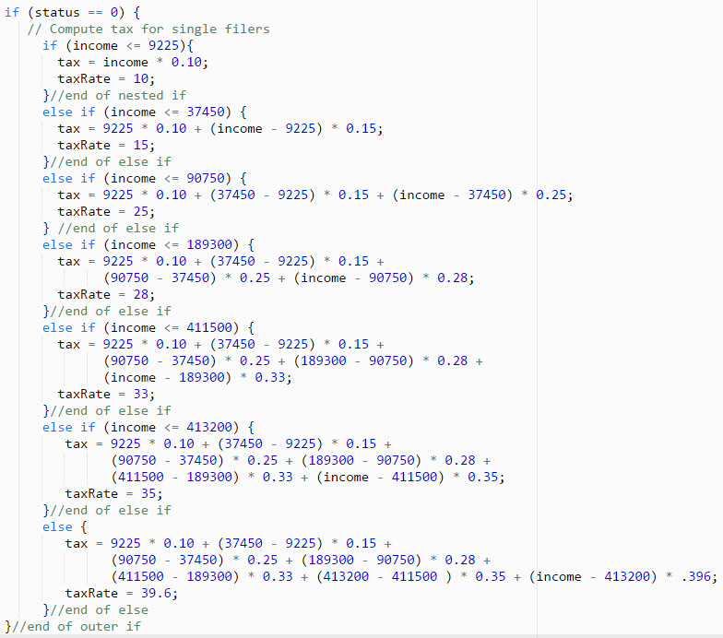
Lesson 5 Assignment: Estimate Tax Rate and Tax Amount – Code for Single Filer

Slide 8
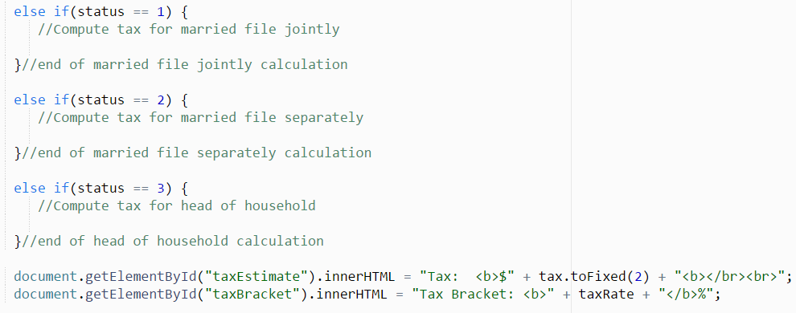
Lesson 5 Assignment: Estimate Tax Rate and Tax Amount – Complete the program for the remaining filers

Slide 9
Resource:
https://www.taxact.com/tools/tax-bracket-calculator.asp
http://blog.taxact.com/how-tax-brackets-work/?utm_source=TaxACT&utm_medium=Tax-Bracket-Calculator&utm_campaign=Learn-More&_ga=1.73577618.1233321099.1456235121

Slide 10
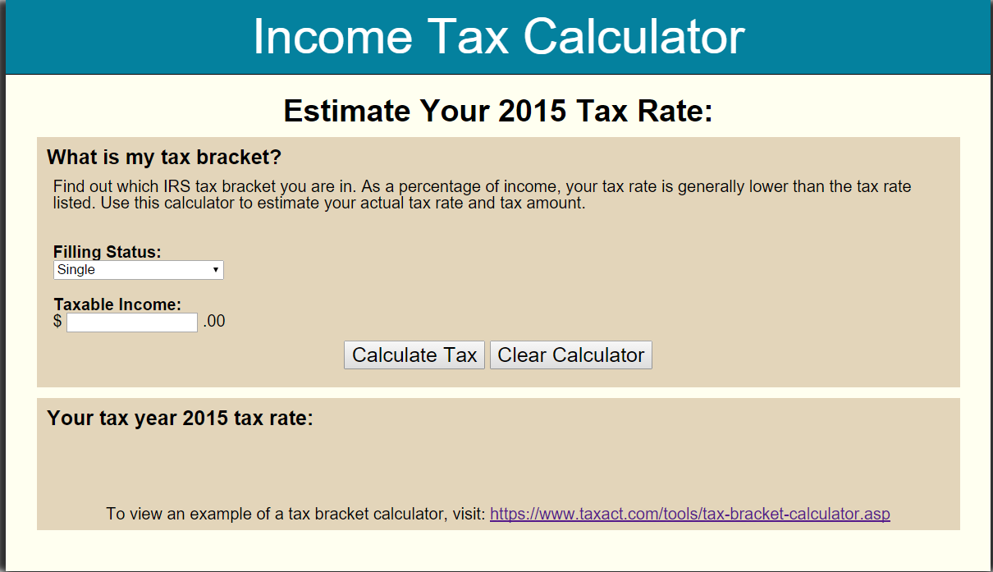

Slide 11
