Slide 1

Lesson 5: Tax Calculator Setup Workspace

Slide 2
Setup Workspace - 6 STEPS
Step #1: Setup a new workspace in Cloud9
Step #2: Move files to the local repository in Cloud9
Step #3: Connect Cloud9 Account to GitHub Account
Step #4: Create a new remote repository in GitHub
Step #5: Push files to the Remote Repository (GitHub)
Step #6: Verify!

Slide 3
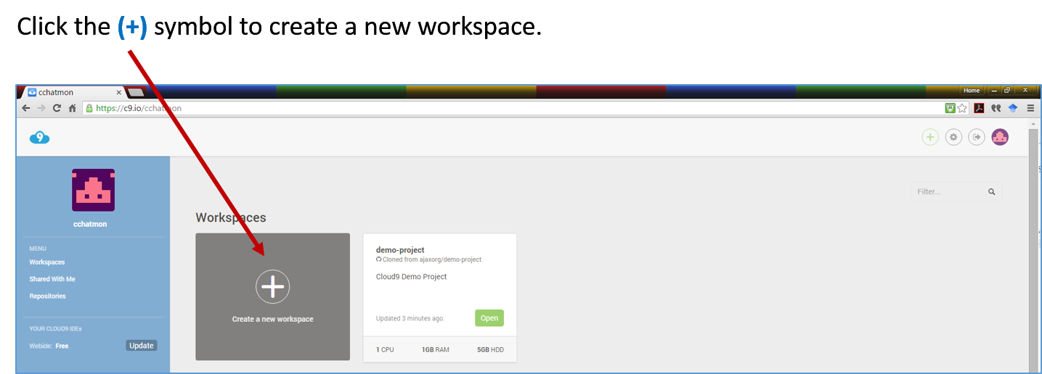
Step #1: Setup a new workspace in Cloud9
Create a new workspace in Cloud9 for Lesson 5:

Slide 4
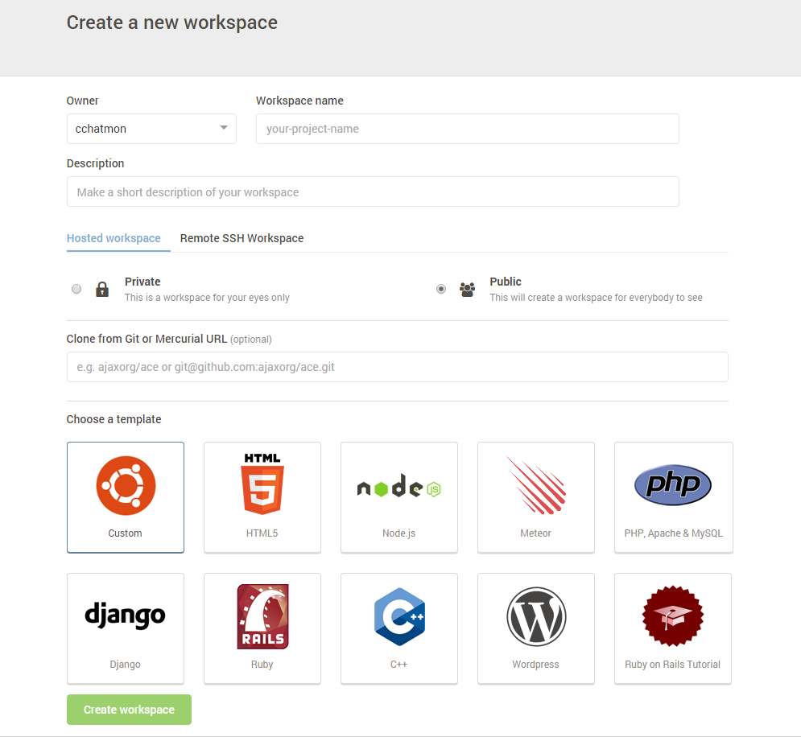
Step #1: Setup a new workspace in Cloud9
Add the workspace details for Lesson 5:
Step 1. Give the workspace the following name:
yourLastName_lesson5_javascript2
Example: chatmon_lesson5_javascript5
Step 2. Give the following description for the workspace:
Lesson 5: This lesson introduces the advantages of code
modularization and reusable code by using conditional
statements, loops, and functions.
Step 3. Leave the remaining default options.
Step 4. Click the “Create Workspace” button.
Your workspace should now be created!

Slide 5
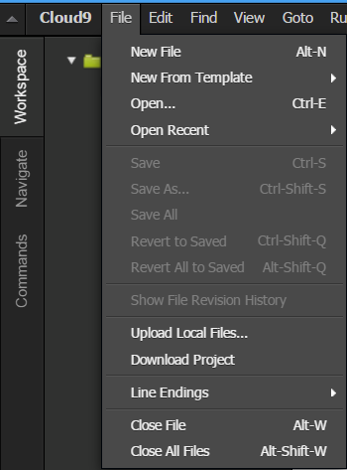
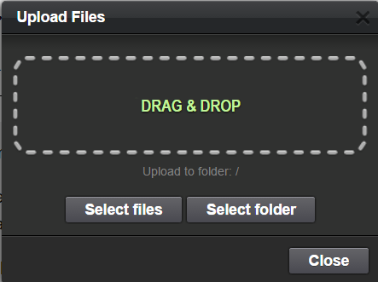
Step #1: Setup a new workspace in Cloud9
Upload Lesson 5 Assignment files into the Cloud9 workspace:
Click the following link to DOWNLOAD and ADD the files to the workspace: Lesson5_taxCalculator
(taxCalculator.html and sytles.css)
In Cloud9, select File > Upload Local Files…
Click Select folder and upload required folder for this lesson to the workspace or DRAG & DROP the required folder in the Upload Files panel. Close the panel after all files/folders have been uploaded.

Slide 6
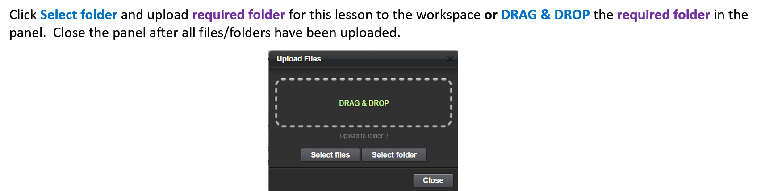
Step #1: Setup a new workspace in Cloud9
Upload Lesson 5 Assignments files into the Cloud9 workspace:
Move the files into the workspace.

Slide 7
Step #2: Move Files to Local Repository in Cloud9
In Cloud9 Terminal, enter the following commands below which achieve the following:
initialize the local git repository (git init)
add all file(s) and folder(s) from the current directory to the staging area (git add .)
copy the file(s) and folder(s) to the local repository (git commit –m ‘message’)
COMMANDS TO ENTER IN THE Cloud9 TERMINAL: (Type commands AFTER the ‘$’):
$ git init
$ git add .
$ git commit -m ‘lesson 5 first commit’

Slide 8
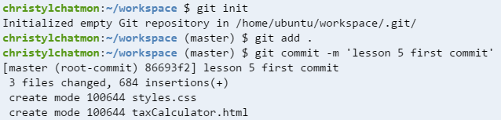
Step #2: Move Files to Local Repository in Cloud9
**EXAMPLE**
HINT: Yours may look slightly different!!
Your username
Your username
Your username

Slide 9

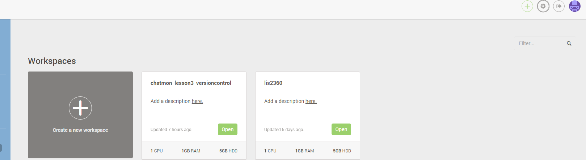
Step #3: Connect Cloud9 Account to GitHub Account
In the Cloud9 dashboard, select Accounting Settings icon in the top right hand corner:
Click to access your Account Settings menu in the Cloud9

Slide 10
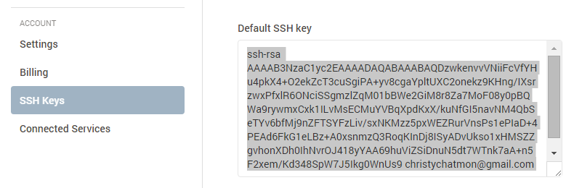
Step #3: Connect Cloud9 Account to GitHub Account
In Cloud9 in the Account Settings screen, select the SSH Keys option.
Click in the screen for the Default SSH Key and copy this key to the buffer!!!!
CTRL + C (Windows) or
Command + C (Mac)

Slide 11
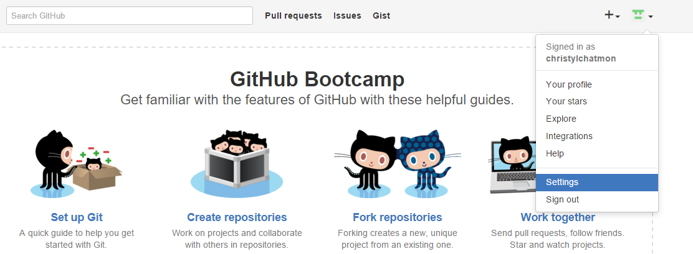
Step #3: Connect Cloud9 Account to GitHub Account
In order to add the SSH Key from Cloud9 to GitHub, go to GitHub (https://github.com/) and select the Settings option using the View Profile and More icon in the top right corner.

Slide 12
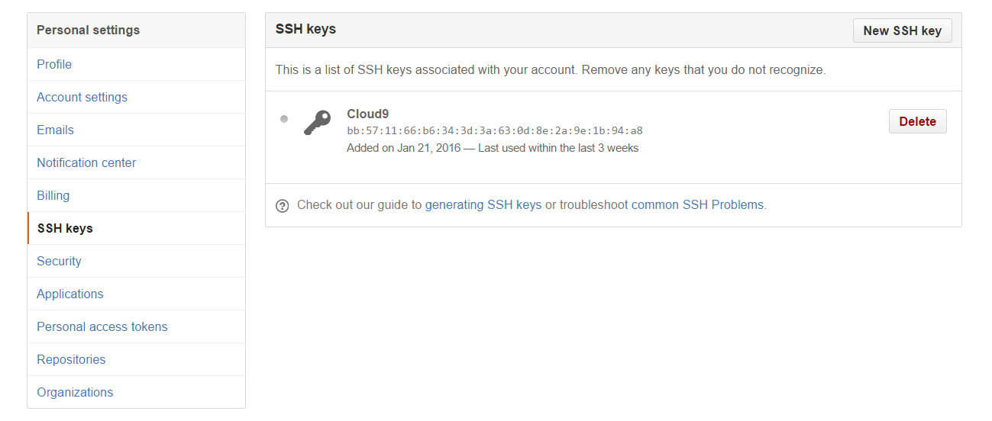
Step #3: Connect Cloud9 Account to GitHub Account
In GitHub Settings screen, select the SSH Keys option.
Select the New SSH Key button.
***IF YOU RECEIVED THE ERROR MESSAGE, “THE KEY ALREADY EXISTS”,
GO TO STEP #4!!!***

Slide 13
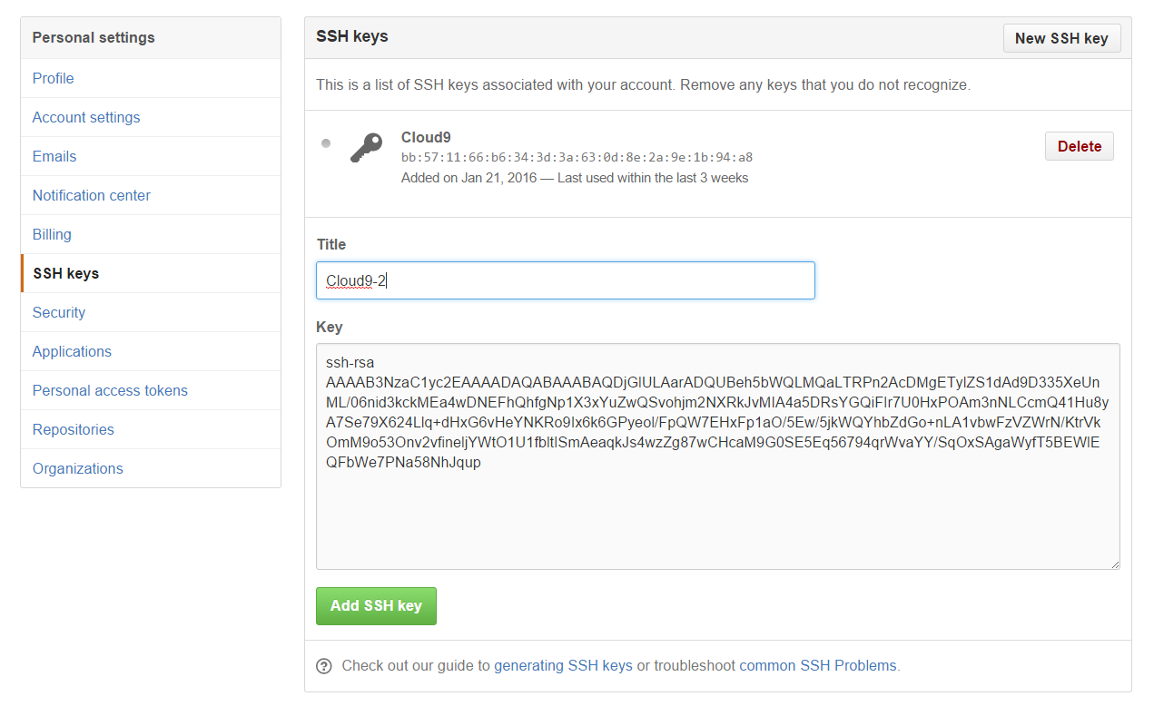
Step #3: Connect Cloud9 Account to GitHub Account
Give this SSH Key the following Title: Cloud9-5
Paste the SSH Key in the Key textbox. (CTRL+V for Windows; Command+V for Mac)
Press Add Key button.

Slide 14
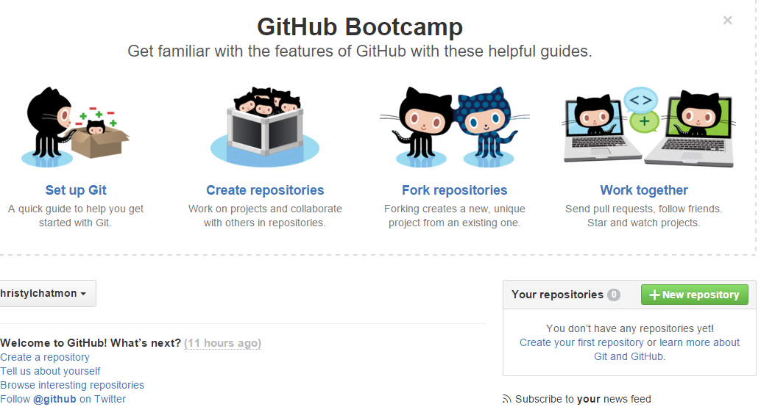
Step #4: Create a New Remote Repository in GitHub
Select the GitHub icon in the top left-hand corner to return to the GitHub dashboard.
In GitHub, create a new repository (using default options) in GitHub
Click the New Repository button on the GitHub main page.

Slide 15
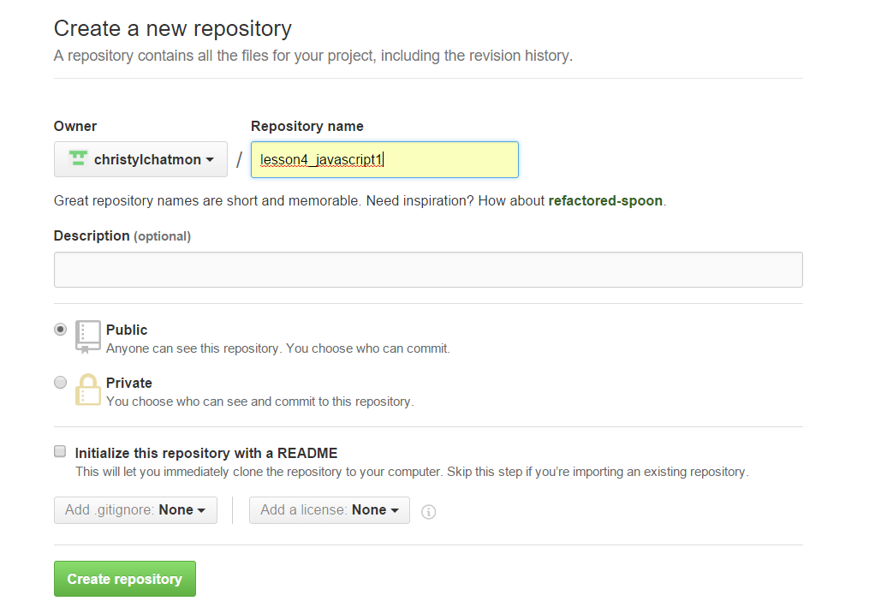
Step #4: Create a New Remote Repository in GitHub
Create a Repository (using default options) in GitHub
Repository Name: “lesson5_javascript2”
Leave all default options
Click “Create repository” button
lesson5_javascript2

Slide 16
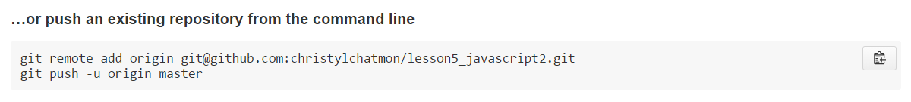
Step #5: Push (Backup) files to the Remote Repository (GitHub)
In GitHub:
Select the SSH button in the new remote repository
Copy each statement in “…or push an existing repository…” section or just click the copy button

Slide 17
Step #5: Push (Backup) files to the Remote Repository (GitHub)
In Cloud9:
Paste (DO NOT TYPE IT) the commands that were copied in the previous step in the Cloud9 Terminal to PUSH (or copy) the code to your remote repository in GitHub by typing the following commands:
COMMANDS TO ENTER OR PASTE IN Cloud9 TERMINAL: (Type commands after the ‘$’)
$ git remote add origin git@github.com:YOUR-USERNAME/PROJECT-TITLE.git
$ git push -u origin master
<press enter>

Slide 18
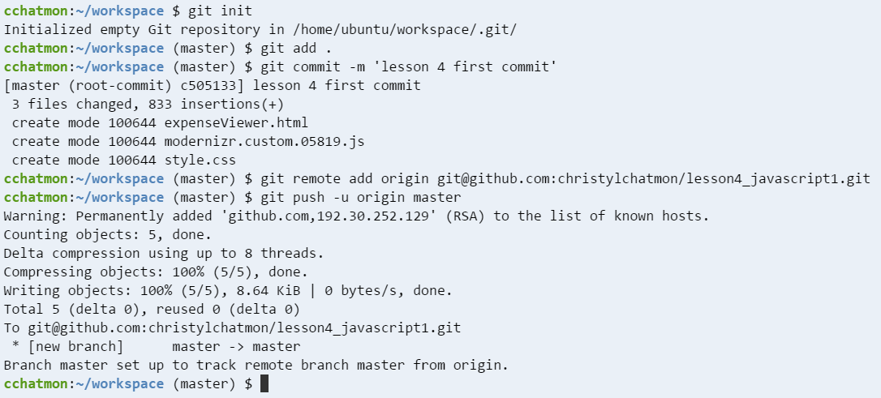
Step #5: Push (Backup) files to the Remote Repository (GitHub)
**EXAMPLE OUTPUT**
HINT: Your statement may look slightly different!!
You should see the last statement indicating that the branch is set up!
Statements from
the previous step:

Slide 19
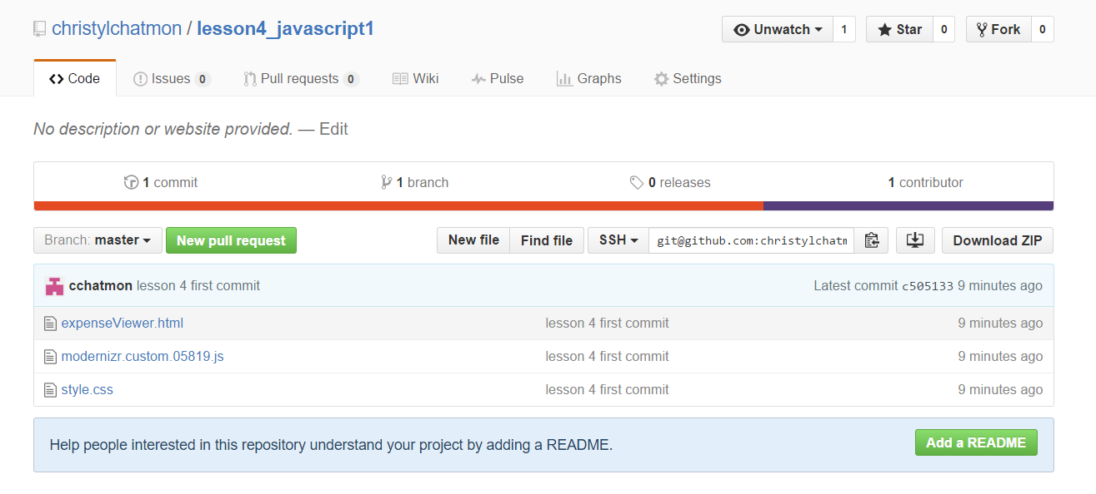
Step #6: Verify! New Remote Repository (GitHub) contains Files from Local Repository (Cloud9)
Go back to GitHub and refresh the browser to view the newly ‘PUSHED’ files!
lesson5_javascript2
lesson 5 first commit
lesson 5 first commit
lesson 5 first commit
lesson 5 first commit

Slide 20


Slide 21
rm –rf .git //removes all of the repository, leaving only the working directory
ssh-keygen -t rsa

