Slide 1
10Be(d,6Li) -> Beam energy, can we decrease the beam energy?
-> Target thickness?
-> 10Be + d -> 6He (DE-E) + 6Li (ToF 6Li? or 6He?) because V=d/t and E = 1/2mv2 no Z dependency…
-> 10Be + 12C -> 6He
E 6Li
(ToF)?
Theta 6Li
(ToF)?
??
??
E 6He
E 6Li/6He
Theta 6He
To be done in nptool and LISE++
??
Theta 6Li / 6He

Slide 2
List of stuffs to do:
- E(6Li) vs Theta(6Li) and E(6He) vs Theta(6He) -> This is simple… PhysicsTree->Draw(“ELab:ThetaLab>>h(…)”,”CsIE>0”,”col”)
- Theta(6Li) vs Theta(6He)
- E(6Li) vs E(6He) ?? LISE++??
- Ex
For different CD2 target thickness: 50um, 90um (7mg), 100um, 150um
For different beam dispersion X and Y: (0,0), (10,10), (20,20), (50,50) without CATS!
How Theta3 vs Theta4 and Ex evolve with Target Thickness and beam sigmaX, sigmaY dispersion

Slide 3
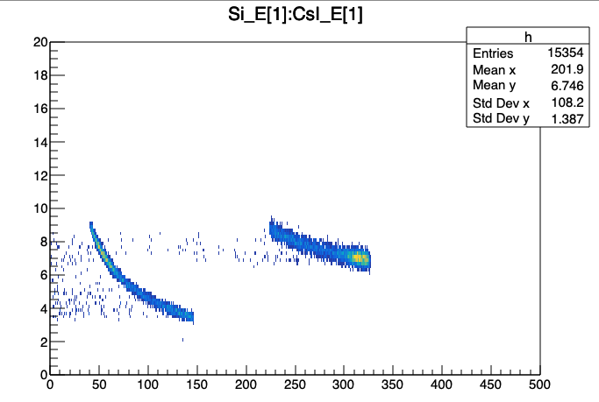
For illustration
6He
7Li
10Be
alpha
CD₂
D -> ²H
6Li
1 single Event -> Everything that happen in a give time window: ~us
Si_E -> size 2
CsI_E -> size 2 too!
PhysicsTree->Draw(“Si_E”) this draw both
PhysicsTree->Draw(“Si_E[0]”) this draw first hit
PhysicsTree->Draw(“Si_E[1]”) this draw second hit

Slide 4
Si -> 300um thick
p
t
10Be
CH2
1 single Event -> Everything that happen in a give time window: ~us
Si_E -> size 2
CsI_E -> size 2 too!
PhysicsTree->Draw(“Si_E”) this draw both
PhysicsTree->Draw(“Si_E[0]”) this draw first hit
PhysicsTree->Draw(“Si_E[1]”) this draw second hit

Slide 5
p
10Be
CH2
10Be
p
NPL::Reaction r("10Be(p,4He)7Li@380")
NPL::Reaction r1(“10Be(d,6Li)6He@270”)
r1.GetKinematicLine3()->Draw()
r1.GetTheta3Theta4()->Draw()
CH2

Slide 6
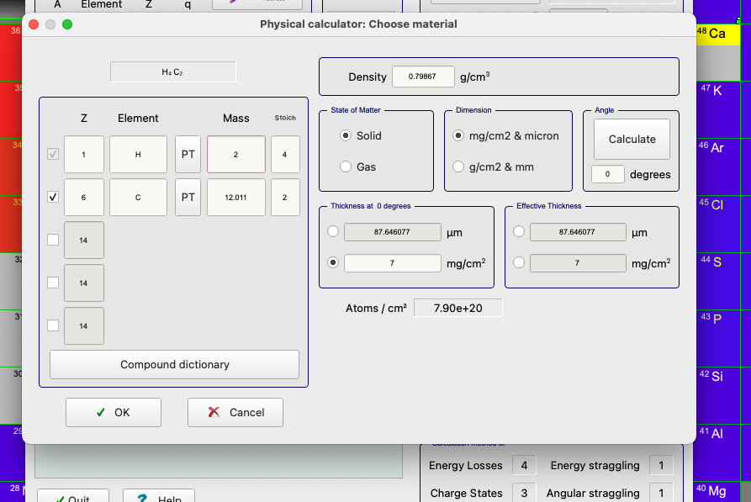
Up to 150 um !

