Slide 1
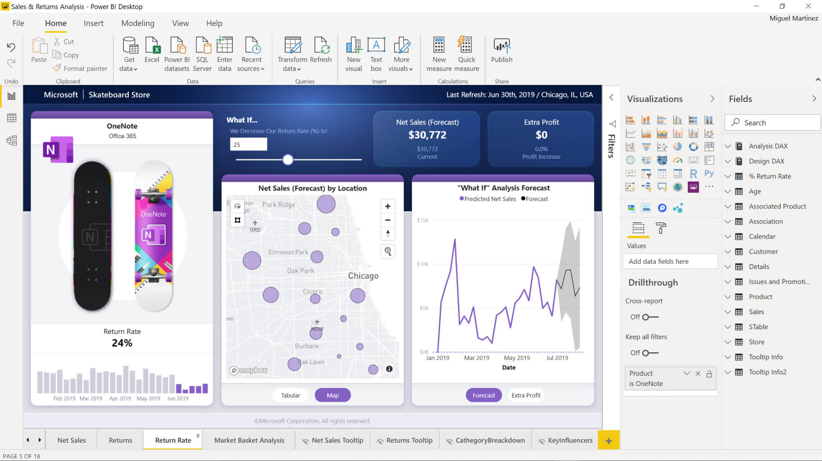
Toolbar
Visualization Options
Data Explorer
Design Area

