Slide 1
PA3 : Segmentation

Slide 2
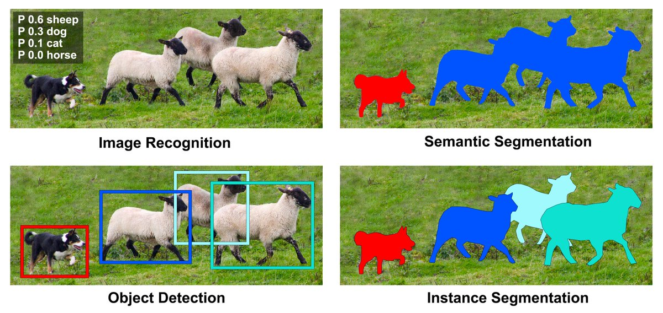
What is Segmentation?
Segmentation in computer vision refers to the process of partitioning an image into multiple sements to simplify its representation or make it more meaningful for analysis.
https://desupervised.io/computer-vision

Slide 3

What is Binary segmentation?
Binary segmentation is a technique that involves dividing an image into two distinct regions or segments based on certain criteria. The primary aim is to separate the image into two parts: foreground and background

Slide 4
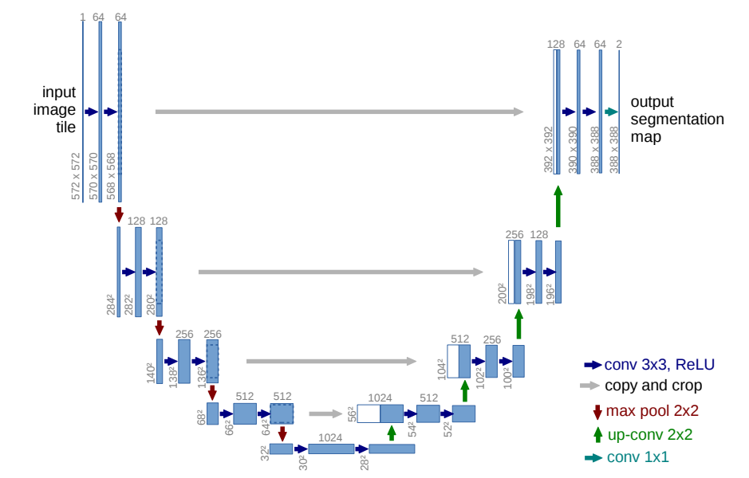
Simple Approach - UNet
Input
Output
Ronneberger et al. “U-Net: Convolutional Networks for Biomedical Image Segmentation”

Slide 5
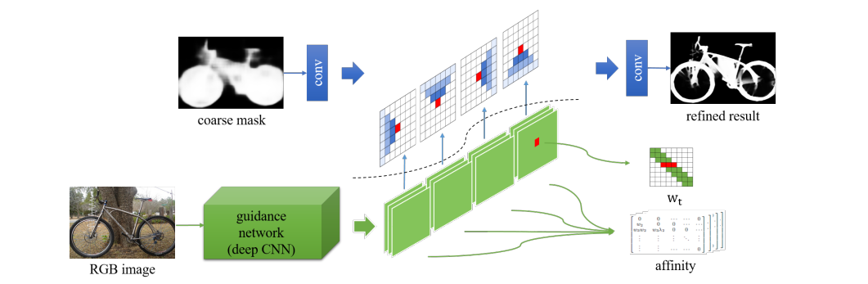
Spatial Propagation Network
Liu et al. “Learning Affinity via Spatial Propagation Networks”

Slide 6
What is affinity?
Affinity refers to the measure of similarity between pixels or image segments.
Affinity matrix of yellow circle point
0.01 | 0.02 | 0.22
0.02 |  | 0.21
0.01 | 0.24 | 0.22

Slide 7
What is affinity?
Affinity matrix of yellow circle point
0.01 | 0.02 | 0.22
0.02 |  | 0.21
0.01 | 0.24 | 0.22
We can say that pixels with an affinity greater than 0.2 are very strongly related with yellow pixels.

Slide 8
What is affinity?
Spatial Proximity:
Pixels that are clos to each other in terms spatial distance are often considered more likely to be related or part of the same object
Similarity in Color and Intensity:
Pixels that have similar color or intensity values are more likely to belong to the same object or region
Texture and Gradient:
Affinity can also be defined based on the texture or gradient information of pixels, especially in scenarios where textural properties are significant for distinguishing regions or objects

Slide 9
What is affinity?
Spatial Proximity
Similarity in Color and Intensity
Texture and Gradient
Deep learning automatically determines the optimal affinity in its own way!!

Slide 10
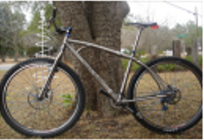

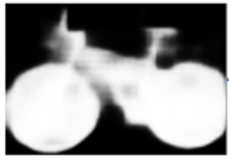
PA3 - Overview
Coarse segmentation
RGB
Affinity
Refine Initial
segmentaiton
0.01 | 0.02 | 0.22
0.02 |  | 0.21
0.01 | 0.24 | 0.22
3 x H x W
1 x H x W
9 x H x W
1 x H x W
Liu et al. “Learning Affinity via Spatial Propagation Networks”

Slide 11
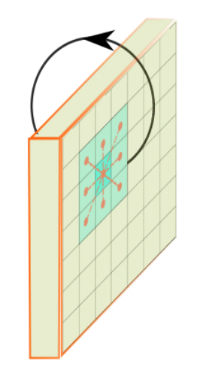
What is CSPN?
Propagate information from neighborhood pixel to center pixel
0.01 | 0.02 | 0.22
0.02 | 1 – (0.01 + 0.02 + 0.22 + 0.02 + 0.21 + 0.01 + 0.24 + 0.22) | 0.21
0.01 | 0.24 | 0.22
Cheng et al. “Learning Depth with Convolutional Spatial Propagation Network”

Slide 12
What is CSPN?
Iteration 1 Segmentation
P(1,1) | P(2,1) | P(3,1) | P(4,1) | P(5,1)
P(1,2) | P(2,2) | P(3,2) | P(4,2) | P(5,2)
P(1,3) | P(2,3) | P(3,3) | P(4,3) | P(5,3)
P(1,4) | P(2,4) | P(3,4) | P(4,4) | P(4,5)
P(1,5) | P(2,5) | P(3,5) | P(4,5) | P(5,5)
Corase Segmentation
Coarse Segmentation
P(1,1) refers to pixel value on (1,1) coordinate
Cheng et al. “Learning Depth with Convolutional Spatial Propagation Network”

Slide 13
What is CSPN?
Iteration 1 Segmentation
Zero padding
Segmentation
Left top Affinity Matrix
P(1,1) | P(2,1) | P(3,1) | P(4,1) | P(5,1)
P(1,2) | P(2,2) | P(3,2) | P(4,2) | P(5,2)
P(1,3) | P(2,3) | P(3,3) | P(4,3) | P(5,3)
P(1,4) | P(2,4) | P(3,4) | P(4,4) | P(4,5)
P(1,5) | P(2,5) | P(3,5) | P(4,5) | P(5,5)
0 | 0 | 0 | 0 | 0
0 | P(2,2) ↓ P(1,1) | P(3,2) ↓ P(2,1) | P(4,2) ↓ P(3,1) | P(5,2) ↓ P(4,1)
0 | P(2,3) ↓ P(1,2) | P(3,3) ↓ P(2,2) | P(4,3) ↓ P(3,2) | P(5,3) ↓ P(4,2)
0 | P(2,4) ↓ P(1,3) | P(3,4) ↓ P(2,3) | P(4,4) ↓ P(3,3) | P(4,5) ↓ P(4,3)
0 | P(2,5) ↓ P(1,4) | P(3,5) ↓ P(2,4) | P(4,5) ↓ P(3,4) | P(5,5) ↓ P(4,4)
0.01 | 0.02 | 0.22
0.02 |  | 0.21
0.01 | 0.24 | 0.22
P(2,2)
↓
P(1,1)
How much does p(2,2) affect p(1,1)
Cheng et al. “Learning Depth with Convolutional Spatial Propagation Network”

Slide 14
What is CSPN?
Iteration 1 Segmentation
Segmentation * Left top Affinity Matrix
0 | 0 | 0 | 0 | 0 | 0 | 0
0 | P(2,2) * P(2,2)→P(1,1) | P(3,2) * P(3,2)→P(2,1) | P(4,2) * P(4,2)→P(3,1) | P(5,2) * P(5,2)→P(4,1) | 0 | 0
0 | P(2,3) * P(2,3)→P(1,2) | P(3,3) * P(2,2)→P(2,2) | P(4,3) * P(4,3)→P(3,2) | P(5,3) * P(5,3)→P(4,2) | 0 | 0
0 | P(2,4) * P(2,4)→P(1,3) | P(3,4) * P(3,4)→P(2,3) | P(4,4) * P(4,4)→P(3,3) | P(4,5) * P(4,5)→P(4,3) | 0 | 0
0 | P(2,5) * P(2,5)→P(1,4) | P(3,5) * P(3,5)→P(2,4) | P(4,5) * P(4,5)→P(3,4) | P(5,5) * P(5,5)→P(4,4) | 0 | 0
0 | 0 | 0 | 0 | 0 | 0 | 0
0 | 0 | 0 | 0 | 0 | 0 | 0
Cheng et al. “Learning Depth with Convolutional Spatial Propagation Network”

Slide 15
What is CSPN?
Iteration 1 Segmentation
Segmentation * Left top Affinity Matrix
P(2,2) * P(2,2)→P(1,1) | P(3,2) * P(3,2)→P(2,1) | P(4,2) * P(4,2)→P(3,1) | P(5,2) * P(5,2)→P(4,1) | 0
P(2,3) * P(2,3)→P(1,2) | P(3,3) * P(2,2)→P(2,2) | P(4,3) * P(4,3)→P(3,2) | P(5,3) * P(5,3)→P(4,2) | 0
P(2,4) * P(2,4)→P(1,3) | P(3,4) * P(3,4)→P(2,3) | P(4,4) * P(4,4)→P(3,3) | P(4,5) * P(4,5)→P(4,3) | 0
P(2,5) * P(2,5)→P(1,4) | P(3,5) * P(3,5)→P(2,4) | P(4,5) * P(4,5)→P(3,4) | P(5,5) * P(5,5)→P(4,4) | 0
0 | 0 | 0 | 0 | 0
Cheng et al. “Learning Depth with Convolutional Spatial Propagation Network”

Slide 16
What is CSPN?
Iteration 1 Segmentation
Segmentation * Left top Affinity Matrix
+
Segmentation * Left Affinity Matrix
+
…
Initial Segmentation (t = 0)
P(2,2)*LT + P(2,1)*L + P(1,2)*T | P(1,1)*R + P(1,2)*RT + P(2,2)*T + P(3,2)*LT + P(3,1)*L
P(1,1)*D + P(2,1)*LD + P(2,2)*L + P(2,3)*LT + P(1,3)*T | P(1,1)*RD + P(2,1)*D + P(3,1)*LD + P(1,2)*R + P(3,2)*L + P(1,3)*RT + P(2,3)*T + P(3,3)*LT
(1-sum(weight(1,1)))*P(1,1) | (1-sum(weight(2,1)))*P(2,1)
(1-sum(weight(1,2)))*P(1,2) | (1-sum(weight(2,2)))*P(2,2)
+
Weight(1,1):
The sum of all the affinities at that pixel(1,1)
Weight(1,1) = LT + L + T
LT: Left Top affinity
L: Left affinity
…
Cheng et al. “Learning Depth with Convolutional Spatial Propagation Network”

Slide 17
What is CSPN?
Iteration 1 Segmentation
Segmentation * Left top Affinity Matrix
+
Segmentation * Left Affinity Matrix
+
…
Initial Segmentation (t = 0)
P(2,2)*LT + P(2,1)*L + P(1,2)*T | P(1,1)*R + P(1,2)*RT + P(2,2)*T + P(3,2)*LT + P(3,1)*L
P(1,1)*D + P(2,1)*LD + P(2,2)*L + P(2,3)*LT + P(1,3)*T | P(1,1)*RD + P(2,1)*D + P(3,1)*LD + P(1,2)*R + P(3,2)*L + P(1,3)*RT + P(2,3)*T + P(3,3)*LT
(1-sum(weight(1,1)))*P(1,1) | (1-sum(weight(2,1)))*P(2,1)
(1-sum(weight(1,2)))*P(1,2) | (1-sum(weight(2,2)))*P(2,2)
+
Weight(1,1):
The sum of all the affinities at that pixel(1,1)
Weight(1,1) = LT + L + T
LT: Left Top affinity
L: Left affinity
…
Cheng et al. “Learning Depth with Convolutional Spatial Propagation Network”

Slide 18
What is CSPN?
Iteration 2 Segmentation
0.01 | 0.02 | 0.22
0.02 |  | 0.21
0.01 | 0.24 | 0.22
Segmentation
Left top Affinity Matrix
P(1,1) | P(2,1) | P(3,1) | P(4,1) | P(5,1)
P(1,2) | P(2,2) | P(3,2) | P(4,2) | P(5,2)
P(1,3) | P(2,3) | P(3,3) | P(4,3) | P(5,3)
P(1,4) | P(2,4) | P(3,4) | P(4,4) | P(4,5)
P(1,5) | P(2,5) | P(3,5) | P(4,5) | P(5,5)
0 | 0 | 0 | 0 | 0
0 | P(2,2) ↓ P(1,1) | P(3,2) ↓ P(2,1) | P(4,2) ↓ P(3,1) | P(5,2) ↓ P(4,1)
0 | P(2,3) ↓ P(1,2) | P(3,3) ↓ P(2,2) | P(4,3) ↓ P(3,2) | P(5,3) ↓ P(4,2)
0 | P(2,4) ↓ P(1,3) | P(3,4) ↓ P(2,3) | P(4,4) ↓ P(3,3) | P(4,5) ↓ P(4,3)
0 | P(2,5) ↓ P(1,4) | P(3,5) ↓ P(2,4) | P(4,5) ↓ P(3,4) | P(5,5) ↓ P(4,4)
P(2,2)
↓
P(1,1)
How much does p(2,2) affect p(1,1)
Cheng et al. “Learning Depth with Convolutional Spatial Propagation Network”

Slide 19
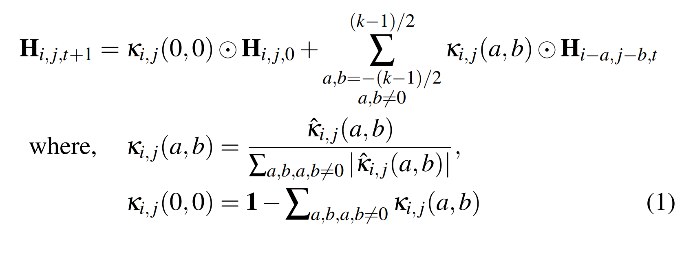
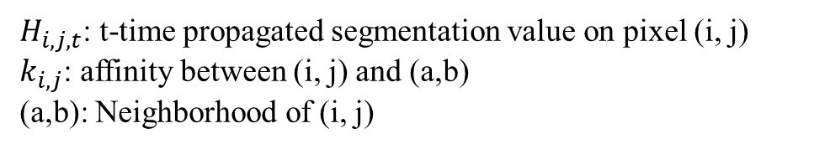
What is CSPN?
$H_{i, j,t}$: t-time propagated segmentation value on pixel (i, j)
$k_{i, j}$: affinity between (i, j) and (a,b)
(a,b): Neighborhood of (i, j)
Cheng et al. “Learning Depth with Convolutional Spatial Propagation Network”

Slide 20
PA3: Implement CSPN
C S
P
N
UNet
Affinity
3 x H x W
9 x H x W (3x3 kernel)
1 x H x W
1 x H x W
Lin et al. “Dynamic Spatial Propagation Network for Depth Completion”

Slide 21




What is DYSPN? – Use Attention
Affinity Matrix
24 x H x W
Attention Matrix
1 x H x W
$$×$$
Affinity Matrix
16 x H x W
Attention Matrix
1 x H x W
$$×$$
Affinity Matrix
8 x H x W
Attention Matrix
1 x H x W
Affinity Matrix
7 x 7 x H x W
$$×$$
New Affinity Matrix
7 x 7 x H x W
Affinity Matrix
1 x H x W
Attention Matrix
1 x H x W
$$×$$
Lin et al. “Dynamic Spatial Propagation Network for Depth Completion”

Slide 22
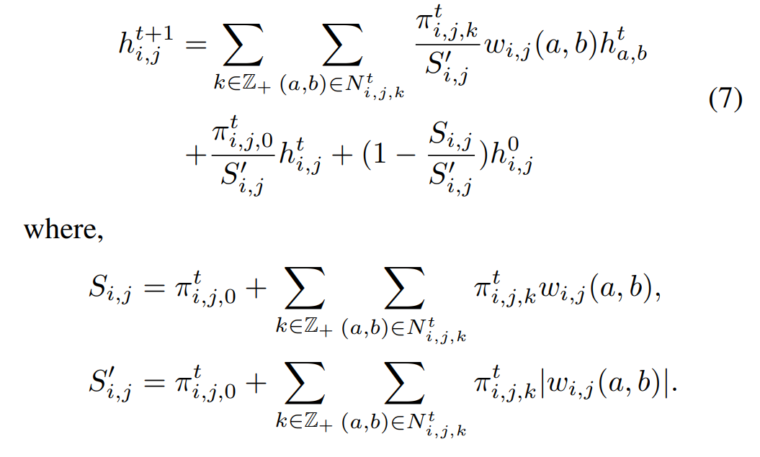
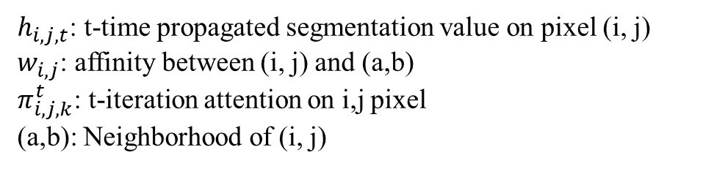
What is DYSPN?
$h_{i, j,t}$: t-time propagated segmentation value on pixel (i, j)
$w_{i, j}$: affinity between (i, j) and (a,b)
$π_{i,j,k}^{t}$: t-iteration attention on i,j pixel
(a,b): Neighborhood of (i, j)
Lin et al. “Dynamic Spatial Propagation Network for Depth Completion”

Slide 23
PA3: Implement DYSPN
DY S
P
N
Attention
UNet
3 x H x W
6 x 4 x H x W (6 iteration)
Affinity
49 x H x W (7x7 kernel)
1 x H x W
1 x H x W
Lin et al. “Dynamic Spatial Propagation Network for Depth Completion”

Slide 24
PA3: Implement DYSPN – Attention
Attention:
Iter x 4 x H x W
Attention varies from iteration to iteration.
(0 ~ 1 Values)

Slide 25
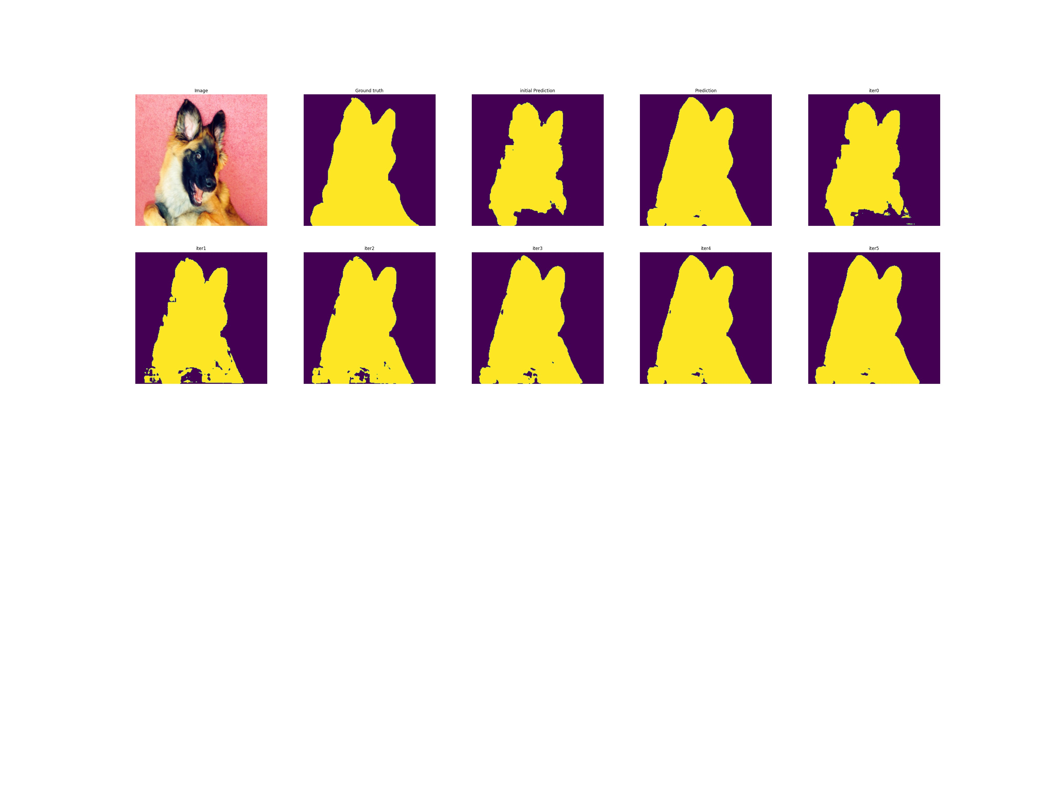
PA3 – What I Give you
Dataset – SimpleOxfordPetDataset
2. Train code
3. CSPN pseudo code
Image
GT

Slide 26
PA3 – What I Give you
Class CSPN()
def __init__()
pass
# affinity: b, 9, h, w (sum to 1 in dimension 1)
# current_segmentation: b, 1, h, w
# coarse_segmentation: b, 1, h, w
def forward(affinity, current_segmentation, coarse_segmentation)
#unfold current_segmentation
current_segmentation_unfold = unfold(current_segmentation) # b, 9, h*w
#replace coarse_segmentation
current_segmentation[x] = coarse_segmentation
#sum
output = current_segmentation_unfold * affinity # b, 9 , h*w
output = sum_properly(output)
return output # b, 1, h, w

Slide 27
PA3 – What I Give you
Affinity = Unet(RGB, Coarse_segmentation)
Current_segmentation = Coarse_segmentation
For i in iteration(N):
Current_segmentation = CSPN(Affinity, Current_segmentation, Coarse_segmentation)
Return Current_segmentation

Slide 28
PA3 – What you have to do
Implement any Unet network
Get coarse segmentation
Implement CSPN based on pseudo code to obtain refined segmentation (Only affinity)
4. Implement DYSPN to obtain refined segmentation (Affinity and attention)
5. Visualize all results (iteration results, final segmentation, attention)

Slide 29
PA3 – What you have to do
Implement any Unet network
Get coarse segmentaion
Image
Coarse Segmentation

Slide 30
PA3 – What you have to do
3. Implement CSPN based on pseudo code to obtain refined segmentation (Only affinity)
C S
P
N
UNet
Affinity
RGB
9 x H x W (3x3 kernel)
Final Segmentation
Coarse segmentation

Slide 31
PA3 – What you have to do
4. Implement DYSPN to obtain refined segmentation (Affinity and attention)
DY S
P
N
Attention
Iter x 4x H x W (7x7 kernel)
UNet
Affinity
RGB
49 x H x W (7x7 kernel)
Final Segmentation
Coarse Segmentation

Slide 32

Guideline
좋은 propagation 시각화를 보기 위해 corase segmentation을 최대한 안 좋게 구하는 것을 추천한다. (val/coarse seg: miou: 0.6 ~ 0.7)
절대적인 성능은 중요하지 않으며, 원래의 coarse segmentation을 좋게 refine 하기만 하면 된다.
Task가 쉽기 때문에 DYSPN의 올바른 구현에도 CSPN과 성능이 비슷할 수 있다. 따라서 성능이 비슷해도 attention의 결과가 합리적이면 점수를 얻을 수 있다.
슬라이드에서 보여준 과정은 이해를 위해 적어 놨고 이를 꼭 따를 필요는 없다. CSPN을 구현할 때 Unfold 함수를 사용하는 것을 매우 추천한다.
Iteration 6을 추천한다.
Unet을 어떤 식으로 사용해도 괜찮다. (단 report에 어떤 모델을 사용하였는지 명시할 것)
제공한 Train 코드를 사용하지 않고 직접 구현해도 괜찮다.
CSPN / DYSPN 논문에 명시된 식과 다르게, 원래의 input값을 치환하지 않는다.
Attention의 시각화에서 semantic한 정보가 담겨있음을 보이면 점수를 얻을 수 있다.

Slide 33
Scoring criteria
Implementation of any Unet (coarse segmentation) (4pt)
Implementation of CSPN (refined segmentation)
a. Get an affinity that sums to 1. (only code check) (3pt)
b. The segmetnation map multiplied by the affinity of the correct position. (only code check) (3pt)
c. Iteratively refine the segmentation (2pt)
d. Show iteration results. (visualization check) (3pt)
e. performance improvement than coarse segmentation (miou check in your report) (2pt)
Implementation of DYSPN (refined segmentation) (Additional)
a. Check if you multiplied attention to affinity correctly. (code check) (1.5pt)
b. Show attention results. (visualization check) (1.5pt)
4. Report (3pt)
Total 20pt + a

Slide 34
Submission
Submission should include…
Source code
Result of your code
Readme file explaining how to execute the program
Report (3pts)
Report should include…
Your understanding of each steps of algorithms
Results
Validation dataset per image_iou: Coarse segmentation, CSPN segmentation
Visualization of each iteration segmentation
Notice
[Delayed submission] Not allowed
[Plagiarism] Definitely F grade for copied codes (from friends or internet)

Slide 35
Example – CSPN
CSPN – Iteartion result
RGB
GT
Coarse Segmentation
Final Prediction
Iteration 1
Iteration 2
Iteration 3
Iteration 4
Iteration 5
Iteration 6

Slide 36
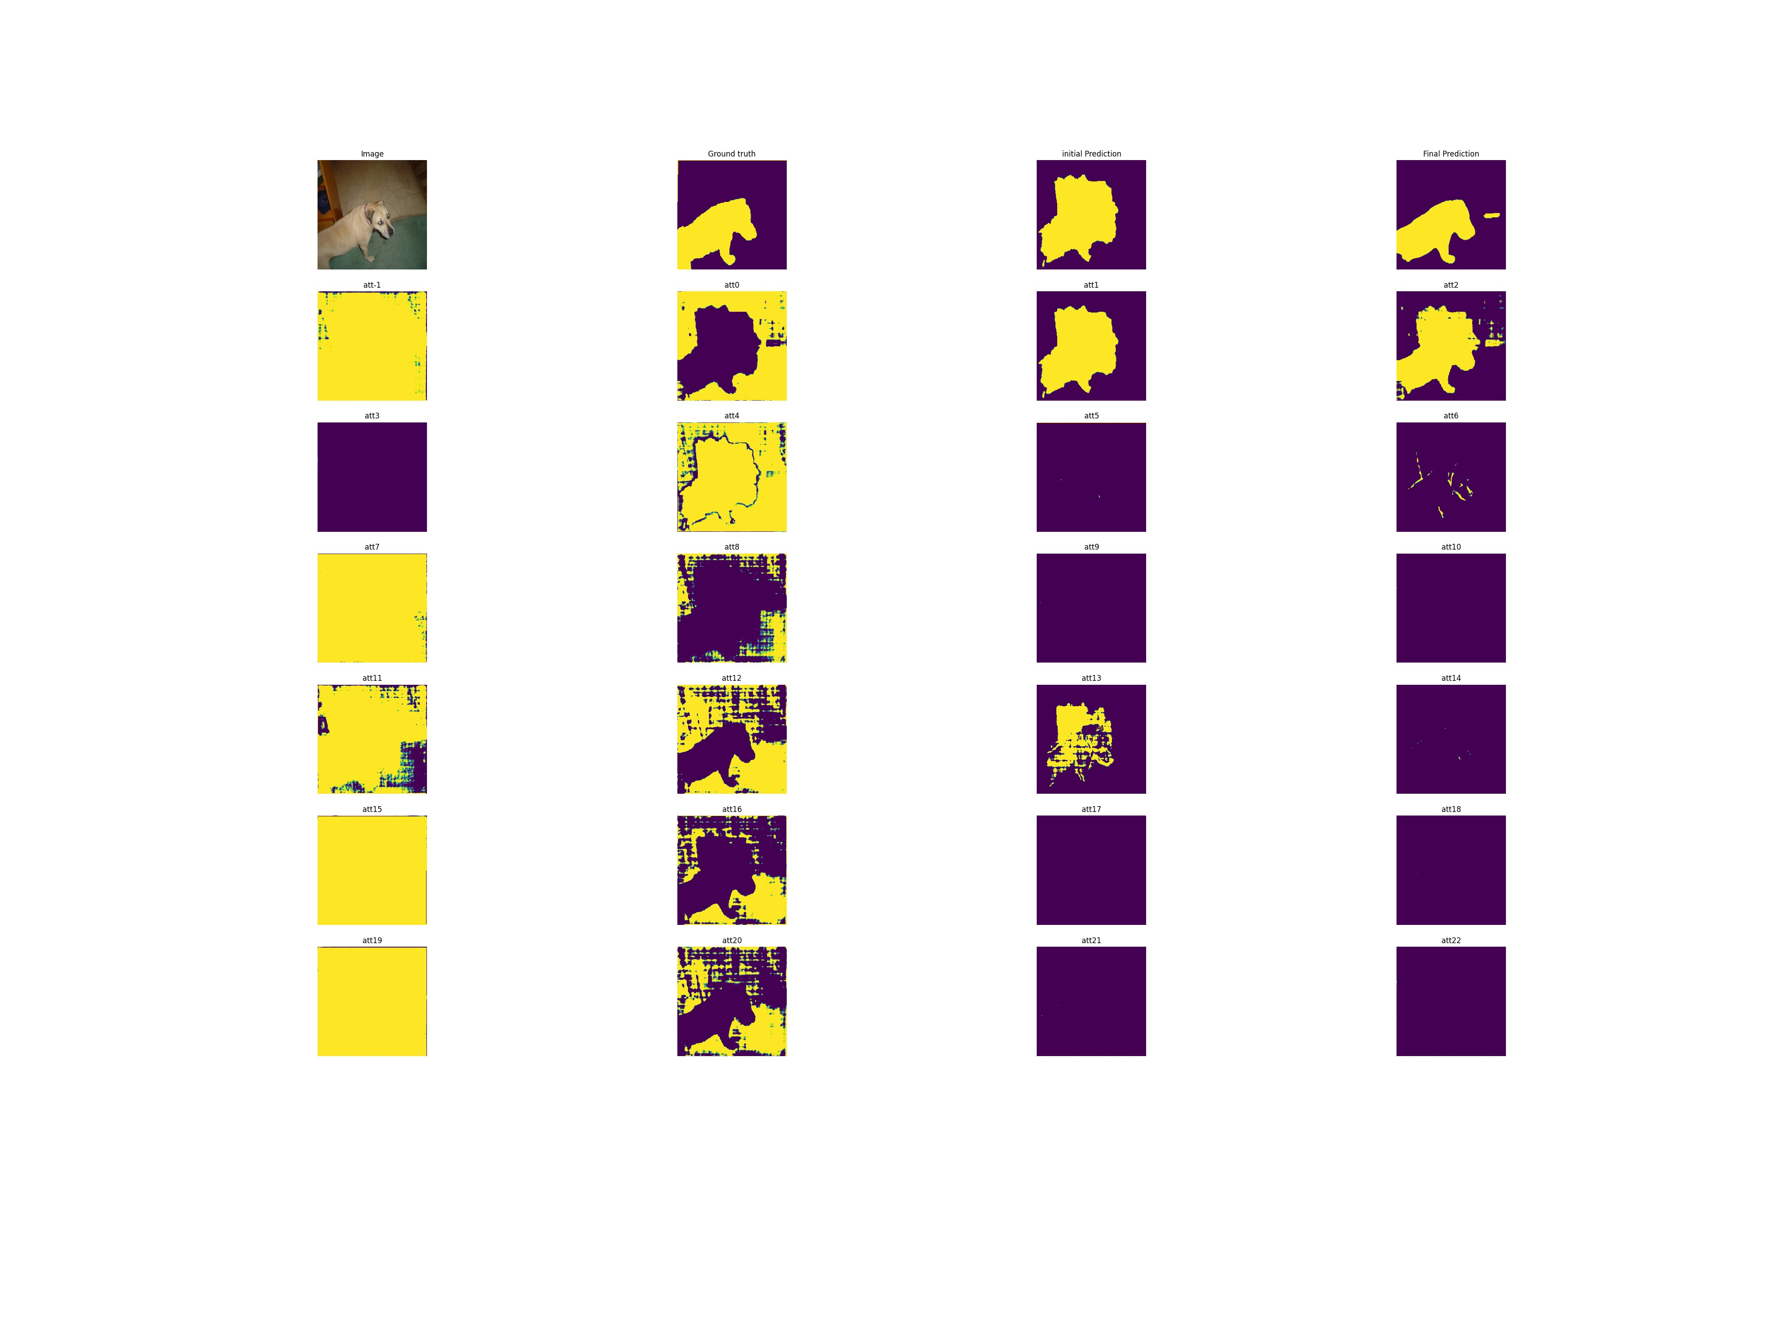
Example – DYSPN
DYSPN - Attention
iter 1
iter 2
iter 3
iter 4
iter 5
iter 6
Kernel 0
Kernel 3
Kernel 5
Kernel 7

Slide 37
Information
Due Date: 12. 9. 11:55pm
NEVER COPY! PLAGIARISM IS STRICTLY FORBIDDEN!
All tricks such as simply changing the name of variables or wrapping into the functions will be regarded to plagiarism.
Please submit codes, results and reports.
Additional credits: up to 5pts ( Best Result / Report 2pts + Ideas for improvement 3pts )
Additional credit can be earned if you submit notable reports, code or results.
If you have any questions about PA3, please contact TA
TA: Chanhwi Jeong (정찬휘)
E-mail: chanhwij@gm.gist.ac.kr
Office Hour: 1:00pm ~ 2:15pm (Tue. & Thu.)
Office Location: Electrical Engineering and Computer Science Building C, Room 405
Call: 062-715-6375

