Slide 2














Slide 3





Slide 5
D'BREED
TEMPLATE
Presentation Design Group - D'Breed
www.dbreed.co.kr

Slide 6
PRESENTATION TITLE
CONTENTS
01.
Contents sub title
02.
Contents sub title
03.
Contents sub title
04.
Contents sub title
05.
Contents sub title
06.
Contents sub title

Slide 7
Presentation Design Group - D'Breed
CONTENTS TITLE
01

Slide 8
D'breed Template
CONTENTS
CONTENTS 1
CONTENTS 2
CONTENTS 3
When I find myself in times of trouble Mother Mary comes to me Speaking words of wisdom Let it be And in my hour of darkness She is standing right in front of me Speaking words of wisdom Let It be Let it be, Let it be, Let it be, Let it be Whisper words of wisdom Let it be

Slide 9
D'breed Template
CONTENTS
When I find myself in times of trouble Mother Mary comes to me Speaking words of wisdom Let it be And in my hour of darkness She is standing right in front of me Speaking words of wisdom Let It be Let it be, Let it be, Let it be, Let it be Whisper words of wisdom Let it be

Slide 10
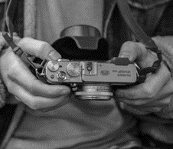

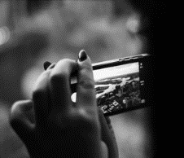
D'breed Template
PEOPLE
When I find myself in times of trouble Mother Mary comes to me Speaking words of wisdom Let it be And in my hour of darkness She is standing right in front of me Speaking words of wisdom Let It be Let it be, Let it be, Let it be, Let it be Whisper words of wisdom Let it be

Slide 11
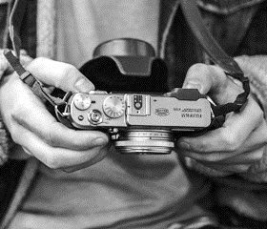


D'breed Template
CONTENTS
CONTENTS
CONTENTS
When I find myself in times of trouble Mother Mary comes to me Speaking words of wisdom Let it be And in my hour of darkness She is standing right in front of me Speaking words of wisdom Let It be Let it be, Let it be, Let it be, Let it be Whisper words of wisdom Let it be
When I find myself in times of trouble Mother Mary comes to me Speaking words of wisdom Let it be And in my hour of darkness She is standing right in front of me Speaking words of wisdom Let It be Let it be, Let it be, Let it be, Let it be Whisper words of wisdom Let it be
When I find myself in times of trouble Mother Mary comes to me Speaking words of wisdom Let it be And in my hour of darkness She is standing right in front of me Speaking words of wisdom Let It be Let it be, Let it be, Let it be, Let it be Whisper words of wisdom Let it be

Slide 12
D'breed Template
CONTENTS
Contents | Contents | Contents | Contents | Contents
Contents | 1,000 | 1,000 | 2,000 | 1,000
Contents | 2,000 | 1,000 | 2,000 | 2,000
Contents | 1,000 | 2,000 | 1,000 | 1,000
Contents | 2,000 | 1,000 | 1,000 | 2,000
Contents | 1,000 | 1,000 | 2,000 | 1,000
Contents | 1,000 | 1,000 | 1,000 | 2,000
Contents | 2,000 | 2,000 | 1,000 | 2,000
Contents | 2,000 | 2,000 | 2,000 | 2,000
Contents | 1,000 | 2,000 | 1,000 | 1,000
Contents | 2,000 | 2,000 | 2,000 | 2,000

Slide 13
THANK YOU
Presentation Design Group - D'Breed
www.dbreed.co.kr

