Slide 1
Self Introduction
Problem statement / Business Case
Code Walk through (POC)

Slide 2
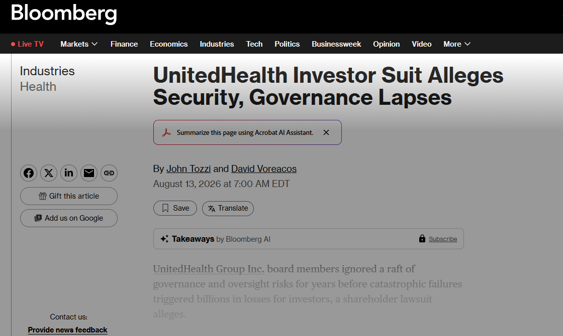
Geopolitical and regulatory
risk intelligence
for
UnitedHealth Group
Identify and validate the Right problem
Architect the Solution
Build, Demo, Refine
Prepare for Launch
Run, Monitor & Improve
AIDLC ->
Discovery
Inception
Construction
Readiness
Operations
5 Layer spine ->
Layer 1 — model
Layer 2 — wrapping
Layer 3 — evals & guardrails
Layer 4 — production & ops
Layer 5 — optimization
non-deterministic component
Knowledge, tools, memory
release gate, moved to the center
latency, cost, observability, rollback
routing, caching, multi agent decision
technical walkthrough
credit to LevelUp Labs
Notes:
1. Discovery — Identify & Validate the Right Problem
Discovery transforms market, user, and operational signals into validated business outcomes. Teams define the opportunity, quantify impact and ROI, and establish measurable success metrics. The output is a prioritized, high‑confidence problem worth solving.
2. Inception — Architect the Solution
Inception converts the validated outcome into a complete solution blueprint. Specifications, architecture, UX, prototypes, and work plans are generated to ensure clarity across engineering, design, and product teams. The result is a build‑ready plan with aligned stakeholders.
3. Construction — Build, Demo, Refine
Construction executes an iterative engineering loop that turns specs into hardened increments. Automated code generation, reviews, testing, and performance hardening accelerate delivery while maintaining quality. Each cycle produces a stable, demo‑ready feature.
4. Readiness — Prepare for Launch
Readiness ensures the product meets operational, compliance, and reliability standards. Release notes, runbooks, monitoring baselines, and readiness scoring confirm that the system is safe and stable for deployment. This phase reduces launch risk and improves predictability.
5. Operations — Run, Monitor & Improve
Operations manages the live AI system with continuous monitoring, automated defect detection, incident response, cost optimization, and risk management.
Insights from production feed directly back into Discovery, creating a closed loop that drives continuous improvement.
Layer 1 The model the one non-deterministic component
Layer 2 The wrapping layer knowledge, tools, memory. knowledge (what the system knows, usually
retrieval over your own data), tools (what the system can do, the typed
actions it can take), and memory (what it remembers across a turn, a task,
and a user).
Layer 3 Evals and guardrails the release gate, moved to the center. This layer is evals (how you measure quality offline and online, and
catch silent degradation) and guardrails (the runtime checks on input and
output that keep a bad generation from reaching a user or an action).
Layer 4 Production and ops serving, latency, cost, observability, rollback. What it takes to run the thing: serving and
scale, the cost, latency, and quality triangle, observability so every step is a
traceable span, and a rollback plan.
Layer 5 Optimization routing, caching, and where multi-agent belongs. Once the system works
and you can measure it, you make it faster and cheaper: model routing,
caching, and, where the task genuinely justifies it, multi-agent orchestration.
Multi-agent lives here because it is an optimization, not a starting
point.

Slide 3
FRAMING
The problem, and what this walkthrough is meant to show
The business problem
UHG operates across Optum Health, Optum Insight, Optum Rx, and related segments under one roof, generating $447.6B in revenue
44% of that revenue comes directly from CMS — regulatory and policy risk isn't a side consideration here, it's close to the central one
Today: comparing exposure across segments is manual, inconsistent, and produces no audit trail
This project: one auditable risk and opportunity score per business driver per segment, in minutes instead of days
Analysts and executives need a consistent, auditable answer to:
“How exposed is segment X to disruptor Y — and what pathway should we consider?”
Shared disruptors: Medicare/regulatory changes, cyber/data risk, political volatility
Today: spreadsheets or unconstrained LLM chats — neither is governed or reproducible

Slide 4
SCOPING
Problem - first scoping, before any architecture
Dimension | Answer
User and their pain | Segment finance/strategy leads and executive leadership, both self-serve. Today: manual reconciliation of a cardinal score against two ordinal ranking systems, inconsistent, no audit trail.
Outcome, written before the system | A natural-language scenario question answered in minutes with every number traceable to a source indicator and formula.
AI intervention, narrowed | Three LLM steps only: query parsing, event-to-schema extraction, narrative generation. Everything else is deterministic.
System and safety | The model never generates a score. Overlay events are staged pending human confirmation. A confidence floor blocks low-confidence recommendations. Access is role- and segment-scoped.
Notes:
This is the scoping discipline from the system-design methodology being used — name the user, write the outcome before the system, narrow the AI intervention until it hurts, and name the safety net at scoping time.

Slide 5
What this POC shows
A designed framework adapted to UnitedHealth Group
End-to-end ownership — scoped, designed, built, and pressure-tested (for the today’s demo – not fully vetted)
Deterministic quant core produces scores; LLMs do narrow, bounded tasks only
Fail-closed guardrails: refuse when out of scope, unauthorized, or low confidence
Human-in-the-loop for high-judgment overlay extractions (always staged first)
One-line thesis: governed risk intelligence — numbers from code, not from chat
Note: No proprietary UHG data used.

Slide 6
Source & ontology layer
Three sources, mapped into one common taxonomy before any math touches them
Hazard source (S&P): 6 categories,
22 subfactors
Structural source (IMD WCY): 4 categories, 20 subfactors
Digital source (IMD WDCR): 3 categories,
9 subfactors
Cardinal · event-driven
Ordinal · annual
Ordinal · annual
Political Policy Instability State failure Government Instability
Economic Recession Inflation Currency depreciation Capital transfer Sovereign default Under development
Legal Exportation State contract alteration Contract enforcement
Taxation Tax increase Tax inconsistency
Operational Consumption Regulatory burden Labor strikes Infrastructure disruption
Security Protests and riots Terrorism Interstate war Civil war
Economic Performance Domestic Economy International Trade International Investment Employment Prices
Government Efficiency Public Finance Tax Policy Institutional Framework Business legislation Social Framework
Business Efficiency Productivity Labor Market Finance Management Practices Attitudes and Values
Infrastructure Basic Technological Scientific Health and Environment Education
Knowledge Talent Training and Education - Scientific Concentration
Technology Regulatory Framework Capital Technological Framework
Future Readiness Adaptive Attitudes Business Agility IT Integration
POLICY
SYSTEM QUALITY
INTEROPERABILITY
CMS Medicare Advantage rate notice
State health-system performance rank
Health-data interoperability maturity rank
Capital (3)
Demand (2)
Demand (2)
Infra (1)
Data/Digital (3)
POLICY
ACCESS
COMPLIANCE
PBM / drug-pricing rulemaking
State Medicaid eligibility/
redetermination rank
HIPAA enforcement-activity rank
Capital (2)
Supply (2)
Demand (3)
Data/Digital (2)
Brand/Rep (1)
ENFORCEMENT
WORKFORCE
CMS/OIG enforcement action
Clinical labor-market tightness rank
Brand/Rep (3)
Capital (1)
Talent (3)
SECURITY
Health-data breach disclosure
Data/Digital (3)
Brand/Rep (2)
Common driver taxonomy — every indicator above loads onto one or more of these 7 drivers
Demand
Supply
Infrastructure
Data & Digital
Capital
Talent
Brand/Reputation
Notes:
This is the real Layer-1 indicator registry from the code (src/quant_core/ontology.py), not illustrative content. Each row now shows the full path the original framework itself uses — category (factor) above, specific subfactor below, e.g. 'POLICY → CMS Medicare Advantage rate notice' — mirroring how S&P and IMD structure their own raw data (S&P: 6 categories / 22 subfactors; IMD WCY: 4 factors / 20 subfactors; IMD WDCR: 3 factors / 9 subfactors) before this project's own registry adapted a smaller, purpose-built set for a payer. The point of this slide: raw fields from three structurally incompatible sources all get mapped into the SAME seven-driver taxonomy before any transform or weighting touches them. That ordering matters: meaning is standardized first (this slide), scale is standardized second (harmonize.py), and weights are computed last (weighting.py) — mixing those steps out of order is exactly the 'ontological fragmentation' problem the source framework was designed to solve. If asked why an indicator loads on more than one driver (e.g. the CMS MA rate notice loading on both Capital and Demand), the answer is that the loading scale is 0-3 relevance, not a one-hot category — a single event can matter to more than one driver at different strengths.
CMS – Center for Medicare & Medicaid Services
MA – Medicare Advantages
IMD – International Institute for Management Development

Slide 7
THE BUSINESS
UnitedHealth Group segments, FY2025
Component | FY2025 revenue | YoY | Primary disruptor relevance
UnitedHealthcare - Medicare & Retirement | part of $344.9B UHC total | - | CMS rate policy (D6)
UnitedHealthcare - Community & State (Medicaid) | $94.4B | +17% | State/federal policy (D6)
UnitedHealthcare - Employer & Individual | part of $344.9B UHC total | - | ACA/commercial policy (D6)
Optum Health | $102.0B | -3% | CMS reimbursement (D6)
Optum Rx | $154.7B | +16% | Drug-pricing/PBM policy (D6)
Optum Insight | $19.4B | +4% | Data/cyber regulation (D3)
Consolidated FY2025 revenue: $447.6B. 44% of revenue is CMS-derived — the structural fact that reweights this framework toward D6 and D3 and away from the trade/conflict disruptors that dominated the original automotive design.
Notes:
this is a deliberate re-weighting of the six disruptors to the business, not even coverage for its own sake.

Slide 8
METHODOLOGY
The five-layer spine
1
The model
The one non-deterministic component. Smallest model that clears the bar for each job.
Fast model: parse & narrate
Strong model: overlay extraction
Structured output only
2
Wrapping layer
Knowledge, tools, memory — most design time goes here.
Knowledge: indicator registry
Tools: typed & narrow
Memory: session-scoped
3
Evals and guardrails
The center of the design, not a final check, because the model is non-deterministic.
Guardrails: confidence floor, staging
Evals: double-rated ground truth
Validated via real backtest
4
Production and ops
Serving, cost/latency/quality tradeoffs, observability, rollback.
Latency & cost targets
Observability: traceable spans
Rollback: versioned params
5
Optimization
Routing, caching, and — last, and only if earned — multi-agent.
Semantic caching
Model routing
No multi-agent by default
Notes:
As per the five-layer spine, evals/guardrails move to the center rather than being a final QA pass, and multi-agent is explicitly the last resort, not a default. Both are direct rebuttals to the most common design mistakes in this space. Note: observability lives under Layer 4 (production and ops) here, not Layer 3 — Layer 3 owns guardrails and evals specifically; this separation is deliberate, not an oversight.

Slide 9
AI DLC × five-layer spine
Where each lifecycle phase does its heaviest architectural work
operational insight feeds back into the next Discovery pass
1
2
3
4
5
Discovery
Inception
Construction
Readiness
Operations
Validate a problem worth solving
Spec, architecture & prototype
Build-demo-refine to a hardened increment
Prepare environment, confirm compliance
Run, monitor, improve, feed back
Opportunity Scanner · Outcome & Metrics Definer
Spec & Eval Generator · Architecture Mapper
Build-Demo-Refine Copilot · Test Generator
Deployment Readiness Scorer · Runbook Generator
Production Monitoring Agent · Cost Optimization Agent
Layer 1 · model
Layer 4 · ops
Layer 3 · seeds evals
Layer 2 · wrapping
Layer 3 · runs evals
Layer 4 · production
Layer 5 · optimize
Layer 1 — model
Layer 2 — wrapping
Layer 3 — evals & guardrails
Layer 4 — production & ops
Layer 5 — optimization
Notes:
Discussing how AI DLC and five-layer spine fit together. They are not different. AI DLC is a process timeline for how AI-assisted teams build products; the five-layer spine is an architecture anatomy for a single AI system, different kinds of frameworks, so this is 'which layer is the primary focus at this point in the process,' not a strict 1:1. Discovery and Inception both seed Layer 3 (evals) before Construction runs them, evals aren't bolted on at the end in either framework, which is exactly the discipline the book argues for. The representative-skill names under each phase are taken directly from the AI DLC source document, not invented for this slide.

Slide 10
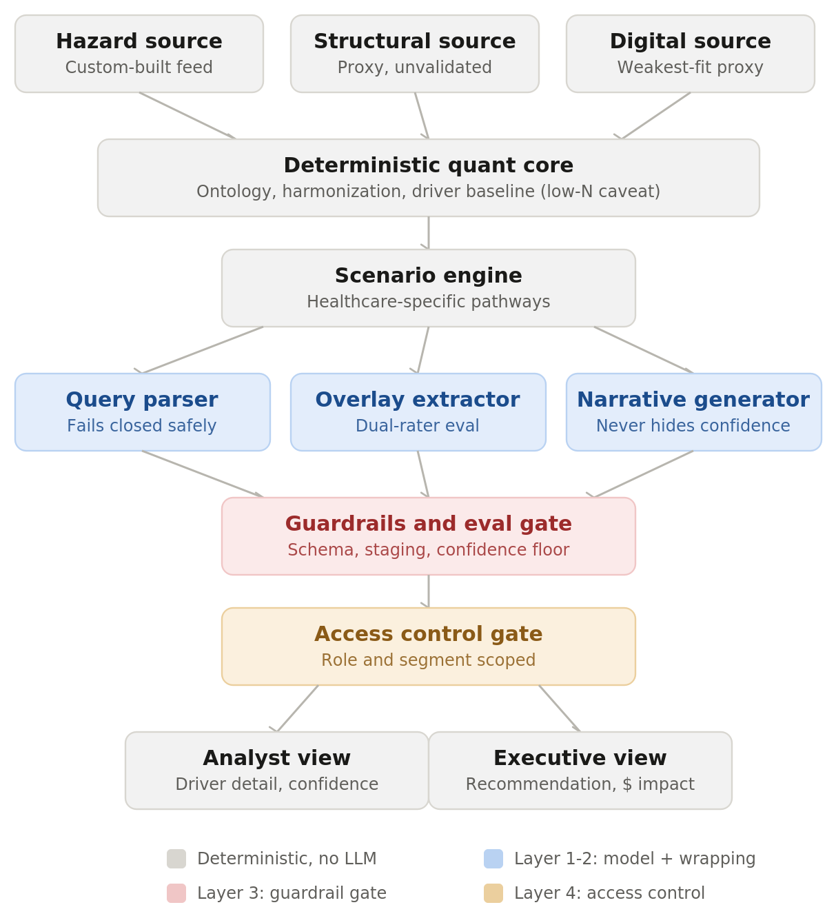
ARCHITECTURE
The full pipeline for the current POC
Notes:
The key visual point: most of the pipeline is gray (deterministic, no LLM).
Only one tier is blue (the AI layer), and
it's immediately followed by a red guardrail gate before anything reaches a person. Honestly AI is in three narrow places, on purpose. And this is for PoC.

Slide 11
Closing
Deterministic scoring at the center · LLMs in narrow roles · Guardrails that fail closed
Human confirmation where judgment matters · Clear path from POC to validation
POC code — available to walk through.
Notes:
Bridge to a live code walkthrough if the panel wants to go deeper.

Slide 12
LAYER 1
The model — two tiers, contained non-determinism
Query parsing & narration
Overlay extraction
Small, fast model. Forced into structured output — a parsed query or a narrative template — so its non-determinism is contained by schema validation, not trusted on faith.
Stronger model. Harder judgment call — reading a policy notice or incident disclosure into a 10-field structured schema. Paired with a mandatory human-review gate before anything it produces goes live.
LAYER 2
Knowledge, tools, memory
Component | Design
Knowledge | Indicator registry and driver baselines, re-scoped from country-level to federal CMS policy, state Medicaid policy, and a thin international/supply-chain layer. Structured knowledge, not document RAG — the one retrieval-style use is surfacing recent news for overlay extraction.
Tools | Deliberately narrow, typed set: get_driver_baseline, run_scenario, get_component_impact, propose_overlay_event. One workflow, not four.
Memory | Session-scoped scenario state only, so a user can chain follow-up questions. No long-term user memory in v1 — nothing in the problem calls for it.
Notes:
The model-selection logic: match model strength to the cost of being wrong, not to task difficulty alone. Parsing and narration fail visibly (a validation error, a template that reads oddly); overlay extraction fails silently if wrong, which is why it gets both the stronger model and the human gate.

Slide 13
LAYER 3
Evals and guardrails — the center of the design
Guardrails
Evals
The model never generates a score, only structured inputs a deterministic engine consumes
Every parsed query is schema-validated before it reaches the quant core
Overlay events are staged, never live, until a human confirms
A confidence floor blocks a pathway recommendation from surfacing at all
Query parsing: labeled NL question to structured-object accuracy, run on every deploy
Overlay extraction: graded against double-rated ground truth, not a single label, since two analysts would plausibly disagree by ±1 point
Core validation eval: backtest driver baselines against real, disclosed financial outcomes
LAYER 4
Production and ops — targets, not measured numbers
Concern | Target design
Latency | Deterministic quant core: sub-100ms (cached, refreshed on source cadence, not per query). Query parse: target <500ms. Narrative generation: target <800ms. End-to-end cached query: target 1-2s.
Cost | Scales with user queries (1-2 small-model calls per session for parse and narrate), not with dataset size — the right property for a many-user, self-serve system.
Observability | Every scenario run is a traceable span: parsed query to resolved segment to driver-baseline version to weight version to final score. 'Why did this number change' has a real, logged answer.
Rollback | Parameter sets (severity-curve constants, blend weights, betas) are versioned. A bad recalibration is a revert, not a fire drill.
Labeled explicitly as target SLAs from the design, not measured production numbers — consistent with this being a designed-but-unvalidated system.
Notes:
This layer is positioned at the center of the design, not as a final QA pass, which is the single biggest methodological difference from a naive build. Say explicitly: the eval design changed with the domain — a healthcare policy backtest, not a generic accuracy benchmark.

Slide 14
LAYER 5
Optimization — and why not multi-agent
What's actually used
Why not multi-agent
Semantic caching on narrative generation
Model routing — straightforward parses to a cheap model, ambiguous ones escalate
Cache invalidation tied to source-refresh events, never a fixed time window
Nothing about this problem is a reasoning-decomposition task. The pressure this system is under is scale and latency from many concurrent users — a caching and routing problem, not a reasoning problem. Multi-agent is earned by task shape, not reached for because the system is under load.
Notes:
This is a direct answer to 'why single pipeline instead of multi-agent,' which was explicitly discussed and pressure-tested earlier in the design process. Keep the answer anchored to task shape, not to a general skepticism of multi-agent systems.

Slide 15
KNOWN LIMITATIONS
Deliberate scope decisions
Data sourcing is a build, not a buy
No off-the-shelf equivalent exists for a CMS regulatory hazard feed.
Scoped explicitly as a construction workstream.
Objective weighting breaks down at low N
Entropy/CRITIC needs a large cross-section (211 countries originally); ~6 segments here isn't enough. Falls back to documented, expert-elicited weights.
Response pathways were redesigned, not relabeled
Divest/Decouple/Double-Down doesn't map to payer economics.
Healthcare-specific pathways replace it.
Notes:
Frame the whole slide as: naming a limitation you scoped on purpose is a stronger answer than being caught by one you didn't see. Don't rush this slide — it's the most differentiated material in the deck.

Slide 16
VALIDATION
The backtest plan
1
Pull driver baselines the framework would have produced for Optum Health in early 2025
2
Compare against the actual disclosed swing: $7.8B operating profit to a $278M loss
3
Pull driver baselines for Optum Insight ahead of the 2024 Change Healthcare cyberattack
4
Compare against the actual disclosed impact on that segment
5
Double-rate a sample of overlay-extraction events with independent analysts to set the eval baseline
Notes:
Emphasize this is a real backtest against disclosed, independently verifiable numbers — not a synthetic benchmark. This is the credibility anchor for the whole result story.

Slide 17
Design choices
Likely follow-ups
Question | Short answer
Why not multi-agent? | Nothing here is a reasoning-decomposition task; the real pressure is scale/latency, which is a caching and routing problem.
How would you validate this? | Direct backtest against two real, disclosed events (Optum Health earnings swing, Change Healthcare cyberattack).
Biggest risk in this design? | Objective weighting breaking down at low N; mitigated with documented expert-elicited weights, named as a real compromise.
Why scope out state-level Medicaid? | Real added scope (4th knowledge source, new aggregation layer, coverage-floor policy); named explicitly rather than shipped quietly incomplete.
Where does the LLM touch a number? | Nowhere. It parses, extracts, and narrates — every number comes from the deterministic core.
Notes:
These five are the ones prepared in full in the written narrative doc. If something outside this list comes up, use the same move: name the gap plainly, explain the tradeoff, state what the next version looks like.

Slide 18
Live Demo — Core Query Path
Happy path
python demo.py query "How exposed is Optum Health to a Medicare Advantage rate cut?"
Shows: segment, driver, disruptor
Deterministic risk / opportunity scores
Recommended pathway + analyst narrative
Numbers are reproducible; LLM only structures & summarizes
Executive audience
python demo.py query "How exposed is Optum Insight to a cyber disruptor?" --audience executive
Same pipeline, one-sentence executive summary
Same scenario object — different presentation layer

Slide 19
Live Demo — Guardrails (Fail Closed)
Out of scope: query "Should I buy NVIDIA stock?" → out_of_scope
Retired segment: "Optum International" → unknown_segment (no silent substitution)
Access control: --role guest + Optum Insight → access_denied (guest → Optum Rx only)
Confidence floor: --sparse-data Capital → no pathway; narrative shows caveat
System refuses rather than force-fitting or over-confident recommendations

Slide 20
Live Demo — Overlay Extraction (Human in the Loop)
python demo.py overlay --segment Optum_Insight --driver Data_Digital
Optional: --live-search (Tavily) or --mcp-search
Flow: text in → LLM rates severity / immediacy / persistence
Status is always STAGED — never live until analyst confirms
Second confirmation attempt is rejected (invalid_transition guardrail)
Connects to real anchor: 2024 Change Healthcare cyberattack (Optum Insight)

Slide 21
Live Demo — MCP Supplemental Tools
python demo.py tool list
python demo.py tool call local.get_backtest_anchors
python demo.py tool call yfmcp.yfinance_get_ticker_info --symbol UNH
python demo.py query "..." --mcp-context
Formatted analyst / executive summaries — not raw JSON dumps
Explicitly non-authoritative: does NOT change scenario scores
Phoenix traces: mcp.call_tool spans when OBSERVABILITY_BACKEND=phoenix

Slide 22
Data Provenance
Real (public)
Segment revenue — UHG FY2025 SEC / earnings
Backtest anchors — Medicare Advantage(MA) rate impact (Optum Health)
Change Healthcare cyberattack (Optum Insight)
Synthetic (illustrative)
Indicator registry & driver loadings
Expert-elicited weights
Sample overlay event texts (paraphrases)
No proprietary or internal UHG data required

