Slide 1
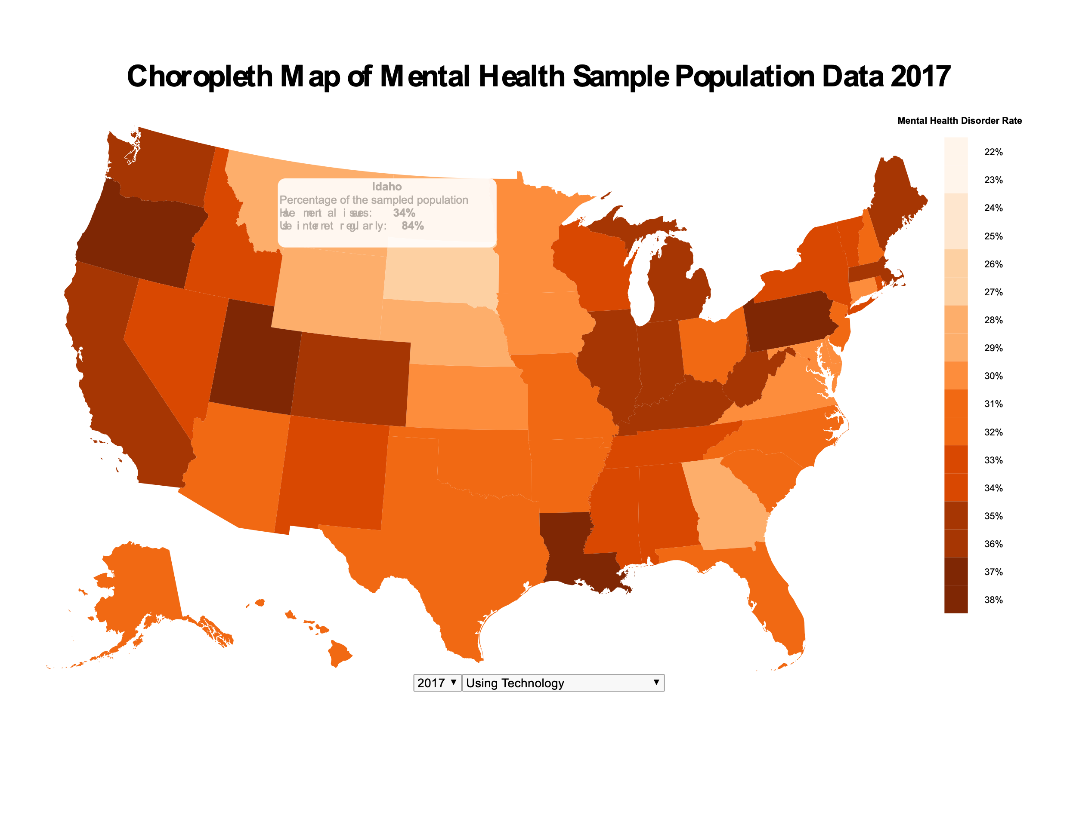

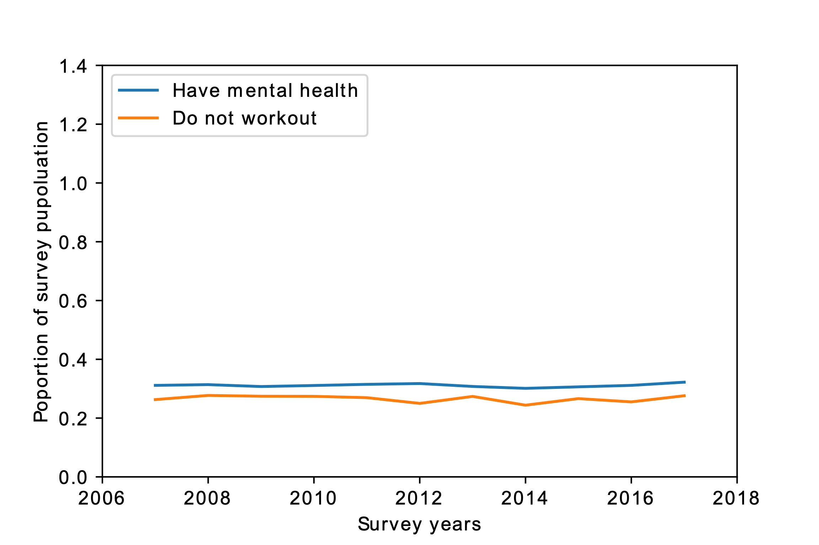
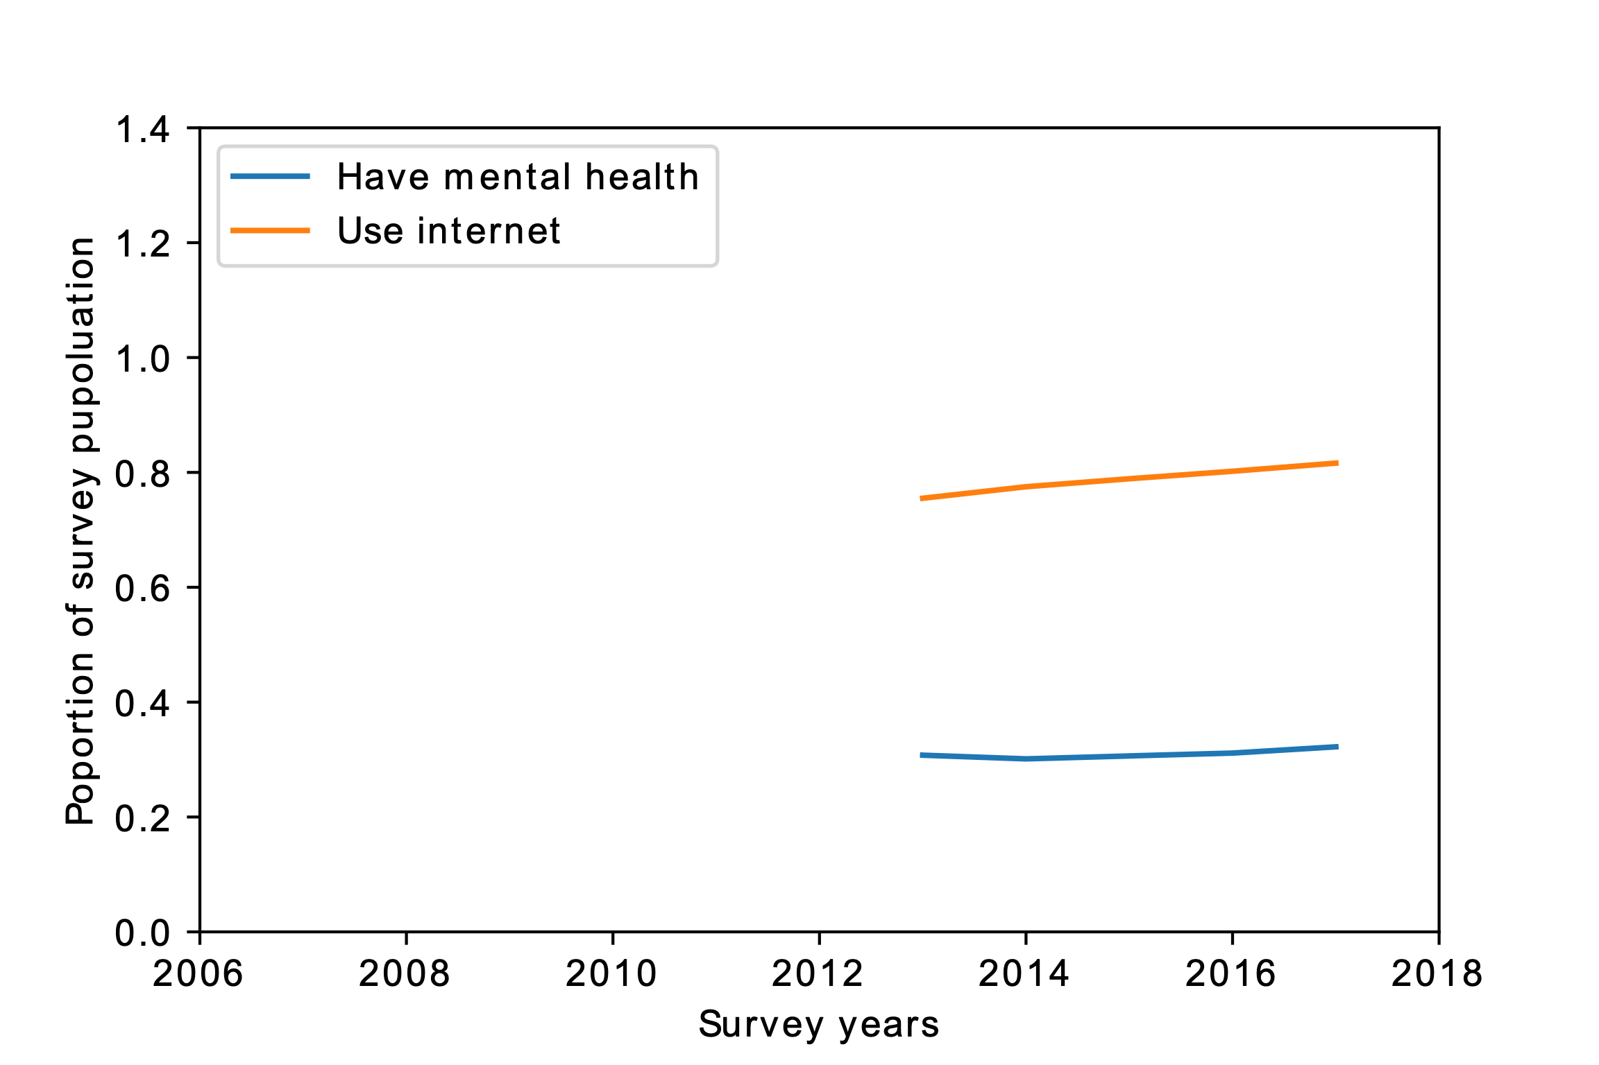


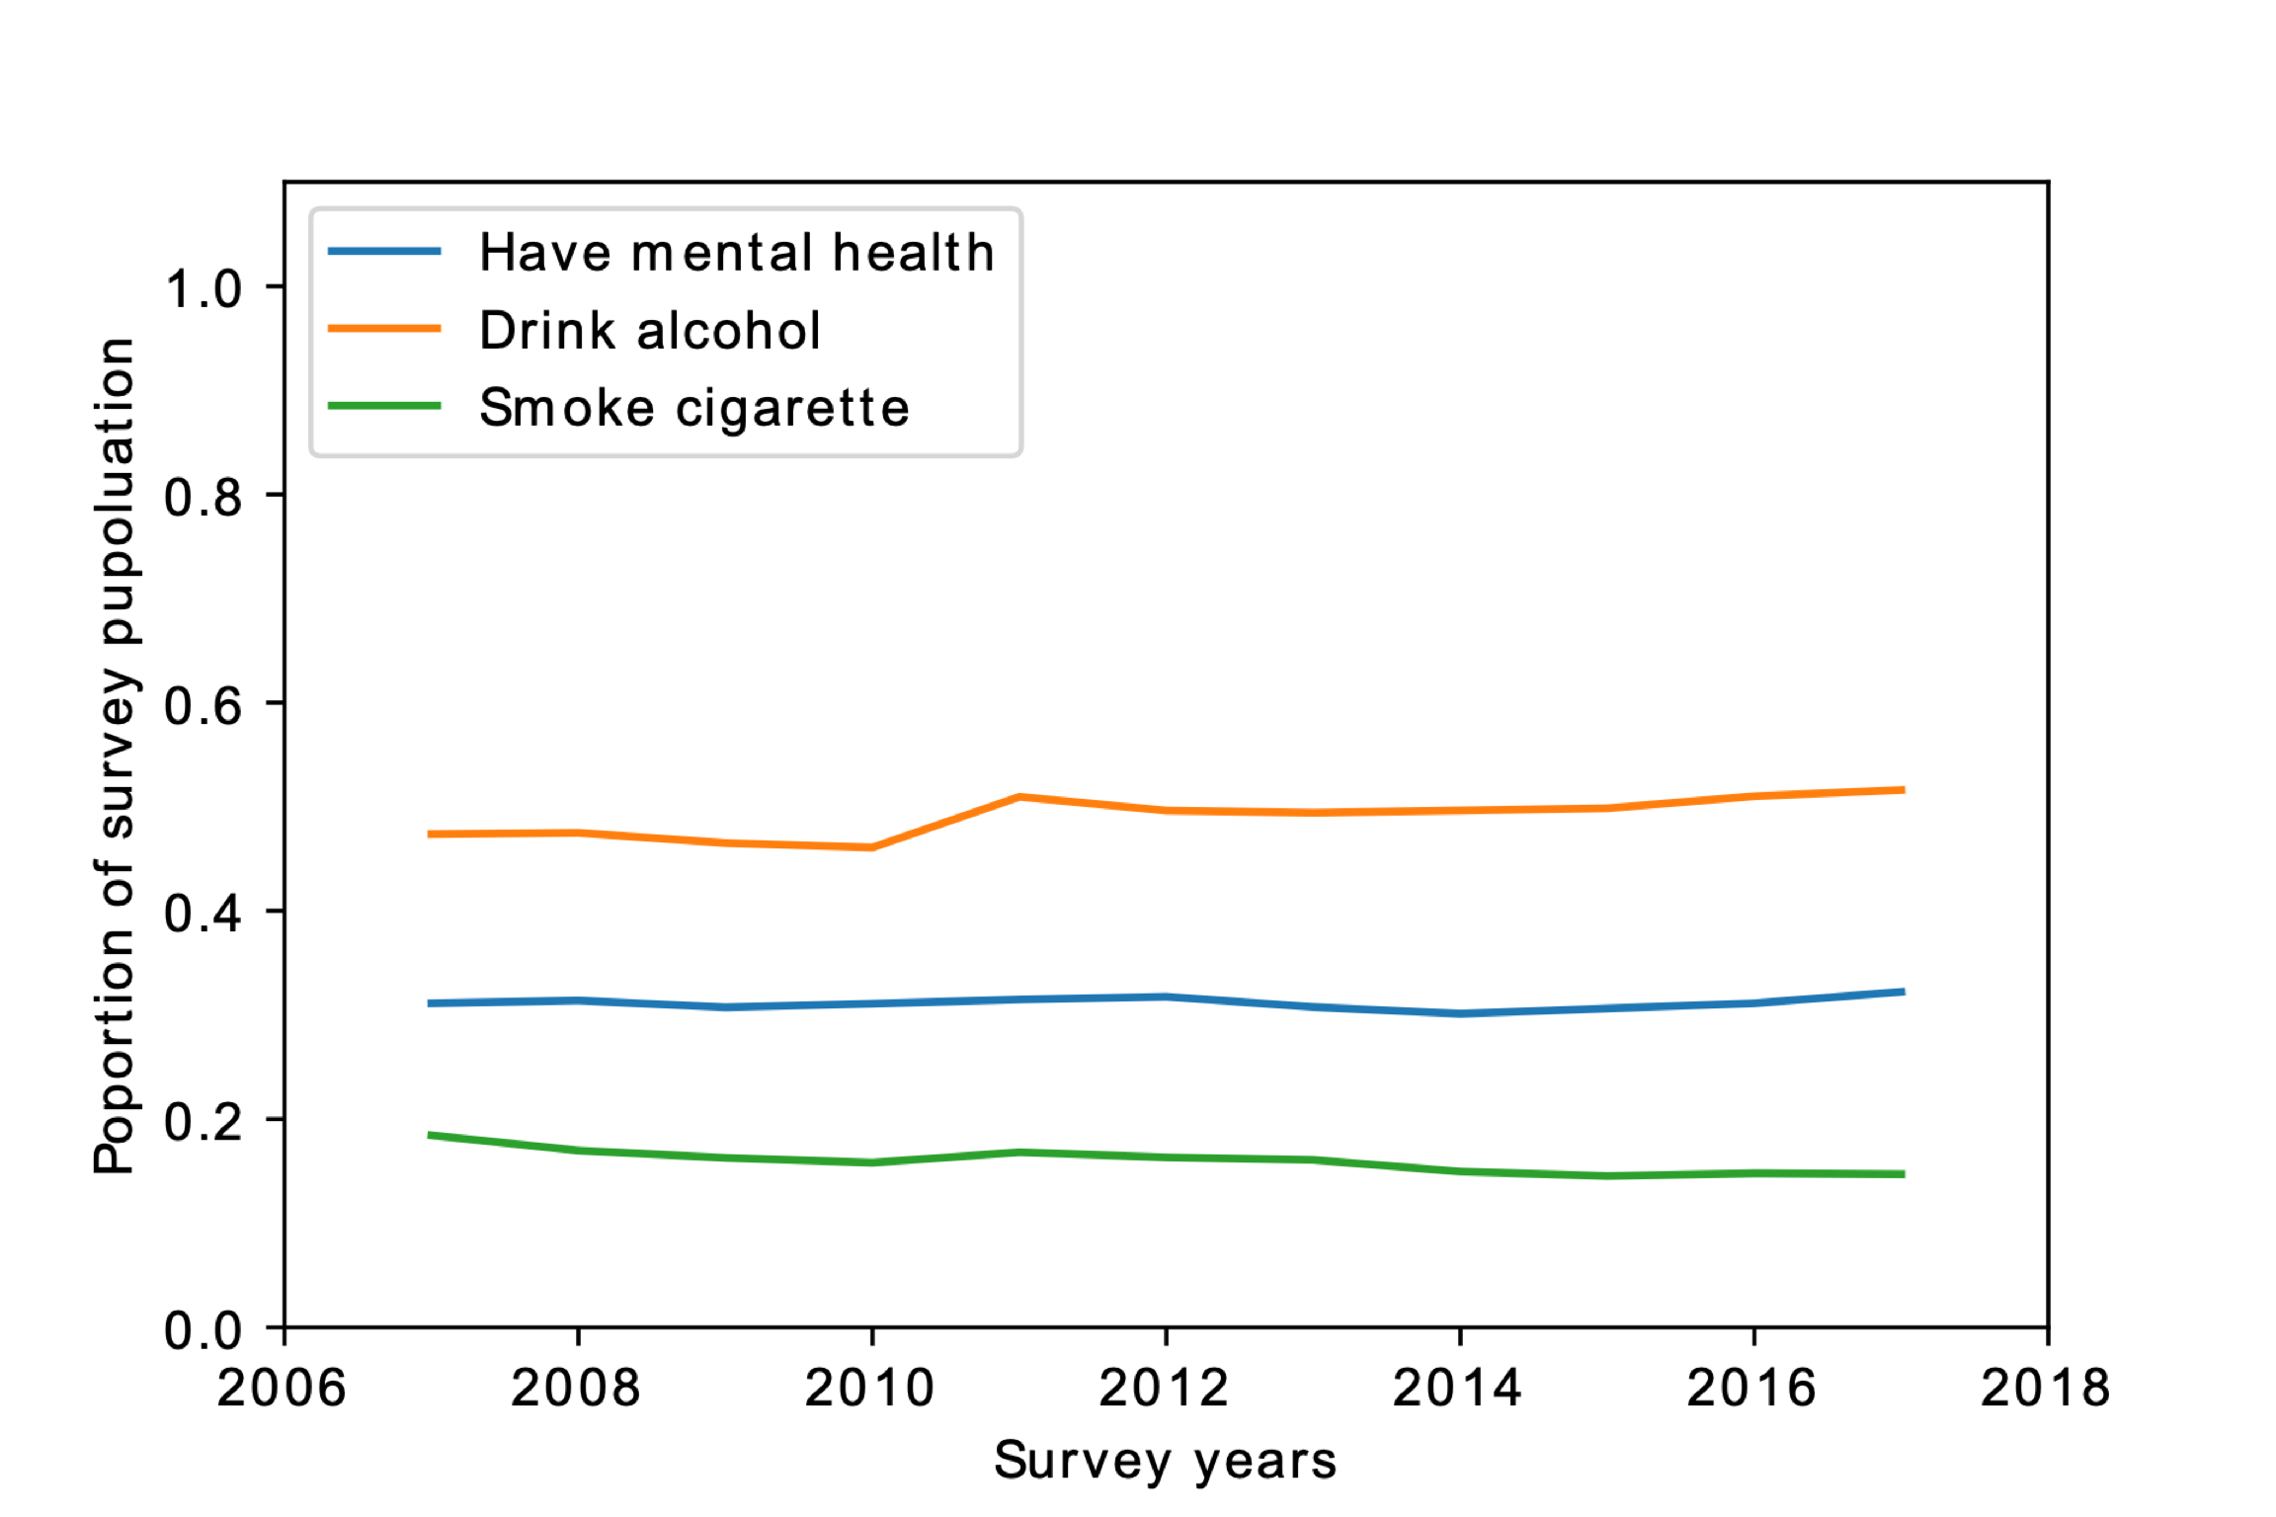
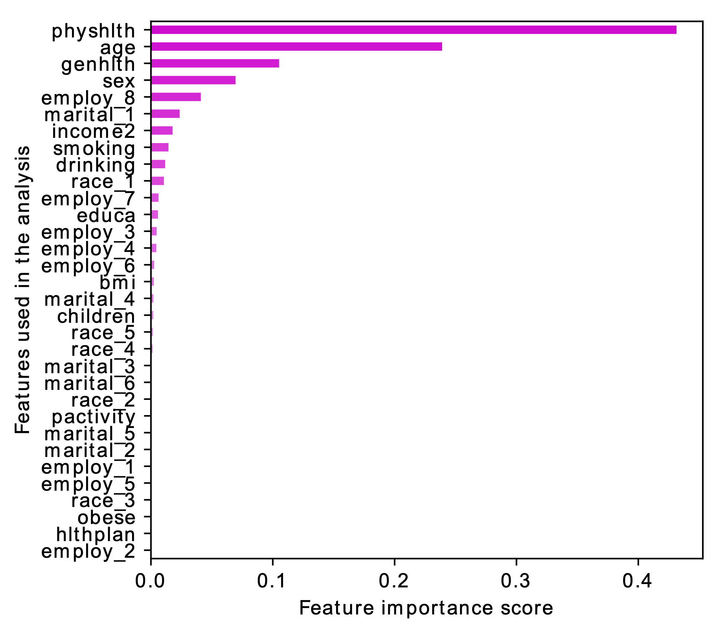
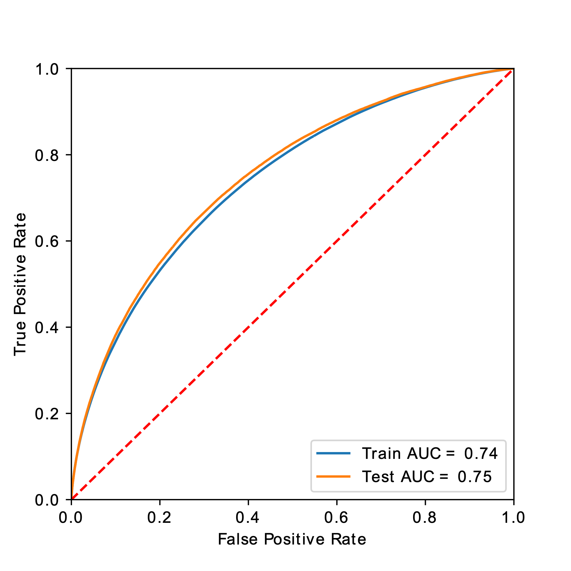
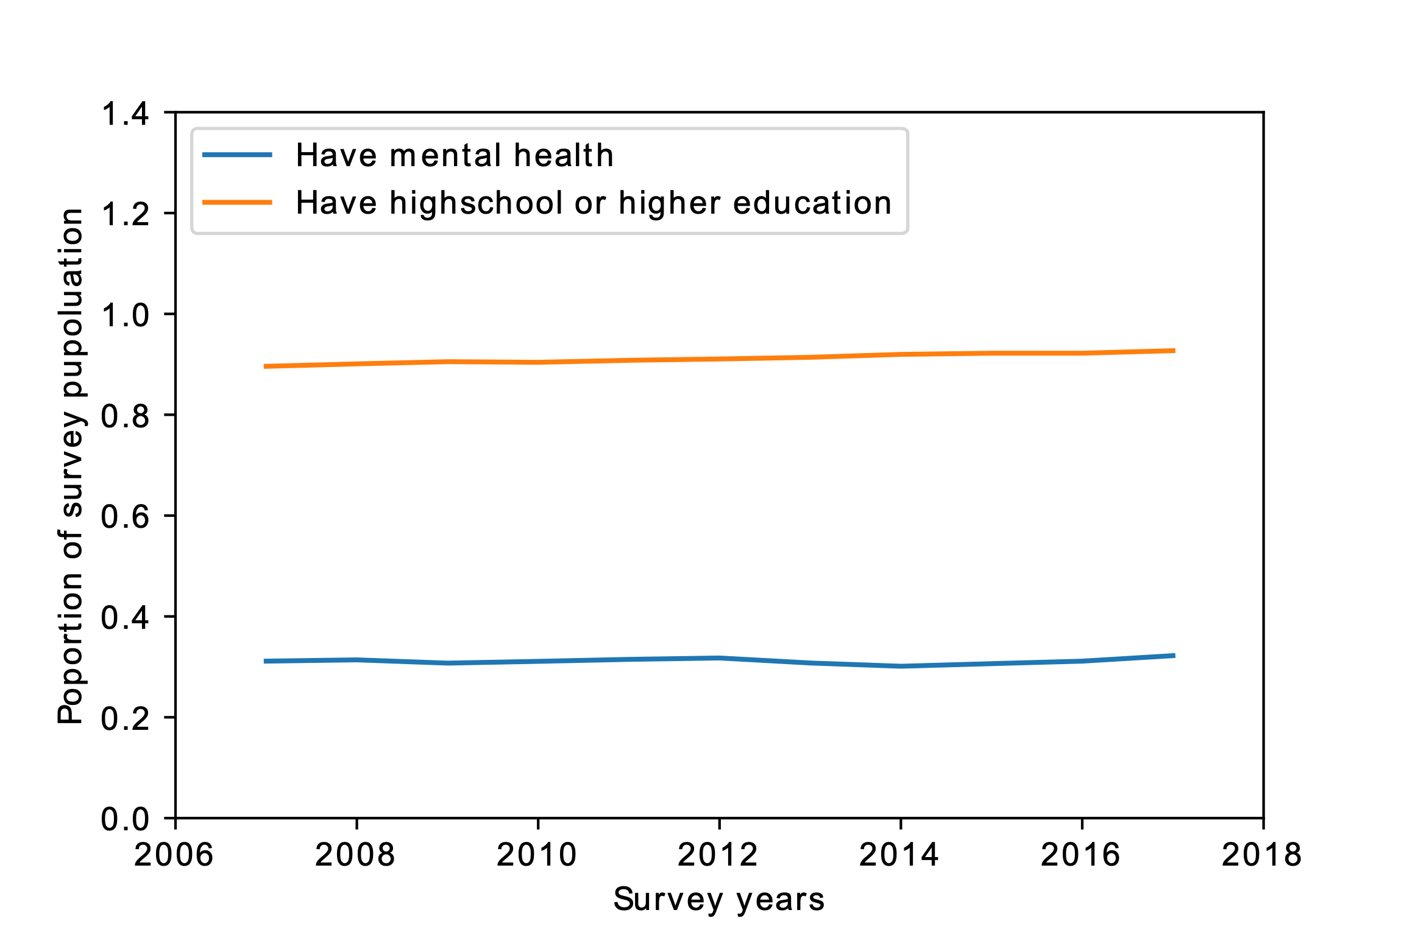


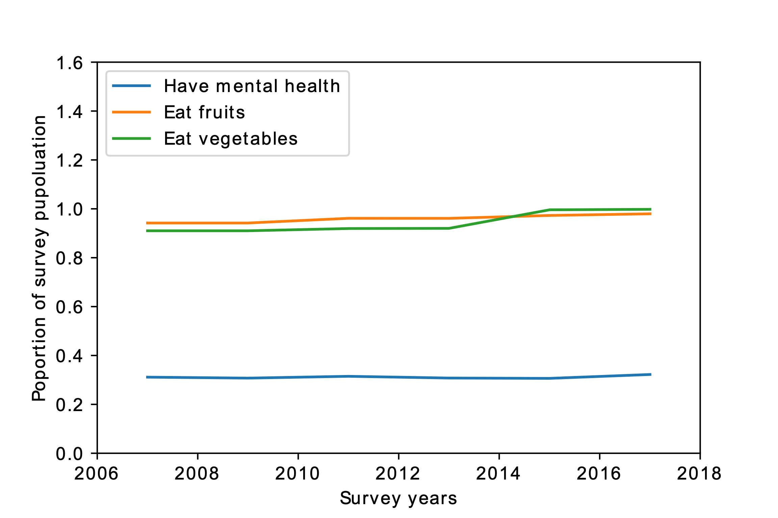


Lowering Depression and Anxiety A Quantitative Research on the Effects of Six Common Behaviors on Human’s Mental Health
Dang Quang Hoang, Karthikeyan Marikrishnan, Yuqing Ren, Muhammad Hamza Raza, Hadi Sharifi | CSE6242| Georgia Institute of Technology
Motivation / Introduction
Research Novelty
Physical Activity vs Mental Health
Depression and anxiety are two widespread types of disorders that cause a tremendous consequence on human life. The World Health Organization (WHO) has ranked depression as the fourth leading cause of human disability. By 2020, it is expected to be the second leading cause [19].
Depression causes health complications [32], cardiovascular diseases [14], in some cases increases the risk of cardiovascular diseases by 80% [25]. In case of anxiety, on average, up to 33.7% of the human populations experience it in their life time [12].
To have a healthy society, we need to address mental health issues. In order to address them, we need to better understand what causing them.
The novelty of this research is that, we examined six behavior factors while usually few factors are examined. We statistically showed the effect of these factors on mental health. And above all, we produce a ML/DL models that could predict mental health.
The Data
Internet vs Mental Health
We used 11 years of BRFSS data (9GB from 2007 to 2017). We obtain the data in SAS XPT format and we converted it to SQLite tables.
We used the database to extract the data we needed. The extracted data were saved in CSV files. Due to the large size of database, we kept the SQLite database available online.
Hypothesis
Experiments and Results
Our research hypothesis is that human behavioral factors such as smoking, drinking alcohol, eating unhealthy, physical activity, education/knowledge, and social media/internet factors has direct effect on the mental health mainly depression and anxiety.
The results of statistical analysis of BRFSS data from 2007 to 2017 of the effects of six factors on mental health (depression and anxiety). The analysis of data was our evaluation method of the research hypothesis.
We used ML/DL analysis to produce a prediction model. To prune features, we used Random Forest feature importance, applied PCA using the first 24 principle components, used MINMAX method to normalize data. The accuracy of the models (Random Forest and Gradient Boosting and Multiple Layer Perceptron) increased to 72%.
Our Research Approach
Alcohol/Smoke vs Mental Health
By research survey, we identified six behavioral factors that proven to have impact on mental health (depression and anxiety).
We decided to quantitatively understand the effect of these factors, come up with a statistical model that could help identify or prevent mental issues based on these behavioral factors. We identified six factors: smoking, drinking alcohol, eating unhealthy, physical activity, education/knowledge, and social media/internet.
We used Behavioral Risk Factor Surveillance System (BRFSS)[4] as the source of our research dataset. We statistically analyzed the data for years 2007 to 2017. The statistical results approved our hypothesis that these six factors indeed effects the mental health.
We used machine learning and deep learning models and produced predictive models with 72% accuracy in two weeks effort.
We also produced an interactive visualization that is portable on all operating systems. In this visualization, users can pick a behavioral factor, and not only visually see the effect of this factor on mental health for eleven years, but also can get information from each US state by hovering the mouse over the state. A picture of the interactive visualization is in the top right corner of this poster.
Conclusion
Education vs Mental Health
The research showed that the six behavioral habits has effect on mental health particularly on depression and anxiety. The data is from BRFSS dataset from 2007 to 2017.
The analytics activities included, data conversion, cleaning, normalization, aggregation, and applying machine and deep learning algorithms. The best accuracy achieved after model enhancing was 72%.
The research also produced an interactive visualization that showed the effects of the six factors on mental health in the form of choropleth map in which user can visually interact with the map and get information on the proportion of BRFSS takers who has mental health and one of the six factors for year 2007 to 2017.
Include print and electronic sources in alphabetical order
Fruit/Vegetables vs Mental Health
Works Cited
Please refer to the paper.
Notes:
To change this poster, replace our sample content with your own. Or, if you'd rather start from a clean slate, press the New Slide button on the Home tab to insert a new page. Now enter your text and pictures in the empty placeholders. If you need more placeholders for titles, subtitles or body text, copy any of the existing placeholders, then drag the new one into place.

