Slide 1




Driving License Sindh Pre-Online Appointment System

Slide 2
TABLE OF CONTENTS
ABOUT THE PROJECT
MAJOR REQUIRMENTS
PROJECT GOALS and TECHNIQUES USED
PROJECT DEMONSTRATION
PROJECT STAGES AND APPLICATIONS
Revised UML diagram
CONCLUSION AND FUTURE WORK

Slide 3
ABOUT THE PROJECT
1
Due to the recent pandemic situation, the concept of online pre appointment has substituted the conventional way of booking for your driving license. Prior to covid people were expected to go to the branch and collect tokens and then proceed with their whole process. But now, this is discouraged as it directly increased physical interaction, therefore we have introduced this online method that nullifies any interaction, and smoothens the process to a great effect.

Slide 4
MAJOR REQUIREMENTS
2
Jframe
Filing
Nadra Database
Verification
Teamwork!!

Slide 5
PROJECT GOALS AND TECHNIQUES USED
3
The project aims to identify the flaws, and create a system that has no loopholes with in. We have used verification methods via CNIC, that checks an entry by the most authentic source. We have used various techniques, from GUI implementation to several conditional statements (for loops, if loops, while loops) and have brought in the OOP concepts of inheritance and packaging in too. There is an immense focus on file handling as well.

Slide 6
PROJECT DEMONSTRATION
4
NOW WE WILL MOVE ON TO SHOW YOU THE DEMO OF OURPROJECT

Slide 8
PROJECT STAGES AND APPLICATIONS
MAIN PAGE
(BOOK APPOINTMET OR VERIFY APPOINTMENT)
USER INFORMATION
(NAME & CNIC)
5
VERIFICATION FRAME
(USES CNIC TO VERIFY)
CHOOSING BRANCH
LICENSE TYPE
(PERMANENT OR LEARNER)
TIME SLOT
IF CNIC ENTERED HAS BOOKED AN APPOINTMENT, HIS DETAILS SHOWED
CONFIRMATION
SEAT SLOT
TOKEN GENERATE

Slide 9
REVISED UML
6
UML:

Slide 10
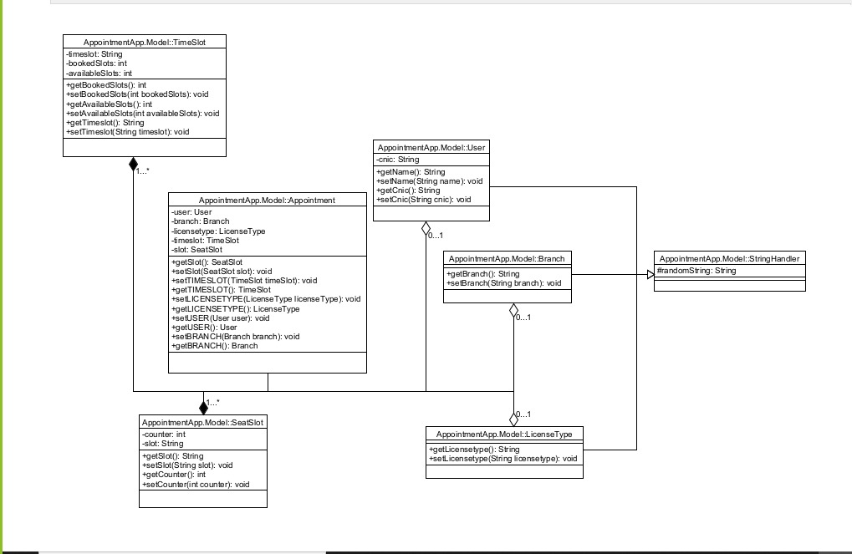

Slide 11
FUTURE WORK
7
WE WOULD LOVE TO IMPLEMENT THIS AS A WEBSITE, AND INSTEAD OF GIVING THE OUTPUT ON GUI, WE SHALL SHARE IT IN FORM OF HTML OR SOMETHING THAT CAN BE USED AS WEBSITE

Slide 12
CONCLUSION
8
WE WOULD LIKE TO CONCLUDE ON THE POINT THAT WE AS A GROUP HAVE WORKED REALLY HARD ON THIS PROJECT, AND WHILST THERE ARE A FEW LOGICAL FLAWS IN OUR WORK, WE ARE PROUD ON THE FUNCTIOANLITY AND PRECISION OF THIS PROJECT. HOPE YOUR FEELINGS ARE MUTUAL, THANKYOU.

Slide 13
THANK YOU!
END

