Slide 1

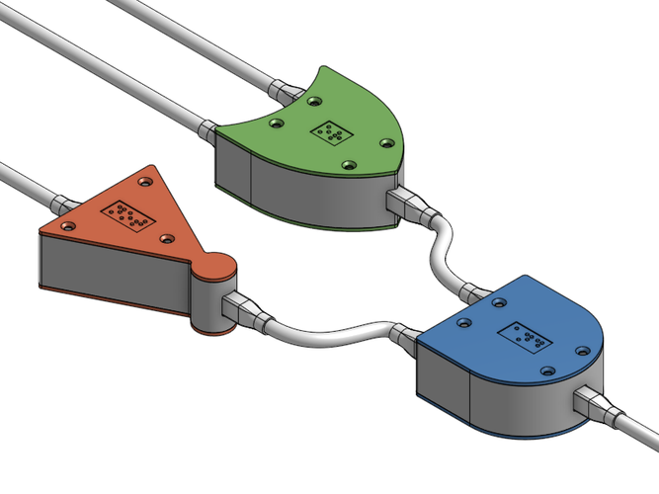
CS 211 - Digital Logic Design 211 عال - تصميم المنطق الرقمي First Term - 1439/1440 Lecture #1
Dr. Hazem Ibrahim Shehata
Assistant Professor
College of Computing and Information Technology

Slide 2
Teaching Staff
Instructor:
Hazem Ibrahim Shehata
Email: hshehata@su.edu.sa
Lectures: Wednesday 8:00am – 9:50am
Tutorial/lab: Sunday 1:00pm – 2:50pm
Office Hours: TBA

Slide 3
Course Info
Course website:
http://hshehata.github.io/courses/su/cs211/
Textbook:
“Digital Fundamentals”, Thomas L. Floyd, 10th Edition, 2009, http://catalogue.pearsoned.co.uk/educator/product/Digital-Fundamentals-Pearson-New-International-Edition-10E/9781292025629.page

Slide 4
Course Info (Cont.)
Grading
Course Work | Grade Distribution
Attendance | 10pt | 60pt
Quizzes | 10pt
Assignments | 10pt
Midterm Exam (1) | 15pt
Midterm Exam (2) | 15pt
Final Exam | 40pt
Total Points | 100pt

Slide 5
Course Overview
Number Systems, Operations, Codes ➔ Ch. 2
Logic Gates and Boolean Algebra ➔ Ch. 3, 4
Combinational Logic ➔ Ch. 5, 6
Sequential Logic ➔ Ch. 7, 8, 9
Memory ➔ Ch. 10 [Optional!]

Slide 6
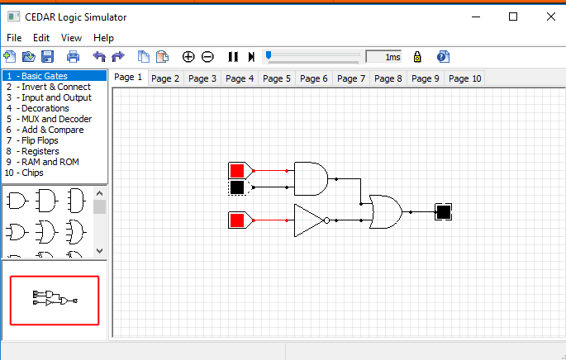
Cedar Logic Simulator
Concepts learned in this course are applied using: Cedar Logic Simulator (or shortly: Cedar LS).
Open-source digital logic simulator
Developed for academic purposes.
Very simple and intuitive user interface.
Download link:
https://sourceforge.net/projects/cedarlogic/files/latest/download

Slide 7

Ch.2: Number Systems, Operations, and Codes

Slide 8
Decimal Numbers
Position of each digit in a weighted number system is assigned a weight based on the base or radix of that system.
Radix/base of decimal system is 10.
Ten possible values for each digit: 0, 1, 2, …, 9.
Example: The number 409.631₁₀
Column weights of decimal numbers are powers of 10:
… 10³ 10² 10¹ 10⁰. 10⁻¹ 10⁻² 10⁻³ 10⁻⁴ …
Radix Point
(Decimal Point)

Slide 9
Decimal Numbers (Cont.)
Decimal numbers can be expressed as sum of products of each digit times column value for that digit.
Example:
Express the number 480.52₁₀ as the sum of values of each digit.
Solution:
480.52₁₀ = (4 x 10²) + (8 x 10¹) + (0 x 10⁰) + (5 x 10⁻¹) + (2 x 10⁻²)

Slide 10
Binary Numbers
Digital systems use binary number system.
Radix/base of system is 2.
Two possible values for each binary digit (know as bit): 0 or 1.
Example: The number 10010.001₂
Note: Values 0 and 1 can be easily represented in hardware using 2 distinct voltage values: low (e.g., 0 volt) and high (e.g., 5 volt)!
Column weights of decimal numbers are powers of 2:
… 2³ 2² 2¹ 2⁰. 2⁻¹ 2⁻² 2⁻³ 2⁻⁴ …
Binary Point

Slide 11
Conversion: Binary ➔ Decimal
Method: Sum of weights (Add column values of all of bits that are 1 and discard all of bits that are 0).
Example: Convert 100101.01₂ to decimal.
Solution: Write column weights ➔ Add weights that correspond to 1’s.
2⁵ 2⁴ 2³ 2² 2¹ 2⁰ . 2⁻¹ 2⁻²
32 16 8 4 2 1 . ½ ¼
1 0 0 1 0 1 . 0 1
32 +4 +1 +¼ = 37.25₁₀

Slide 12
Conversion: Decimal ➔ Binary (Integer)
Method #1: Reverse sum-of-weights (Write down column weights and place 1’s in columns that sum to decimal num.)
Example: Convert 49₁₀ to binary.
Solution: Write down column weights until the last number is larger than the one you want to convert.
2⁶ 2⁵ 2⁴ 2³ 2² 2¹ 2⁰
64 32 16 8 4 2 1
0 1 1 0 0 0 1 = 110001₂

Slide 13
Conversion: Decimal ➔ Binary (Integer)
Method #2: Repeated division-by-2 (divide decimal num. by 2 until quotient is 0. Remainders form binary num.)
Example: Convert 12₁₀ to binary.
Solution:
12 ÷ 2 = 6 0
6 ÷ 2 = 3 0
3 ÷ 2 = 1 1
1 ÷ 2 = 0 1
Quotient
Remainder
STOP
1
1
0
0

Slide 14
Conversion: Decimal ➔ Binary (Fraction)
Method: Repeated multiplication-by-2 (multiply fractional results repeatedly by 2. Carries form binary fraction)
Example: Convert 0.3125₁₀ to binary.
Solution:
0.3125 * 2 = 0 .625
0.625 * 2 = 1 .25
0.25 * 2 = 0 .5
0.5 * 2 = 1 .0
Carry
Result
0.
0
1
0
1
STOP

Slide 15
Counting in Binary
Decimal Number | Binary Number
00 | 0 | 0 | 0 | 0
01 | 0 | 0 | 0 | 1
02 | 0 | 0 | 1 | 0
03 | 0 | 0 | 1 | 1
04 | 0 | 1 | 0 | 0
05 | 0 | 1 | 0 | 1
06 | 0 | 1 | 1 | 0
07 | 0 | 1 | 1 | 1
08 | 1 | 0 | 0 | 0
09 | 1 | 0 | 0 | 1
10 | 1 | 0 | 1 | 0
11 | 1 | 0 | 1 | 1
12 | 1 | 1 | 0 | 0
13 | 1 | 1 | 0 | 1
14 | 1 | 1 | 1 | 0
15 | 1 | 1 | 1 | 1
Decimal Number | Binary Number
00 | 0 | 0 | 0 | 0
01 | 0 | 0 | 0 | 1
02 | 0 | 0 | 1 | 0
03 | 0 | 0 | 1 | 1
04 | 0 | 1 | 0 | 0
05 | 0 | 1 | 0 | 1
06 | 0 | 1 | 1 | 0
07 | 0 | 1 | 1 | 1
08 | 1 | 0 | 0 | 0
09 | 1 | 0 | 0 | 1
10 | 1 | 0 | 1 | 0
11 | 1 | 0 | 1 | 1
12 | 1 | 1 | 0 | 0
13 | 1 | 1 | 0 | 1
14 | 1 | 1 | 1 | 0
15 | 1 | 1 | 1 | 1
Using 4 bits, we can represent numbers: 0 : 2⁴-1
Using n bits, we can represent numbers: 0 : 2^{n}-1

Slide 16
Reading Material
Floyd, Chapter 2:
Pages 45 – 54

