Slide 1

CSE 321a
Computer Organization (1)
تنظيم الحاسبات (1)
3rd year, Computer Engineering
Fall 2016
Lecture #9
Dr. Hazem Ibrahim Shehata
Dept. of Computer & Systems Engineering
Credits to Dr. Ahmed Abdul-Monem Ahmed for the slides

Slide 2
Administrivia
Midterm:
New Date: Tuesday, Dec. 5, 2016
New Time: 11:00am - 12:30pm
Location: classroom #27321 (قاعة 4د)
Coverage: lecture #1 ➔ lecture #6
Stack:
SP points to top element of stack!
Push ➔ (1) decrement SP (2) Copy element to stack
Pop ➔ (1) Copy element from stack (2) increment SP
Website: http://hshehata.github.io/courses/zu/cse321a/
Office hours: Sunday 12:00pm – 1:00pm

Slide 3
Chapter 13. Instruction Sets: Addressing Modes and Formats
How the address of an operand is specified
How the bits of an instruction are organized

Slide 4
Addressing Modes
What: how address of operand is specified.
Why: address field in an instruction is small!
Tradeoff: address range/addressing flexibility vs. number of memory references/complexity of address calculation.
Immediate
Direct
Indirect
Register
Register Indirect
Displacement
Stack
Notes:
2

Slide 5
1. Immediate Addressing
Address field A contains operand.
Syntax: #A
Ex.: ADD #5
AC ⬅ [AC] + 5.
5 is the operand.
Fast: no memory reference to fetch data.
Limited operand magnitude.
Requires sign extension if loaded to larger register.
Notes:
3

Slide 6
2. Direct Addressing
Address field contains address of operand.
Operand Address ➔ effective address (EA).
EA = A
Syntax: A
Ex.: ADD 500
AC ⬅ [AC] + [500].
Look in mem. at address 1000 for operand.
Fast: single memory reference to access data.
Simple: no additional calculations to work out effective address.
Limited address space.
Notes:
6

Slide 7
3. Indirect Addressing
Address field contains address of memory location that contains address of operand.
EA = [A]
Syntax: (A)
Ex.: ADD (1000)
AC ⬅ [AC] + [ [1000] ].
Large address range: 2^{n} locations, where n = word length.
Slow: multiple memory references to find operand.
May be nested, multilevel, cascaded
Ex.: SUB (((100)))
EA = [[[100]]]
Operand = ?
Draw the diagram yourself!
Notes:
7

Slide 8
4. Register Addressing
Address field identifies a register that holds the operand.
c.f. Direct addressing
EA = R
Notation: R
Ex.: ADD R1
AC ⬅ [AC] + [R1].
Number of registers is relatively small.
Small address field (R: 3-5 bits).
Fast fetch: short instruction.
Fast execution: no memory reference.
Very limited address space.
Notes:
10

Slide 9
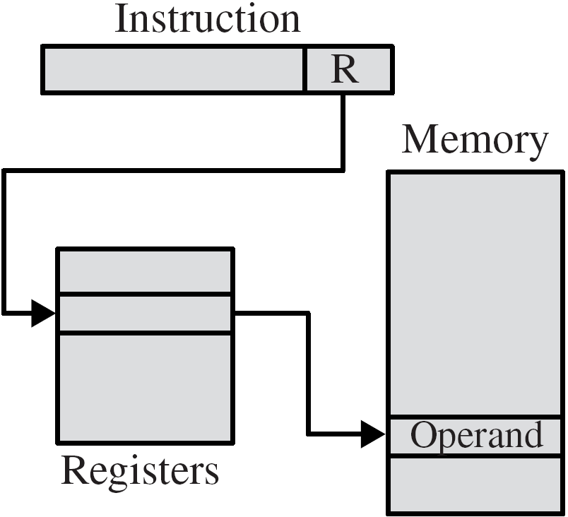
5. Register Indirect Addressing
Address field identifies register that contains the address of the operand.
c.f. Indirect addressing.
EA = [R]
Notation: (R)
Ex.: ADD (R1)
AC ⬅ [AC] + [ [R1] ].
Large address space (2^{n}).
One fewer memory access than indirect addressing.
Notes:
13

Slide 10
6. Displacement Addressing
Operand described using 2 address fields: A and R.
One holds base value and the other holds displacement.
EA = A + [R]
Notes:
16

Slide 11
6. Displacement Addressing – Relative
Relative Addressing (PC-relative)
R is implicitly defined as the PC ➔ R=PC
A is the displacement; a signed number (in 2’s complement representation by default).
Meaning: operand found A locations far from following instruction.
EA = A + [PC]
Notation: @(A)
Ex.: ADD @(-100)
AC ⬅ [AC] + [ – 100 + [PC] ].
Most common usage: defining target address in (conditional) branch instructions.
Ex.: “BRZ @(+30)” means “PC ⬅ 30 + [PC]” if zero flag is true.
Notes:
17

Slide 12
6. Displacement Addressing – Base Register
Base-Register Addressing
Register R holds a base address.
A is a number representing a displacement from the base address.
EA = A + [R]
Notation: R(A)
Ex.: ADD R2(50)
AC ⬅ [AC] + [ 50 + [R2] ]
R may be explicit or implicit (e.g., segment registers in x86).
With N registers and K-bit displacement A, an instruction can reference one of N areas of 2^{K} words.
Most common usage: implementing segmentation.
Notes:
17

Slide 13
6. Displacement Addressing – Indexed
Indexed Addressing
A is a memory address.
Register R holds displacement (index register).
EA = A + [R]
Notation: A(R)
Ex.: ADD R5, 40(R3); DEC R3;
R5 ⬅ [R5] + [ 40 + [R3] ]; R3 ⬅ [R3] – 1
Typically, A would have more bits than it does in base-register addressing mode.
Most common usage: referencing arrays.
Notes:
17

Slide 14
6. Displacement Addressing – Autoindexing
Autoindexing Addressing
Typically, there is a need to increment/decrement the index register after each reference to it.
EA = A + [R]; R ⬅ [R] ± 1
Notation: A(R)±
Ex.: ADD R5, 40(R3) –
R5 ⬅ [R5] + [ 40 + [R3] ]; R3 ⬅ [R3] – 1
Most common usage: referencing arrays.
If certain registers are devoted exclusively to indexing ➔ autoindexing can be done automatically.
Notes:
20

Slide 15
6. Displacement Addressing – Pre/Post-indexing
Preindexing / Postindexing Addressing:
Sometimes both indexing and indirection are provided.
Preindexing: indexing is done before indirection.
EA = [ A + [R] ]
Notation: (A(R))
Ex.: ADD R5, (200(R4))
R5 ⬅ [R5] + [ [ 200 + [R4] ] ]
Usage: implement multiway branch tables. Table starts at location A. Table is indexed by [R] to select br. target address.
Postindexing: indexing is done after indirection.
EA = [A] + [R]
Notation: (A)(R)
Ex.: ADD R5, (200)(R4)
R5 ⬅ [R5] + [ [200] + [R4] ]
Usage: accessing fixed-format data blocks. A block is identified by [A]. Target element in block is identified by [R].
Notes:
20

Slide 16
7. Stack Addressing
Operand is (implicitly) on top of stack.
EA = [SP]
Notation: N/A
Ex.: ADD
Pop top two items from stack,
add them, push result back to stack
[SP] + 1 ⬅ [[SP]] + [[SP] + 1];
SP ⬅ [SP] + 1
Notes:
21

Slide 17
Addressing Modes – Summary
[A]
[R]
[R]
Notes:
21

Slide 18
X86 Addressing Modes
Virtual or effective address is offset into segment.
Starting address plus offset gives linear address.
This goes through page translation if paging is enabled.
Addressing modes available
Immediate
Register operand: 8-bit, 16-bit, 32-bit, 64-bit GPR’s.
Displacement: equivalent to indirect.
Base: equivalent to register indirect.
Base with displacement: equivalent to base-register disp.
Scaled index with displacement: Indexed disp. + scaling (to handle word sizes greater than 1 byte).
Base with index and displacement: 2D arrays, array in SF
Base with scaled index & displacement
Relative

Slide 19
x86 Address Calculation

Slide 20
x86 Addressing Modes – Summary
[SR] + A
[SR] + [B]
[SR] + [B] + A
[SR] + [I] * S + A
[SR] + [B] + [I] + A
[SR] + [I] * S + [B] + A
[PC] + A
[X]
General-purpose register

Slide 21
Instruction Formats
Defines layout of bits of instruction, in terms of its constituent fields.
Includes opcode and (implicit or explicit) zero or more operands.
Each explicit operand is referenced using one of the addressing modes.
Most instruction sets use more than one instruction format.
Key design issues:
Instruction length
Allocation of bits
Variable-length instructions

Slide 22
Instruction Length
Instruction format length affects/affected by: memory size/organization, bus structure, CPU complexity/speed.
Tradeoff: Instruction capabilities vs. storage requirements.
Programmers need powerful instructions ➔ more opcodes, operands, addr. modes ➔ longer instructions ➔ bigger storage!!
Also, instruction length should:
Suit memory-transfer rate.
Long instruction & small memory-transfer rate ➔ CPU fetches less instructions than it executes ➔ memory becomes bottleneck ➔ CPU becomes less busy ➔ performance is hurt!!
Equal length of memory-transfer unit (or multiple)
Equal multiple of character length.
Equal word length.
Equal length of fixed-point numbers.

Slide 23
Allocation of Bits (1)
Tradeoff: number of opcodes vs. power of addressing.
Work around: variable-length opcodes ➔ more opcodes for operations that require less operands and/or addressing.
Factors go into determining use of addressing bits:
Number of addressing modes
Implicit: opcode ➔ particular addressing mode.
Explicit: some bits to specify addressing mode.
Number of operands
Fewer addresses ➔ longer programs.
Each operand could need its mode indicator, or just one.
Register versus memory
Accumulator ➔ no bits, but longer program.
More registers ➔ used instead of memory ➔ less bits.

Slide 24
Allocation of Bits (2)
… (Cont.)
Number of register sets
A set of general-purpose vs. 2⁺ specialized sets
e.g., a set for data and another set for displacement.
2 sets of 8 registers ➔ 3 bits are needed, opcode determines which set.
Address range (for addresses that reference memory)
Direct addressing is rarely used.
Displacement addressing: large disp. ➔ more bits.
Address granularity (for addresses that reference memory)
Byte addressing vs. word addressing.
Byte addressing is convenient for characters, but needs large number of bits.

Slide 25
Variable-Length Instructions
A variety of instruction formats of different lengths.
Pros
Larger repertoire of opcodes.
More flexible addressing, i.e., various combinations of reg/mem references.
Cons
Increase processor complexity.
Instruction lengths should be integrally related to word length.
Typically, processor fetches a number of words equal to longest possible instruction.

Slide 26
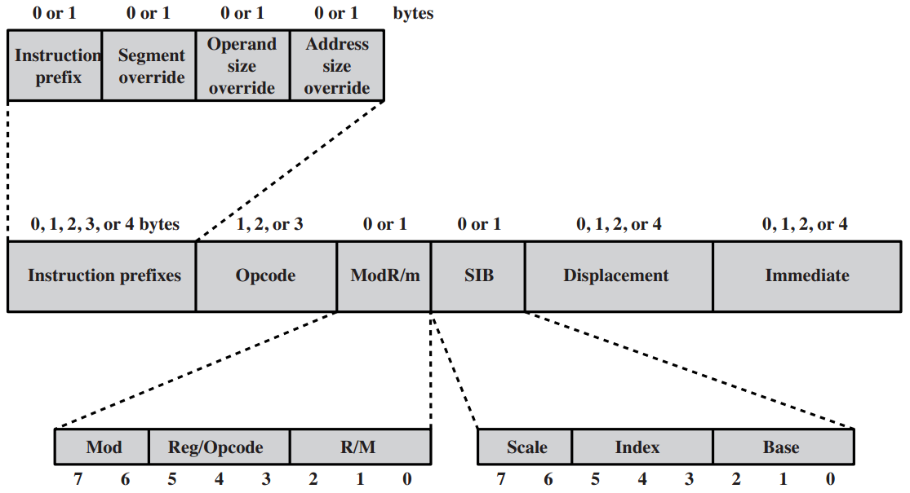
x86 Instruction Format: variable-length (1-15B)
Inst. prefix: LOCK or repeat prefixes to repeat operations on strings. # in CX.
Segment override: which segment register to use.
Operand size override: specifies 16- or 32-bit operands.
Address size override: specifies 16- or 32-bit addresses ➔ displacement size.

Slide 27
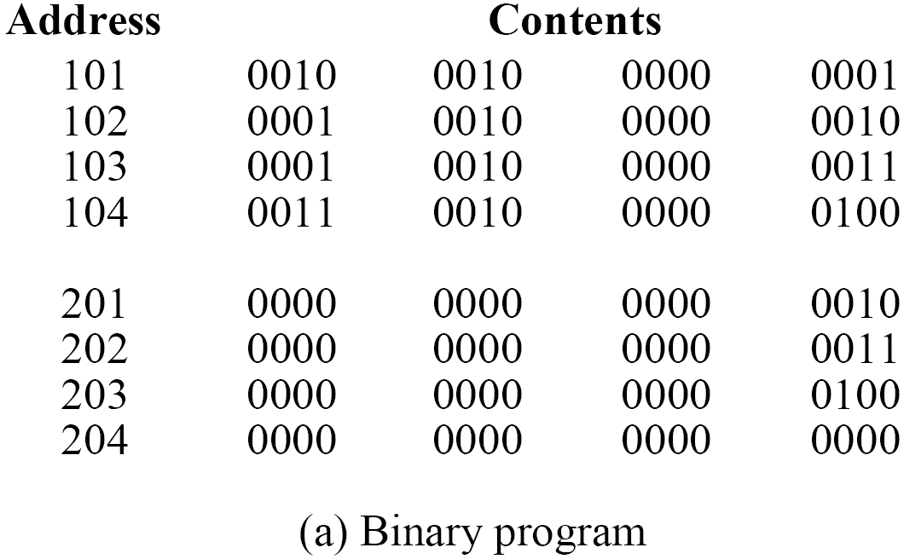
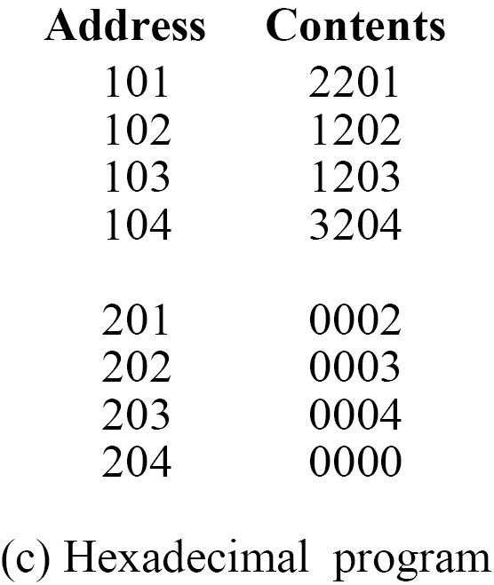
Assembly Language (N=I+J+K)
Notes:
30

Slide 28
Reading Material
Stallings, Chapter 13:
Pages 452 – 461
Pages 464 – 467
Page 469
Pages 473 – 475
Pages 477 – 479

