Slide 1
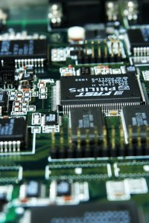
CSE 321b
Computer Organization (2)
تنظيم الحاسب (2)
3rd year, Computer Engineering
Winter 2016
Lecture #8
Dr. Hazem Ibrahim Shehata
Dept. of Computer & Systems Engineering
Credits to Dr. Ahmed Abdul-Monem Ahmed for the slides

Slide 2
Adminstrivia
Assignment #2:
  Released: Saturday. Due: Wednesday, April 13, 2016.
Midterm:
  Date: Thursday, April 21, 2014
  Time: 10:30am – 12:00pm
  Location: classroom #27309
  Coverage: lectures #1 ➔ #7
Lecture include material from another textbook:
  ”Computer Organization and Embedded Systems”, C. Hamacher, Z. Vranesic, S. Zaky, N. Manjikian (6th Ed.)
Website: http://hshehata.github.io/courses/zu/cse321b/
Office hours: Sunday 11:30am – 12:30pm

Slide 3
Chapter 10. Computer Arithmetic

Slide 4
Outline
Integer Representation
  Sign-Magnitude, Two’s Complement, Biased
Integer Arithmetic
  Negation, Addition, Subtraction
  Multiplication, Division
Floating-Point Representation
  IEEE 754
Floating-Point Arithmetic
  Addition, Subtraction
  Multiplication, Division
  Rounding

Slide 5
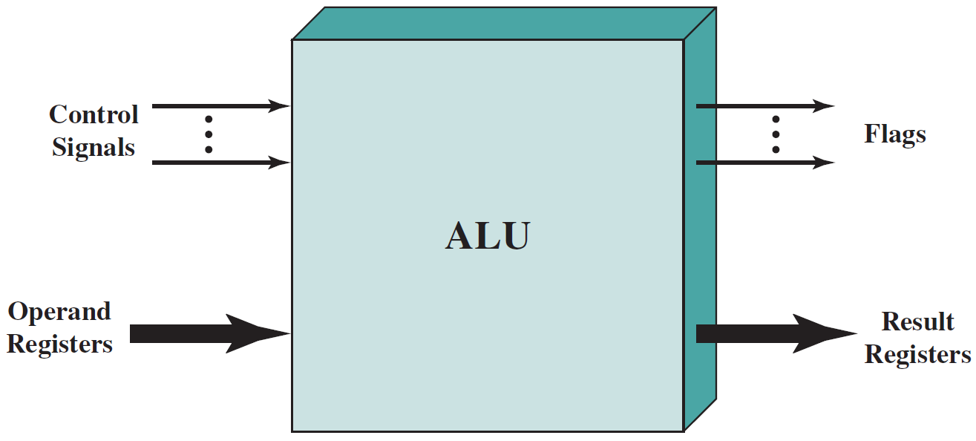
Arithmetic & Logic Unit (ALU)
The unit that does all the calculations!
Everything else in computer is there to bring data to ALU and take results back out.
It can handle both integers & real (floating point) numbers.
  Note: In the past, Floating-Point Unit (FPU) used to be separate from ALU (off-chip) ➔ math co-processor!!
overflow, carry, …
Operation
Data
Results

Slide 6
Integer Representation
General-case number: –548.923
Only have 0 & 1 to represent everything!
  No minus sign!!
  No radix point (period)!!!
Unsigned (i.e., always positive) integers:
  Straightforward ➔ represent integer value in binary!
  An n-bit word can represent the numbers: 0 → 2^{n}-1
  Ex.: (41)₁₀ represented using 8-bits as “00101001”.
Signed integers:
  Not straightforward!
    Sign-magnitude representation
    Biased representation
    Two’s complement representation

Slide 7
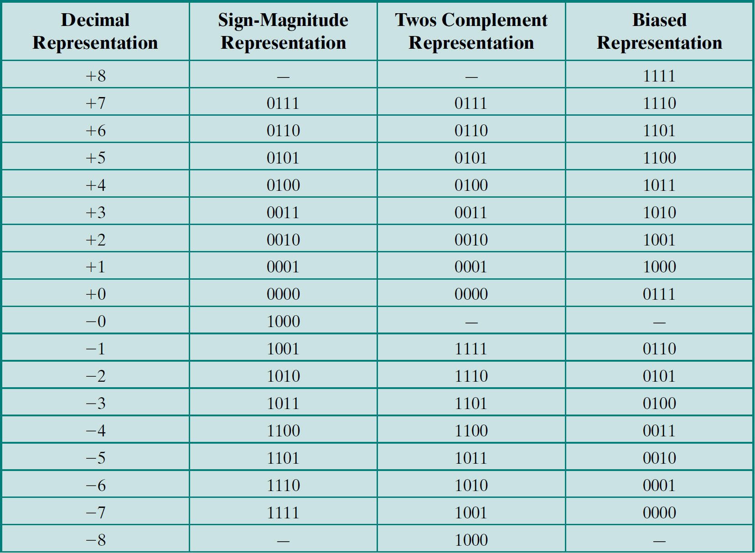

Representations of 4-Bit Signed Integers
+x₁₀
x₂
x₂
2
1
1
2
(2⁴⁻¹ – 1) ± x₂
-x₁₀
2⁴⁻¹ + x₂
2⁴ – x₂
1
2
1

Slide 8
Sign-Magnitude Representation
Left most bit is sign bit.
  “0” means positive. “1” means negative.
Rest of the bits represent the magnitude.
Example:
  +18 = 00010010
  –18 = 10010010
Range of n-bit Numbers: -(2^{n-1} - 1) ➔ 2^{n-1} - 1.
Problems:
  Need to consider both sign & magnitude in arithmetic.
  Two representations of zero (+0 and –0)
    More difficult to test for 0!
    One wasted bit combination!!

Slide 9
Biased Representation
A bias is added to the binary value of the number.
  Bias = 2^{n-1} – 1 (if numbers are represented by n bits).
Example:
  +18 = 00010010 + 01111111 = 10010001
  –18 = -00010010 + 01111111 = 01101101
Range of n-bit Numbers: -(2^{n-1} – 1) ➔ 2^{n-1}.
Problems:
  Need to compensate for the bias in arithmetic (by adding/subtracting a value to/from result)!!
    Example: Suppose numbers are represented using 4 bits.
      2₁₀ + 1₁₀ = 1001 + 1000 = 10001 ➔ Wrong result!!
      Result is biased twice ➔ subtract one bias from the result
      10001 – 0111 = 1010 = 3₁₀

Slide 10
Two’s Complement Representation
Like sign-magnitude representation, leftmost bit is used as a sign bit.
Differs from sign-magnitude representation in how the remaining bits are interpreted.
Positive number: convert to binary
Negative number: 2’s complement
Example: 8-bit 2’s complement representation
  +3 = 00000011
  +2 = 00000010
  +1 = 00000001
  +0 = 00000000
  –1 = 11111111
  –2 = 11111110
  –3 = 11111101

Slide 11
n-bit Two’s Complement Representation
Suppose we want to represent a set of signed integer numbers using n bits.
Then, we have 2^{n} different combinations ➔ we can represent 2^{n} different numbers.
  Represent the number: 0 by the combination: “00…0”.
    We now have 2^{n}–1 different combinations left.
  Represent each positive number: +A by a combination (whose value is): A ➔ positive integers: 1, 2, …, 2^{n–1}–1 are represented by combinations: 1, 2, .., 2^{n–1}–1.
  Represent each negative number: –A by a combination (whose value is): 2^{n} – A ➔ negative integers: –2^{n–1}, –2^{n–1}+1, …, –1 are represented by combinations: 2^{n–1}, 2^{n–1}+1, …, 2^{n}–1.
Range of representable numbers is: –2^{n – 1} ➔ 2^{n – 1} – 1.

Slide 12
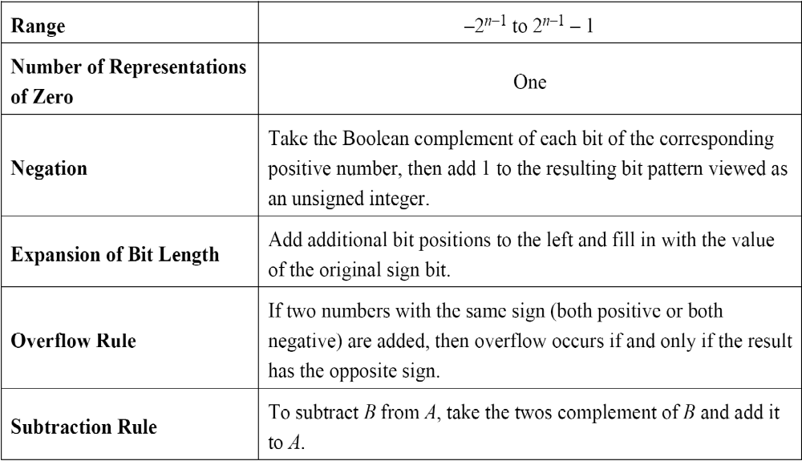
Characteristics of 2’s Comp. Rep. & Arithmetic
Consider n-bit 2’s complement representation
1’s complement
Equivalent to: 2^{n} – x₂

Slide 13
Benefits
One representation of zero.
Arithmetic works easily (see later).
Negating is fairly easy
  3₁₀ = 00000011
  Boolean (one’s) complement gives 11111100
  Add 1 to LSB 11111101
  This is equivalent to 2⁸ – 3 = 253 = 11111101
2’s complement of 3

Slide 14
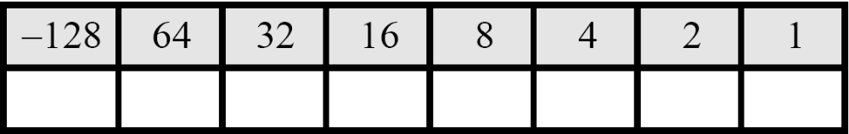
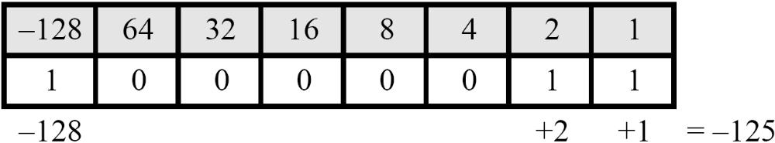
Conversion between 2’s Comp. & Decimal
Value Box
Result obtained using value box is correct because:
  ➔ Sign bit is 1
  ➔ Number = -(2’s comp. of 10000011)
  = -(2⁸ - 10000011)
  = -125
0
= +3

Slide 15
Conversion Between Lengths
Positive numbers ➔ pack with leading zeros
  +18 = 00010010
  +18 = 00000000 00010010
Negative numbers ➔ pack with leading ones
  -18 = 11101110
  -18 = 11111111 11101110
i.e. pack with MSB (sign bit) ➔ Sign extension

Slide 16
Addition and Subtraction
Addition ➔ Normal binary addition.
  Monitor sign bit for overflow.
Subtraction ➔ Take two’s complement of subtrahend and add to minuend
  A – B = A + (–B)
So we only need addition and complement circuits.

Slide 17
Why Addition of Numbers in 2’s Comp. Works?
Two positive number
  Normal binary addition if no overflow.
Two negative numbers: –A and –B
  Represent –A as 2^{n} – A
  Represent –B as 2^{n} – B
  Do the addition: Result = (2^{n} – A) + (2^{n} – B)
  = 2^{n} + [2^{n}–(A+B)]
One positive and one negative: A and –B
  Represent A as A
  Represent –B as 2^{n} – B
  Result = A + 2^{n} – B = 2^{n} – (–A + B)
Extra bit ➔ ignored
2’s comp. of (A+B) ➔ –(A+B)
2’s comp. of (–A+B) ➔ (A–B)

Slide 18
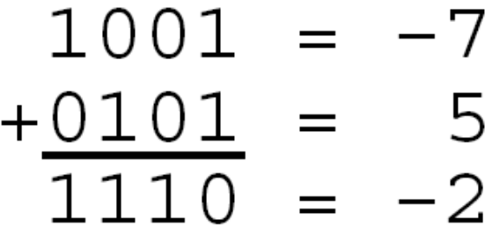
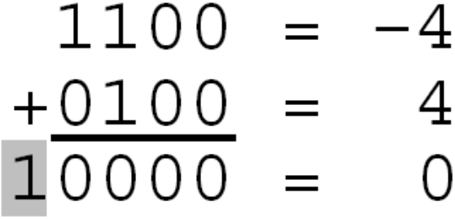
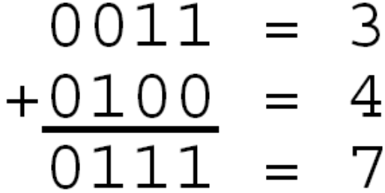
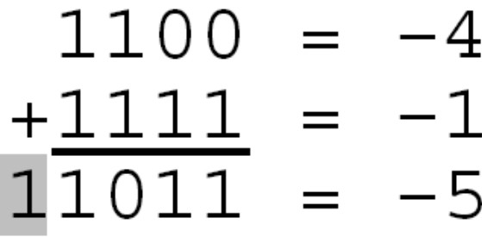
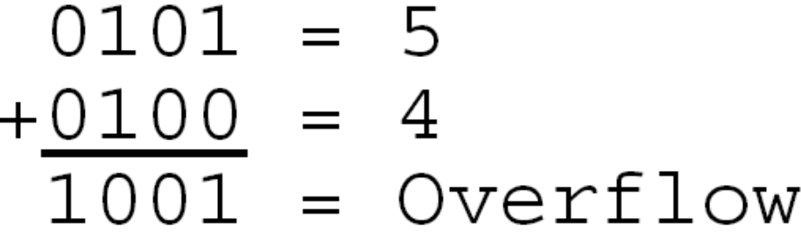
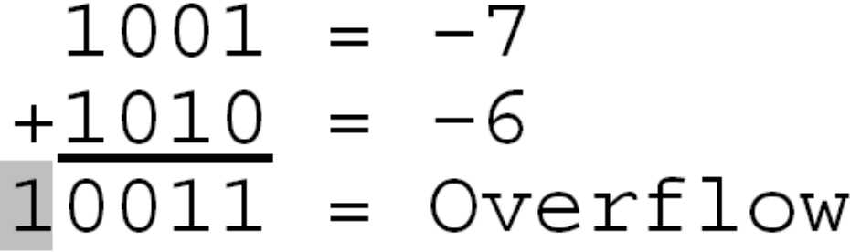
Addition of Numbers in 2’s Comp. Rep.
4-bit 2’s comp. representation

Slide 19
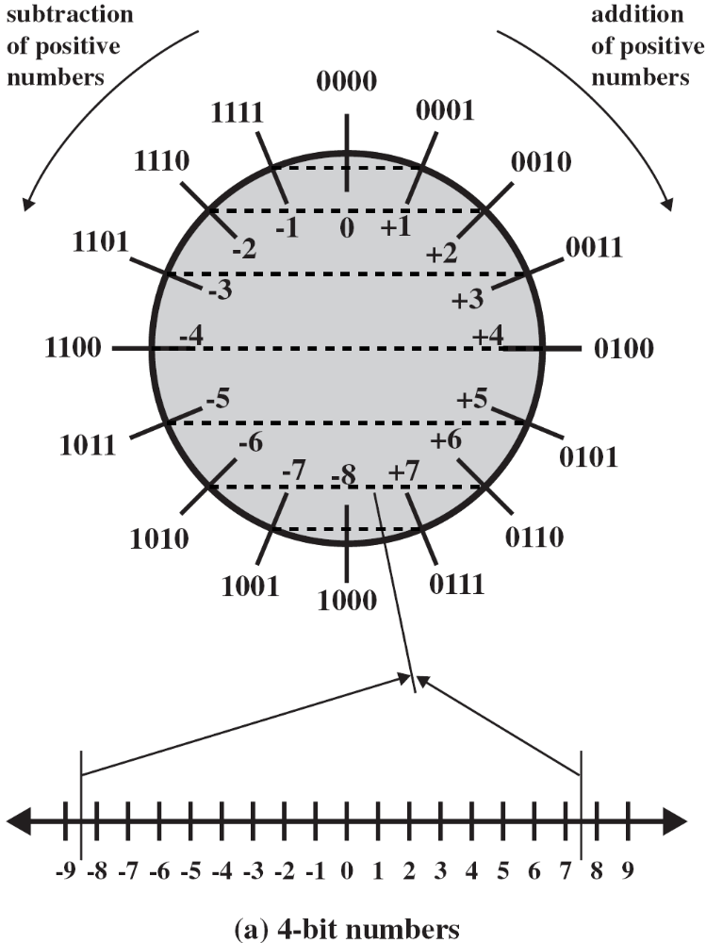
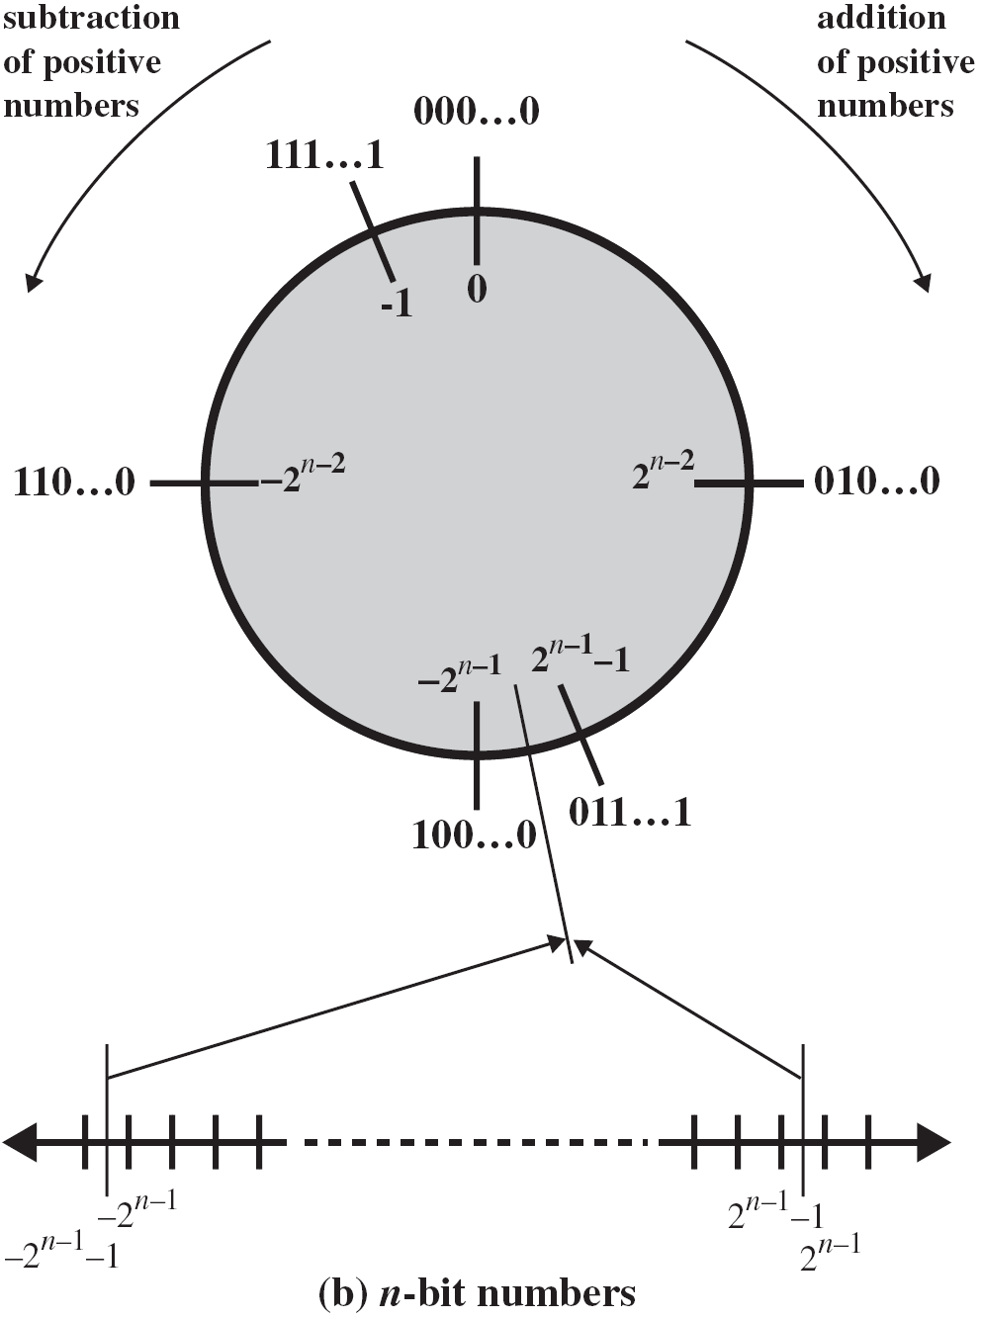
Geometric Depiction of 2’s Comp. Integers

Slide 20
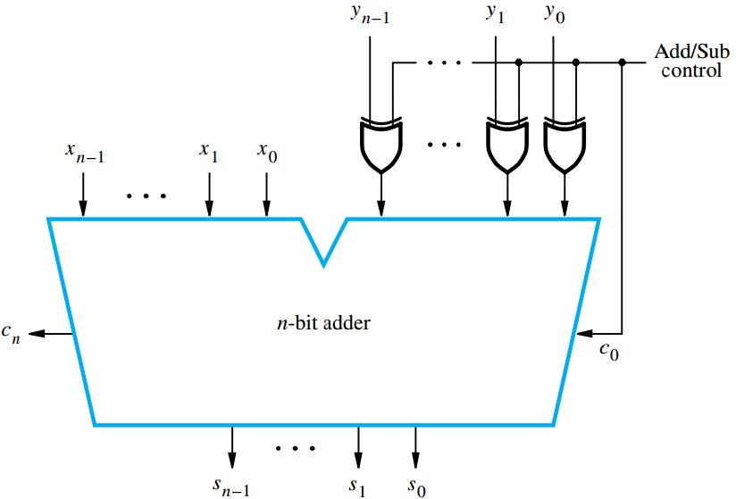
Binary Addition/Subtraction Logic Circuit.
x_{n–1}
z_{n–1}
s_{n–1}
z_{n–1}
Overflow Logic
V
Addition ➔ Add/sub control = 0.
Subtraction ➔ Add/sub control = 1

Slide 21
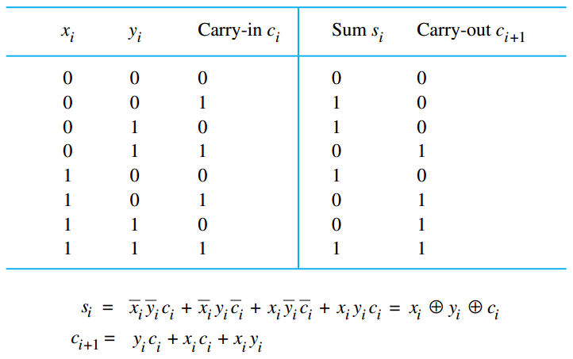
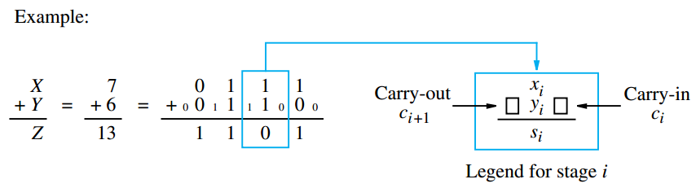
1-Bit Addition (Full Adder)
At the stage i:
Input:
x_{i} is i^{th} bit of x
y_{i} is i^{th} bit of y
c_{i} is carry-in from stage i-1
Output:
s_{i} is the sum
c_{i+1} carry-out to stage i+1

Slide 22
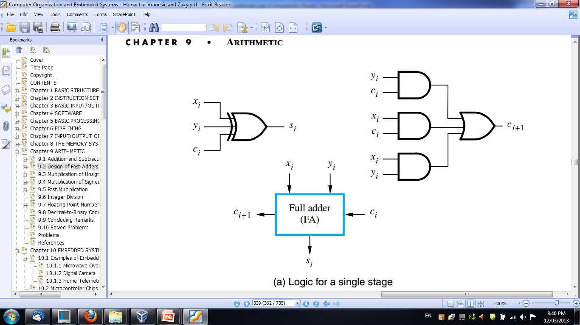
Addition Logic for a Single Stage
Sum
Carry
Full Adder (FA): Symbol for the complete circuit for a single stage of addition.

Slide 23
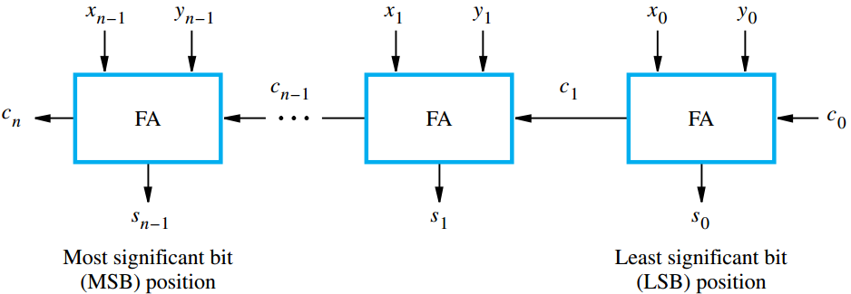
An n-bit Ripple-Carry Adder
Cascade n full adder (FA) blocks to form a n-bit adder.
Carries propagate or ripple through this cascade ➔ n-bit ripple carry adder.
Carry-in c₀ into the LSB position provides a convenient way to perform subtraction.

Slide 24
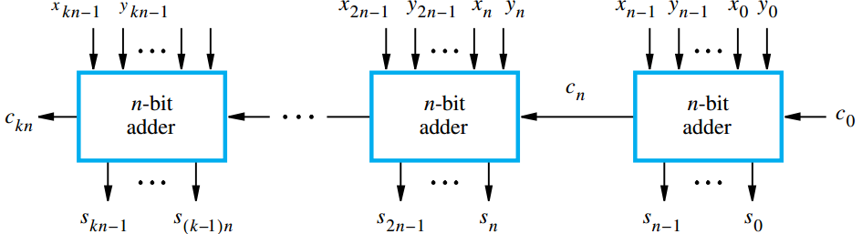
Cascade of k n-bit Adders
k n-bit numbers can be added by cascading k n-bit adders.
Each n-bit adder forms a block, so this is cascading of blocks.
Carries ripple or propagate through blocks ➔ Blocked Ripple Carry Adder.

Slide 25
Computing the Add Time
x₀
y₀
Consider 0th stage:
c₁
FA
c₀
c₁ is available after 2 gate delays.
s₁ is available after 1 gate delay.
s₀
Sum
Carry

Slide 26
Computing the Add Time (cont.)
Cascade of 4 Full Adders, or a 4-bit adder
x₀
y₀
x₀
y₀
x₀
y₀
x₀
y₀
FA
FA
FA
c₁
FA
c₀
c₄
c₃
c₂
s₃
s₂
s₁
s₀
s₀ available after 1 gate delay, c₁ available after 2 gate delays.
s₁ available after 3 gate delays, c₂ available after 4 gate delays.
s₂ available after 5 gate delays, c₃ available after 6 gate delays.
s₃ available after 7 gate delays, c₄ available after 8 gate delays.
For an n-bit ripple-carry adder:
  s_{n-1} is available after 2n-1 gate delays
  c_{n} is available after 2n gate delays.

Slide 27
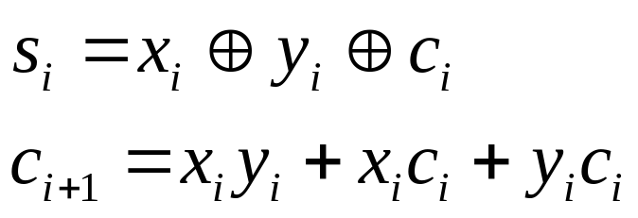
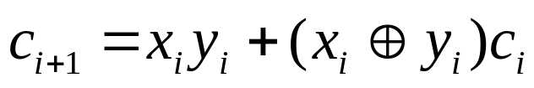
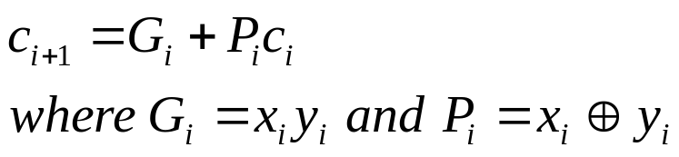
Fast Addition
Recall the equations:
Second equation can be written as:
We can write:
G_{i} is called generate function.
P_{i} is called propagate function.
G_{i} and P_{i} are computed only from x_{i} and y_{i} and not c_{i}
➔ they can be computed in one gate delay from X and Y.

Slide 28
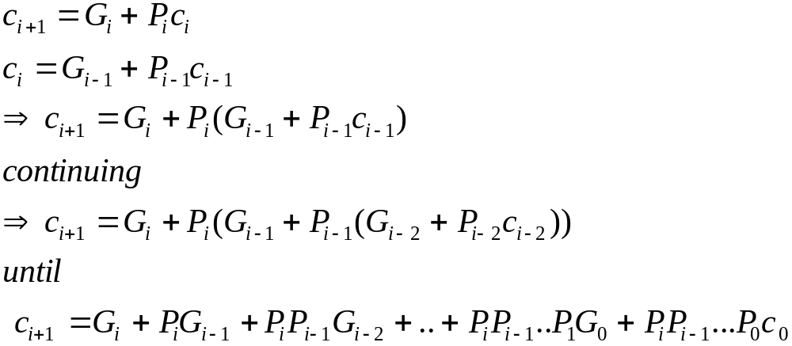
Carry-Lookahead Adder – Main Idea
All carries can be obtained 3 gate delays from x, y and c₀.
  One gate delay for P_{i} and G_{i}
  Two gate delays in the AND-OR circuit for c_{i+1}
All sums can be obtained 1 gate delay after the carries are computed.
Independent of n, n-bit addition requires only 4 gate delays.
This is called Carry Lookahead adder.

Slide 29
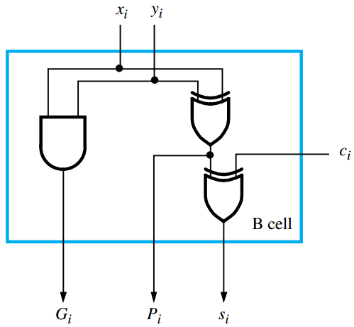
Carry-Lookahead adder – Basic Cell
Bit-stage cell

Slide 30
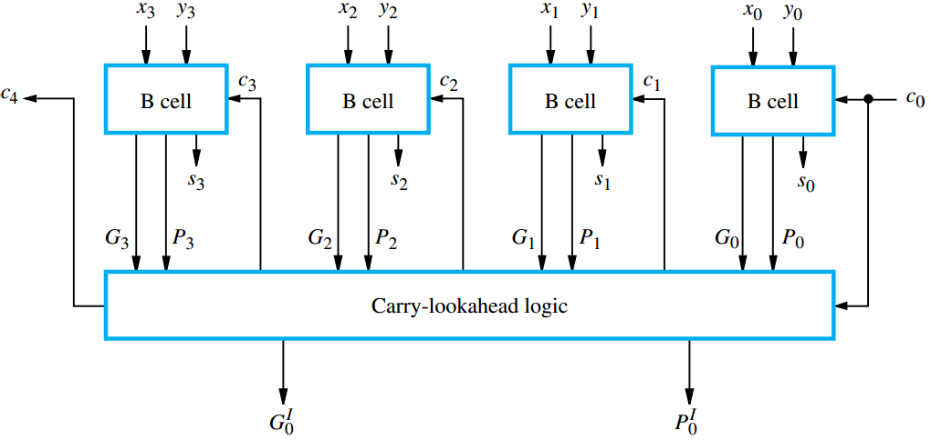
Carry-Lookahead Adder – Structure
4-bit carry-lookahead adder

Slide 31
Carry-Lookahead adder – Limitation
Performing n-bit addition in 4 gate delays independent of n is good only theoretically because of fan-in constraints!
Last AND gate and OR gate require a fan-in of (n+1) for an n-bit adder.
  For a 4-bit adder (n=4) fan-in of 5 is required.
  Practical limit for most gates!
In order to add operands longer than 4 bits, we can cascade 4-bit Carry-Lookahead adders.
➔ Blocked Carry-Lookahead adder.
c
=
G
+
P
G
+
P
P
G
+
..
+
P
P
..
P
G
+
P
P
...
P
c₀
i
+
1
i
i
i
−
1
i
i
−
1
i
−
2
i
i
−
1
1
0
i
i
−
1
0

Slide 32
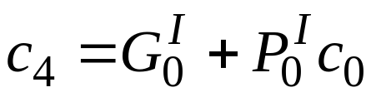
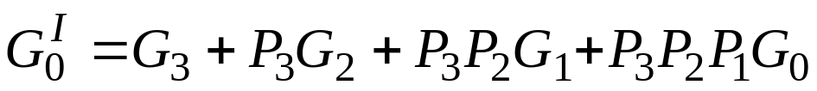
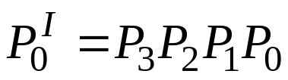
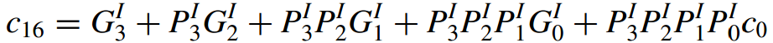
Blocked Carry-Lookahead adder – Main Idea
Carry-out from a 4-bit block can be given as:
Rewrite this as:
  Where:
  And:
  Known as: high-order generate/propagate functions.
To build a 16-bit blocked carry-lookahead adder:
  Use a carry-lookahead logic block to connect the high-order generate/propagate functions from 4 4-bit carry-lookahead adders such that:

Slide 33
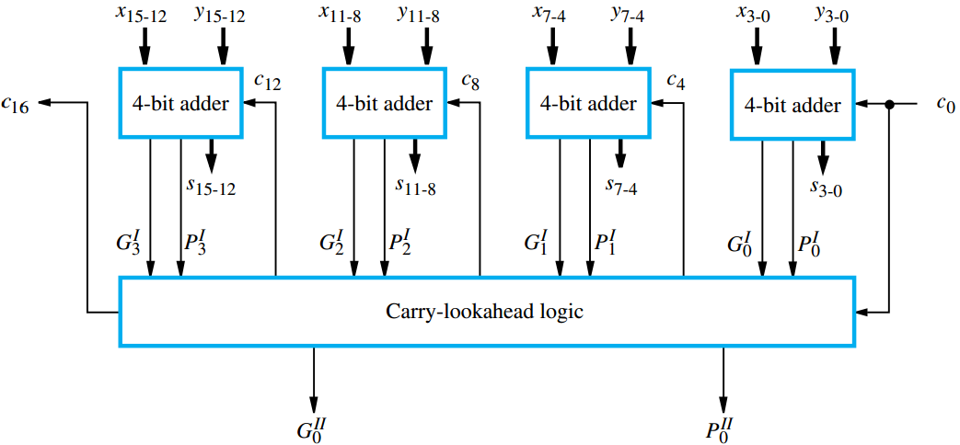
Blocked Carry-Lookahead adder – Structure
Time taken to produce s₁₅
= 1 (X,Y ➔ P,G) + 2 (P,G ➔ P^{I},G^{I})
+ 2 (P^{I},G^{I} ➔ c₁₂) + 2 (c₁₂ ➔ c₁₅)
+ 1 (c₁₅ ➔ s₁₅) = 8 gate delays

Slide 34
Reading Material
Stallings, Chapter 10:
  Pages 320-331
Hamacher, Chapter 9:
  Pages 336-344

