Slide 1
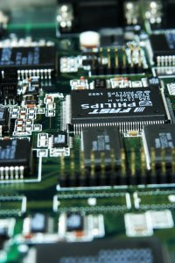
CSE 321b
Computer Organization (2)
تنظيم الحاسب (2)
3rd year, Computer Engineering
Winter 2016
Lecture #6
Dr. Hazem Ibrahim Shehata
Dept. of Computer & Systems Engineering
Credits to Dr. Ahmed Abdul-Monem Ahmed for the slides

Slide 2
Adminstrivia
Assignment #2:
  To be released next week.
Website: http://hshehata.github.io/courses/zu/cse321b/
Office hours: Sunday 11:30am – 12:30pm

Slide 3
Chapter 6. External Memory (Cont.)

Slide 4
Types of External Memory
Magnetic Disk
Redundant Array of Independent Disks (RAID)
Solid-State Drive (SSD)
Optical Disk
Magnetic Tape

Slide 5
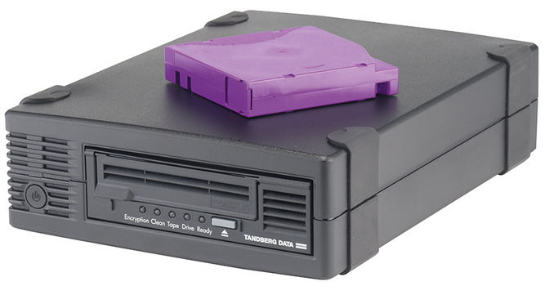
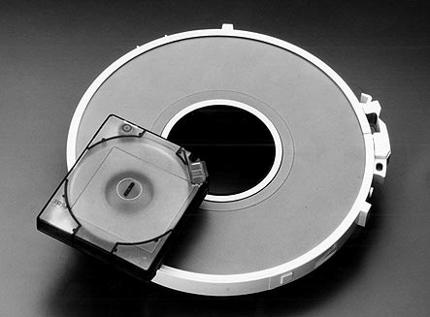
Magnetic Tape
Features:
  Oldest secondary memory (1951).
  Slowest-speed & lowest-cost in memory hierarchy.
Usage: offline storage (i.e., backup).
Access method: sequential ➔ slow!
Medium: flexible polyester tape coated with magnetizable material (metal particles).
Tape width: 0.38cm - 1.27cm.
Tape package:
  Used to be open reels.
  Now housed in cartridges.

Slide 6
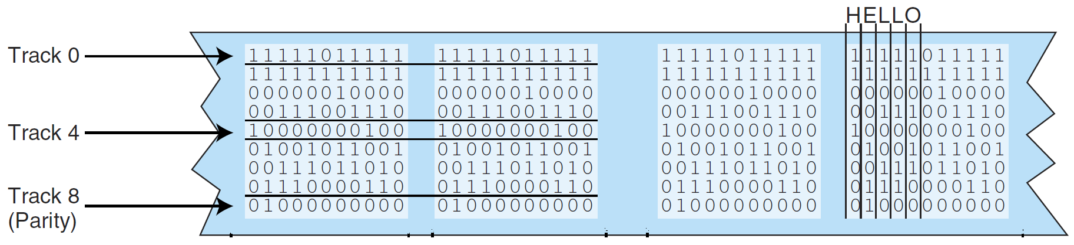
Data Layout and Recording Techniques
Data are laid out on tape along parallel tracks running lengthwise ➔ linear recording.
Tape moves underneath magnetic head in drive.
Head has multiple (8-32) read/write elements ➔ read/write multiple (8-32) tracks simultaneously.
There are two types of linear recording:
Parallel recording: Each byte/word is stored on multiple tracks in parallel, .e.g., 9-track tapes.

Slide 7
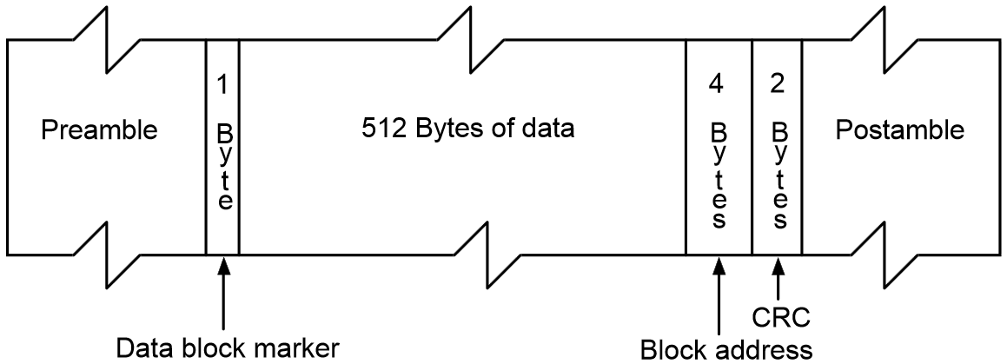
Serial Recording
… types of linear recording ... (cont.):
Serial Recording: data laid out as sequence of bits along each track, similar to magnetic disks.
  Data read/written in contagious blocks called records.
  Records are separated by inter-record gaps.
  Tape is formatted to assist in locating records.

Slide 8

Serpentine Recording
Typical recording technique in serial tapes.
  First set of bits is recorded on tracks in forward direction.
  When tape reaches end, rd/wr elements are repositioned to new tracks & recording is resumed in opposite direction.
  Process continues, back and forth, until tape is full.
  Data still recorded serially along individual tracks, but blocks in sequence are stored in adjacent tracks.
  Adv.: more tracks than head/elements ➔ increasing capacity.
.
.
.
B(6n+2)
B(6n+5)
B(9n-1)
B(6n-1)
B(3n+5)
B(3n+2)
B(2)
B(5)
.
B(3n-1)
.
B(6n+1)
B(6n+4)
B(9n-2)
B(6n-2)
B(3n+4)
B(3n+1)
B(1)
B(4)
.
B(3n-2)
.
B(6n)
B(6n+3)
B(9n-3)
B(6n-3)
B(3n+3)
B(3n)
B(0)
B(3)
B(3n-3)

Slide 9
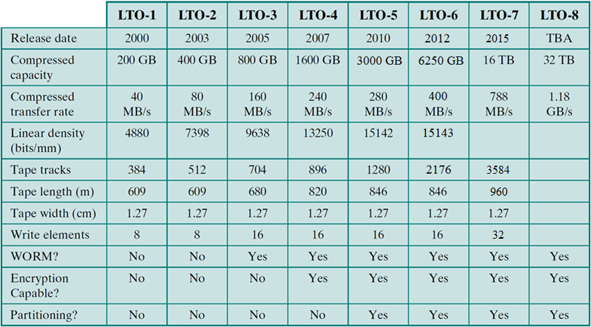
Linear Tape-Open (LTO)
Dominant magnetic tape technology today.
Developed late 1990s as an open source alternative to proprietary tape systems.

Slide 10
Chapter 7. Input / Output

Slide 11
Outline
External Devices
  Types
  Structure
I/O Modules
  Function
  Structure
I/O Techniques
  Programmed I/O
  Interrupt-Driven I/O
  Direct Memory Access
I/O Channels & Processors

Slide 12
Terms
Essential Computer Units
  CPU and Memory
Peripheral (or External or I/O) devices
  Any device attached to a computer in order to increase its functionality.
    Input: keyboard, mouse, scanner, … etc.
    Output: printers, speakers, … etc.
    Input and output: hard disk, modem, … etc.
I/O (Input/Output) Operations
  Transfer of data to/from computer from/to peripheral device (done by program, operation, or device).
  Input: from a device to the computer
  Output: from the computer to a device.

Slide 13
Input/Output Problems
There is a wide variety of peripherals!
  Different methods of operation (H/W).
  Delivering different amounts of data.
  At different speeds (which are also different from CPU and memory).
  In different formats (e.g., word length).
Conclusion: Hard to connect such variety of different devices directly to same Bus!!
Solution: I/O Module

Slide 14
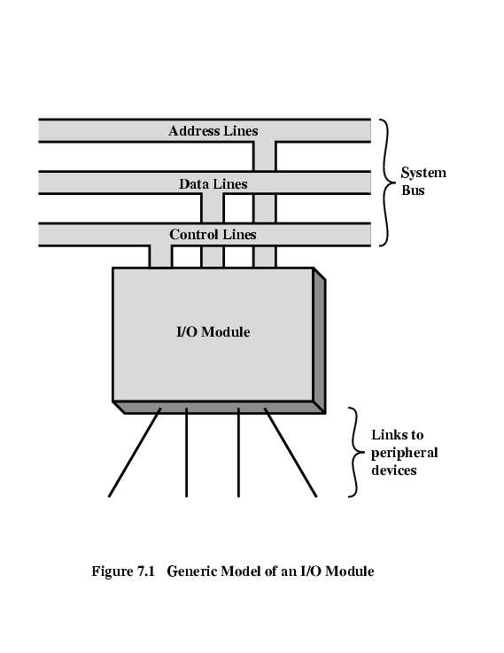
I/O Module
Interface to CPU and Memory
Interface to one or more peripheral devices

Slide 15
Types of Peripherals
Human readable
  Screen, printer, keyboard, … etc.
Machine readable
  Magnetic disk, tape, … etc.
Communication
  Modem, Network Interface Card (NIC), Wireless Network Adaptor, … etc.

Slide 16
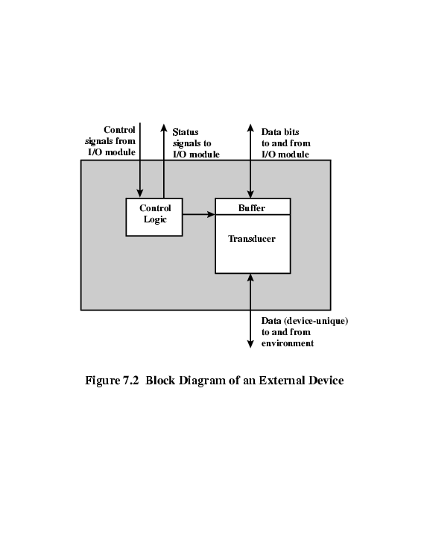
Peripheral (External) Device
Computer
To/from computer
Control Signals
  Send data to module, receive data from module, send status, position disk head.
Status Signals
  READY, NOT READY, …
Buffer
  Temporarily hold data being transferred. Size: x bytes ➔ x Kbytes!!
Transducer
  Converts energy: electrical ⬅➔ other.
Control logic
  Controls operation.
I/O Module
External Device
Outside world

Slide 17
Examples: Keyboard/Monitor, and Disk Drive
Keyboard (input)
  A key is pressed.
  Transducer translates signal into ASCII.
  ASCII is transmitted to I/O module in the computer.
  Text can be stored as ASCII in the computer.
Monitor (output)
  Computer sends ASCII to I/O module. I/O module sends ASCII to external device (monitor).
  Transducer at the monitor sends electronic signals to display the character.
Hard Disk Drive (input/output)
  Head moves in and out across disk surface.
  Transducer converts magnetic patterns to/from bits.

Slide 18
Functions of I/O Module
Control & Timing.
CPU Communication.
Device Communication.
Data Buffering.
Error Detection.

Slide 19
1. Control & Timing
I/O includes control & timing requirement to coordinate the flow of traffic between internal resources (CPU, MM, …) and external devices.
Ex.: Transfer data from input device to CPU:
  CPU checks I/O module device status.
  I/O module returns status.
  If ready, CPU requests data transfer (command to I/O module).
  I/O module gets data from external device.
  I/O module transfers data to CPU.
If transfer goes through bus, each CPU/module interaction may involve 1⁺ bus arbitrations.

Slide 20
2. CPU Communication
CPU communication involves the following:
  Command decoding
    Module accepts commands from CPU on control lines.
    Command parameters can be sent over data line.
    e.g., SEEK track in a disk drive: SEEK command sent on control lines and track # sent on data lines.
  Address recognition
    One unique address for each peripheral it controls.
  Data exchange
    Between CPU and device over the data bus.
  Status reporting
    BUSY, READY, or some error conditions.

Slide 21
3. Device Communication
I/O module must also be able to do device communication:
  Commands
  Status information
  Data

Slide 22
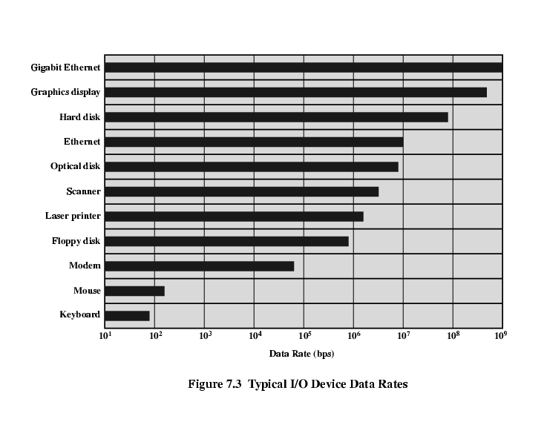
4. Data Buffering (Speed Mismatch)
I/O module must be able to operate at both device and memory/CPU speeds.

Slide 23
5. Error Detection
Mechanical and electrical malfunctions
  Report to CPU.
  e.g., paper jam, bad disk sector/track.
Unintentional changes to transmitted bit pattern
  Detected using error-detecting codes.
  e.g., parity bit (ASCII).

Slide 24
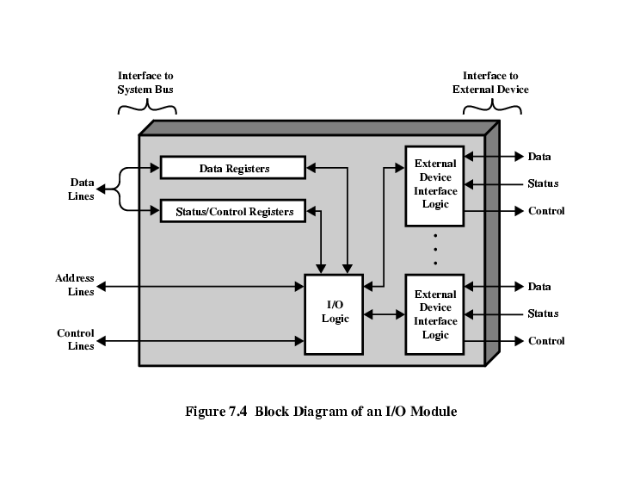
I/O Module Structure
St./Ctrl. registers: hold device status or accept control info from CPU.
CPU issues commands to I/O module via control lines.
Some control lines are also used by I/O module for bus arbitration.
Module controlling more than 1 device has a set of unique addresses.
Interface to
System Bus
Interface to
External Device

Slide 25
I/O Module Design Decisions
I/O module lets CPU view a wide range of devices in a simple-minded way.
Module may hide device properties from CPU:
  Quite complex module design.
  Simple CPU commands (e.g., render object).
  Referred to as I/O channel (I/O processor).
  Common in mainframes.
Module may reveal device properties to CPU:
  Relatively simple module design.
  Detailed CPU commands (e.g., rewind tape).
  Referred to as I/O controller (device controller).
  Common in microcomputers.

Slide 26
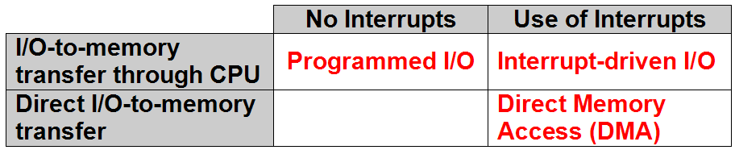
Input Output Techniques
Programmed I/O.
Interrupt-driven I/O.
Direct Memory Access (DMA).

Slide 27
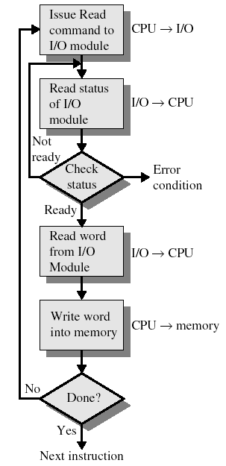
Programmed I/O
CPU (program) has direct control over I/O.
  Issuing commands
  Sensing status
  Transferring data
CPU issues a command to I/O module.
CPU checks status bits periodically.
  This process is called: pooling.
I/O module performs operation.
I/O module sets status bits.
CPU transfers data: device ⬅➔ memory.
Notes:
  I/O module does not inform CPU directly.
    I/O module does not interrupt CPU.
  CPU waits for I/O operation to complete.
    Disadvantage: Wasting CPU time!

Slide 28
I/O Commands vs. I/O Instructions
I/O Command
  Signal: issued by (or Sent from) CPU to I/O module.
  Types:
    Control: activate device & tell it what to do (e.g., rewind tape).
    Test: check status (e.g., is power on? is error detected?)
    Read/Write: transfer data CPU ⬅➔ buffer ⬅➔ peripheral
I/O instruction
  Step in program: fetched from MM & executed by CPU.
  To execute an I/O instruction: (1) CPU issues address of I/O module & device, (2) CPU issues an I/O command.
  Instruction form depends on how devices are addressed.
In programmed I/O, there is a one-to-one mapping between I/O instructions and I/O commands.

Slide 29
Addressing Techniques of I/O Devices
Two ways to assign addresses to I/O devices:
  Memory-mapped I/O
    Devices & memory share same address space.
    I/O looks just like memory read/write.
    No special instructions for I/O ➔ “load”, “store”, … etc.
    Bus has one Read & one Write control line.
    Pros: Large selection of memory access instructions.
    Cons: Valuable memory address space is used up!
  Isolated I/O
    Separate address space for devices.
    Special instructions for I/O ➔ “in”, “out”, “test”, … etc.
    Need two Rd & two Wr control lines.
    Pros: efficient use of memory address space.
    Cons: Not so many I/O instructions.

Slide 30
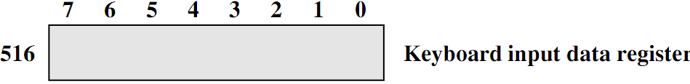
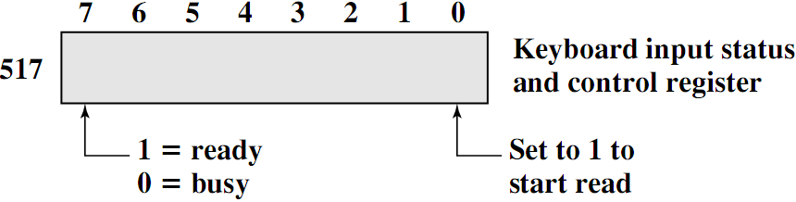
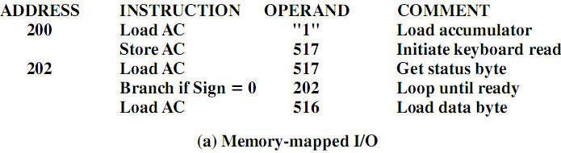
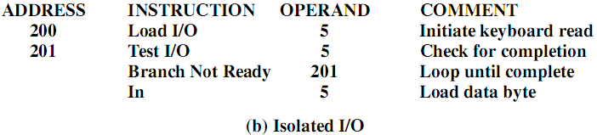
I/O Mapping - Example

Slide 31
Reading Material
Stallings, Chapter 6:
  Pages 215-217
Stallings, Chapter 7:
  Pages 222-232

