Slide 1

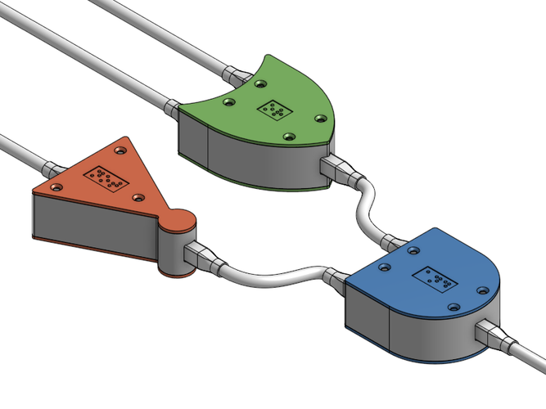
CS 211 - Digital Logic Design 211 عال - تصميم المنطق الرقمي First Term - 1439/1440 Lecture #2
Dr. Hazem Ibrahim Shehata
Assistant Professor
College of Computing and Information Technology

Slide 2
Administrivia
Course website:
Up and running but not fully functional yet!!
URL: http://hshehata.github.io/courses/su/cs211/

Slide 3
Hexadecimal Numbers
10₁₀
12₁₀
14₁₀
Radix/base of system is 16.
Sixteen possible values for each digit: 0, 1, 2, …, 9, A, B, C, D, E, F.
Example: The number 3D57.F0E₁₆
Column weights of hexadecimal num’s are powers of 16:
… 16³ 16² 16¹ 16⁰. 16⁻¹ 16⁻² 16⁻³ 16⁻⁴ …
11₁₀
13₁₀
15₁₀

Slide 4
Conversion: Hexadecimal ➔ Decimal
Method: Sum of weights
Example: Convert 3FA.4₁₆ to decimal.
Solution:
16² 16¹ 16⁰ . 16⁻¹
256 16 1 . 1/16
3 F A . 4
768 +240 +10 +0.25 = 1018.25₁₀
*
*
*
*

Slide 5
Conversion: Decimal ➔ Hexadecimal
Method:
Repeated division-by-16 (for integer)
Repeated multiplication-by-16 (for fraction)
Example: Convert 943₁₀ to Hexadecimal.
Solution:
943 ÷ 16 = 58 15
58 ÷ 16 = 3 10
3 ÷ 16 = 0 3
Quotient
Remainder
STOP
3
A
F

Slide 6
Conversion: Binary ➔ Hexadecimal
Method: 4-bit grouping (Break binary num. into 4-bit groups starting from radix point; replace each 4-bit group with the equivalent hexadecimal symbol)
Example: Convert 10011101010.101111₂ to hexadecimal.
Solution:
0100 1110 1010 . 1011 1100
4 E A . B C = 4EA.BC₁₆
NOTE: A zero added to the right of a fraction or the left of an integer, doesn’t change its value!!

Slide 7
Conversion: Hexadecimal ➔ Binary
Method: 4-bit replacement (Replace each hexadecimal symbol with the appropriate four bits)
Example: Convert 2B9.3A₁₆ to binary.
Solution:
2 B 9 . 3 A =
0010 1011 1001 . 0011 1010 = 1010111001.0011101₂
NOTE: A zero removed from the right of a fraction or the left of an integer doesn’t change its value!!

Slide 8
Octal Numbers
Radix/base of system is 8.
Eight possible values for each digit: 0, 1, 2, …, 7.
Example: The number 2407.321₈
Column weights of octal numbers are powers of 8:
… 8³ 8² 8¹ 8⁰. 8⁻¹ 8⁻² 8⁻³ 8⁻⁴ …

Slide 9
Conversion: Octal ⬅➔ Dec./Hex./Bin.
Methods are similar to hexadecimal; with few changes.
Octal ➔ decimal: sum of weights
Decimal ➔ octal: repeated division-by-8 and repeated multiplication-by-8
Binary ➔ octal: 3-bit grouping
Octal ➔ binary: 3-bit replacement

Slide 10
Conversion Methods Summary
 | Decimal | Binary | Octal | Hexadecimal
Decimal | - | Repeated Div./Mult. By 2 | Repeated Div./Mult. By 8 | Repeated Div./Mult. By 16
Binary | Sum of Weights | - | 3-bit Grouping | 4-bit Grouping
Octal | Sum of Weights | 3-bit Replacement | - | Oct. ➔ Bin. Bin. ➔ Hex.
Hexadecimal | Sum of Weights | 4-bit Replacement | Hex. ➔ Bin. Bin. ➔ Oct. | -
To
From

Slide 11
Unsigned Binary Addition
Eight basic rules for adding binary digits (bits):
Example:
When there is no carry (or a carry of 0) | When there is a carry of 1
0 + 0 ➔ Sum = 0, carry = 0 | 1 + 0 + 0 ➔ Sum = 1, carry = 0
0 + 1 ➔ Sum = 1, carry = 0 | 1 + 1 + 0 = 10 ➔ Sum = 0, carry = 1
1 + 0 ➔ Sum = 1, carry = 0 | 1 + 0 + 1 = 10 ➔ Sum = 0, carry = 1
1 + 1 ➔ Sum = 0, carry = 1 | 1 + 1 + 1 ➔ Sum = 1, carry = 1
1
1
1
0
0
1
1
1
0
+
0
0
1
1
1
1
0
1
0
1

Slide 12
Unsigned Binary Subtraction
Eight basic rules for subtracting binary digits (bits):
Example:
When there is no borrow (or a borrow of 0) | When there is a borrow of 1
0 – 0 ➔ sum = 0, borrow = 0 | 0 – 0 – 1 ➔ sum = 1, borrow = 1
0 – 1 ➔ sum = 1, borrow = 1 | 0 – 1 – 1 ➔ sum = 0, borrow = 1
1 – 0 ➔ sum = 1, borrow = 0 | 1 – 0 – 1 ➔ sum = 0, borrow = 0
1 – 1 ➔ sum = 0, borrow = 0 | 1 – 1 – 1 ➔ sum = 1, borrow = 1
1
1
1
0
1
0
1
0
1
–
0
1
1
1
1
0
0
1
1
0

Slide 13
Unsigned Binary Multiplication
Four basic rules for multiplying binary digits (bits):
0 × 0 = 0, 0 × 1 = 0, 1 × 0 = 0, 1 × 1 = 1
Example:
1
0
1
1
Multiplicand
×
1
1
0
1
Multiplier
1
0
1
1
+
0
0
0
0
Partial
Products
+
1
0
1
1
+
1
0
1
1
1
0
0
0
1
1
0
1
Product

Slide 14
Unsigned Binary Division
Same procedure as decimal division ➔ Long Division
Example:
0
0
0
0
1
1
0
1
Quotient
Divisor
1
0
1
1
1
0
0
1
0
0
1
1
Dividend
1
0
1
1
0
0
1
1
1
0
Partial
Remainders
1
0
1
1
0
0
1
1
1
1
1
0
1
1
0
1
0
0
Remainder

Slide 15
Reading Material
Floyd, Chapter 2:
Pages 54 – 57
Pages 72 – 82

