Slide 1

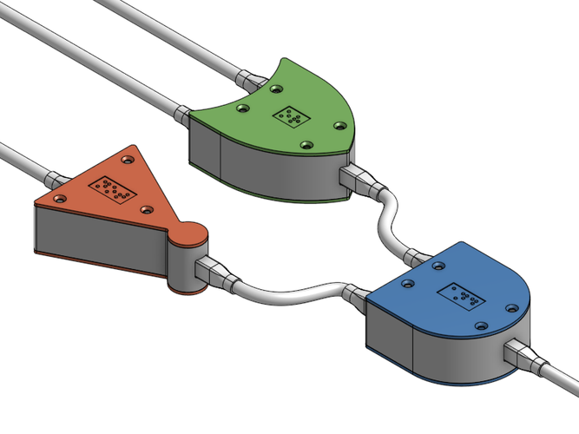
CS 211 - Digital Logic Design 211 عال - تصميم المنطق الرقمي First Term - 1439/1440 Lecture #3
Dr. Hazem Ibrahim Shehata
Assistant Professor
College of Computing and Information Technology

Slide 2
Administrivia
Course website:
http://hshehata.github.io/courses/su/cs211/

Slide 3
Complements of Binary Numbers
1’s complement:
Definition: 1’s complement of xxx…xxx₂ = 111…111₂ – xxx…xxx₂.
= (2^{n} – 1)₁₀ – xxx…xxx₂.
Meaning: Value that complements xxx…xxx₂ to 111…111₂.
Method: Flip each bit in the binary number, i.e., (1 ➔ 0, 0 ➔ 1).
Example: What is the 1’s complement of 11010001₂?
Solution:
1
1
0
1
0
0
0
1
0
0
1
0
1
1
1
0

Slide 4
Complements of Binary Numbers
2’s complement:
Definition: 2’s complement of xxx…xxx₂ = 1000…000₂ – xxx…xxx₂.
= (2^{n} )₁₀ – xxx…xxx₂
= 1’s complement + 1.
Meaning: Value that complements xxx…xxx₂ to 1000…000₂.

Slide 5
Complements of Binary Numbers
2’s complement (Cont.):
...
Method #1: (1) Find 1’s complement, and then add 1 to it!
Example: What is the 2’s complement of 10011000₂?
Solution:
1
0
0
1
1
0
0
0
0
1
1
0
0
1
1
1
+
1
0
1
1
0
1
0
0
0
5

Slide 6
Complements of Binary Numbers
2’s complement (Cont.):
...
Method #2: Flip all bits to the left of the least significant 1.
Example: What is the 2’s complement of 10011000₂?
Solution:
1
0
0
1
1
0
0
0
0
1
1
0
1
0
0
0
6

Slide 7
Signed Numbers
Signed numbers refer to: positive and negative integers.
Represented in digital systems (using bits) in 1 of 3 forms:
Sign-magnitude, 1’s complement, or 2’s complement.
Most significant (i.e., left-most) bit represents the sign ➔ sign bit.
Sign bit = 0 ➔ positive number
Sign bit = 1 ➔ negative number

Slide 8
Signed Number Representation
 | Sign-magnitude | 1’s Complement | 2’s Complement
Positive Numbers +xxx…xxx₂ | 0 for sign bit followed by magnitude 0xxx…xxx₂
 | Sign-magnitude | 1’s Complement | 2’s Complement
Positive Numbers +xxx…xxx₂ | 0 for sign bit followed by magnitude 0xxx…xxx₂
Negative Numbers -xxx…xxx₂ | 1 for sign bit followed by magnitude 1xxx…xxx₂ | 1’s complement of corresponding +ve number 1’s of 0xxx…xxx₂ | 2’s complement of corresponding +ve number 2’s of 0xxx…xxx₂
 | Sign-magnitude | 1’s Complement | 2’s Complement
Positive Numbers +xxx…xxx₂ | 0 for sign bit followed by magnitude 0xxx…xxx₂
Negative Numbers -xxx…xxx₂ | 1 for sign bit followed by magnitude 1xxx…xxx₂ | 1’s complement of corresponding +ve number 1’s of 0xxx…xxx₂ | 2’s complement of corresponding +ve number 2’s of 0xxx…xxx₂
Range n bits | -(2^{n-1}-1) ➔ 2^{n-1}-1 | -(2^{n-1}-1) ➔ 2^{n-1}-1 | -(2^{n-1}-1) ➔ 2^{n-1}

Slide 9
Conversion: Decimal ➔ Signed (Ex.)
Example: Represent +12₁₀ and -12₁₀ using 6 bits in the sign-magnitude, 1’s complement, 2’s complement forms.
Solution:
In binary 12₁₀ ➔ 001100
 | S-M | 1’s | 2’s
+12 | 001100 | 001100 | 001100
 | S-M | 1’s | 2’s
+12 | 001100 | 001100 | 001100
-12 | 101100 | 110011 | 110100

Slide 10
Conversion: Signed ➔ Decimal (Ex.)
Example: Which decimal number is represented by the signed value 101110₂?
Solution:
Sign bit = 1 ➔ decimal number is negative!
S-M Form ➔ Number = - 01110₂ = -14₁₀
1’s Comp. Form ➔ Number = - (1’s of 101110₂) = - 010001 = -17₁₀
2’s Comp. Form➔ Number = - (2’s of 101110₂) = - 010010 = -18₁₀

Slide 11
Representations of 4-Bit Signed Integers
Decimal
+8
+7
+6
+5
+4
+3
+2
+1
+0
-0
-1
-2
-3
-4
-5
-6
-7
-8
Decimal | S-M
+8 | -
+7 | 0111
+6 | 0110
+5 | 0101
+4 | 0100
+3 | 0011
+2 | 0010
+1 | 0001
+0 | 0000
-0 | 1000
-1 | 1001
-2 | 1010
-3 | 1011
-4 | 1100
-5 | 1101
-6 | 1110
-7 | 1111
-8 | -
Decimal | S-M | 1’s
+8 | - | -
+7 | 0111 | 0111
+6 | 0110 | 0110
+5 | 0101 | 0101
+4 | 0100 | 0100
+3 | 0011 | 0011
+2 | 0010 | 0010
+1 | 0001 | 0001
+0 | 0000 | 0000
-0 | 1000 | 1111
-1 | 1001 | 1110
-2 | 1010 | 1101
-3 | 1011 | 1100
-4 | 1100 | 1011
-5 | 1101 | 1010
-6 | 1110 | 1001
-7 | 1111 | 1000
-8 | - | -
Decimal | S-M | 1’s | 2’s
+8 | - | - | -
+7 | 0111 | 0111 | 0111
+6 | 0110 | 0110 | 0110
+5 | 0101 | 0101 | 0101
+4 | 0100 | 0100 | 0100
+3 | 0011 | 0011 | 0011
+2 | 0010 | 0010 | 0010
+1 | 0001 | 0001 | 0001
+0 | 0000 | 0000 | 0000
-0 | 1000 | 1111 | -
-1 | 1001 | 1110 | 1111
-2 | 1010 | 1101 | 1110
-3 | 1011 | 1100 | 1101
-4 | 1100 | 1011 | 1100
-5 | 1101 | 1010 | 1011
-6 | 1110 | 1001 | 1010
-7 | 1111 | 1000 | 1001
-8 | - | - | 1000
Range of integers that can be represented by 4 bits:
S-M ➔ -7 : +7
➔ -(2⁴⁻¹-1) : 2⁴⁻¹-1
1’s ➔ -7 : +7
➔ -(2⁴⁻¹-1) : 2⁴⁻¹-1
2’s ➔ -8 : +7
➔ -2⁴⁻¹ : 2⁴⁻¹-1

Slide 12
Signed Addition (2’s Complement)
Addition of 2’complement signed numbers is similar to addition in unsigned binary with two exceptions:
Final carry bit must be discarded!
Overflow can happen ➔ Result is incorrect, when:
Added numbers are positive yet result is negative!!
Added numbers are negative yet result is positive!!

Slide 13

Signed Addition (2’s Complement) (Ex.)
Example:
00000111
7
00001111
15
01111101
125
+
00000100
+
4
+
11111010
+
-6
+
00111010
+
58
00001011
11
1
00001011
9
10110111
183
Discard!
Overflow!
00010000
16
11111011
-5
‭10110000‬
-80
+
11101000
+
-24
+
11110111
+
-9
+
‭11001001‬
+
-55
11111000
-8
1
11110010
-14
1
01111001
-135
Discard!
Overflow!

Slide 14
Signed Subtraction (2’s Complement)
Transformed into addition by the following rule:
x – y = x + (-y) = x + 2’s complement of y
Example:
11100111
-25
–
11110100
–
-12
11100111
-25
+
00001100
+
12
11110011
-13

Slide 15
Signed Multiplication (2’s Complement)
Performed in three steps:
Transform multiplicand and multiplier into positive numbers.
Perform unsigned multiplication.
Adjust the sign of product if needed!
Leave product positive if multiplicand and multiplier signs are similar.
Negate product (taking its 2’s complement) if multiplicand and multiplier signs are different.

Slide 16
Signed Division (2’s Complement)
Performed in three steps:
Transform dividend and divisor into positive numbers.
Perform unsigned division.
Adjust the sign of quotient and remainder if needed!
Leave quotient positive if dividend and divisor signs are similar.
Negate quotient (taking its 2’s complement) if dividend and divisor signs are different.
Leave remainder positive if dividend is positive.
Negate remainder (taking its 2’s complement) if dividend is negative.

Slide 17
Reading Material
Floyd, Chapter 2:
Pages 58 - 63
Pages 66 - 72

