Slide 1
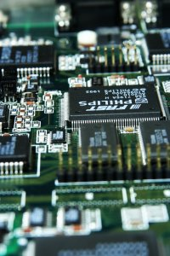
CSE 321a
Computer Organization (1)
تنظيم الحاسبات (1)
3rd year, Computer Engineering
Fall 2017
Lecture #1
Dr. Hazem Ibrahim Shehata
Dept. of Computer & Systems Engineering
Credits to Dr. Ahmed Abdul-Monem Ahmed for the slides

Slide 2
Teaching Staff
Instructor:
Hazem Ibrahim Shehata
Email: hshehata@uwaterloo.ca
Lectures: Tuesday 10:15am – 12:45am
Office Hours: TBA
Teaching Assistant:
Hisham Abdullah
Email: eng_hisham22@yahoo.com
Tutorials: TBA
Office Hours: TBA

Slide 3
Course Info
Course website:
http://hshehata.github.io/courses/zu/cse321a/
Textbook:
“Computer Organization and Architecture: Designing for Performance”, William Stallings, 9th Edition, 2013, www.williamstallings.com/ComputerOrganization

Slide 4
Course Info (Cont.)
Grading:
Course work | Grade distribution
Participation | 3pt | 30
Assignments | 12pt
Midterm Exam | 15pt
Final Exam | 70pt
Total Points | 100

Slide 5
Course Overview
Ch. 1: Introduction
Ch. 2: Computer Evolution and Performance
Ch. 3: A Top-Level View of Computer Function and Interconnection
Ch. 4: Cache Memory
Ch. 12: Instruction Sets: Characteristics and Functions
Ch. 13: Instruction Sets: Addressing Modes and Formats
Ch. 19: Control Unit Operation
…

Slide 6
Ch. 1: Introduction

Slide 7
Organization vs. Architecture (1)
Architecture: attributes visible to the programmer.
Instruction set, number of bits used for data representation, I/O mechanisms, addressing techniques.
Ex.: Is there a multiply instruction?
Organization: how features are implemented. Such details may be hidden from programmer.
Control signals, interfaces, memory technology, number of cores.
Ex.: Is there a hardware multiply unit or is it done by repeated addition?

Slide 8
Organization vs. Architecture (2)
All Intel x86 family share the same basic architecture.
This gives code compatibility, at least backwards.
Organization differs between different versions (e.g., Core i3/i5/i7, Xeon, Atom, … etc.)

Slide 9
Hardware Structure vs. Function
Structure: the way in which components relate to each other.
Function: the operation of individual components as part of the structure

Slide 10
Structure - Top level
Peripherals
Computer
Central
Processing
Unit
Main
Memory
Computer
Systems
Interconnection
Input
Output
Communication
lines

Slide 11

Structure - CPU
CPU
Computer
Arithmetic
and
Login Unit
CPU
Registers
Memory
System
Bus
Internal CPU
Interconnection
I/O
Control
Unit

Slide 12

Structure – Control Unit
Control Unit
CPU
ALU
Sequencing
Logic
Registers
Internal
Bus
Control Unit
Registers and
Decoders
Control
Unit
Control
Memory

Slide 13
Function
All computers have the following functions:
Data storage
Date processing
Data movement
Control

Slide 14
Functional View of a Computer
Data
Storage
Facility
Data
Movement
Apparatus
Control
Mechanism
Data
Processing
Facility

Slide 15
Data Movement
e.g., keyboard to screen.
Data
Storage
Facility
Data
Movement
Apparatus
Control
Mechanism
Data
Processing
Facility

Slide 16
Storage
e.g., Internet download to a disk.
Data
Storage
Facility
Data
Movement
Apparatus
Control
Mechanism
Data
Processing
Facility

Slide 17
Data Processing to/from Storage
e.g., updating a bank statement.
Data
Storage
Facility
Data
Movement
Apparatus
Control
Mechanism
Data
Processing
Facility

Slide 18
Data Processing from Storage to I/O
e.g., printing a bank statement.
Data
Storage
Facility
Data
Movement
Apparatus
Control
Mechanism
Data
Processing
Facility

Slide 19
Chapter 2: Computer Evolution and Performance

Slide 20
Performance Assessment
Factors considered in evaluating processors:
Cost, size, power consumption, …, and performance.
Performance: amount of work done over time.
Time measurement is straightforward!
seconds, minutes, hours, … etc.
Work measurement is system-specific!
# of tasks performed, # of products completed, # of things done … etc.
Ex.: Car assembly line:
Performance = number of cars assembled every hour.

Slide 21
Processor Performance
Processor performance is reflected by:
Instructions-per-second (IPS) rate (R_{i}): number of instructions executed each second. When instructions are count in millions, this becomes MIPS rate (R_{m}).
Programs-per-second (PPS) rate (R_{p}): number of programs executed each second.
Processor performance parameters:
Clock speed (f) (in cycles/second or Hz)
Processor goes through multiple steps to execute each instruction.
Each step takes one clock cycle to be performed.
Duration of each clock cycle (cycle time τ) = 1/f

Slide 22
Processor Performance Parameters
Processor performance parameters (Continued):
Instruction count (I_{c}) (in instructions)
Number of machine instructions executed for a given program to run from start until completion.
Cycles per instruction (CPI) (in cycles/instruction)
Number of clock cycles taken to execute an instruction.
Different types of instructions have different CPI values!
Average CPI for a program with n different types of instructions:
I_{c}: instruction count for the program.
I_{x}: number of instructions of type x.
CPI_{x}: CPI for instructions of type x.

Slide 23
Performance Metrics
Av. time to execute instruction:
IPS rate:
MIPS rate:
Av. time to execute program:
PPS rate:

Slide 24
Performance Calculation Example
A 2-million instruction program is executed by 400-MHz processor.
Program has 4 types of instructions:
CPI = (1 * 0.60) + (2 * 0.18) +
(4 * 0.12) + (8 * 0.10) = 2.24
R_{m} = (400 * 10⁶) / (2.24 * 10⁶) ≈ 178
R_{p} = (400 * 10⁶) / (2.24 * 2 * 10⁶) ≈ 89
Instruction Type | CPI | Instruction Mix (%)
Arithmetic and logic | 1 | 60
Load/store (Cache hit) | 2 | 18
Branch | 4 | 12
Load/store (Cache miss) | 8 | 10

Slide 25
Benchmarking
R_{i} and R_{m} can’t be used to compare performance of processors with different instruction sets!
Ex.: CISC vs. RISC
Alternative: Compare how fast processors execute a standard set of benchmark programs.
Characteristics of a benchmark program:
Written in high-level language (i.e., machine independent).
Representing different programming styles and applications.
Measured easily.
Widely distributed.

Slide 26

SPEC benchmarks
Best known collection of benchmark suites is introduced by the System Performance Evaluation Corporation (SPEC).
Examples of SPEC benchmark suites:
SPECcpu2017: 43 processor-intensive programs
SPECjvm2008: java virtual machine
SPECsfs2014: file server
…
Suite Name | SPECspeed2017 Integer | SPECspeed2017 Floating Point | SPECrate2017 Integer | SPECrate2017 Floating Point
No. of Programs | 10 | 10 | 10 | 13
Target | Single-task performance |  | Multi-task performance
Language | C, C++, Fortran
Size | 1K – 1.5M lines of code per program
Examples | GNU C compiler, Video compression, Weather Modeling

Slide 27
SPEC Speed Metric (r_{g})
SPEC defines a base runtime (Tref_{x}) for each benchmark program x using a reference machine.
Runtime of system-under-test (Tsut_{x}) is measured.
Result of running benchmark program x on system-under-test is reported as a ratio (r_{x}):
Overall result of running n-program benchmark suite is the geometric mean (r_{g}) of all ratios:

Slide 28
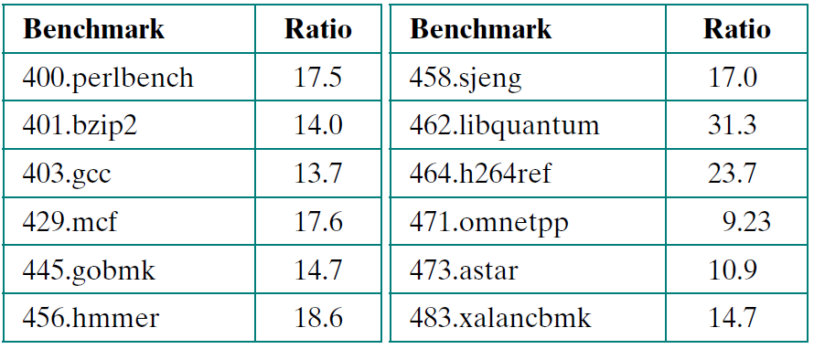
Ex.: SPECint2006 on Sun Blade 6250
Sun Blade 6250: 8 processors (2 chips * 4 cores)
Benchmark program 464.h264ref (Video encoding):
Tref_{x} = 22135s, Tsut_{x} = 934s ➔ r_{x} = 22135/924 = 23.7
Ratios of all SPECint2006 benchmark programs:
Speed metric (r_{g}):
r_{g} = (17.5 * 14 * 13.7 * … * 14.7)^{1/12} = 18.5

Slide 29
Amdahl’s Law
Proposed by Gene Amdahl in 1967.
Deals with potential speedup of a program execution by multiple processors.
Speedup: ratio between program execution time on single processor to that on N processors.
Amdahl’s law: if a program takes time T to be executed by a single processor, and only a fraction f of that program can be executed in parallel using N processors, Then:

Slide 30
Conclusions of Amdahl’s Law
Amdahl’s law has two important conclusions:
Parallel processors has little effect when f is small!
When f goes to 0, speedup goes to 1.
Speedup is bound by 1/(1–f) regardless of N!
When N goes to ∞, speedup goes to 1/(1–f).
Amdahl’s law can be generalized to deal with any system enhancements.
Generalized Amdahl’s law: if an enhancement speeds up execution of a program fraction f by a factor k, then:

Slide 31
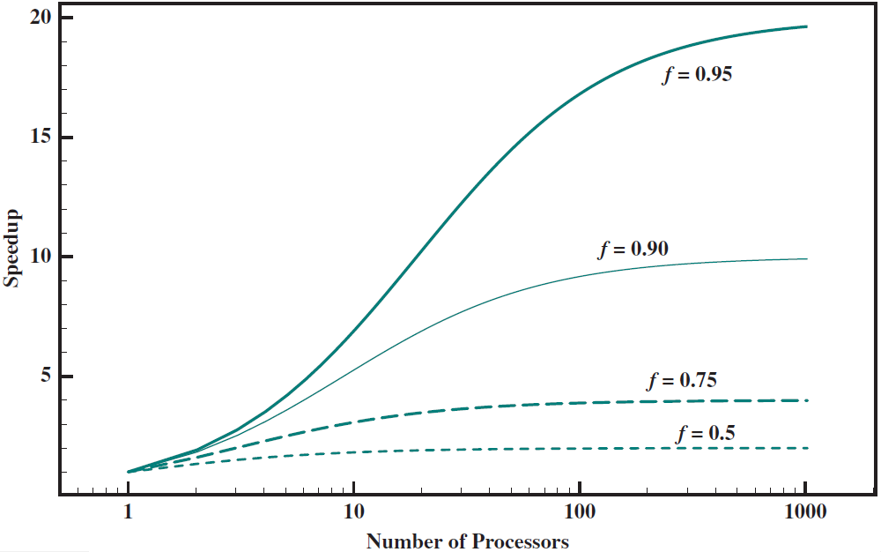
Amdahl’s Law for Multiprocessors

Slide 32
Reading Material
Stallings, Chapter 1:
Pages 7 – 13
Stallings, Chapter 2:
Pages 49 – 57

