Slide 1

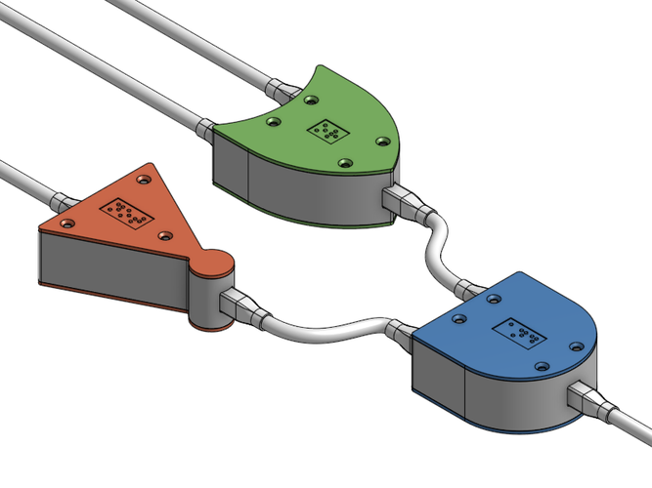
CS 211 - Digital Logic Design 211 عال - تصميم المنطق الرقمي First Term - 1439/1440 Lecture #6
Dr. Hazem Ibrahim Shehata
Assistant Professor
College of Computing and Information Technology

Slide 2
Administrivia
Assignment #1:
Due: Today.
Solution to be posted tomorrow.
Midterm #1:
Date: Wednesday, October 24, 2018.
Time: 8:30am - 9:30am
Scope: Chapters 2 and 3 (Lectures 1, 2, 3, 4, 5, and first part of 6).
Website: http://hshehata.github.io/courses/su/cs211

Slide 3

Chapter 3: Logic Gates (... Continuing …)

Slide 4
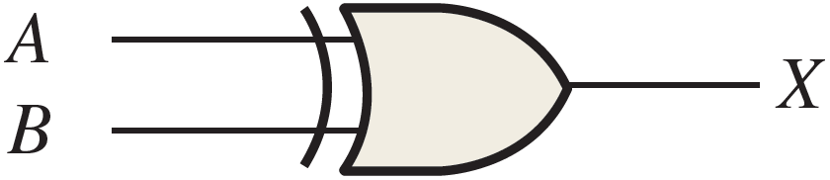
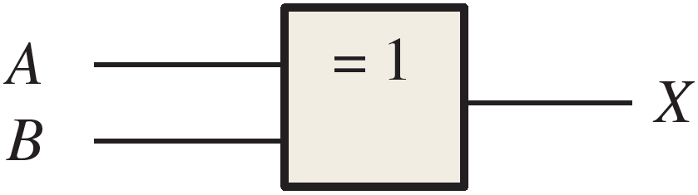
Exclusive-OR (XOR) Gate
Performs operation called modulo-2 addition, which is the same as binary addition with no carry.
Takes 2⁺ inputs, and produces 1 output.
Output is High (1) if and only if number of High (1) inputs is odd.
Output is Low (0) if and only if number of High (1) inputs is even.
Symbols:

Slide 5
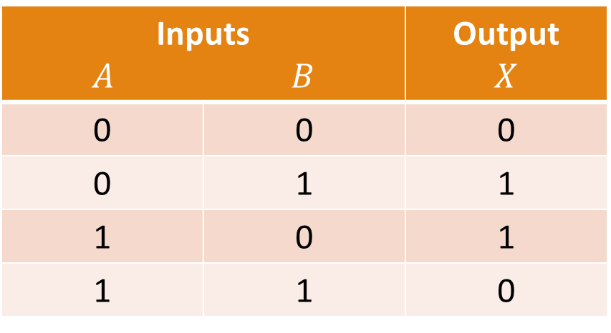
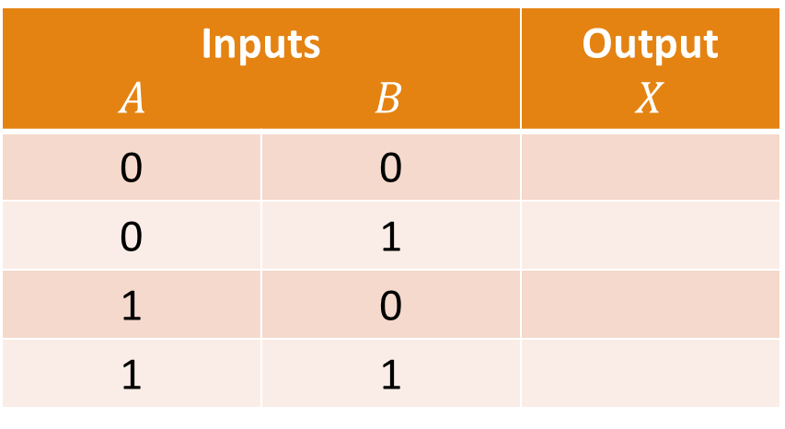
XOR Gate Truth Table
For a 2-input XOR Gate:
Inputs $A$ $B$ |  | Output $$X$$
0 | 0
0 | 1
1 | 0
1 | 1
Inputs $A$ $B$ |  | Output $$X$$
0 | 0 | 0
0 | 1 | 1
1 | 0 | 1
1 | 1 | 0

Slide 6
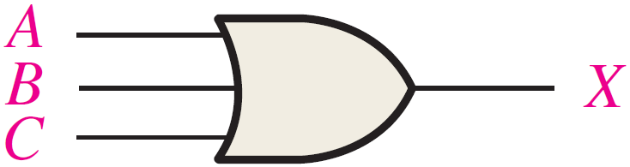

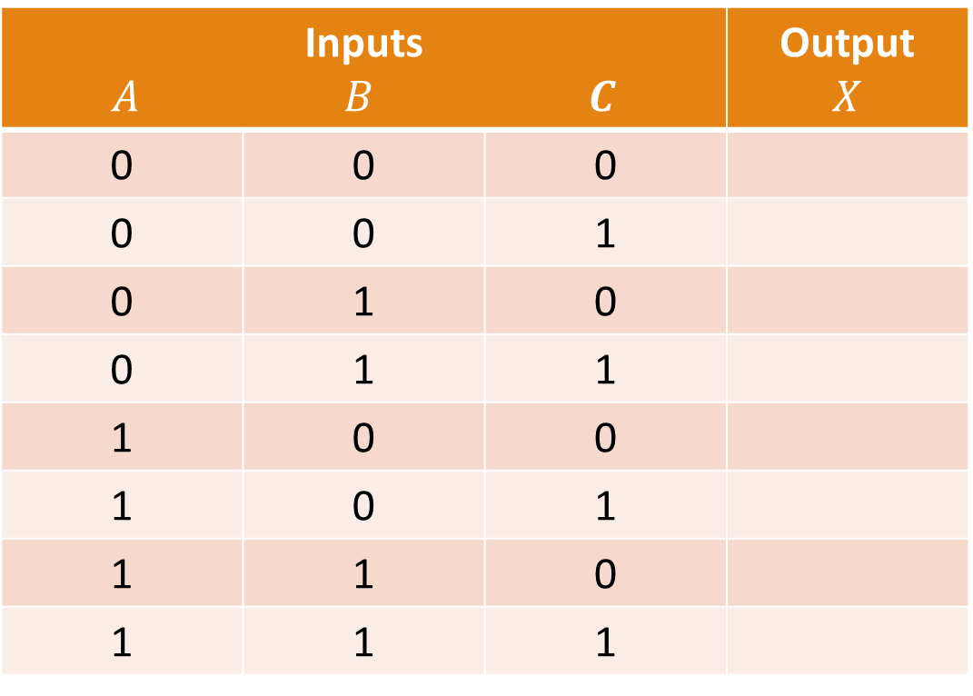
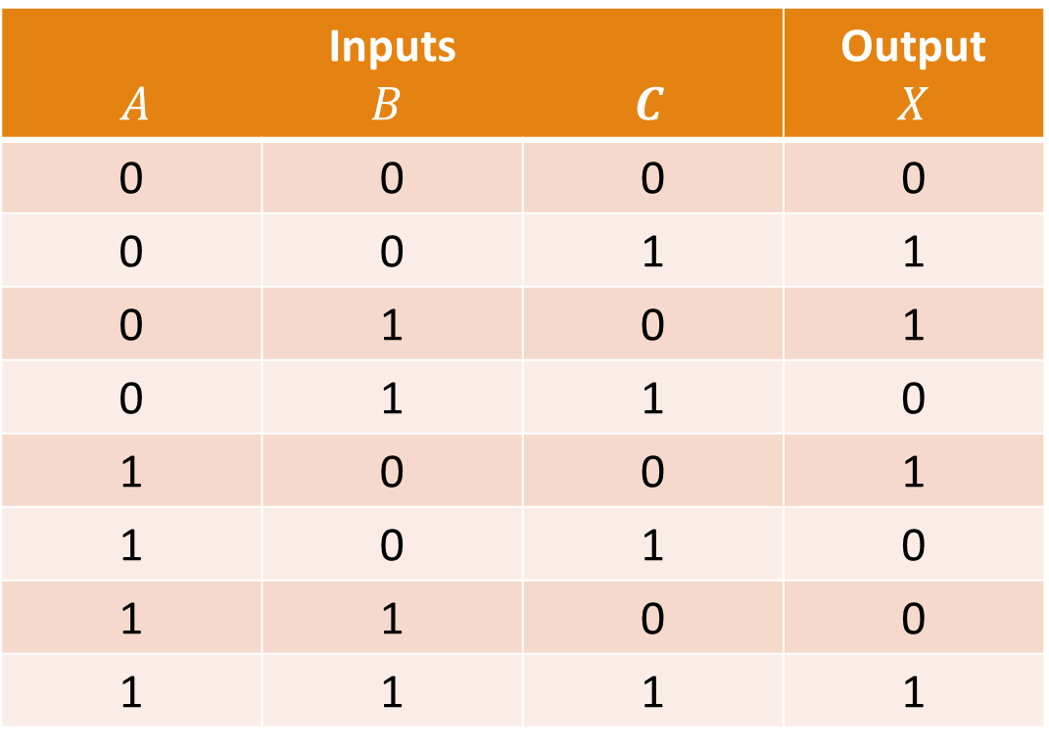
Example: Truth Table for 3-input XOR Gate
Inputs $A$ $B$ $C$ |  |  | Output $$X$$
0 | 0 | 0
0 | 0 | 1
0 | 1 | 0
0 | 1 | 1
1 | 0 | 0
1 | 0 | 1
1 | 1 | 0
1 | 1 | 1
Inputs $A$ $B$ $C$ |  |  | Output $$X$$
0 | 0 | 0 | 0
0 | 0 | 1 | 1
0 | 1 | 0 | 1
0 | 1 | 1 | 0
1 | 0 | 0 | 1
1 | 0 | 1 | 0
1 | 1 | 0 | 0
1 | 1 | 1 | 1
$n=3$ ➔ $N=2^{3}=8$

Slide 7
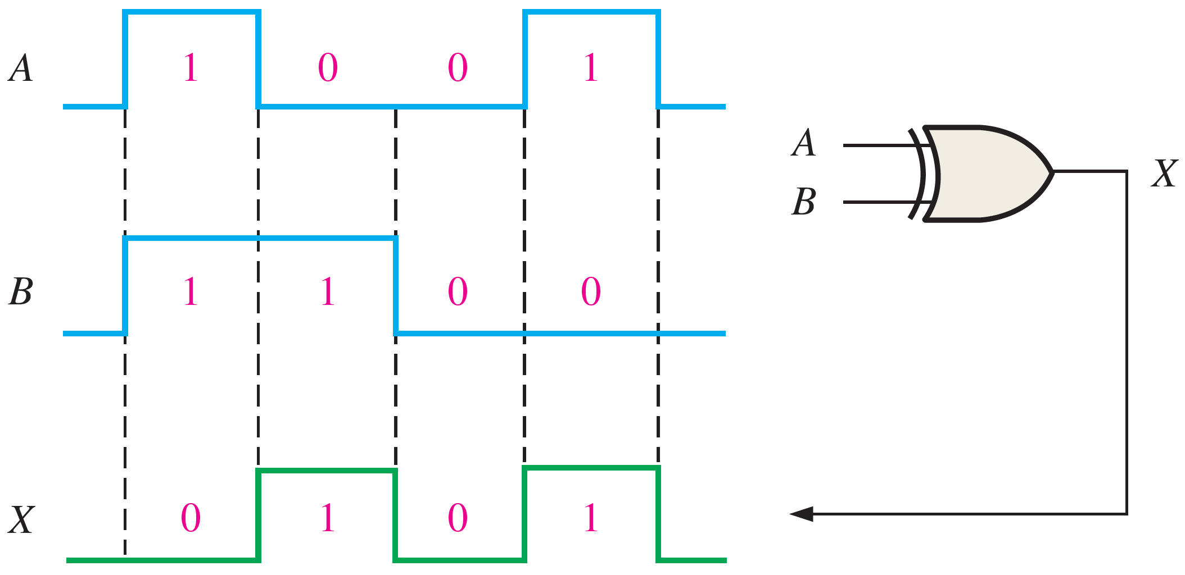
Timing Diagram of XOR Gate
Example: 2-input XOR Gate

Slide 8
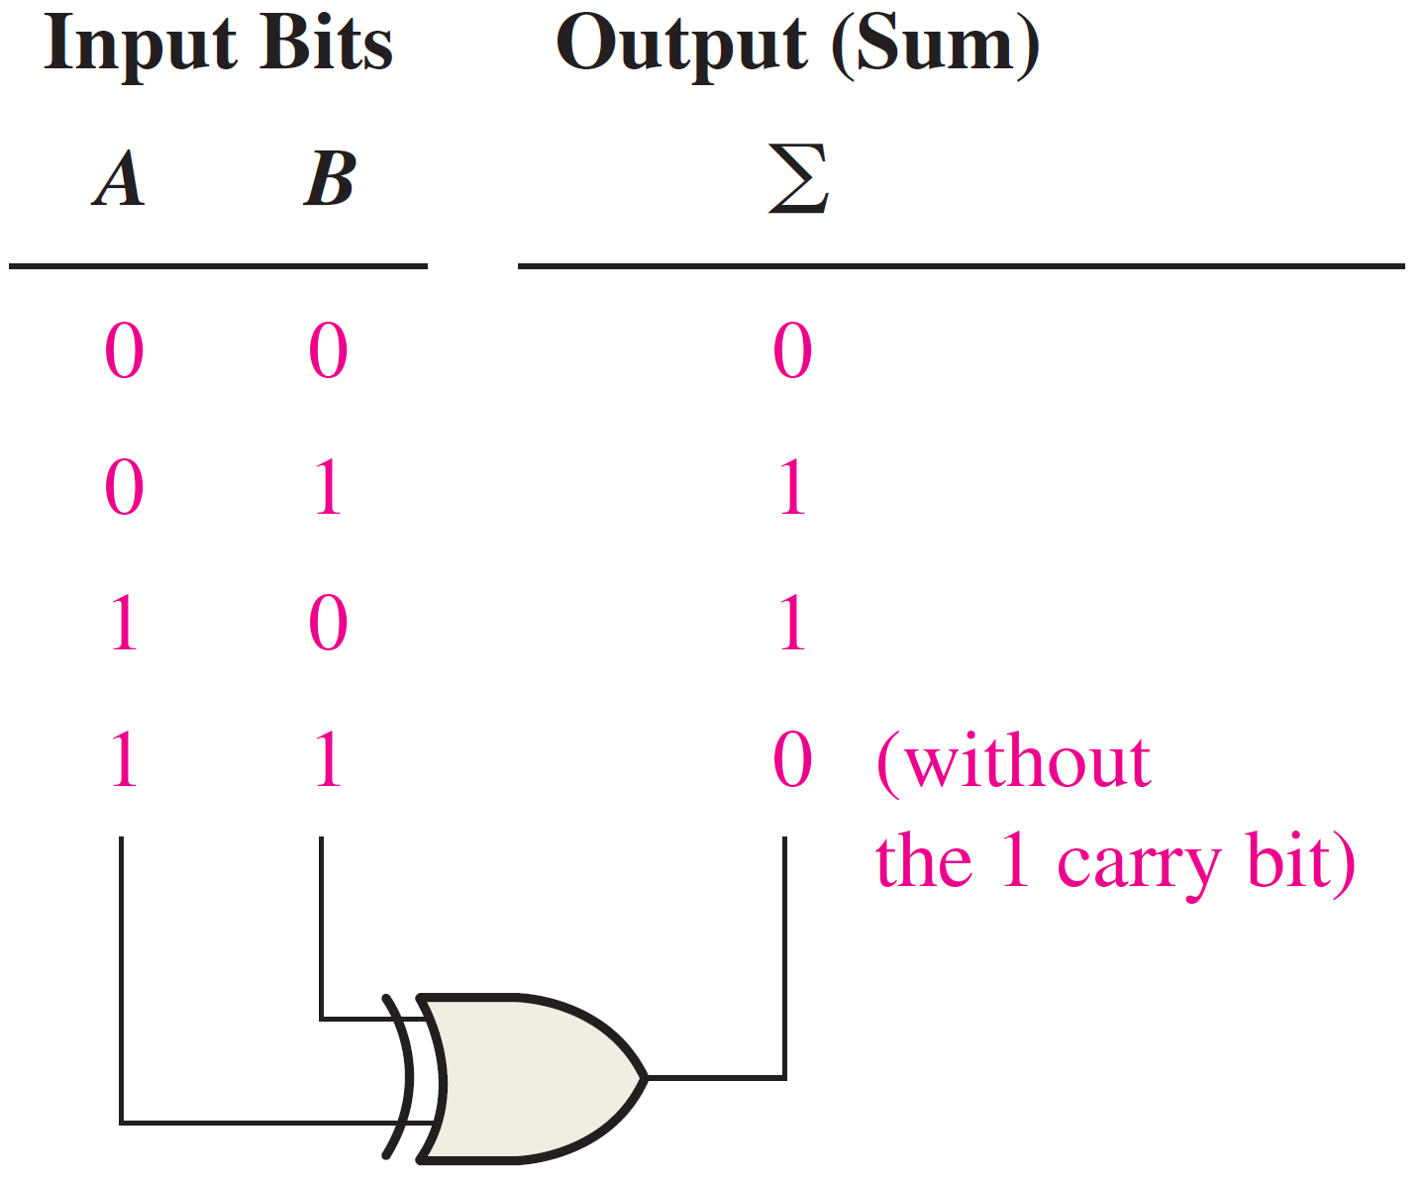
Application of XOR Gate
Example: 1-bit Modulo-2 adder
+
+
+
+

Slide 9
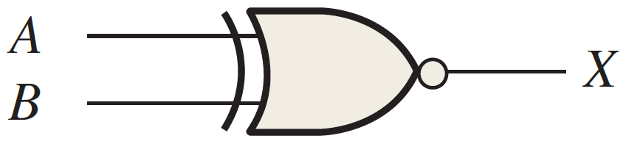
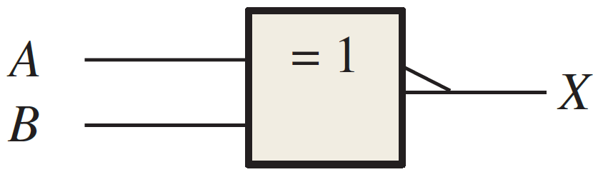
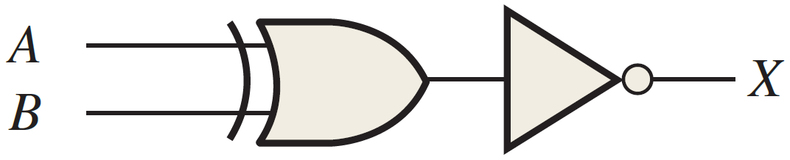
Exclusive-NOR (XNOR) Gate
XOR with an inverted output.
Takes 2⁺ inputs, and produces 1 output.
Output is Low (0) if and only if number of High (1) inputs is odd.
Output is High (1) if and only if number of High (1) inputs is even.
Symbols:
Equivalent to:

Slide 10
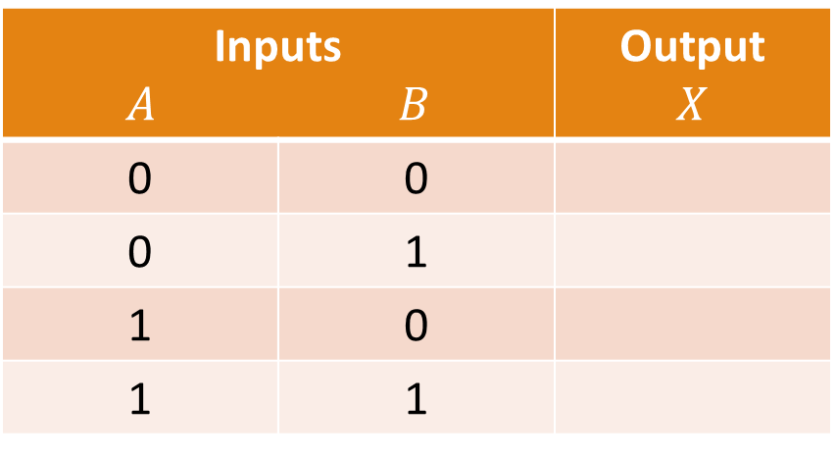
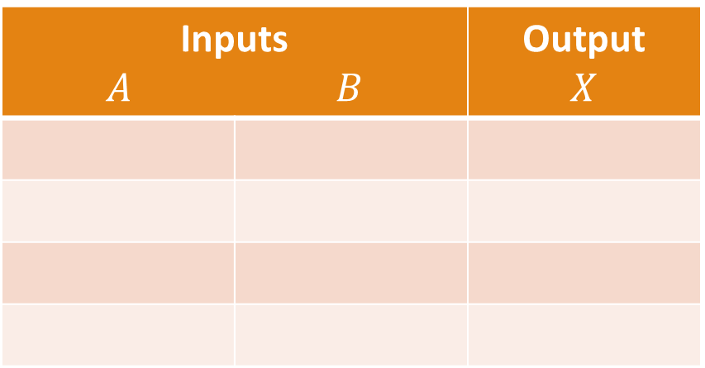
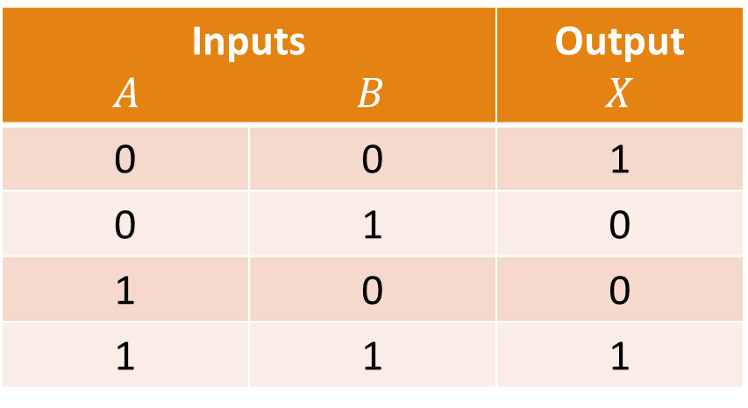
XNOR Gate Truth Table
For a 2-input XNOR Gate:
Inputs $A$ $B$ |  | Output $$X$$
Inputs $A$ $B$ |  | Output $$X$$
0 | 0
0 | 1
1 | 0
1 | 1
Inputs $A$ $B$ |  | Output $$X$$
0 | 0 | 1
0 | 1 | 0
1 | 0 | 0
1 | 1 | 1

Slide 11
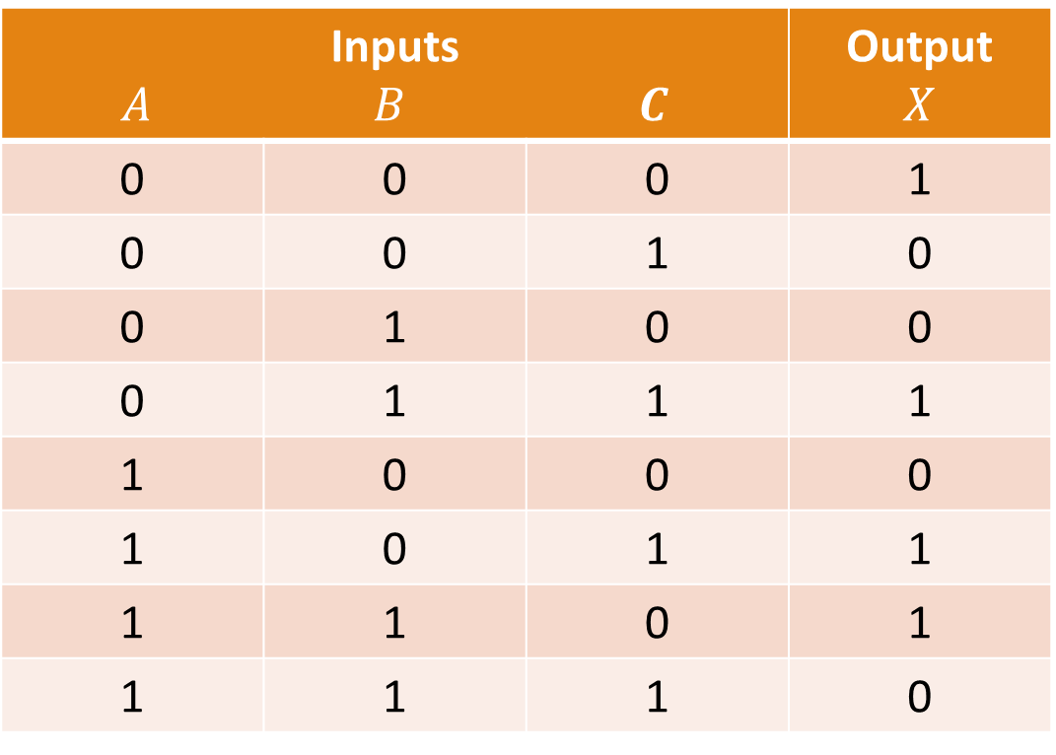
Example: Truth Table for 3-input XNOR Gate
Inputs $A$ $B$ $C$ |  |  | Output $$X$$
0 | 0 | 0
0 | 0 | 1
0 | 1 | 0
0 | 1 | 1
1 | 0 | 0
1 | 0 | 1
1 | 1 | 0
1 | 1 | 1
Inputs $A$ $B$ $C$ |  |  | Output $$X$$
0 | 0 | 0 | 1
0 | 0 | 1 | 0
0 | 1 | 0 | 0
0 | 1 | 1 | 1
1 | 0 | 0 | 0
1 | 0 | 1 | 1
1 | 1 | 0 | 1
1 | 1 | 1 | 0
$n=3$ ➔ $N=2^{3}=8$

Slide 12
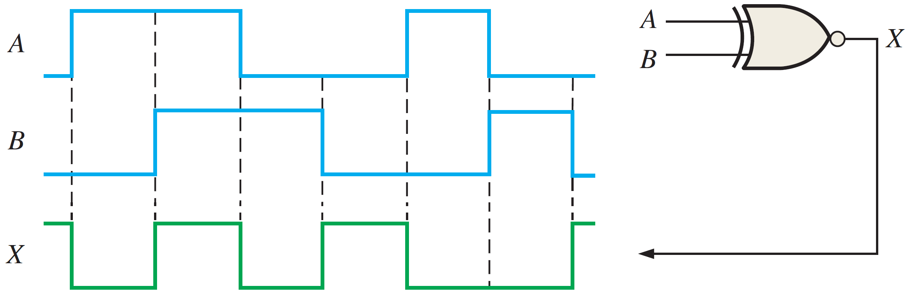
Timing Diagram of XNOR Gate
Example: 2-input XNOR Gate

Slide 13
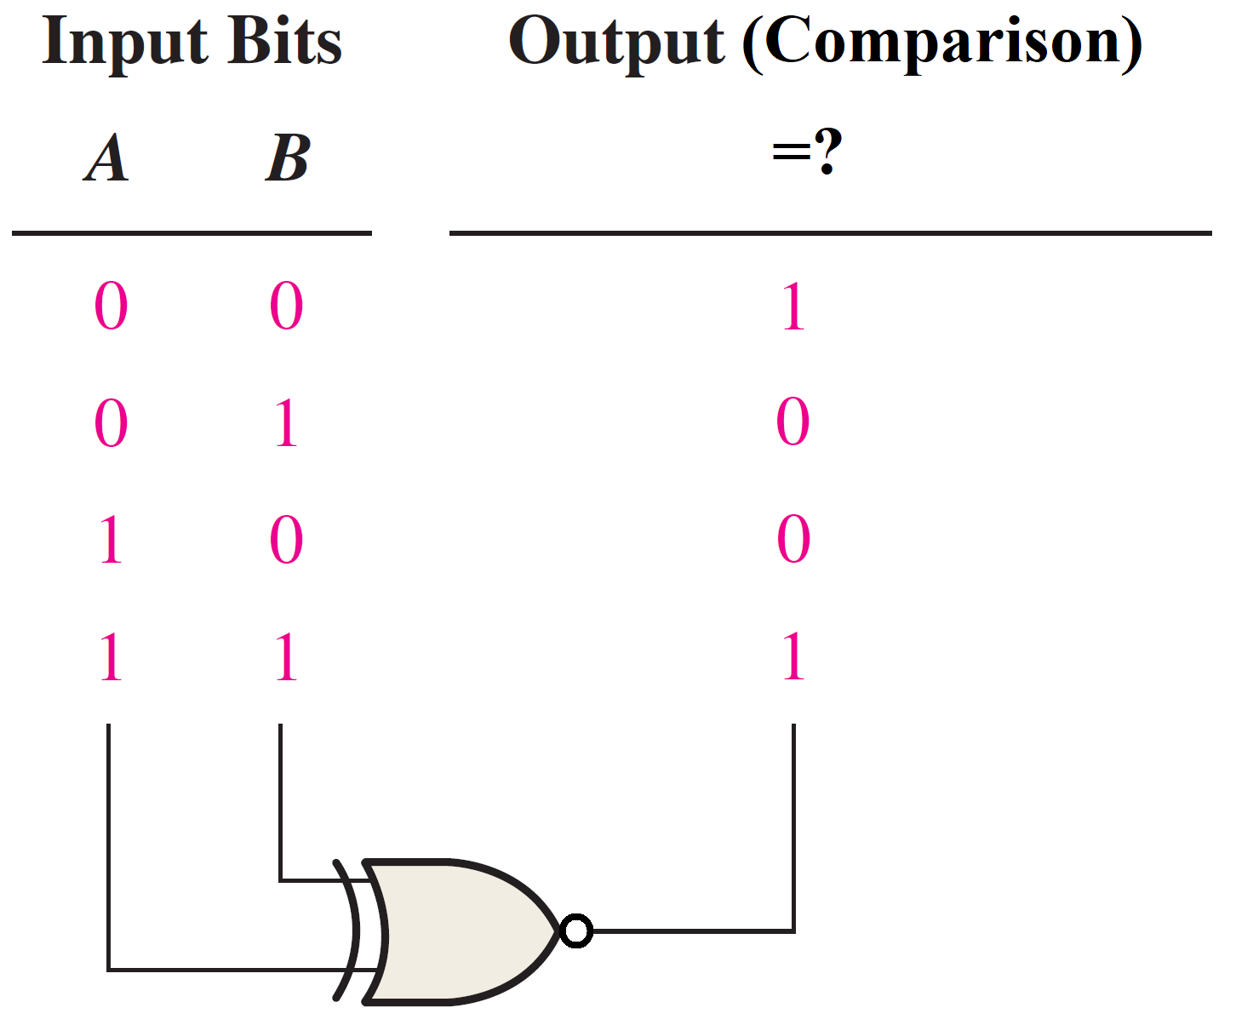
Application of XNOR Gate
Example: 1-bit Binary Comparator
=
≠
≠
=

Slide 14
Chapter 4: Boolean Algebra and Logic Simplification

Slide 15
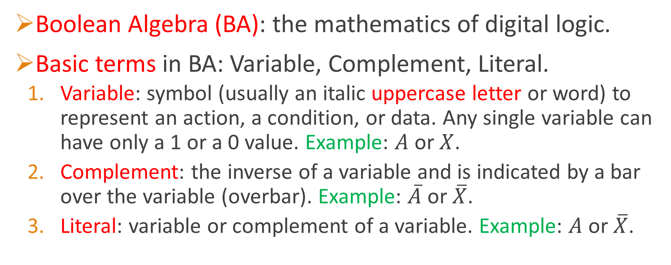
Basic Boolean Terms
Boolean Algebra (BA): the mathematics of digital logic.
Basic terms in BA: Variable, Complement, Literal.
Variable: symbol (usually an italic uppercase letter or word) to represent an action, a condition, or data. Any single variable can have only a 1 or a 0 value. Example: $A$ or $X$.
Complement: the inverse of a variable and is indicated by a bar over the variable (overbar). Example: $\overline{A}$ or $\overline{X}$.
Literal: variable or complement of a variable. Example: $A$ or $\overline{X}$.

Slide 16
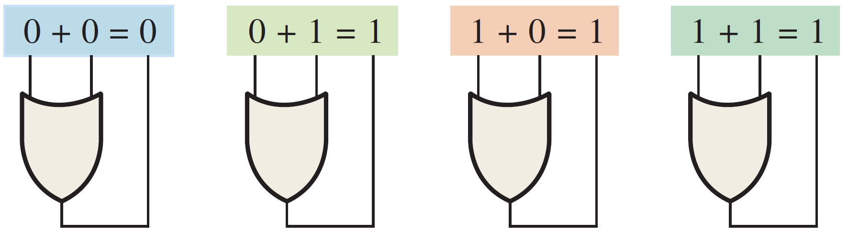
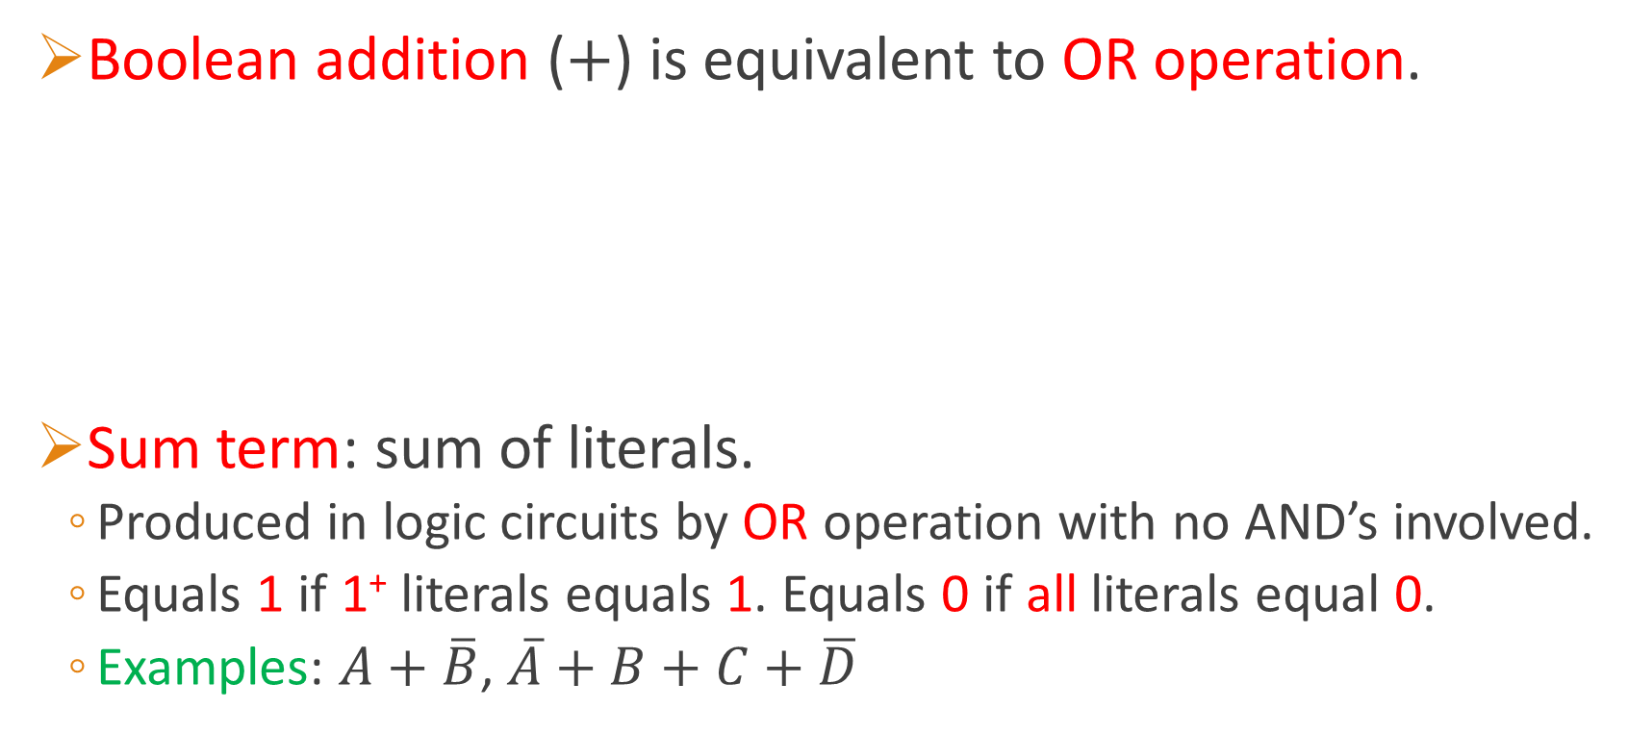
Boolean Addition
Boolean addition ($+$) is equivalent to OR operation.
Sum term: sum of literals.
Produced in logic circuits by OR operation with no AND’s involved.
Equals 1 if 1⁺ literals equals 1. Equals 0 if all literals equal 0.
Examples: $A+\overline{B}$, $\overline{A}+B+C+\overline{D}$

Slide 17
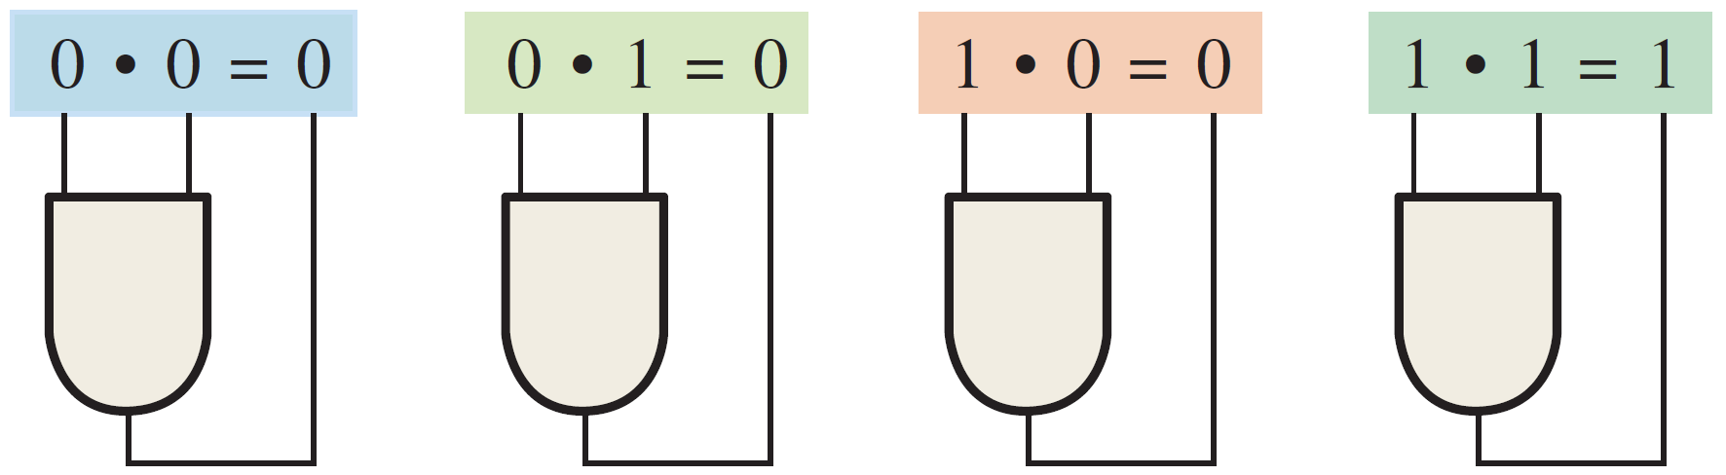
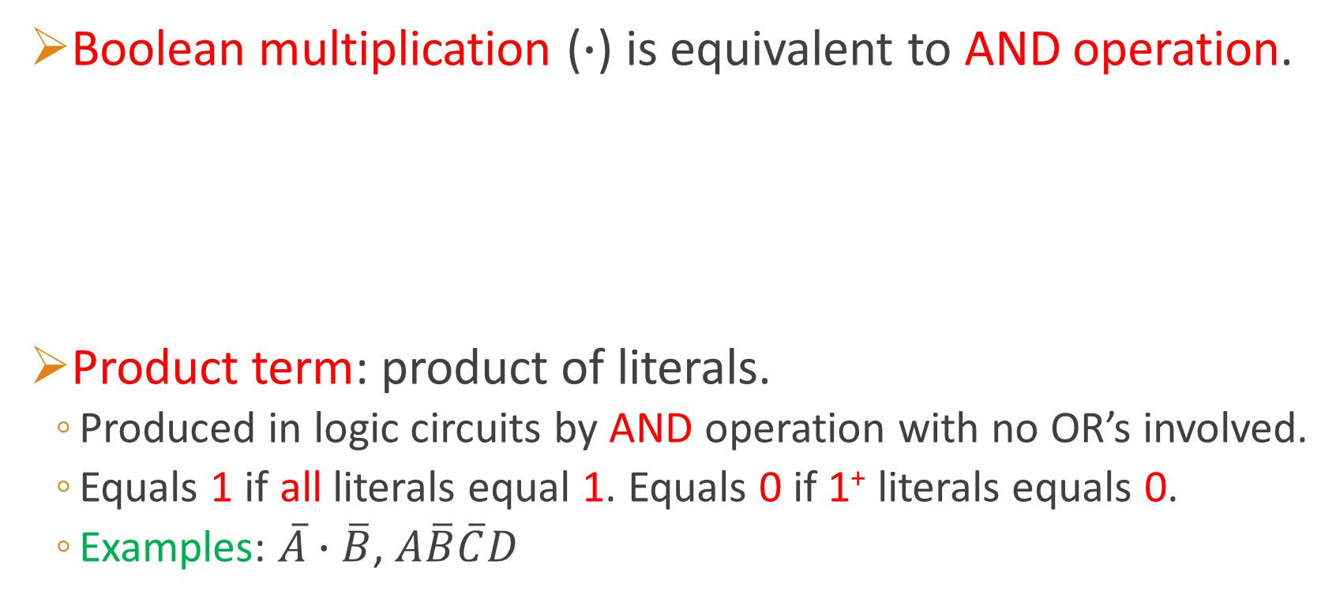
Boolean Multiplication
Boolean multiplication ($∙$) is equivalent to AND operation.
Product term: product of literals.
Produced in logic circuits by AND operation with no OR’s involved.
Equals 1 if all literals equal 1. Equals 0 if 1⁺ literals equals 0.
Examples: $\overline{A}∙\overline{B}$, $A\overline{B}\overline{C}D$

Slide 18
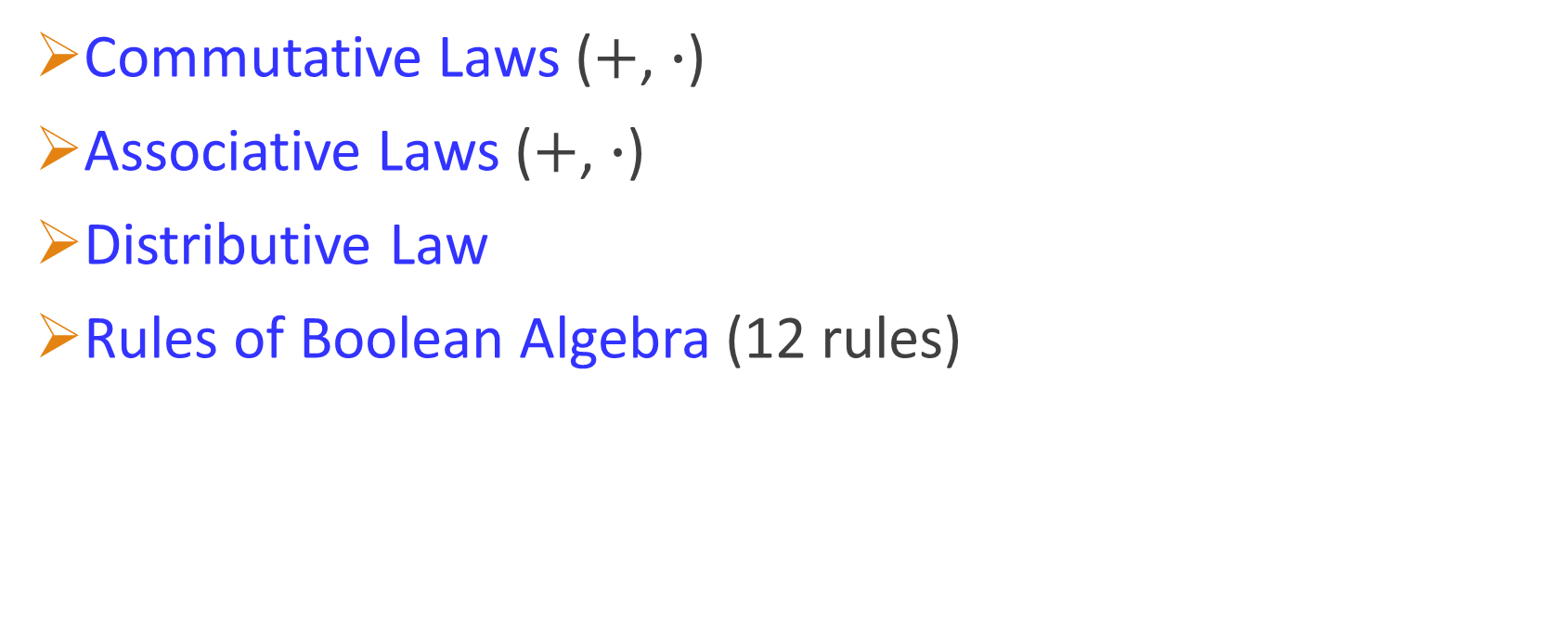
Laws and Rules of Boolean Algebra
Commutative Laws ($+$, $∙$)
Associative Laws ($+$, $∙$)
Distributive Law
Rules of Boolean Algebra (12 rules)

Slide 19
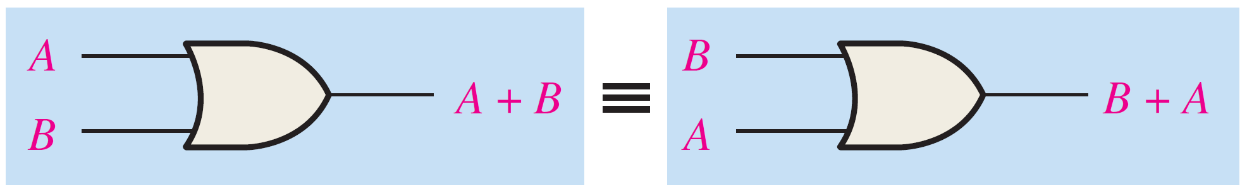
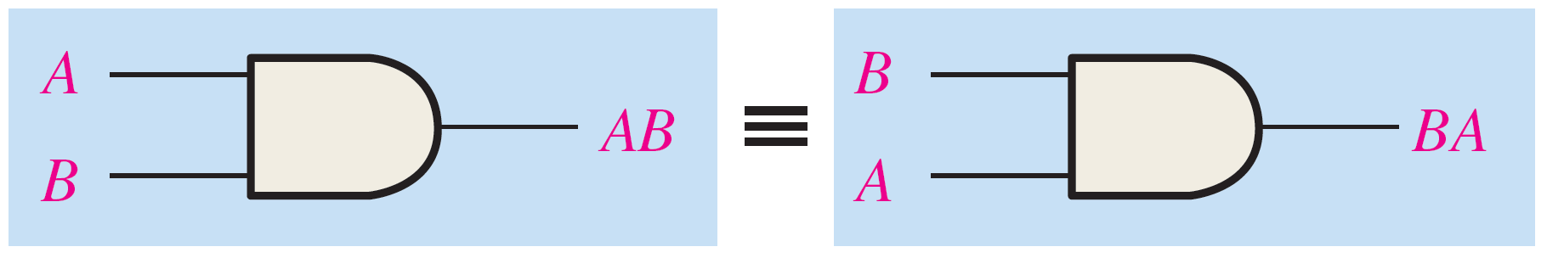

Commutative Laws
Commutative law of addition: $A+B=B+A$
Commutative law of multiplication: $AB=BA$

Slide 20
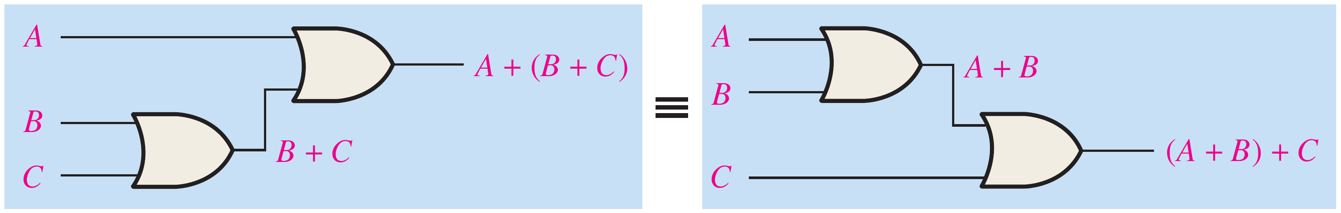
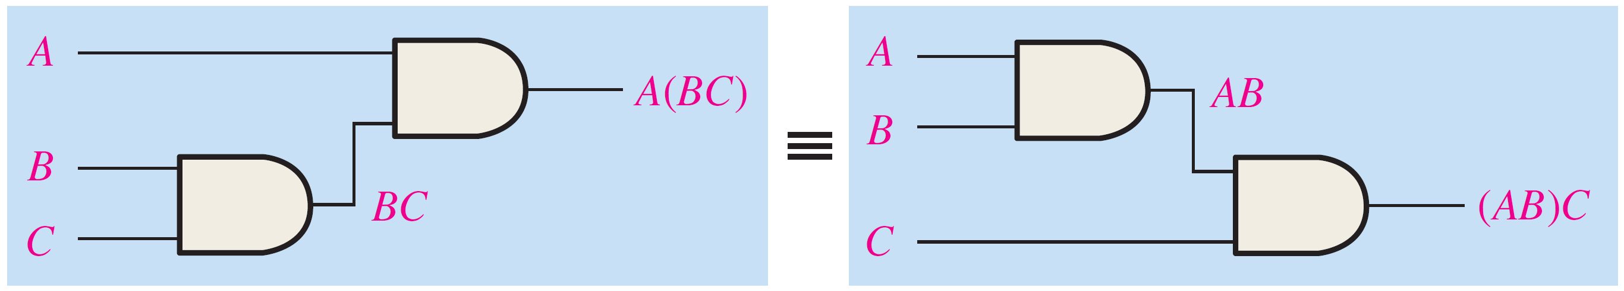

Associative Laws
Associative law of addition: $A+(B+C)=(A+B)+C$
Associative law of multiplication: $A(BC)=(AB)C$

Slide 21
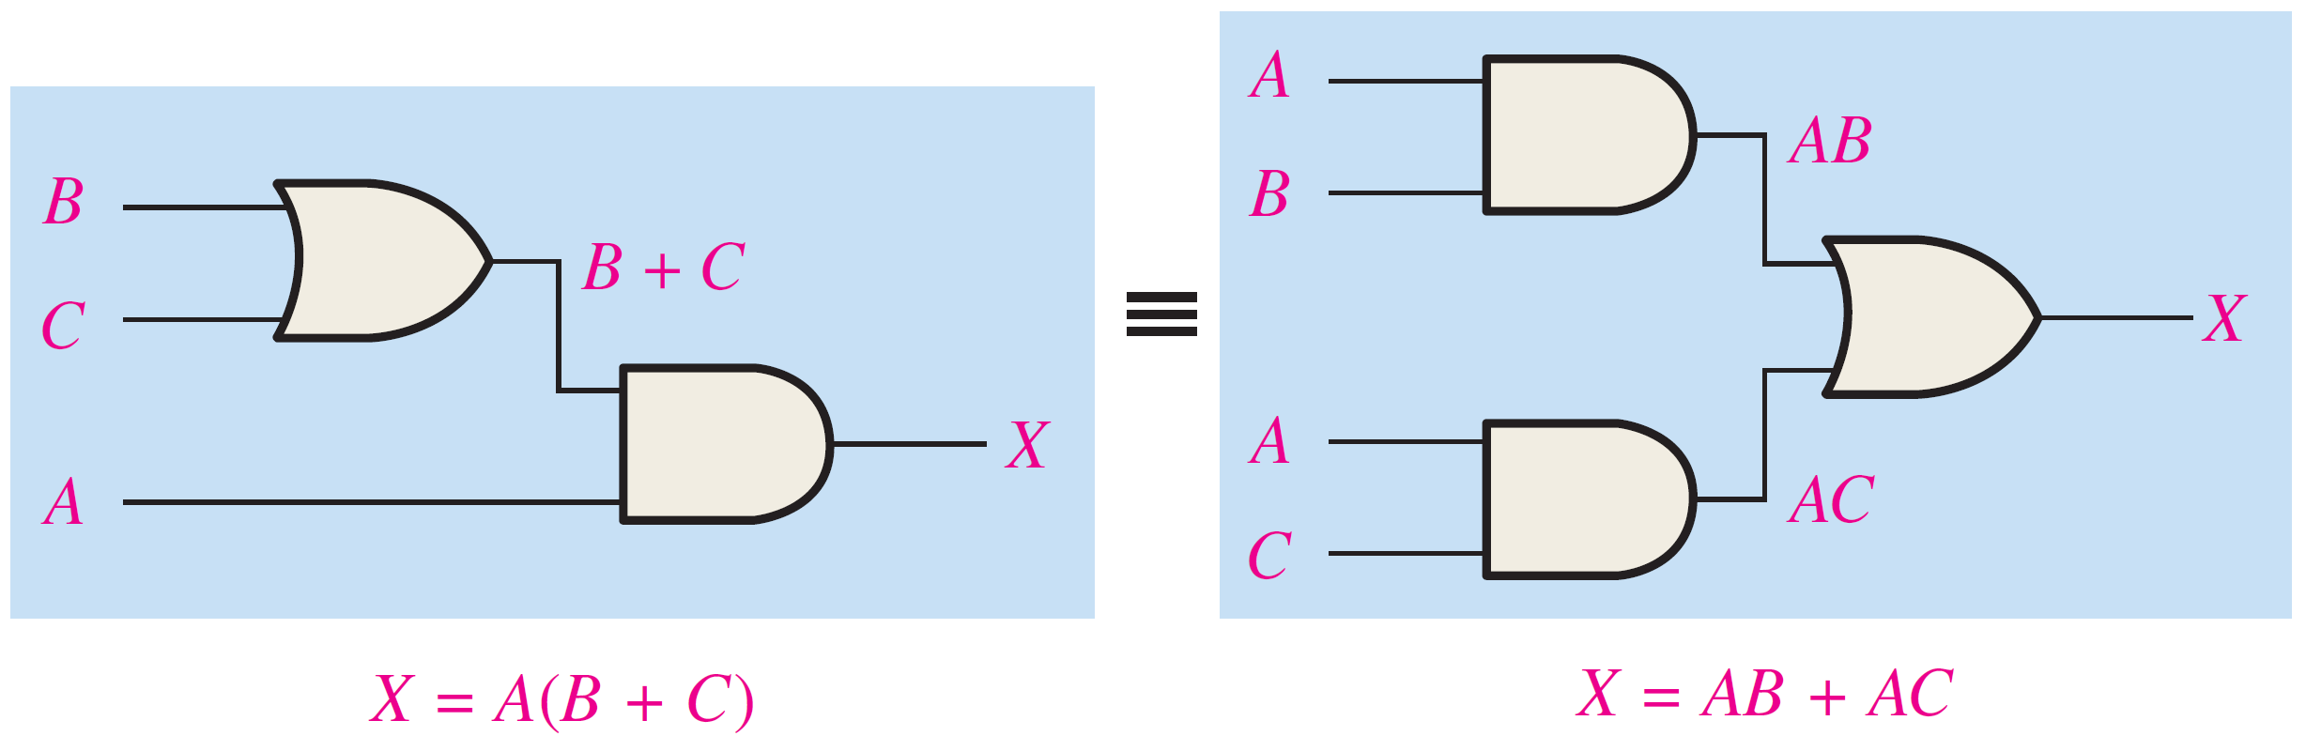

Distributive Law
Distributive Law: $A(B+C)=AB+AC$

Slide 22
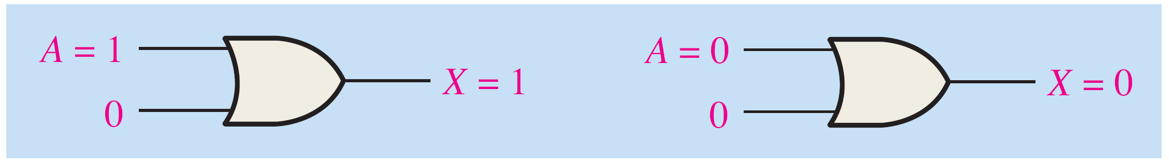
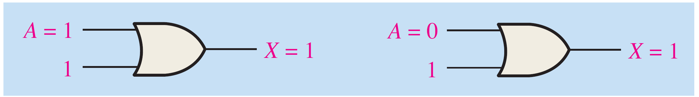

Rules of Boolean Algebra
Rule 1: $A+0=A$
Rule 2: $A+1=1$

Slide 23
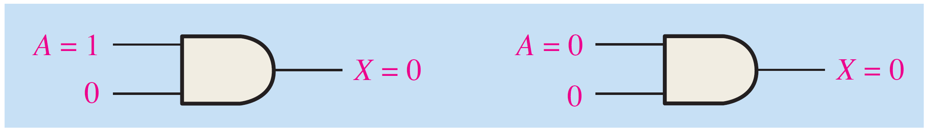
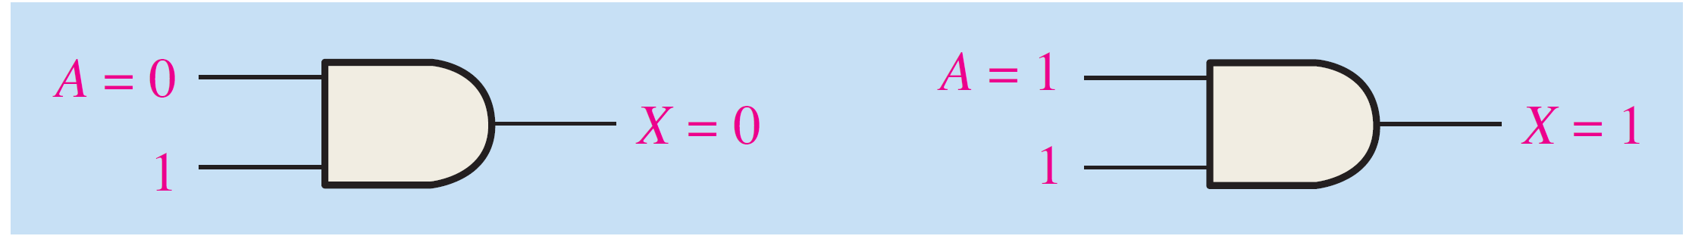

Rules of Boolean Algebra
Rule 3: $A∙0=0$
Rule 4: $A∙1=A$

Slide 24
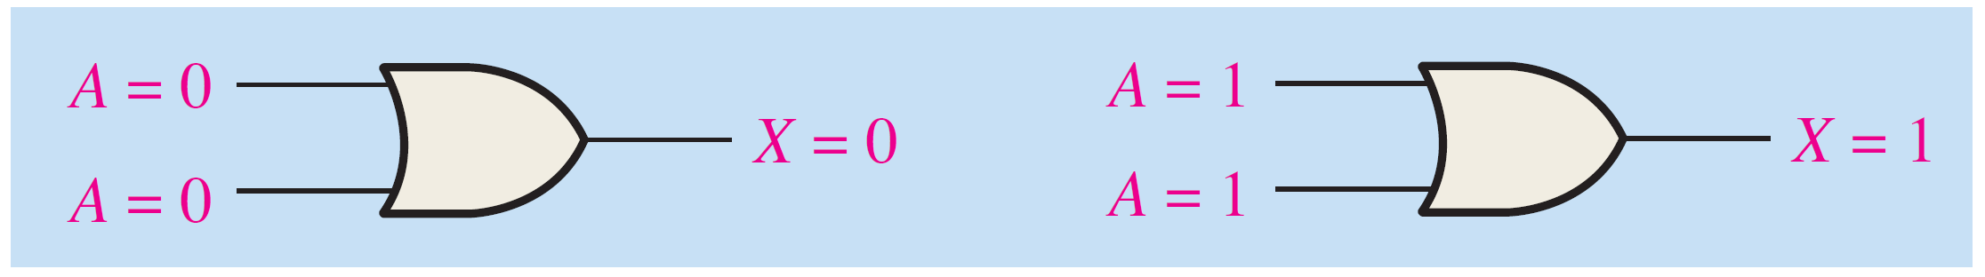
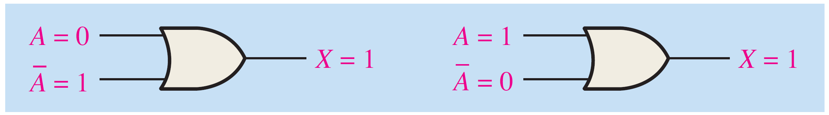

Rules of Boolean Algebra
Rule 5: $A+A=A$
Rule 6: $A+\overline{A}=1$

Slide 25
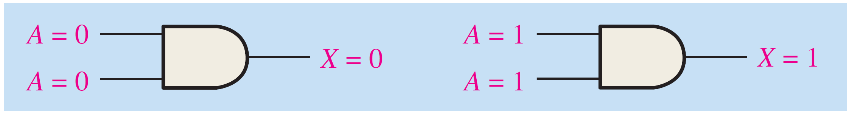
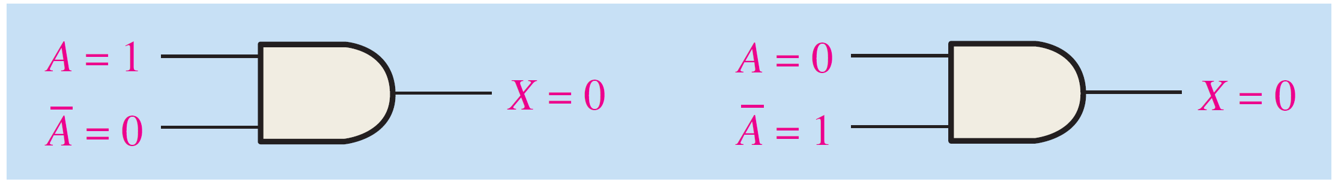

Rules of Boolean Algebra
Rule 7: $A∙A=A$
Rule 8: $A∙\overline{A}=0$

Slide 26
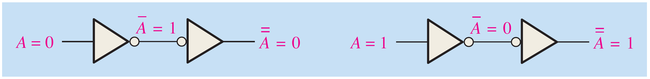
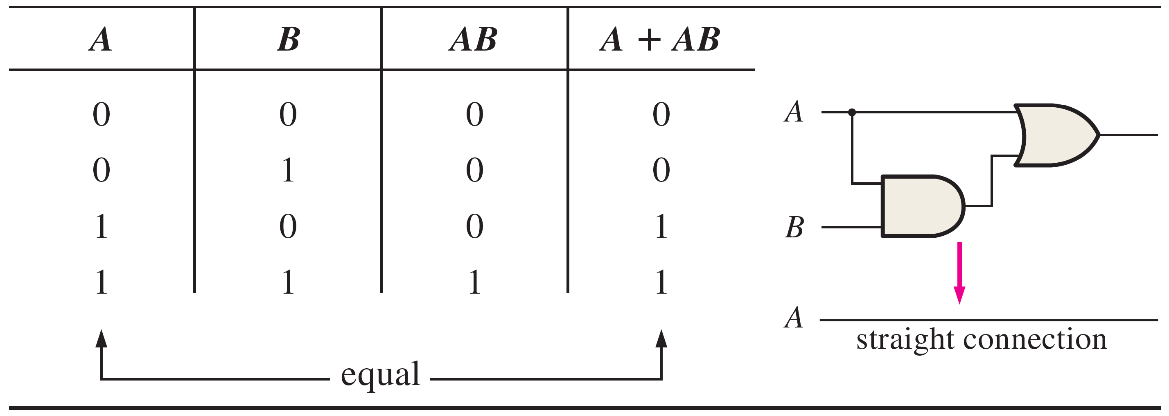

Rules of Boolean Algebra
Rule 9: $\overset{̿}{A}=A$
Rule 10: $A+AB=A$
Proof:
L.H.S. = $A∙1 + AB$ [R4]
= $A\left(1+B\right)$ [Dist. Law]
= $A∙1$ [R2]
=$A$ [R4]
= R.H.S.

Slide 27
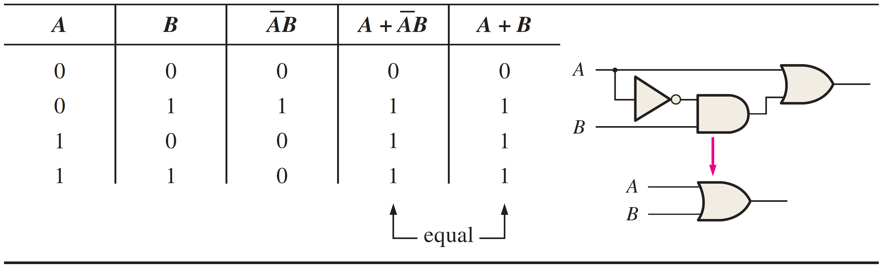

Rules of Boolean Algebra
Rule 11: $A+\overline{A}B=A+B$
Proof:
L.H.S. = $A + AB+\overline{A}B$ [R10] = $A+\left(A+\overline{A}\right)B$ [Dist. Law]
= $A+1∙B$ [R6] =$A+B$ [R4] = R.H.S.

Slide 28

Rules of Boolean Algebra
Rule 12: $(A+B)(A+C)=A+BC$
Proof:
L.H.S. = $AA+AC+AB+BC$ [Dist. Law]
= $A+AC+AB+BC$ [R7]
= $A(1+C)+AB+BC$ [Dist. Law]
= $A∙1+AB+BC$ [R2]
= $A+AB+BC$ [R4]
= $A(1+B)+BC$ [Dist. Law]
= $A∙1+BC$ [R2]
= $A+BC$ [R4]
= R.H.S.

Slide 29


Rules of Boolean Algebra
Rule 12: $(A+B)(A+C)=A+BC$ (…Continuing…)
Proof:

Slide 30

Rules of Boolean Algebra - Summary

Slide 31
Reading Material
Floyd, Chapter 3:
Pages 130 - 134
Floyd, Chapter 4:
Pages 172 - 179

