Slide 1
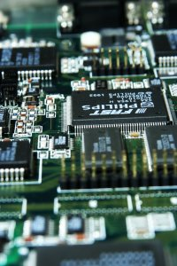
CSE 321b
Computer Organization (2)
تنظيم الحاسب (2)
3rd year, Computer Engineering
Winter 2017
Lecture #5
Dr. Hazem Ibrahim Shehata
Dept. of Computer & Systems Engineering
Credits to Dr. Ahmed Abdul-Monem Ahmed for the slides

Slide 2
Adminstrivia
Assignment #1:
Deadline extended again!
New due date: Sunday, Mar. 14, 2017!
Website: http://hshehata.github.io/courses/zu/cse321b/
Office hours: TBA

Slide 3
Chapter 6. External Memory (Cont.)

Slide 4
Types of External Memory
Magnetic Disk
Redundant Array of Independent Disks (RAID)
Optical Disk
Solid-State Drive (SSD)
Magnetic Tape

Slide 5
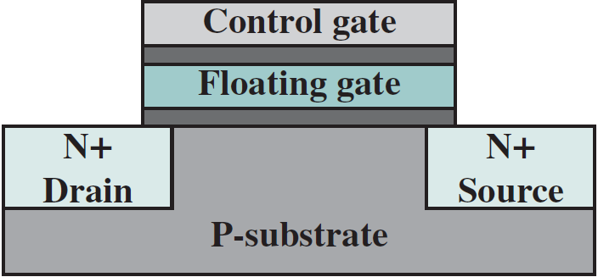
Solid-State Drive (SSD)
Purpose: complement or even replace HDDs!
The term “solid-state” refers to electronic circuitry built with semiconductors.
SSD’s store data in flash memory cells.
Each flash memory cell is built using a single transistor: floating-gate MOSFET (FG-MOSFET).
CG
FG
D
S

Slide 6
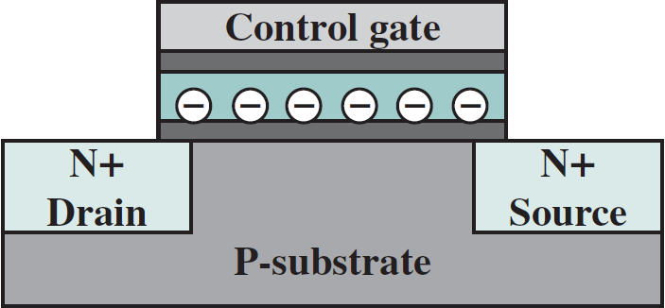
States of FG-MOSFET
I_{d}
“1”
“0”
programming
erasing
V_{T1}
V_{T0}
V_{gs}
Logic 1
No electrons trapped on the FG.
Smaller threshold voltage (V_{T1})
Forming the channel (i.e., turning transistor on) requires applying a relatively smaller voltage to CG.
Logic 0
Electrons trapped on the FG.
Higher threshold voltage (V_{T0})
Forming the channel (i.e., turning transistor on) requires applying a slightly higher voltage to CG.

Slide 7
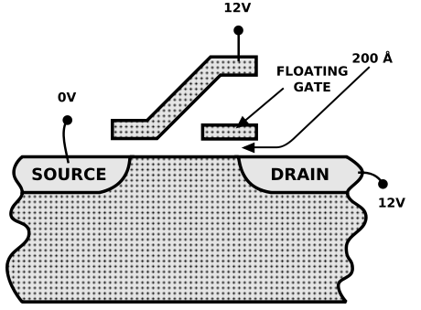
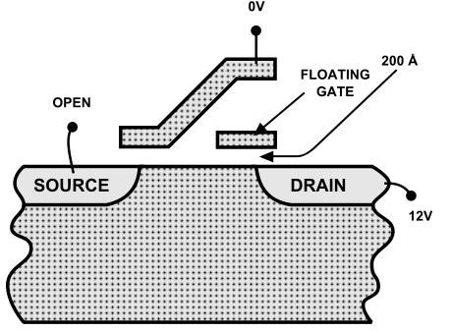
Read/Program/Erase Flash Memory Cell
I_{d}
“1”
“0”
To read:
Apply voltage V_{r} to CG s.t. V_{T1}<V_{r}<V_{T0}.
Measure (sense) drain current (I_{d}).
I_{d} > 0 ➔ transistor on ➔ logic 1.
I_{d} = 0 ➔ transistor off ➔ logic 0.
To program (write “0”):
Apply high +ve voltage to CG & D.
Electrons jump from channel through
insulating layer onto FG ➔ hot-electron injection.
To erase (write “1”):
Apply high voltage diff. between D & CG.
Electrons pulled off FG through insul-
ating layer to D ➔ quantum tunneling.
V_{T1}
V_{T0}
V_{gs}
V_{r}
Only Applicable to NOR flash!!

Slide 8

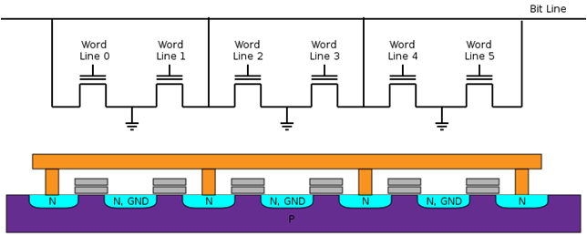

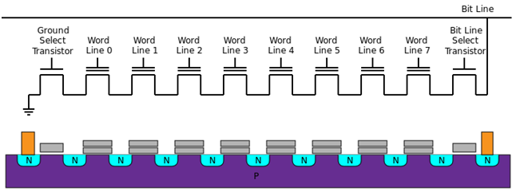

Layouts of Flash Memory
Faster read.
Transistors directly connected to BL.
Simpler Interface.
Random access.
Lower error rate.
Data units
Bytes/words.
Applications
ROM replacement.
Capacity: < 2 Gb.
NOR Flash
Faster program/erase.
Higher Density.
Less connections to GND/BL.
Longer life span.
Data units
Pages/blocks.
Applications
SSDs, USB drives, SD Cards.
Capacity: < 2 Tb.
NAND Flash

Slide 9
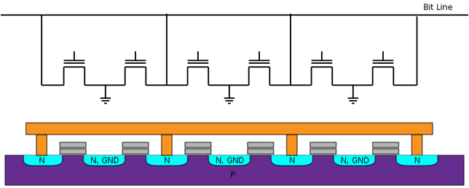
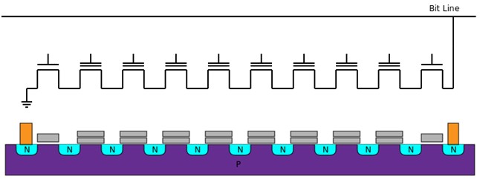
NAND/NOR Flash – Reading
NOR Flash
V_{off}
V_{r}
V_{off}
V_{off}
V_{off}
V_{off}
I_{d}
“1”
“0”
V_{T1}
V_{T0}
V_{gs}
V_{off}
V_{r}
NAND Flash
I_{d}
“1”
“0”
V_{on}
V_{on}
V_{r}
V_{on}
V_{on}
V_{on}
V_{on}
V_{on}
V_{on}
V_{on}
V_{T1}
V_{T0}
V_{gs}
V_{r}
V_{on}

Slide 10
NAND/NOR Flash – Programming (X ➔ 0)
NOR Flash
Technique:
Hot electron injection.
Explanation:
Electrons jump from channel to FG.
V_{high}
V_{off}
V_{high}
V_{off}
V_{off}
V_{off}
V_{off}
1
1
1
1
1
1
0
NAND Flash
Technique:
Quantum tunneling (injection).
Explanation:
Electrons tunnel from B to FG.
V_{high}
1
1
1
1
1
1
1
1
0

Slide 11
NAND/NOR Flash – Block Erasure (X ➔ 1)
NOR Flash
Technique:
Quantum tunneling (ejection).
Explanation:
Electrons tunnel from FG to S/B.
-V_{high}
-V_{high}
-V_{high}
-V_{high}
-V_{high}
-V_{high}
1
1
1
1
1
1
NAND Flash
Technique:
Quantum tunneling (ejection).
Explanation:
Electrons tunnel from FG to B.
-V_{high}
-V_{high}
-V_{high}
-V_{high}
-V_{high}
-V_{high}
-V_{high}
-V_{high}
1
1
1
1
1
1
1
1

Slide 12
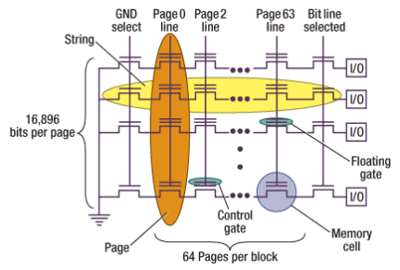
NAND Flash Block Organization
NAND flash memory is organized as a set of independent blocks. Each block has a set of pages.
Blocks are the smallest erasable units.
Pages are the smallest programmable units.
Partial pages can be programmed in some devices!
** The numbers of bits-per-page and pages-per-block here are typical for a 2Gb NAND flash device **

Slide 13
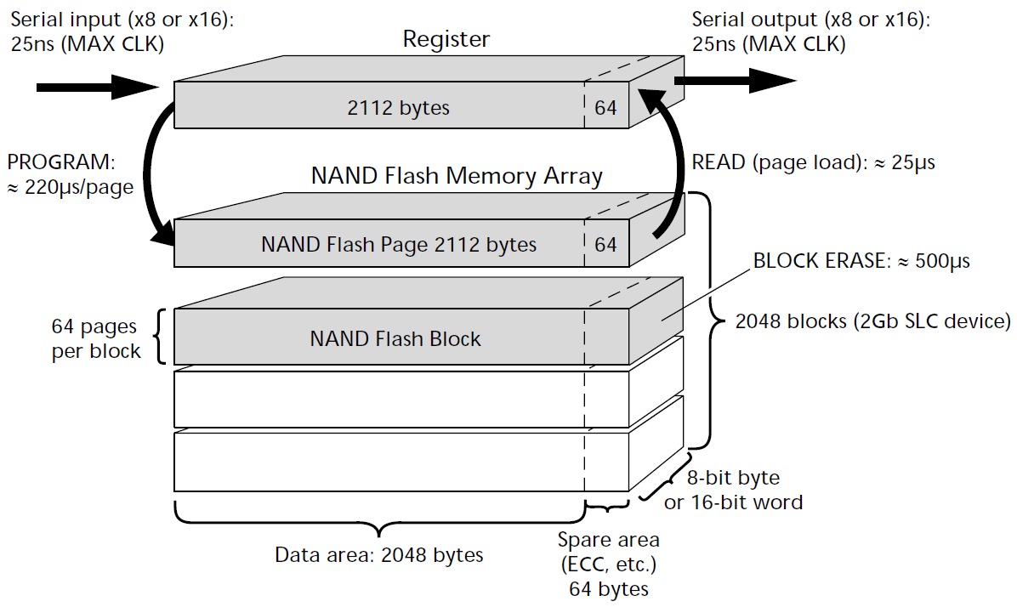
NAND Flash Memory Architecture

Slide 14
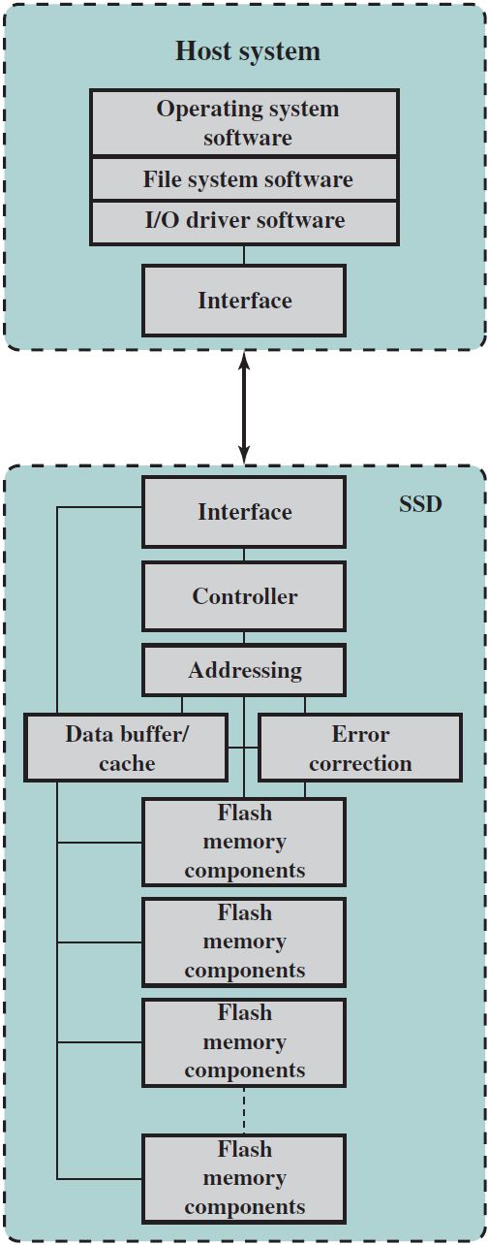
SSD Architecture
Controller: provides SSD device level interfacing & firmware execution.
Addressing: logic to select one of the flash memory components.
Data buffer/cache: High-speed RAM for speed matching and increasing data throughput.
Error correction: Logic for error detection and correction.
Flash memory components: Individual NAND flash chips.

Slide 15
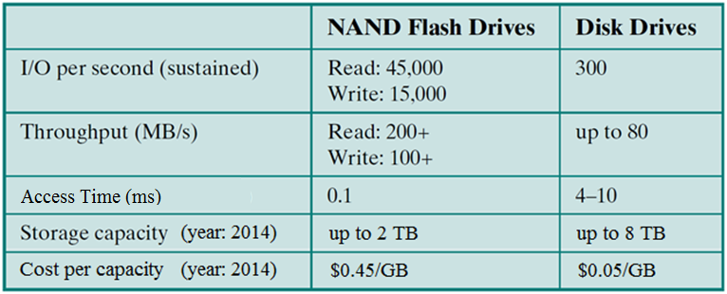
SSD vs. HDD
SSDs have the following advantages over HDDs:
Higher input/output operations per second (IOPS)
Longer lifespan: no mechanical wear.
Lower power consumption.
Quieter and cooler running capabilities.
Lower access times & latency rates: >10x faster.

Slide 16
Types of External Memory
Magnetic Disk
Redundant Array of Independent Disks (RAID)
Optical Disk
Solid-State Drive (SSD)
Magnetic Tape

Slide 17
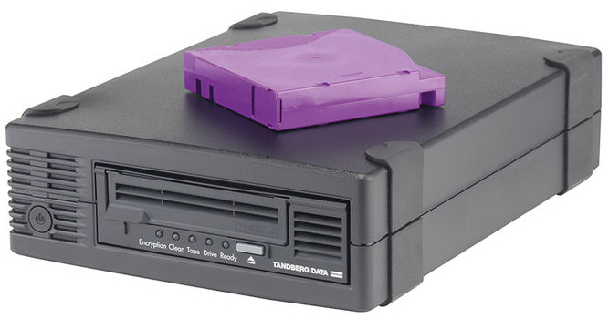
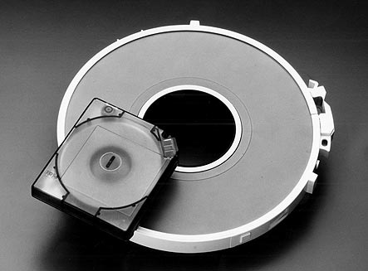
Magnetic Tape
Reading
Features:
Oldest secondary memory (1951).
Slowest-speed & lowest-cost in memory hierarchy.
Usage: offline storage (i.e., backup).
Access method: sequential ➔ slow!
Medium: flexible polyester tape coated with magnetizable material (metal particles).
Tape width: 0.38cm - 1.27cm.
Tape package:
Used to be open reels.
Now housed in cartridges.

Slide 18
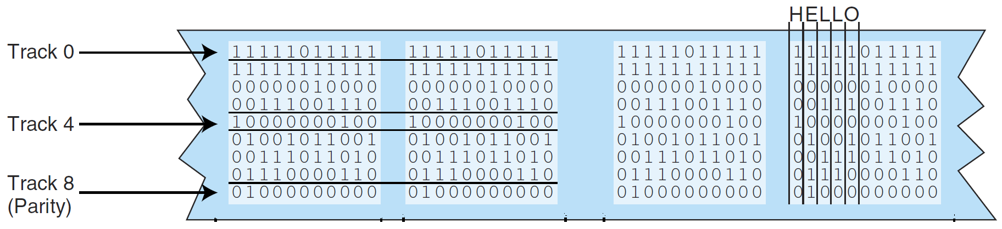
Data Layout and Recording Techniques
Reading
Data are laid out on tape along parallel tracks running lengthwise ➔ linear recording.
Tape moves underneath magnetic head in drive.
Head has multiple (8-32) read/write elements ➔ read/write multiple (8-32) tracks simultaneously.
There are two types of linear recording:
Parallel recording: Each byte/word is stored on multiple tracks in parallel, .e.g., 9-track tapes.

Slide 19
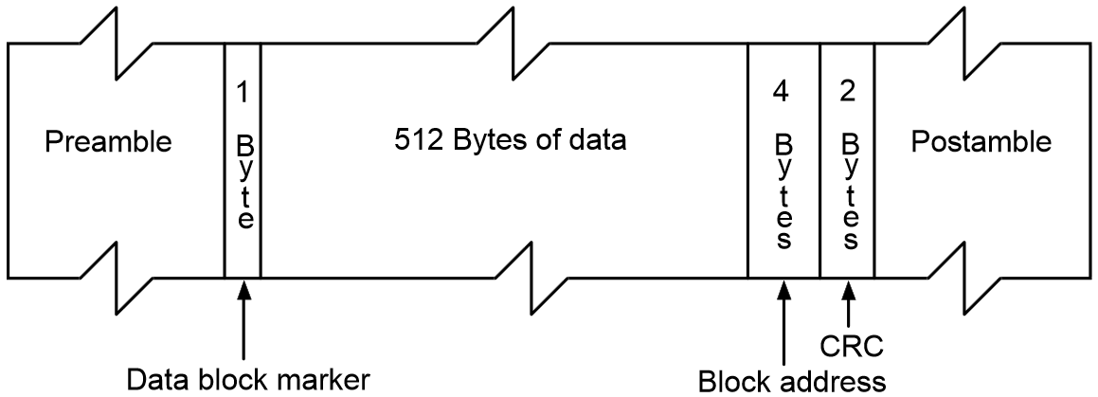
Serial Recording
Reading
… types of linear recording ... (cont.):
Serial Recording: data laid out as sequence of bits along each track, similar to magnetic disks.
Data read/written in contagious blocks called records.
Records are separated by inter-record gaps.
Tape is formatted to assist in locating records.

Slide 20
Serpentine Recording
Reading
Typical recording technique in serial tapes.
First set of bits is recorded on tracks in forward direction.
When tape reaches end, rd/wr elements are repositioned to new tracks & recording is resumed in opposite direction.
Process continues, back and forth, until tape is full.
Data still recorded serially along individual tracks, but blocks in sequence are stored in adjacent tracks.
Adv.: more tracks than head/elements ➔ increasing capacity.
.
.
.
B(6n+2)
B(6n+5)
B(9n-1)
B(6n-1)
B(3n+5)
B(3n+2)
Head
B(2)
B(5)
.
B(3n-1)
.
B(6n+1)
B(6n+4)
B(9n-2)
B(6n-2)
B(3n+4)
B(3n+1)
B(1)
B(4)
.
B(3n-2)
.
B(6n)
B(6n+3)
B(9n-3)
B(6n-3)
B(3n+3)
B(3n)
B(0)
B(3)
B(3n-3)

Slide 21
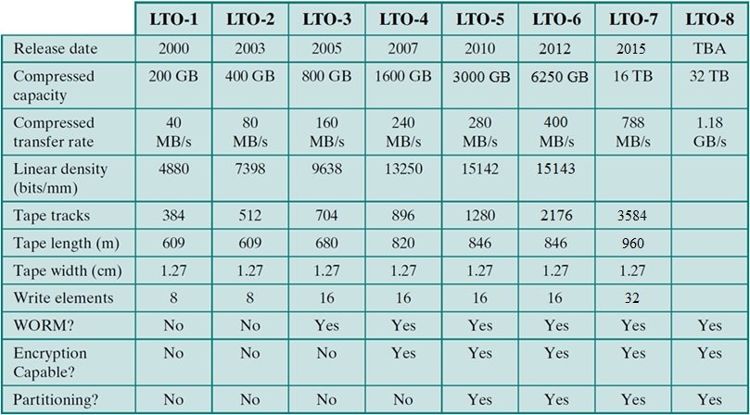
Linear Tape-Open (LTO)
Reading
Dominant magnetic tape technology today.
Developed late 1990s as an open source alternative to proprietary tape systems.

Slide 22
Chapter 7. Input / Output

Slide 23
Outline
External Devices
Types
Structure
I/O Modules
Function
Structure
I/O Techniques
Programmed I/O
Interrupt-Driven I/O
Direct Memory Access
I/O Channels & Processors

Slide 24
Terms
Essential Computer Units
CPU and Memory
Peripheral (or External or I/O) devices
Any device attached to a computer in order to increase its functionality.
Input: keyboard, mouse, scanner, … etc.
Output: printers, speakers, … etc.
Input and output: hard disk, modem, … etc.
I/O (Input/Output) Operations
Transfer of data to/from computer from/to peripheral device (done by program, operation, or device).
Input: from a device to the computer
Output: from the computer to a device.

Slide 25
Input/Output Problems
There is a wide variety of peripherals!
Different methods of operation (H/W).
Delivering different amounts of data.
At different speeds (which are also different from CPU and memory).
In different formats (e.g., word length).
Conclusion: Hard to connect such variety of different devices directly to same Bus!!
Solution: I/O Module

Slide 26
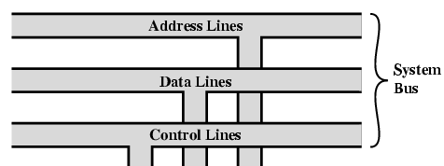

I/O Module
Interface to CPU and Memory
Interface to one or more peripheral devices

Slide 27
Types of Peripherals
Human readable
Screen, printer, keyboard, … etc.
Machine readable
Magnetic disk, tape, … etc.
Communication
Modem, Network Interface Card (NIC), Wireless Network Adaptor, … etc.

Slide 28
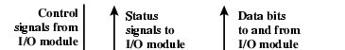

Peripheral (External) Device
Computer
To/from computer
Control Signals
Send data to module, receive data from module, send status, position disk head.
Status Signals
READY, NOT READY, …
Buffer
Temporarily hold data being transferred. Size: x bytes ➔ x Kbytes!!
Transducer
Converts energy: electrical ⬅➔ other.
Control logic
Controls operation.
I/O Module
External Device
Outside world

Slide 29
Examples: Keyboard/Monitor, and Disk Drive
Keyboard (input)
A key is pressed.
Transducer translates signal into ASCII.
ASCII is transmitted to I/O module in the computer.
Text can be stored as ASCII in the computer.
Monitor (output)
Computer sends ASCII to I/O module. I/O module sends ASCII to external device (monitor).
Transducer at the monitor sends electronic signals to display the character.
Hard Disk Drive (input/output)
Head moves in and out across disk surface.
Transducer converts magnetic patterns to/from bits.

Slide 30
Functions of I/O Module
Control & Timing.
CPU Communication.
Device Communication.
Data Buffering.
Error Detection.

Slide 31
1. Control & Timing
I/O includes control & timing requirement to coordinate the flow of traffic between internal resources (CPU, MM, …) and external devices.
Ex.: Transfer data from input device to CPU:
CPU checks I/O module device status.
I/O module returns status.
If ready, CPU requests data transfer (command to I/O module).
I/O module gets data from external device.
I/O module transfers data to CPU.
If transfer goes through bus, each CPU/module interaction may involve 1⁺ bus arbitrations.

Slide 32
2. CPU Communication
CPU communication involves the following:
Command decoding
Module accepts commands from CPU on control lines.
Command parameters can be sent over data line.
e.g., SEEK track in a disk drive: SEEK command sent on control lines and track # sent on data lines.
Address recognition
One unique address for each peripheral it controls.
Data exchange
Between CPU and device over the data bus.
Status reporting
BUSY, READY, or some error conditions.

Slide 33
3. Device Communication
I/O module must also be able to do device communication:
Commands
Status information
Data

Slide 34
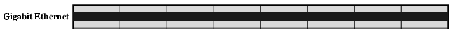

4. Data Buffering (Speed Mismatch)
I/O module must be able to operate at both device and memory/CPU speeds.

Slide 35
5. Error Detection
Mechanical and electrical malfunctions
Report to CPU.
e.g., paper jam, bad disk sector/track.
Unintentional changes to transmitted bit pattern
Detected using error-detecting codes.
e.g., parity bit (ASCII).

Slide 36
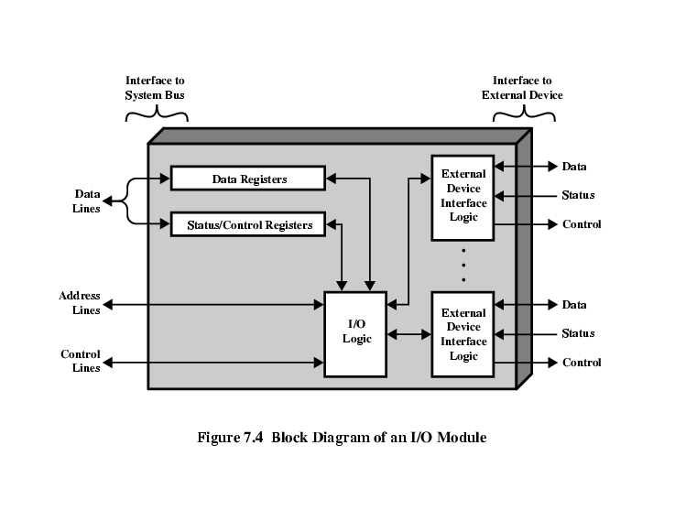
I/O Module Structure
St./Ctrl. registers: hold device status or accept control info from CPU.
CPU issues commands to I/O module via control lines.
Some control lines are also used by I/O module for bus arbitration.
Module controlling more than 1 device has a set of unique addresses.
Interface to
System Bus
Interface to
External Device

Slide 37
I/O Module Design Decisions
I/O module lets CPU view a wide range of devices in a simple-minded way.
Module may hide device properties from CPU:
Quite complex module design.
Simple CPU commands (e.g., render object).
Referred to as I/O channel (I/O processor).
Common in mainframes.
Module may reveal device properties to CPU:
Relatively simple module design.
Detailed CPU commands (e.g., rewind tape).
Referred to as I/O controller (device controller).
Common in microcomputers.

Slide 38
Reading Material
Stallings, Chapter 6:
Pages 205 – 209
Pages 215 – 217
Stallings, Chapter 7:
Pages 222 – 228

