Slide 1
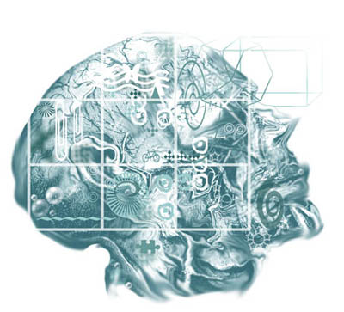
CSE 411 Artificial Intelligence (Elective Course #6)
400 level, Mechatronics Engineering
2nd Term 2016/2017 – Lecture #1
Dr. Hazem Ibrahim Shehata
Computer & Systems Engineering Department

Slide 2
Teaching Staff
Instructor
Name: Hazem Ibrahim Shehata
Email: hshehata@uwaterloo.ca
Office: Room #27308, Ind. Eng. Building
Hours: TBA

Slide 3
Course Info
Webpage
http://hshehata.github.io/courses/zu/cse411/
Textbook
Artificial Intelligence: A Modern Approach
Stuart Russell and Peter Norvig, 3rd edition, 2010
Grading
Course Work | Grade Distribution
Assignments | 25pt
Midterm | 25pt
Final | 50pt

Slide 4
Course Outline (Subject to Change!)
Ch. 1: Introduction
Ch. 2: Intelligent Agents
Ch. 3: Solving Problems by Searching
Ch. 4: Beyond Classical Search
Ch. 5: Adversarial Search
Ch. 6: Constraint Satisfaction Problems
Ch. 7: Logical Agents
…

Slide 5
Chapter 1: Introduction

Slide 6
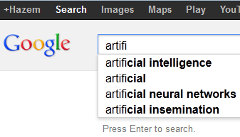
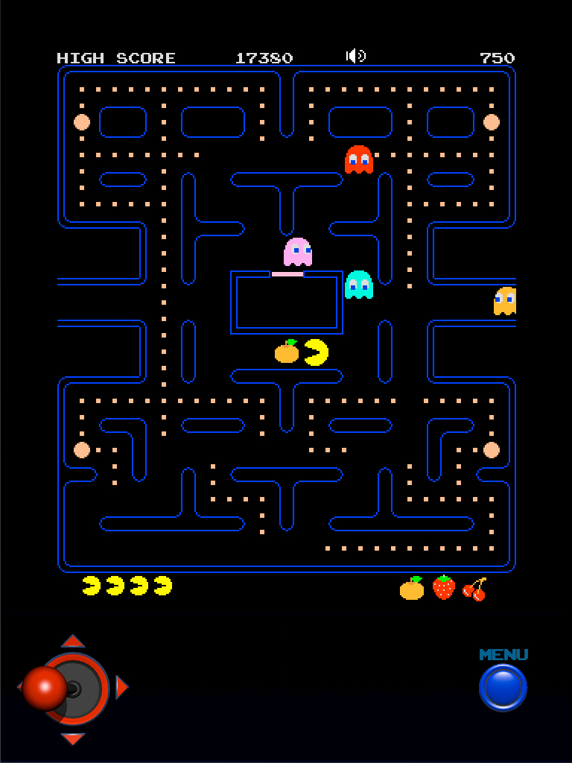
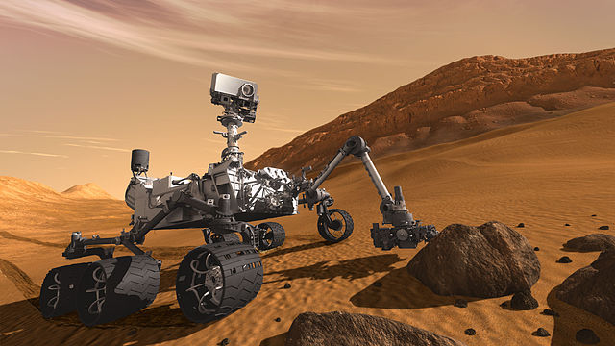
Where Do We See AI?

Slide 7
Where Do We See AI?
AI has been applied in many fields:
Entertainment (e.g., game playing).
Internet (e.g., semantic search engines, spam fighting).
Robotics (e.g., driverless vehicles, vacuum cleaners).
Military (e.g., logistics planning).
Space (e.g., rovers, autonomous planning/scheduling).
Medical (e.g., expert systems for medical diagnosis).
Aviation (e.g., auto-pilot).
Finance (e.g., stock market prediction, fraud detection).
Weather forecasting.
…

Slide 8
What Is AI?
What do you think AI means?
Some definitions from literature:
The exciting new effort to make computers think ... machines with minds, in the full and literal sense.
The art of creating machines that perform functions that require intelligence when performed by people.
The study of mental faculties through the use of computational models.
AI ... is concerned with intelligent behavior in artifacts.

Slide 9
What Is AI?
AI Definitions vary along two dimensions:
The thinking (reasoning) vs. acting (behaving),
Measuring the success against human performance or against an ideal concept of intelligence (rationality).

Slide 10
What Is AI?
 |  |  |  |  | Success in terms of human performance | Success in terms of rational performance
Mimic thought process and reasoning |  |  |  |  | Systems that think humanly | Systems that think rationally
Mimic Behavior |  |  |  |  | Systems that act humanly | Systems that act rationally
 |  |  |  |  | More to do with hypothesis & experimentation | More to do with mathematics & engineering

Slide 11
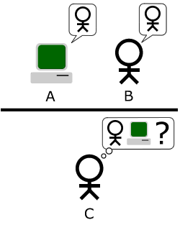
Act Humanly: Turing Test Approach
Turing Test: the computer passes the test if after given a series of written questions by a human interrogator, the interrogator can’t tell if the written responses are coming from a person or a machine.
Examples:
ELIZA (1966) & PARRY (1972)
Contemporary chat bots!

Slide 12
Act Humanly: Turing Test Approach
To pass Turing test, computer needs:
Natural language processing
Knowledge representation
Automated reasoning
Machine learning
Total Turing Test: interrogator can pass physical objects to the computer (through a hatch).
To pass Total Turing test, computer needs:
Computer vision
Robotics

Slide 13
Think Humanly: Cognitive Modeling Approach
If we want the computer to think as humans, we must first determine how humans think.
An interdisciplinary field of cognitive science.
It brings together models from AI and experimental techniques from psychology.
It tries to come up with precise and testable theories of how the human mind works.
Example: Neural Networks.

Slide 14
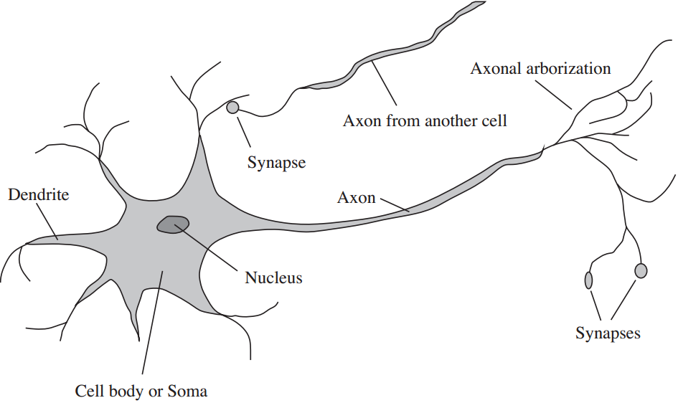
Think Humanly: Cognitive Modeling Approach
Neuron Cell

Slide 15
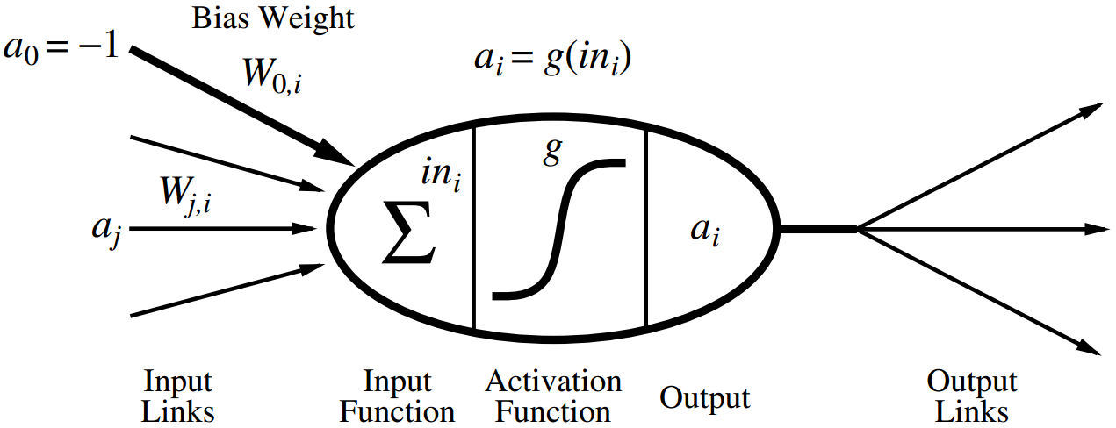
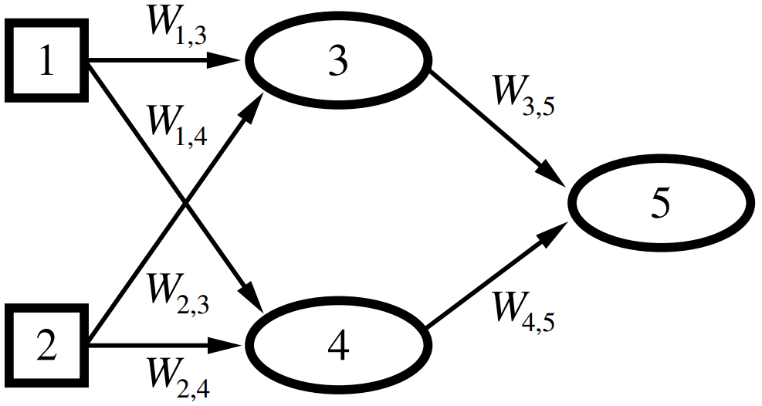
Think Humanly: Cognitive Modeling Approach
Neuron
Unit
Artificial
Neural
Network
(ANN)

Slide 16
Think Rationally: “Laws of Though” Approach
Uses logic to reach a decision given some facts via logical inferences.
Greek philosopher Aristotle was the first to try to codify the way of thinking.
His deductive reasoning always gave correct conclusions when given correct premises.
Example: ”All Cats are Pets; Bob is a Cat; therefore, Bob is a Pet”,
Example: Theorem proving in first-order logic.

Slide 17
Think Rationally: “Laws of Though” Approach
Theorem proving:
Set of rules:
R1:
R2:
R3:
Set of facts (premises):
F1:
F2:
F3:
Goal:
Show that:
c₁
c
a
c₂
b

Slide 18
Act Rationally: Rational Agent Approach
Perceive the environment, and act so as to achieve one’s goal.
Not necessary to do the best action:
There is not always an absolutely best action.
There is not always time to find the best action.
An action that’s good enough can be acceptable.
Example: Game playing.
Sample approach: Tree-searching strategies.
Problem: Choosing what to do given the constraints.

Slide 19
Chapter 2: Intelligent Agents

Slide 20
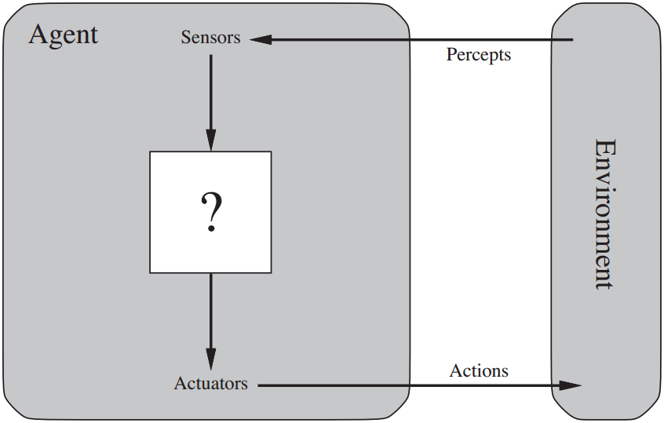
Rational Agents

Slide 21
What is an Agent?
A rational agent is one that does the right thing.
In order to know the right thing, we need a performance measure.
The performance measure is usually chosen by the agent designer.
For each possible percept sequence, a rational agent should select an action that is expected to maximize the performance measure given the evidence provided by the percept sequence and whatever built-in knowledge the agent has.

Slide 22
Specifying the Task Environment
Task Environments are “problems” to which rational agents are the solutions!
To specify a task environment, four items need to be defined:
Performance measure
Environment
Actuators
Sensors
→ The PEAS description

Slide 23
Specifying the Task Environment
Example: PEAS description of the task environment for an automated taxi.
Agent
Performance
Environment
Actuators
Sensors
Type
Measure
Safe, fast,
Roads,
other
Steering,
Cameras,
legal,
traffic,
accelerator,
sonar,
Taxi
maximize
pedestrians,
speedometer,
Driver
signal, horn,
profits,
customers,
…
GPS,
…
…
…

Slide 24
Properties of the Environment
Fully observable vs. partially observable:
See everything vs. hidden information.
Deterministic vs. stochastic:
Controlled by agent vs. randomness.
Episodic vs. sequential:
Independent atomic episodes vs. series of events.

Slide 25
Properties of the Environment
Static vs. dynamic vs. semi-dynamic:
World waits for agent vs. world goes on without agent vs. world waits but agent timed.
Discrete vs. continuous:
Finite distinct states vs. uninterrupted sequence.
Single agent vs. cooperative vs. competitive:
Alone vs. team-mates vs. opponents.

Slide 26
The Environment
Examples of environments and their properties:
Environment
Obs.
Det.
Eps
.
St.
Disc.
Agent
Sudoku
Fully
Det.
Seq.
St.
Disc.
Single
Chess
(With a Clock)
Det.
Fully
Seq.
Semi
Disc.
Comp.
Robot
Soccer Players
Part.
Stoc.
Seq.
Dyn.
Cont.
Comp./
Coop.
Part-Picking
Robot
Part.
Stoc.
Eps.
Dyn.
Cont.
Single

Slide 27
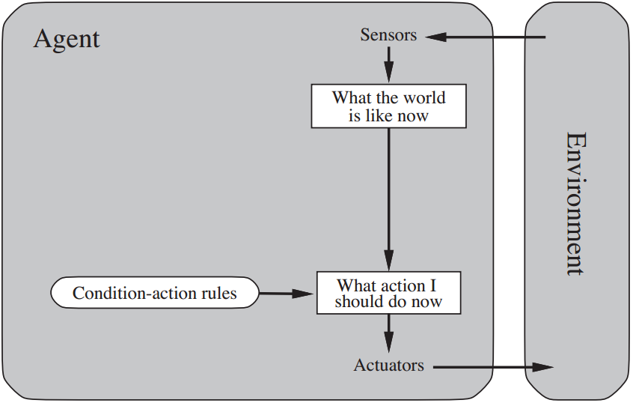
Simple Reflex Agents
Selects action based only on current perception of the environment.
Simple but has a limited intelligence!

Slide 28
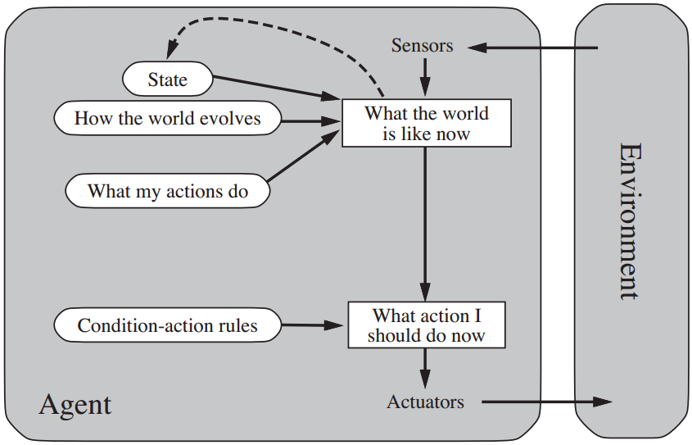
Model-Based Reflex Agent
Keeps track of perception history in the form of internal state (reflecting unobserved aspects of the current state of the World).

Slide 29
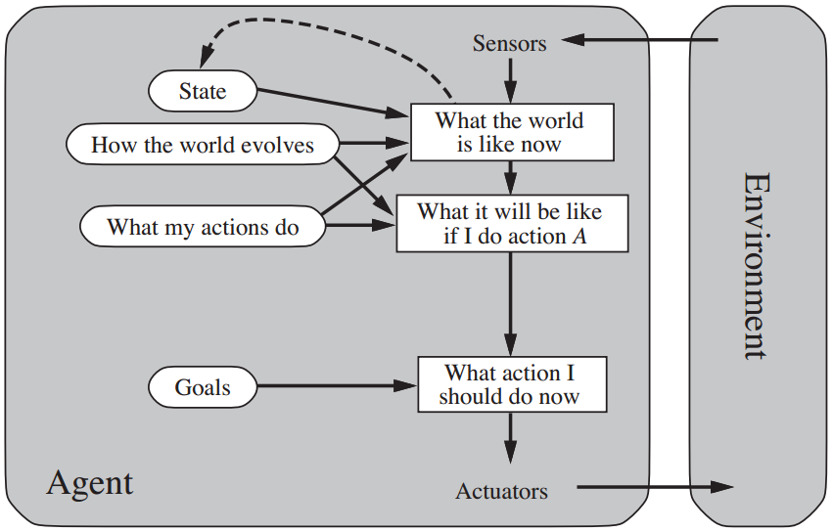
Goal-Based Agent
Keeps track of world state and goals to be achieved.
Chooses action that will lead to achieving its goals.
Flexible (knowledge & goal can be easily modified).

Slide 30
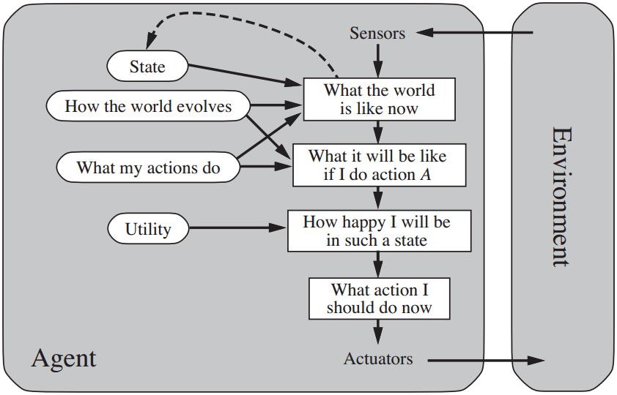
Utility-Based Agent
Keeps track of world state and uses utility function to measure performance among world states.
Agent chooses the actions that maximize its utility.

Slide 31
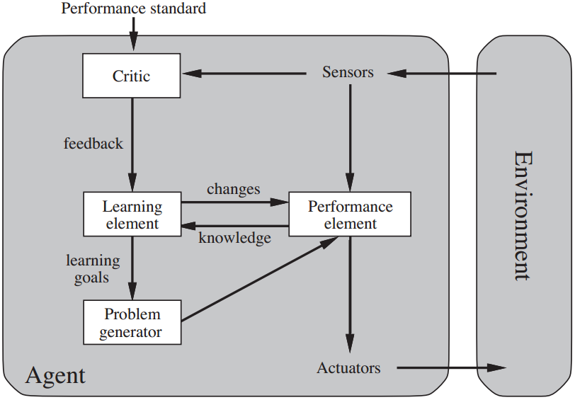
Learning Agent
Adds the ability to learn from its experiences.
Learning element: makes improvements; Performance element: selects external actions; Critic: determines how agent is doing; Problem generator: suggests exploratory actions.

Slide 32
Requirements
What do I need from you?
When given a certain problem you should be able to:
Specify the task environment (PEAS).
Identify the environment properties.
Determine the type of the most suitable agent.
Answer descriptive questions.

Slide 33
Reading Material
Russell-Norvig, Chapters 1 & 2:
Pages 1 – 5.
Pages 28, 29.
Pages 34 – 36.
Pages 40 – 57.

