Slide 1
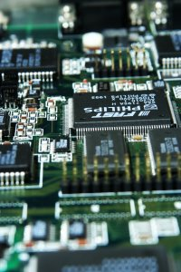
CSE 321a
Computer Organization (1)
تنظيم الحاسبات (1)
3rd year, Computer Engineering
Fall 2016
Lecture #10
Dr. Hazem Ibrahim Shehata
Dept. of Computer & Systems Engineering
Credits to Dr. Ahmed Abdul-Monem Ahmed for the slides

Slide 2
Administrivia
Midterm:
New Date: Tuesday, Dec. 13, 2016
New Time: 11:00am - 12:30pm
Location: classroom #27321 (قاعة 4د)
Coverage: lecture #1 ➔ lecture #6
Website: http://hshehata.github.io/courses/zu/cse321a
Office hours: Sunday 12:00pm-1:00pm

Slide 3
Chapter 19. Control Unit Operation (Online Appendix)

Slide 4
Customized hardware
Sequence of arithmetic and logic functions
Programming in H/W
Results
Data
Instruction codes
Each code is an instruction.
A sequence of codes (or instructions) is called software.
Programming in S/W
Instruction Interpreter
CPU
Control signals
General-purpose arithmetic and logic functions
Data
Results

Slide 5
Micro-operations
A computer executes programs.
A program is a sequence of instructions ➔ instruction cycles.
Each instruction is made up of smaller units (subcycles).
e.g., fetch/execute subcycles.
Each subcycle has a number of steps.
Each step has a number of micro-operations.
Each micro-operation does very little.
Micro-operation is an atomic operation of CPU.
Any instruction is a sequence of micro-operations.

Slide 6
Constituent Elements of Prog. Execution
step
step
step
step

Slide 7
Fetch Subcycle in simple machine
MAR
0000000001100100
MBR
0001000000100000
PC
0000000011001000
IR
0001101001101000
AC
Memory Address Register (MAR)
Specifies address for read or write operation.
Connected to address bus.
Memory Buffer Register (MBR)
Holds data to write or last data read.
Connected to data bus.
Program Counter (PC)
Holds address of next instruction to be fetched.
Instruction Register (IR)
Holds last instruction fetched (being executed).
Accumulator (AC)
Acts as implicit operand.

Slide 8
Fetch Sequence
Address of next instruction is in PC.
Address in PC is copied to MAR.
Memory location (pointed to by MAR) is read to MBR.
Address in MAR is placed on address bus.
Control unit issues READ command.
Result (data from memory) appears on data bus.
Data from data bus is copied into MBR.
PC is incremented by 1 (in parallel with data fetch from memory).
Data (instruction) is moved from MBR to IR.
MBR is now free for further data fetches.

Slide 9
Fetch Subcycle (symbolic)
t₁
t₂
t₃
t₁: MAR ← [PC]
t₂: MBR ← Memory,
PC ← [PC] + I
t₃: IR ← [MBR]
(tx = time unit/clock cycle)
Micro-operations take equal times.
Or
t₁: MAR ← [PC]
t₂: MBR ← Memory
t₃: PC ← [PC] + l,
IR ← [MBR]
Step
Micro-operation

Slide 10
Rules for Clock Cycle Grouping
Proper sequence must be followed
MAR ← [PC] must precede MBR ← Memory
Read/write conflicts must be avoided
A µop reading from reg. X cannot be scheduled at the same step (cycle) with another µop writing to reg. X.
Ex.: MBR ← Memory & IR ← [MBR] must not be in same step.
Resource conflicts must be avoided
For instance, 2 µop’s involving addition cannot be scheduled at the same step if ALU contains 1 adder only.
Note: PC ← [PC] + l involves addition, and hence use ALU.

Slide 11
Indirect Subcycle
t₁: MAR ← [IR-address] - address field of IR
t₂: MBR ← Memory
t₃: IR-address ← [MBR]
MBR contains an address.
IR is now in same state as if direct addressing had been used.

Slide 12
Interrupt Subcycle
At the end of the execute subcycle, interrupts are tested.
Some interrupt occurred ➔ interrupt subcycle.
Assume: address of ISR routine & address of location to save PC become available in the second step.
t₁: MBR ← [PC]
t₂: MAR ← save-address, PC ← routine-address
t₃: Memory ← [MBR]
This is a minimum
May be additional micro-ops to get addresses.
N.B. saving context is done by interrupt handler routine, not micro-ops.

Slide 13
Execute Subcycle (ADD)
Execute subcycle is different for each instruction.
ADD X
Add contents of location X to AC and save result to AC
t₁: MAR ← [IR-address]
t₂: MBR ← Memory
t₃: AC ← [AC] + [MBR]
Note no overlap of micro-operations.

Slide 14
Execute Subcycle (ISZ)
ISZ X - increment and skip if zero
t₁: MAR ← [IR-address]
t₂: MBR ← Memory
t₃: MBR ← [MBR] + 1
t₄: Memory ← [MBR]
if [MBR] == 0 then PC ← [PC] + 1
Notes:
“If …” is a single micro-operation.
Micro-operations done during t₄.

Slide 15
Execute Subcycle (BSA)
BSA X - Branch and save address
Address of instruction following BSA is saved in X
Execution continues from X+1
t₁: MAR ← [IR-address], MBR ← [PC]
t₂: PC ← [IR-address], Memory ← [MBR]
t₃: PC ← [PC] + 1

Slide 16
Instruction Cycle – Flowchart
01

Slide 17
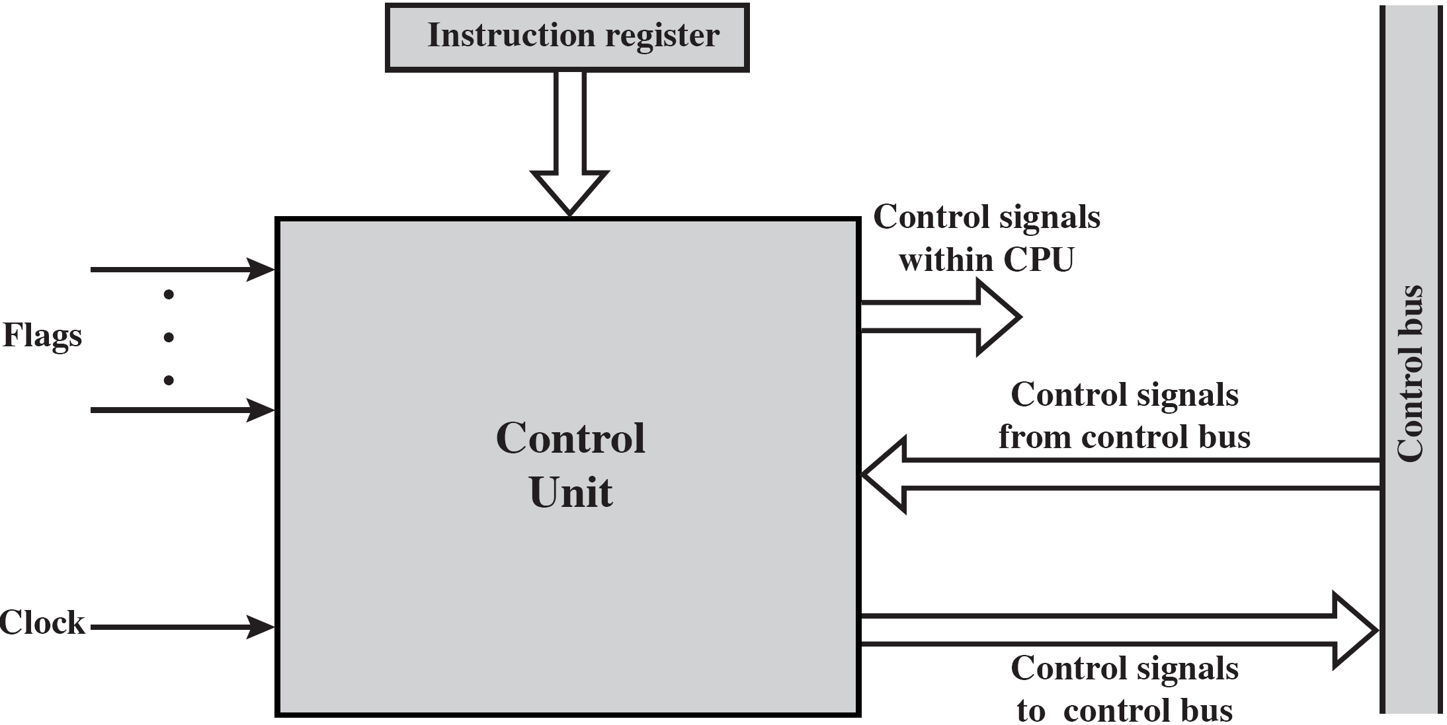
Model of the Control Unit

Slide 18
Control Unit – Inputs and Outputs
Inputs
Clock:
One micro-operation (or set of parallel micro-operations) per clock cycle.
Instruction register
Opcode for current instruction.
Determines which micro-operations are performed.
Flags
State of CPU.
Results of previous operations.
Control signals from control bus
Interrupts.
Acknowledgements.
Outputs (control signals)
Within CPU
Causes data movement.
Activates specific functions.
Via control bus: to memory and to I/O modules.

Slide 19
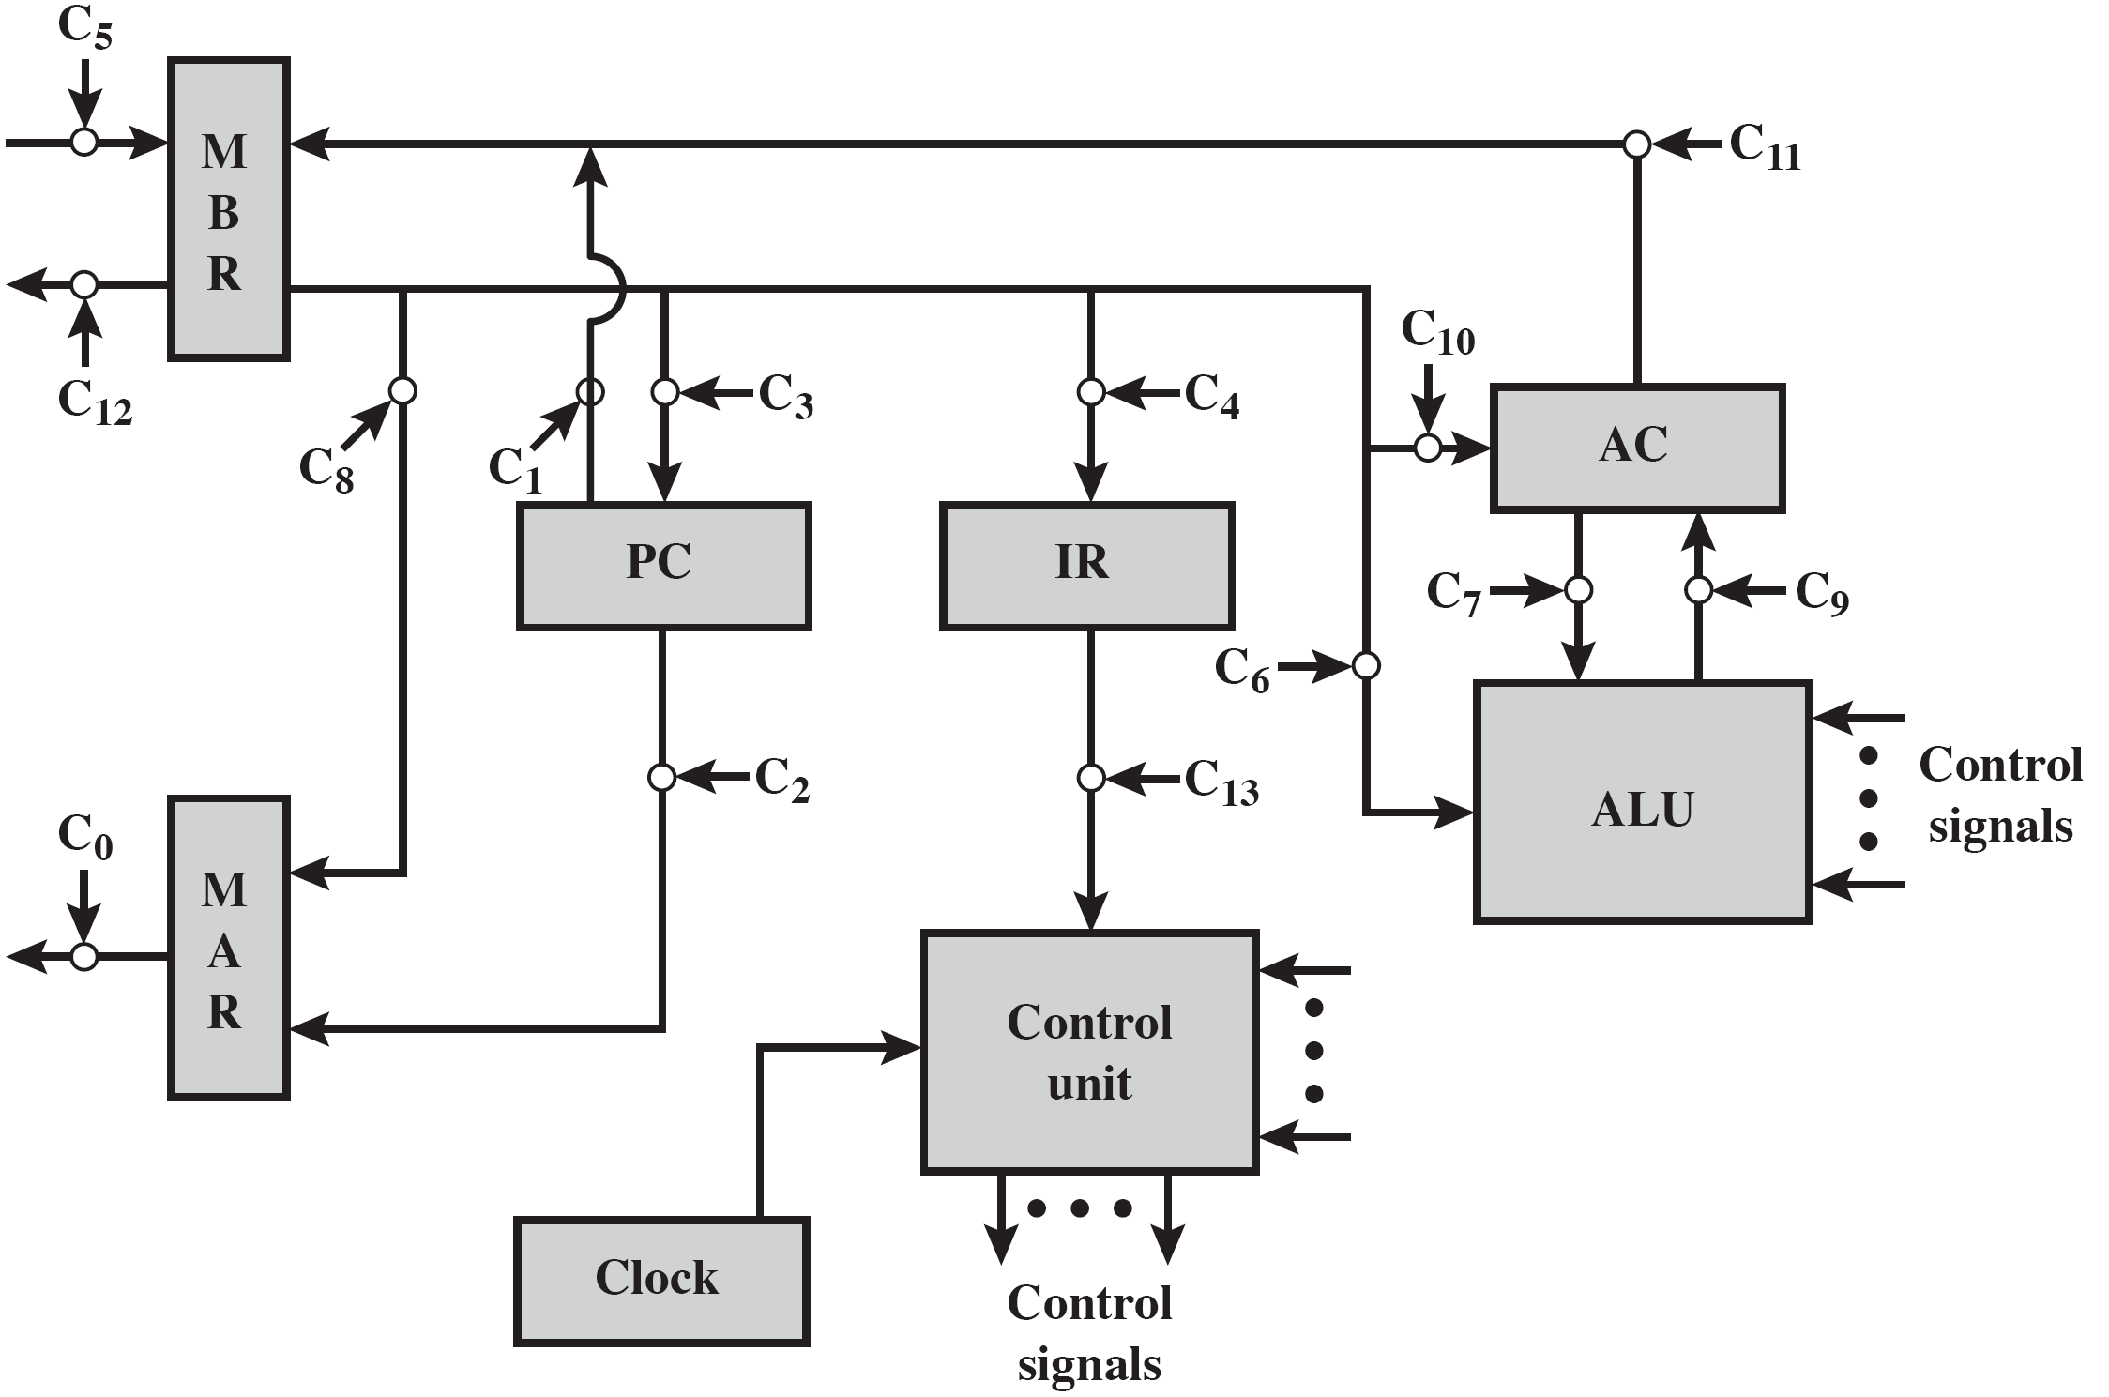
Data Paths and Control Signals
C₁₄
Instruction Fetch
MAR ← [PC]
- Control unit activates signal to open gates between PC and MAR: C₂
MBR ← Memory
- Open gates between MAR and address bus : C₀
- Memory read control signal.: C_{R}
- Open gates between data bus and MBR : C₅

Slide 20
Micro-operations | Timing | Active Control Signals
Fetch: | t₁: MAR ← [PC] | C₂
 | t₂: MBR ← Memory PC ← [PC] +1 | C₀, C_{R},C₅
 | t₃: IR ← [MBR] | C₄
Indirect: | t₁: MAR ← [IR-address] | C₁₄
 | t₂: MBR ← Memory | C₀, C_{R}, C₅
 | t₃: IR-address ← [MBR] | C₄
Interrupt: | t₁: MBR ← [PC] | C₁
 | t₂: MAR ← Save-address PC ← Routine-address
 | t₃: Memory ← [MBR] | C₀, C_{W}, C₁₂
C_{R}: Read control signal to system bus. C_{W}: Write control signal to system bus.

Slide 21
Internal Organization
Usually a single internal bus.
Gates control movement of data onto and off the bus.
Control signals control data transfer to and from external systems bus.
Temporary registers needed for proper operation of ALU.
Example: ADD X
t₁: MAR ← [IR-address]
t₂: MBR ← Memory
Y ← [AC]
t₃: Z ← [MBR] + [Y]
t₄: AC ← [Z]
ALU

Slide 22
Implementing the Control Unit
A wide variety of techniques have been used.
Most of them fall into one of two categories:
Hardwired implementation
Control signals are generated by a state machine circuit.
Microprogrammed implementation
Control signals are generated by a program similar to machine language programs.

Slide 23
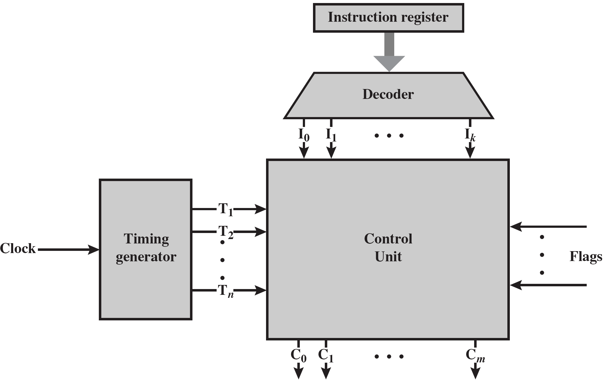
Hardwired Implementation
Control
Unit
ICC
P
Q
Core
Logic

Slide 24
Control Unit Core
To design the core logic, we need to derive a Boolean expression for each control signal.
Example: let’s derive an expression for C₅ (read data from external bus to MBR)
Suppose instruction subcycles are encoded by control signals P & Q s.t. PQ=00 → Fetch, PQ=01 → Indirect, PQ=10 → Execute, PQ=11 → Interrupt.
Suppose C₅ should be activated in:
Step 2 (T₂) during fetch and indirect subcycles.
Step 3 (T₃) during execution of ADD (I₅) and AND (I₈) instructions.
Boolean expression for C₅:

Slide 25
Problems with Hardwired Design
Complex sequencing & micro-operation logic.
Difficult to design and test.
Inflexible design.
Difficult to add new instructions.

Slide 26
Reading Material
Stallings, Chapter 19:
URL: http://www.ecs.csun.edu/~cputnam/Comp546/Stallings-Appendices/19-Control_Unit.pdf
Pages 1 – 24
Pages 30 – 35

