Slide 1
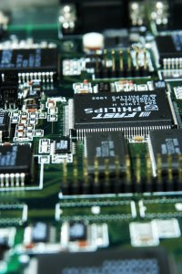
CSE 321b
Computer Organization (2)
تنظيم الحاسب (2)
3rd year, Computer Engineering
Winter 2016
Lecture #7
Dr. Hazem Ibrahim Shehata
Dept. of Computer & Systems Engineering
Credits to Dr. Ahmed Abdul-Monem Ahmed for the slides

Slide 2
Adminstrivia
Assignment #2:
  To be released later on this weekend.
Midterm:
  Date: Thursday, April 21, 2014
  Time: 10:30am – 12:00pm
  Location: classrooms #27321 (قاعة 4د) & #27309
  Coverage: lectures #1 ➔ #7
Website: http://hshehata.github.io/courses/zu/cse321b/
Office hours: Sunday 11:30am – 12:30pm

Slide 3
Chapter 7. Input / Output (Cont.)

Slide 4
Outline
External Devices
  Types
  Structure
I/O Modules
  Function
  Structure
I/O Techniques
  Programmed I/O
  Interrupt-Driven I/O
  Direct Memory Access
I/O Channels & Processors

Slide 5
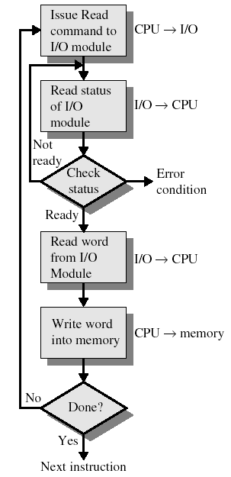
Programmed I/O
CPU issues read/write command to I/O module.
CPU periodically checks status bits.
  CPU waits for command to complete.
  I/O module does not interrupt CPU.
CPU reads data from device/memory and writes it to memory/device.

Slide 6
Interrupt-Driven I/O
Purpose: To overcome CPU waiting.
No repeated CPU checking of device.
CPU issues command and moves on to do other useful work.
I/O module interrupts CPU when ready.

Slide 7
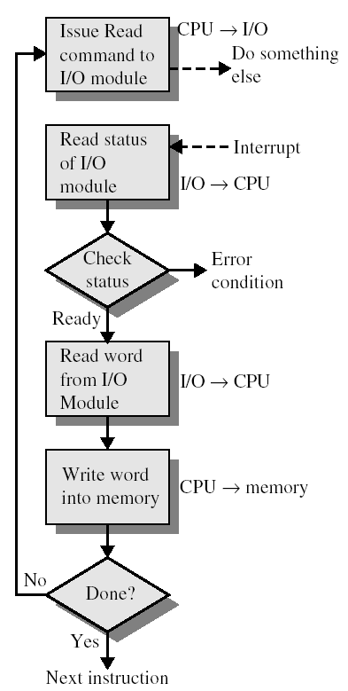
Interrupt-Driven I/O
CPU issues read command
I/O module gets data from peripheral whilst CPU does other work.
I/O module interrupts CPU.
CPU reads data from I/O module.
CPU writes data to memory.

Slide 8
CPU Viewpoint
Issue read command.
Do other work.
Check for interrupt at end of each instruction cycle.
If interrupted:
  Save context (registers).
  Process interrupt.
    Fetch data (from module) & store (to memory)

Slide 9
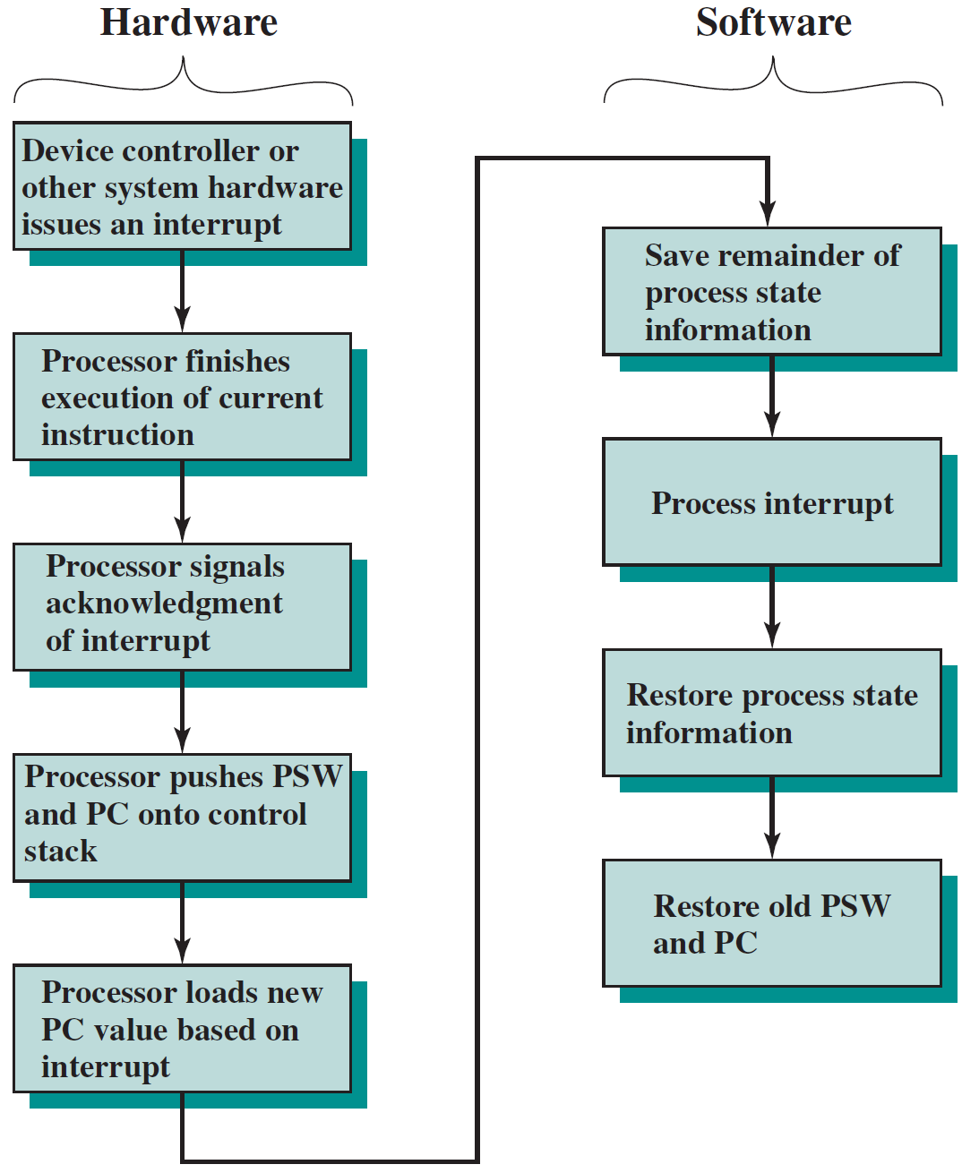
Simple Interrupt Processing

Slide 10
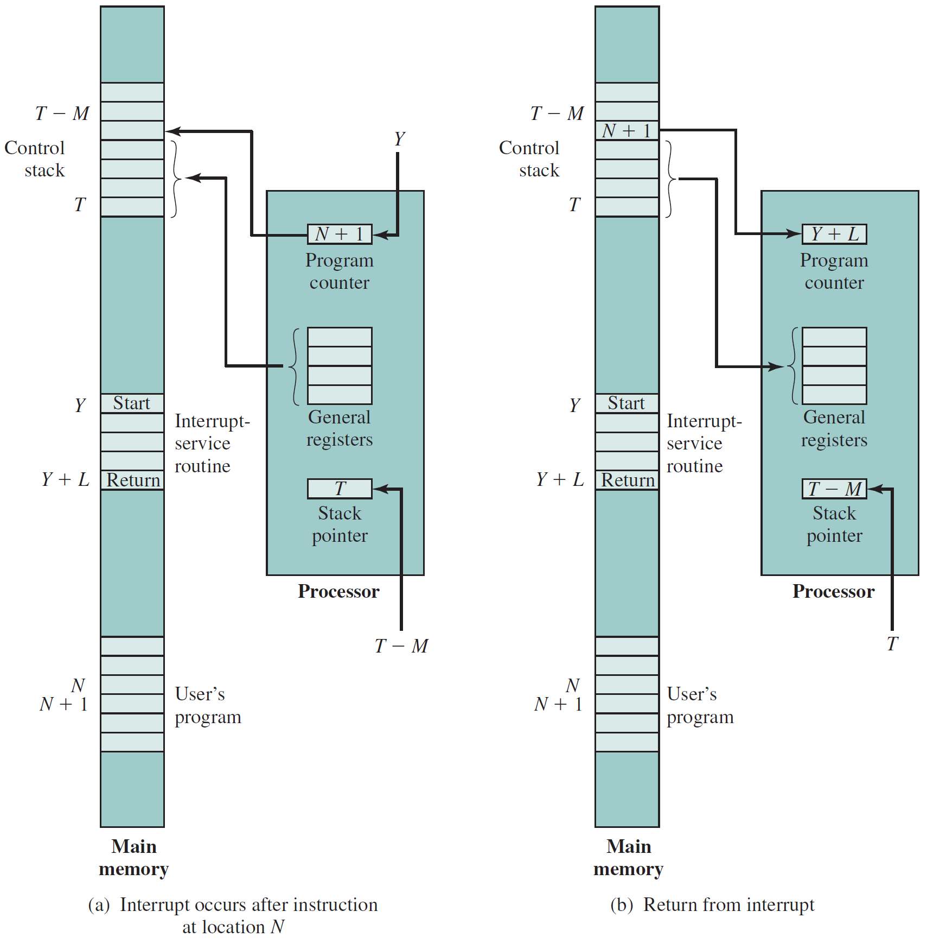
Changes in Mem. & Reg.’s upon Interrupt
3
2
5
2
3
6
1
4
4
1
5

Slide 11
Identifying Interrupting Module
How to identify the module issuing the interrupt?
  Different line for each module
    Limits number of devices.
  Software poll (single line)
    CPU asks each module in turn ➔ time consuming!!
    e.g., Send TESTI/O ➔ Set address lines ➔ Check status reg.
  Daisy chain or Hardware poll (single line)
    All modules share a single interrupt request line.
    Interrupt acknowledge sent down a chain.
    Module (that issued interrupt signal) places its vector on bus.
    CPU uses vector to identify handler routine.
  Bus Master (single line)
    Module must claim the bus before it can raise interrupt.
    e.g., PCI & SCSI.

Slide 12
Multiple Interrupts & Priorities
How to deal with simultaneous interrupts?
Solution: prioritize interrupts!
  With multiple lines:
    Each interrupt line has a priority.
    Higher priority lines can interrupt lower priority lines.
  With software polling:
    Priority determined by order in which modules are polled.
  With daisy chain:
    Priority determined by order of modules on chain.
    Closer modules have higher priority.
  With bus arbitration:
    Only current master can interrupt.
    Priority is defined by the bus arbitration protocol.

Slide 13
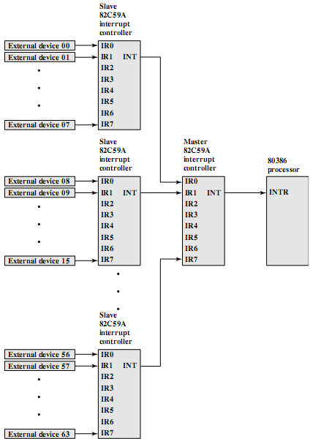
Example - PC Bus
80386 has one interrupt line!
To handle more interrupts, connect 1 (or more) interrupt arbiter ➔ Intel 8259.
Intel 8259 has 8 intrpt. lines.
Sequence of events:
  8259 accepts interrupts.
  8259 determines priority.
  8259 signals 8086 (raises INTR line).
  CPU Acknowledges.
  8259 puts correct vector on data bus.
  CPU processes interrupt.

Slide 14
Direct Memory Access (DMA)
Interrupt driven and programmed I/O require active CPU intervention.
  CPU tests and services a device.
    Transfer rate is limited (depending on CPU availability)!!
  Many instructions are executed for every I/O.
    CPU is tied up in managing an I/O transfer!!
DMA is a more efficient technique (when transferring large volumes of data, i.e., blocks).
  Additional module on the system bus ➔ DMA controller.
  DMA controller mimics CPU and takes over the bus to transfer the data with no CPU intervention!

Slide 15
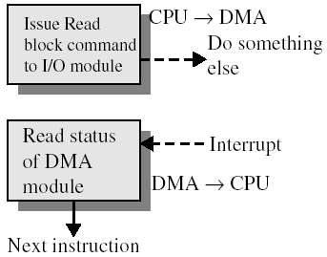
DMA Operation
CPU tells DMA controller:
  Type of Operation (Rd/Wr).
  Address of device.
  Starting address of a data block in memory.
  Amount of data to be transferred.
CPU carries on with other work.
DMA controller performs the transfer.
DMA controller sends interrupt when finished.

Slide 16
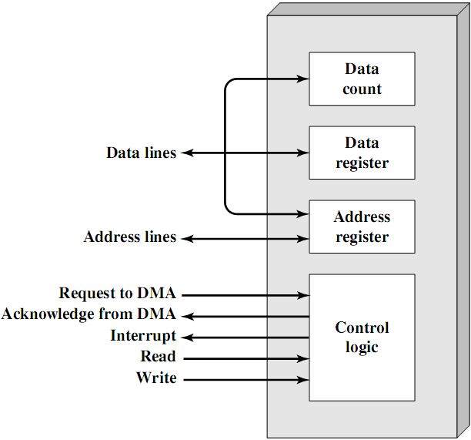
Typical DMA Controller
4
5
4
5
1
2
6
3
3

Slide 17


DMA Transfer modes
DMA controller transfers data from/to MM over the system bus.
DMA controller takes over bus for a bus cycle to transfer data by one of the following techniques:
  Use bus only when CPU not using it: transparent mode.
  Force CPU to suspend operation temporarily ➔ DMA steals bus cycles from CPU: cycle stealing mode.
Notice this is not an interrupt!
  CPU does not switch context.
CPU gets suspended just before it accesses bus.
  i.e. before an operand or data fetch or a data write.
Slows down CPU. Faster than CPU doing transfer!

Slide 18
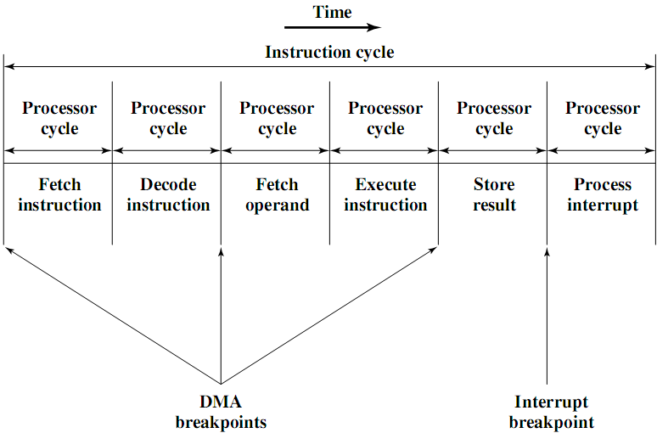
DMA and Interrupt Breakpoints During an Instruction Cycle

Slide 19
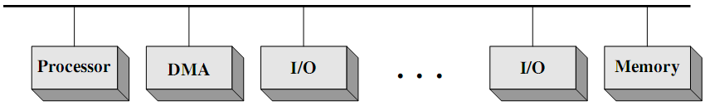
DMA Configurations (1)
Features: single-bus, detached DMA controller.
DMA module acts as a surrogate processor.
DMA module uses programmed I/O.
Each transfer uses system bus twice.
  I/O device ➔ DMA controller ➔ memory.
CPU is suspended twice per transfer.
DMA controller has no I/O interfaces.
Inexpensive yet inefficient!

Slide 20
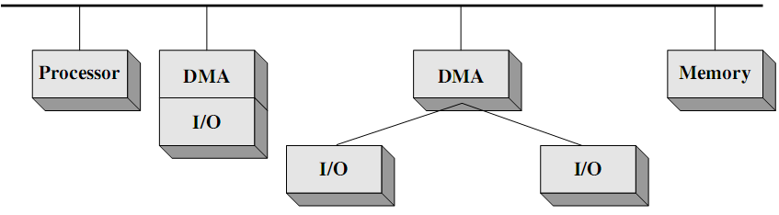
DMA Configurations (2)
Features: single-bus, integrated DMA controller.
Controller may support more than one device.
Each transfer uses system bus once.
  DMA controller ➔ memory.
CPU is suspended once per transfer.
DMA controller has one or more I/O interfaces.
Efficient yet expensive!

Slide 21
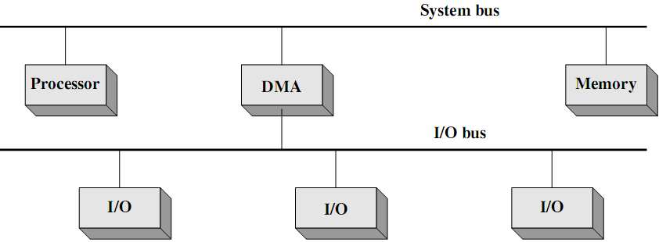
DMA Configurations (3)
Features: separate I/O bus.
  Connecting all DMA-capable devices.
Each transfer uses system bus once.
  DMA controller ➔ memory
CPU is suspended once.
DMA controller has only one I/O interface.
Easily expandable configuration.

Slide 22
Evolution of I/O function
No I/O module.
  CPU directly controls i/o device.
I/O module responding to CPU.
  Programmed I/O.
I/O module interrupting CPU.
  Interrupt-driven I/O.
I/O module accessing memory.
  Direct-memory access (DMA).
I/O module executing program.
  I/O channel.
I/O module executing program from local memory.
  I/O processor, .e.g., GPU.
NOTE: On occasions, no distinction is made between the terms: I/O channel and I/O processer!!!

Slide 23
I/O Channels
I/O channels:
  an extension to the DMA concept
  able to execute I/O instructions
I/O channel equipped with special-purpose processor, referred to as I/O processor (IOP)!!!!
CPU instructs I/O channel to do the transfer
  I/O processor fetches and executes I/O program from memory.
I/O channel does the entire transfer.
Improves speed
  Takes load off CPU.
  Dedicated processor is faster.

Slide 24
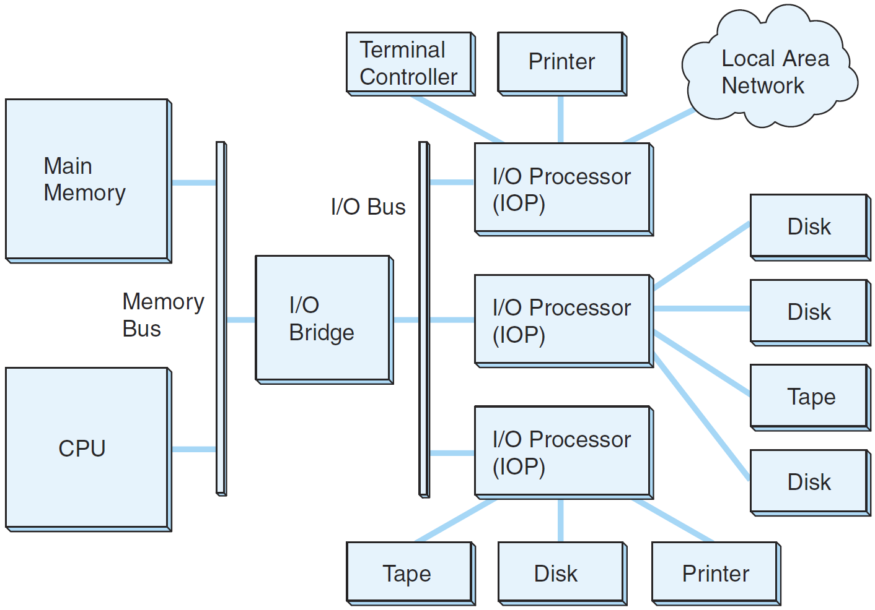
A Channel I/O Configuration
“The Essentials of Computer Organization and Architecture”, Null and Lobur

Slide 25
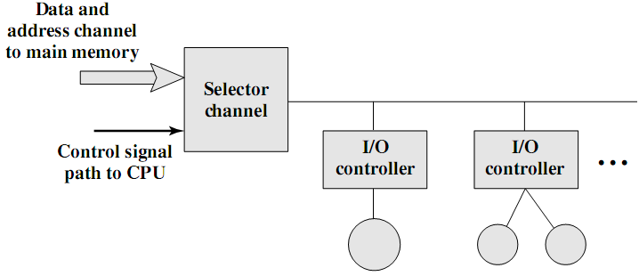
I/O Channel Architecture – Selector
Channel controls multiple high-speed devices.
At any given time, channel is dedicated to data transfer with only one of these devices.
Each device/set of devices is/are handled by a controller (I/O module).

Slide 26
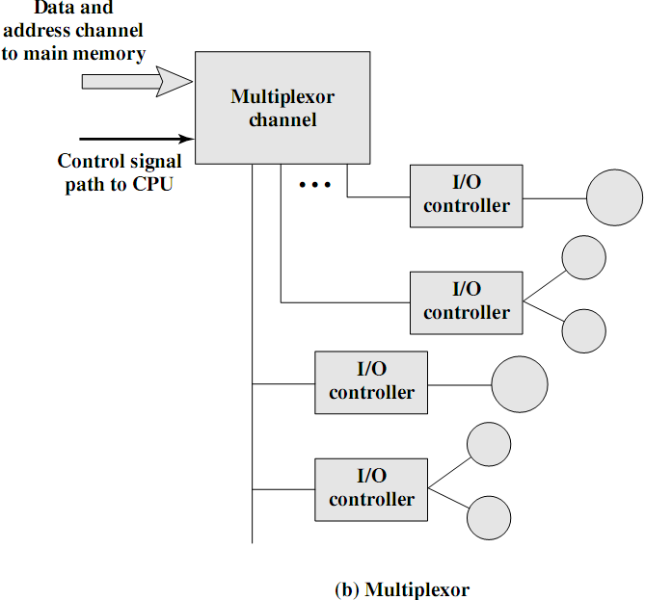
I/O Channel Architecture – Multiplexor
Handles multiple low-speed devices at the same time.
A byte multiplexor accepts or transmits characters as fast as possible to multiple devices.
Example: 3 devices with different rates and individual streams A1A2A3A4 ..., B1B2B3B4 . . ., and C1C2C3C4 might result in the character stream A1B1C1A2C2A3B2C3A4 …

Slide 27
Reading Material
Stallings, Chapter 7:
  Pages 232-237
  Pages 240-243
  Pages 246-248

