Slide 1

CSE 321a
Computer Organization (1)
تنظيم الحاسبات (1)
3rd year, Computer Engineering
Fall 2017
Lecture #4
Dr. Hazem Ibrahim Shehata
Dept. of Computer & Systems Engineering
Credits to Dr. Ahmed Abdul-Monem Ahmed for the slides

Slide 2
Administrivia
Assignment #1:
Released: last Sunday.
Due: Sunday, Oct. 15, 2017.
Website: http://hshehata.github.io/courses/zu/cse321a
Office hours: Sunday 1:00pm-2:00pm

Slide 3
Chapter 4. Cache Memory

Slide 4
Characteristics of Memory Systems
Location
Capacity
Unit of transfer
Access method
Performance
Physical type
Physical characteristics
Organization

Slide 5
1,2. Location and Capacity
Location
Internal (to computer)
Directly accessible by CPU.
e.g., CPU registers, cache, MM.
External (to computer)
Accessible by CPU via an I/O module (controller).
e.g., Secondary storage disks and tapes.
Capacity
Internal memory
# of bytes (or words)
Word length (8, 16, 32, …bits).
External memory
# of bytes.

Slide 6
Concepts for Internal Memory
Word
Natural unit of organization of memory.
Usually holds an integer or an instruction.
Not always the case!
X86: word → 16 bits, instruction → 1+ words!!
Addressable unit (i.e., location)
Smallest location that can be uniquely addressed.
Word, byte, or both.
An A-bit address is needed for a 2^{A} addressable units.
X86: location → 8 bits → byte-addressable memory.

Slide 7
3. Unit of Transfer
Internal memory
Not necessarily the addressable unit or the word!!!
Number of bits read from or written to memory at a time.
Governed by data bus width (# of data lines, MM).
External memory
Usually a block, which is much larger than a word.

Slide 8
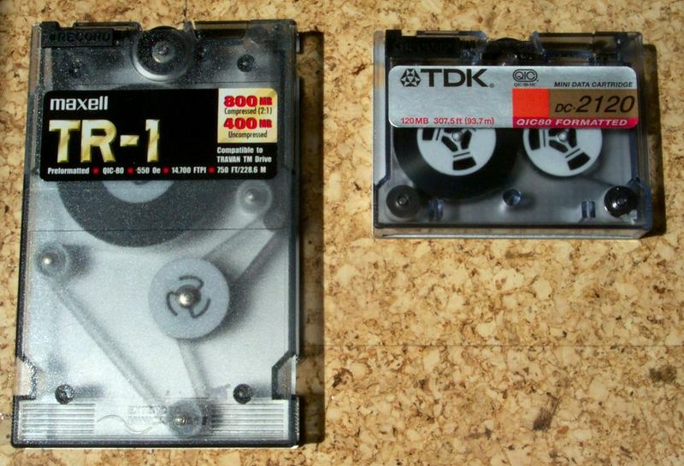
4. Access Methods (1)
Sequential
e.g. tape (demo: https://www.youtube.com/watch?v=y-RpCzxPqac)
Memory is organized into units of data, called records.
Start at the beginning and read through in order.
Stored addressing information is needed.
Shared read/write mechanism.
Access time depends on data location & previous location.

Slide 9
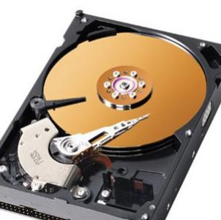

4. Access Methods (2)
Direct
e.g. disk (demo: https://www.youtube.com/watch?v=9eMWG3fwiEU)
Individual records/blocks have unique address based on physical location.
Access is by jumping to vicinity plus sequential search.
Shared read/write mechanism.
Access time depends on data location & previous location.

Slide 10
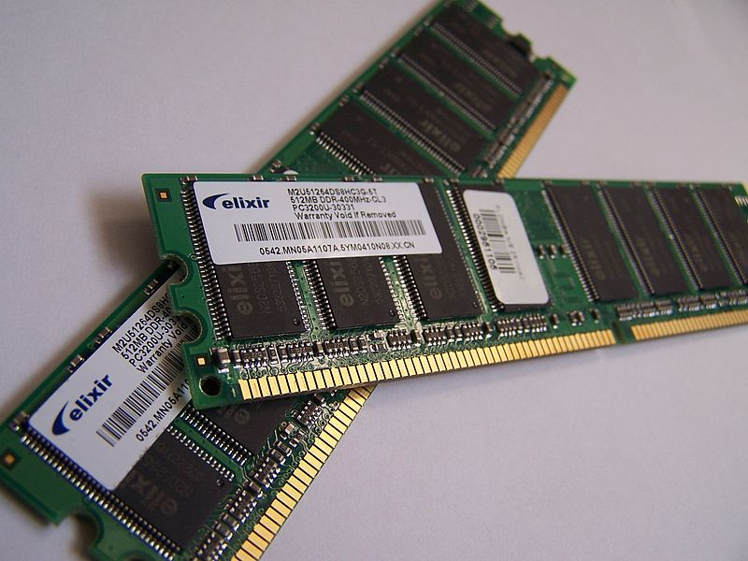
4. Access Methods (3)
Random
e.g. RAM
Individual addresses identify locations exactly.
Access time is independent of location of previous access.

Slide 11
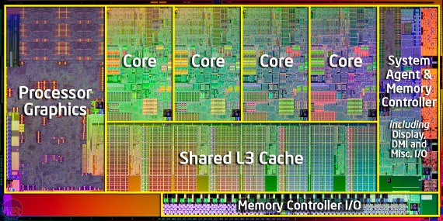
4. Access Methods (4)
Associative
e.g. cache
Data is located by a comparison with contents of a portion of the store.
Access time is independent of location or previous access

Slide 12
5. Performance
Access time
Random: time between presenting add. and getting data.
Non-Random: time to position rd/wr mechanism at desired location
Memory cycle time
Time may be required for memory to “recover” before next access.
Cycle time = access + recovery
Transfer rate
Rate at which data can be moved (e.g. X bps)
Random: R = 1 / Cycle Time (in “data units per second”)
Non-random: R = N / (T_{N} – T_{A}) (in “bps”)
T_{N}: Av. time to read/write N bits. - T_{A}: Av. access time.
N: # of bits. - R: transfer rate.

Slide 13
6,7. Physical Types & Physical Characteristics
Physical Types
Semiconductor
RAM & ROM
Magnetic
Disk & Tape
Optical
CD & DVD
Physical Characteristics
Volatility
Volatile: Information decays and lost when the power is off.
Non-volatile: No power is needed to retain info. (e.g., magnetic surface memory).
Semiconductor memory could be volatile or nonvolatile.
Erasablilty

Slide 14
8. Organization
Key for random-access memory
Physical arrangement of bits to form words.
Obvious arrangement is not always used.
i.e., Cell rows may not correspond to words!!
To be explained more later in internal memory.

Slide 15
Design Constraints on Memory
How much?
Capacity: bigger is better!
How fast?
Speed: keep up with CPU.
How expensive?
Cost: reasonable compared to other components.
Problem: Trade-off among these three characteristics!!
No single memory technology has it all!!
Solution: memory hierarchy.

Slide 16
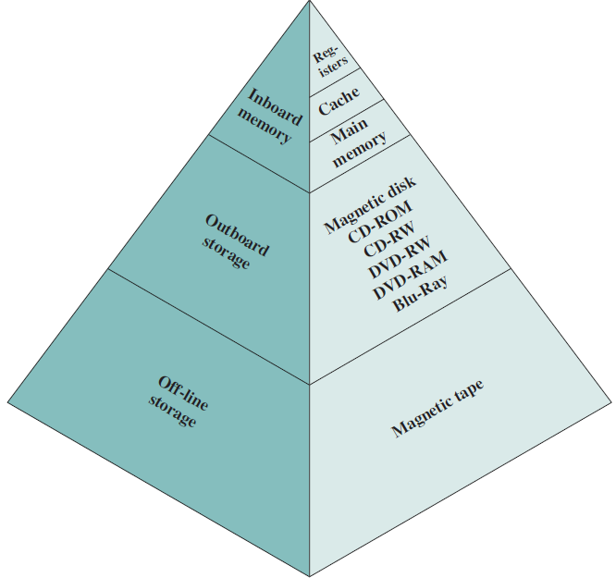
Memory Hierarchy - Diagram
Less cost
Higher capacity
Greater access time
Less access frequency

Slide 17
Locality of Reference
Main memory
CPU

Slide 18
Locality of Reference
During the course of execution of a program, memory references tend to cluster (for both instructions and data).
e.g., loops, subroutines.
e.g., operations on tables and arrays.
Over a short period of time, CPU is working with fixed clusters of memory references.
Over a long period of time, the clusters in use change.
This principle can be applied across all levels of the memory hierarchy.

Slide 19
Cache Memory – Concept
Small amount of fast memory.
Sits between normal main memory and CPU.
May be located on CPU chip.
Not usually visible to the programmer or CPU
Volatile, uses semiconductor technology.

Slide 20
Cache Memory – Operation
CPU requests contents of memory location.
Check cache for this data.
If present ➔ cache hit, get from cache (fast).
Because of locality of reference, this location, or a close one, is likely to be referenced soon.
If not present ➔ cache miss, read required block from MM to cache.
Then deliver from cache to CPU.
Cache includes tags to identify which block of main memory is in each cache slot.

Slide 21
Cache – Read Operation
Miss
Hit

Slide 22
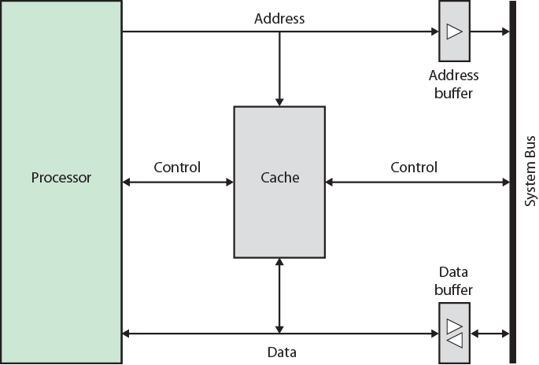
Typical Cache Organization

Slide 23
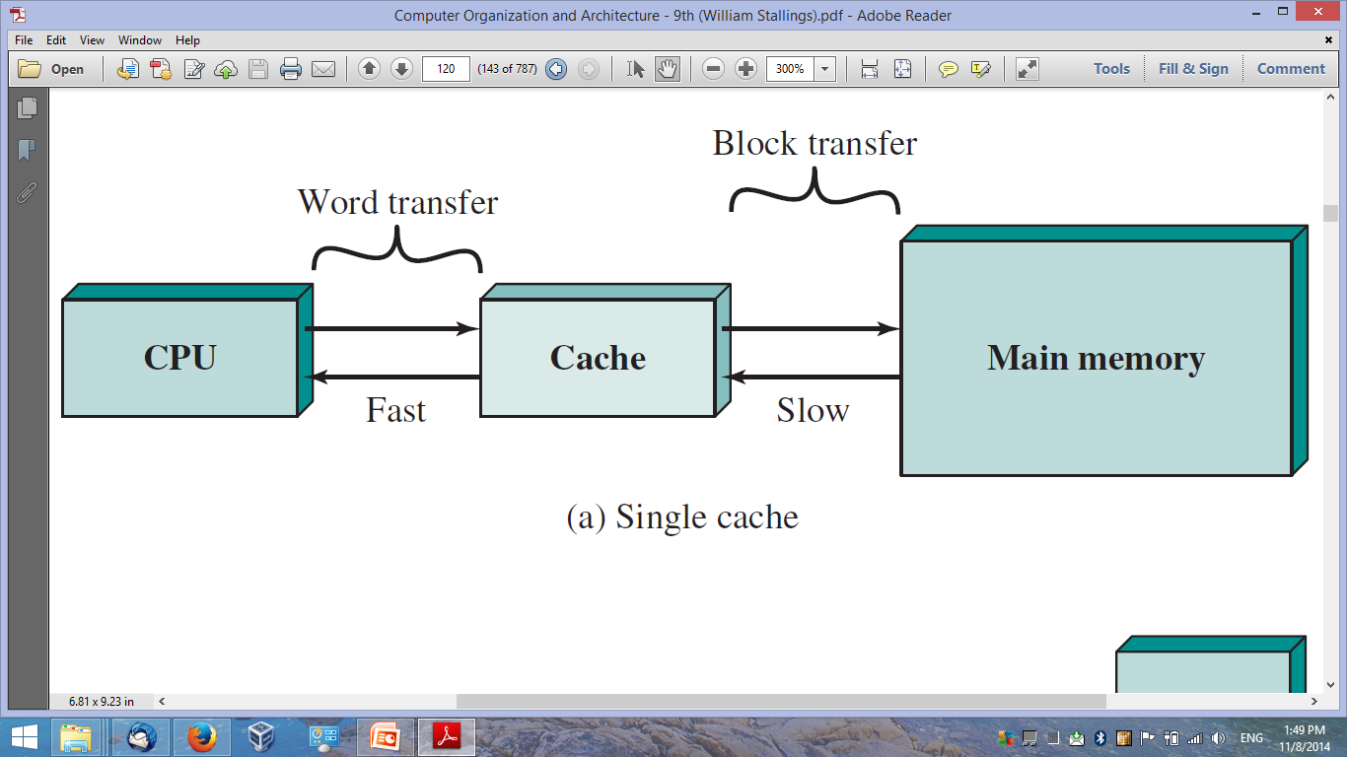
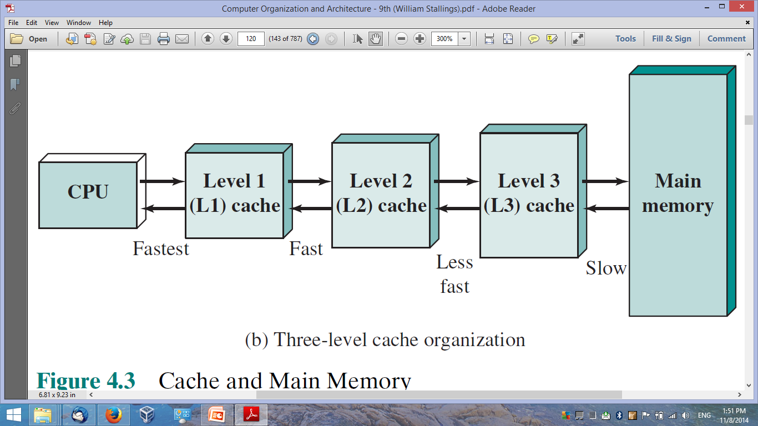
Cache Memory - Concept
One-Level Cached
Memory System
Three-Level Cached
Memory System

Slide 24
Average Access Time of a One-Level Cached Memory System
(0, T_{c}+T_{m})
MM
Access
Time
T_{m}
T_{av} = T_{c} + (1 – H) T_{m}
Average Access Time (T_{av})
(1, T_{c})
Cache
Access
Time
T_{c}
0
1
Hit Ratio (H)
“Fraction of accesses involving only cache”

Slide 25
Reading Material
Stallings, Chapter 4:
Pages 113 – 123

