Slide 1
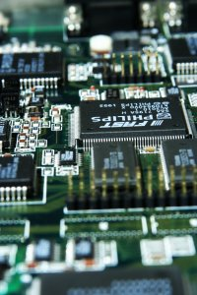
CSE 321b
Computer Organization (2)
تنظيم الحاسب (2)
3rd year, Computer Engineering
Winter 2017
Lecture #6
Dr. Hazem Ibrahim Shehata
Dept. of Computer & Systems Engineering
Credits to Dr. Ahmed Abdul-Monem Ahmed for the slides

Slide 2
Adminstrivia
Assignment #1:
Solution will be posted soon.
Assignment #2:
To be released this weekend.
Website: http://hshehata.github.io/courses/zu/cse321b/
Office hours: TBA

Slide 3
Chapter 7. Input / Output (Cont.)

Slide 4
Outline
External Devices
Types
Structure
I/O Modules
Function
Structure
I/O Techniques
Programmed I/O
Interrupt-Driven I/O
Direct Memory Access
I/O Channels & Processors

Slide 5
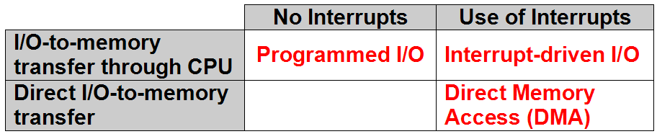
Input Output Techniques
Programmed I/O.
Interrupt-driven I/O.
Direct Memory Access (DMA).

Slide 6
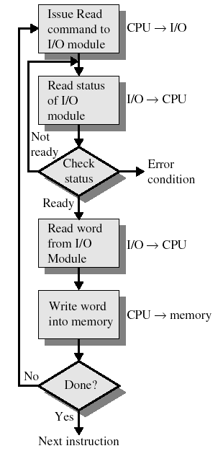
Programmed I/O
CPU (program) has direct control over I/O.
Issuing commands
Sensing status
Transferring data
CPU issues a command to I/O module.
CPU checks status bits periodically.
This process is called: pooling.
I/O module performs operation.
I/O module sets status bits.
CPU transfers data: device ⬅➔ memory.
Notes:
I/O module does not inform CPU directly.
I/O module does not interrupt CPU.
CPU waits for I/O operation to complete.
Disadvantage: Wasting CPU time!

Slide 7
I/O Commands vs. I/O Instructions
I/O Command
Signal: issued by (or Sent from) CPU to I/O module.
Types:
Control: activate device & tell it what to do (e.g., rewind tape).
Test: check status (e.g., is power on? is error detected?)
Read/Write: transfer data CPU ⬅➔ buffer ⬅➔ peripheral
I/O instruction
Step in program: fetched from MM & executed by CPU.
To execute an I/O instruction: (1) CPU issues address of I/O module & device, (2) CPU issues an I/O command.
Instruction form depends on how devices are addressed.
In programmed I/O, there is a one-to-one mapping between I/O instructions and I/O commands.

Slide 8
Addressing Techniques of I/O Devices
Two ways to assign addresses to I/O devices:
Memory-mapped I/O
Devices & memory share same address space.
I/O looks just like memory read/write.
No special instructions for I/O ➔ “load”, “store”, … etc.
Bus has one Read & one Write control line.
Pros: Large selection of memory access instructions.
Cons: Valuable memory address space is used up!
Isolated I/O
Separate address space for devices.
Special instructions for I/O ➔ “in”, “out”, “test”, … etc.
Need two Rd & two Wr control lines.
Pros: efficient use of memory address space.
Cons: Not so many I/O instructions.

Slide 9
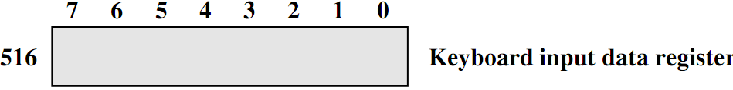
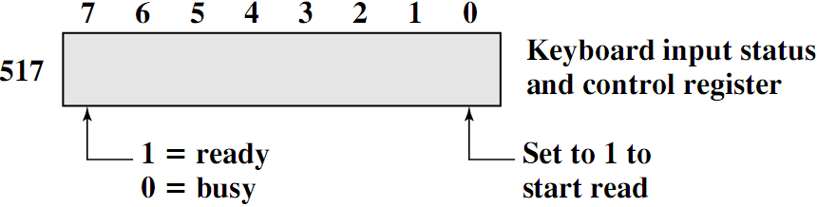
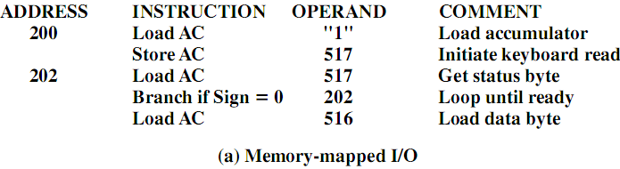
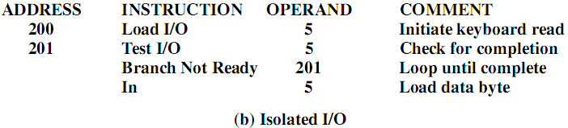
I/O Mapping - Example

Slide 10
Interrupt-Driven I/O
Purpose: To overcome CPU waiting.
No repeated CPU checking of device.
CPU issues command and moves on to do other useful work.
I/O module interrupts CPU when ready.

Slide 11
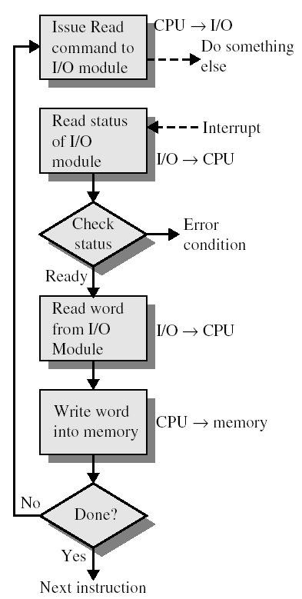

Interrupt-Driven I/O
CPU issues read command
I/O module gets data from peripheral whilst CPU does other work.
I/O module interrupts CPU.
CPU reads data from I/O module.
CPU writes data to memory.

Slide 12
CPU Viewpoint
Issue read command.
Do other work.
Check for interrupt at end of each instruction cycle.
If interrupted:
Save context (registers).
Process interrupt.
Fetch data (from module) & store (to memory)

Slide 13
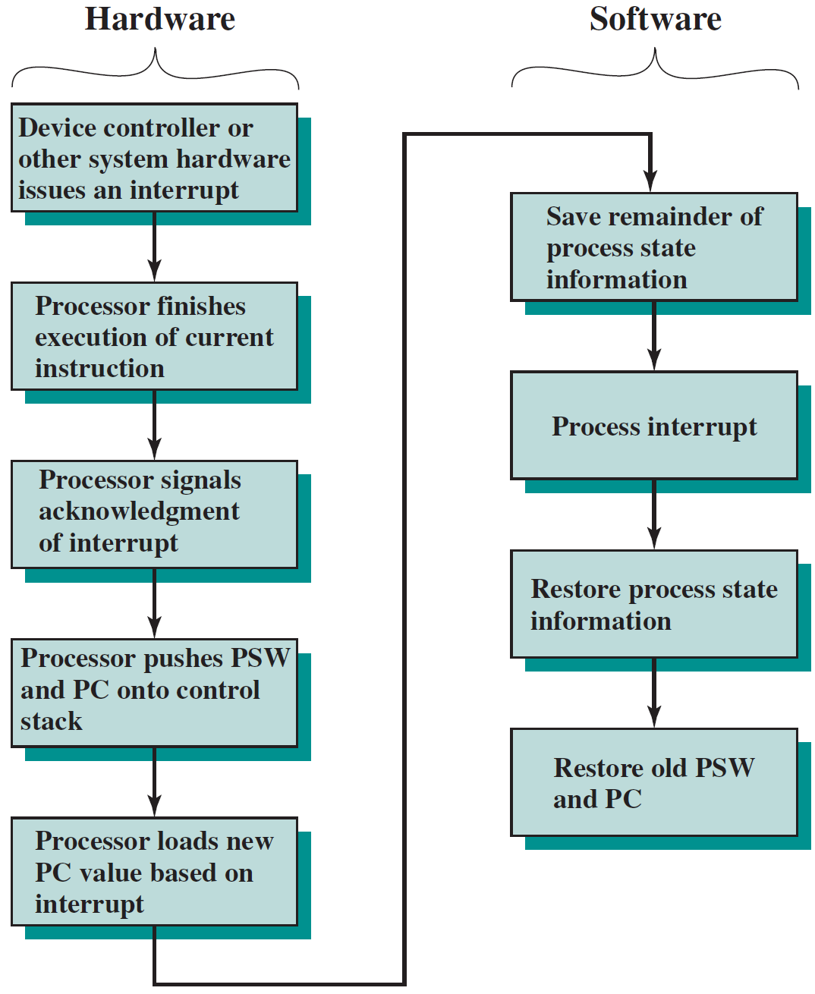
Simple Interrupt Processing

Slide 14
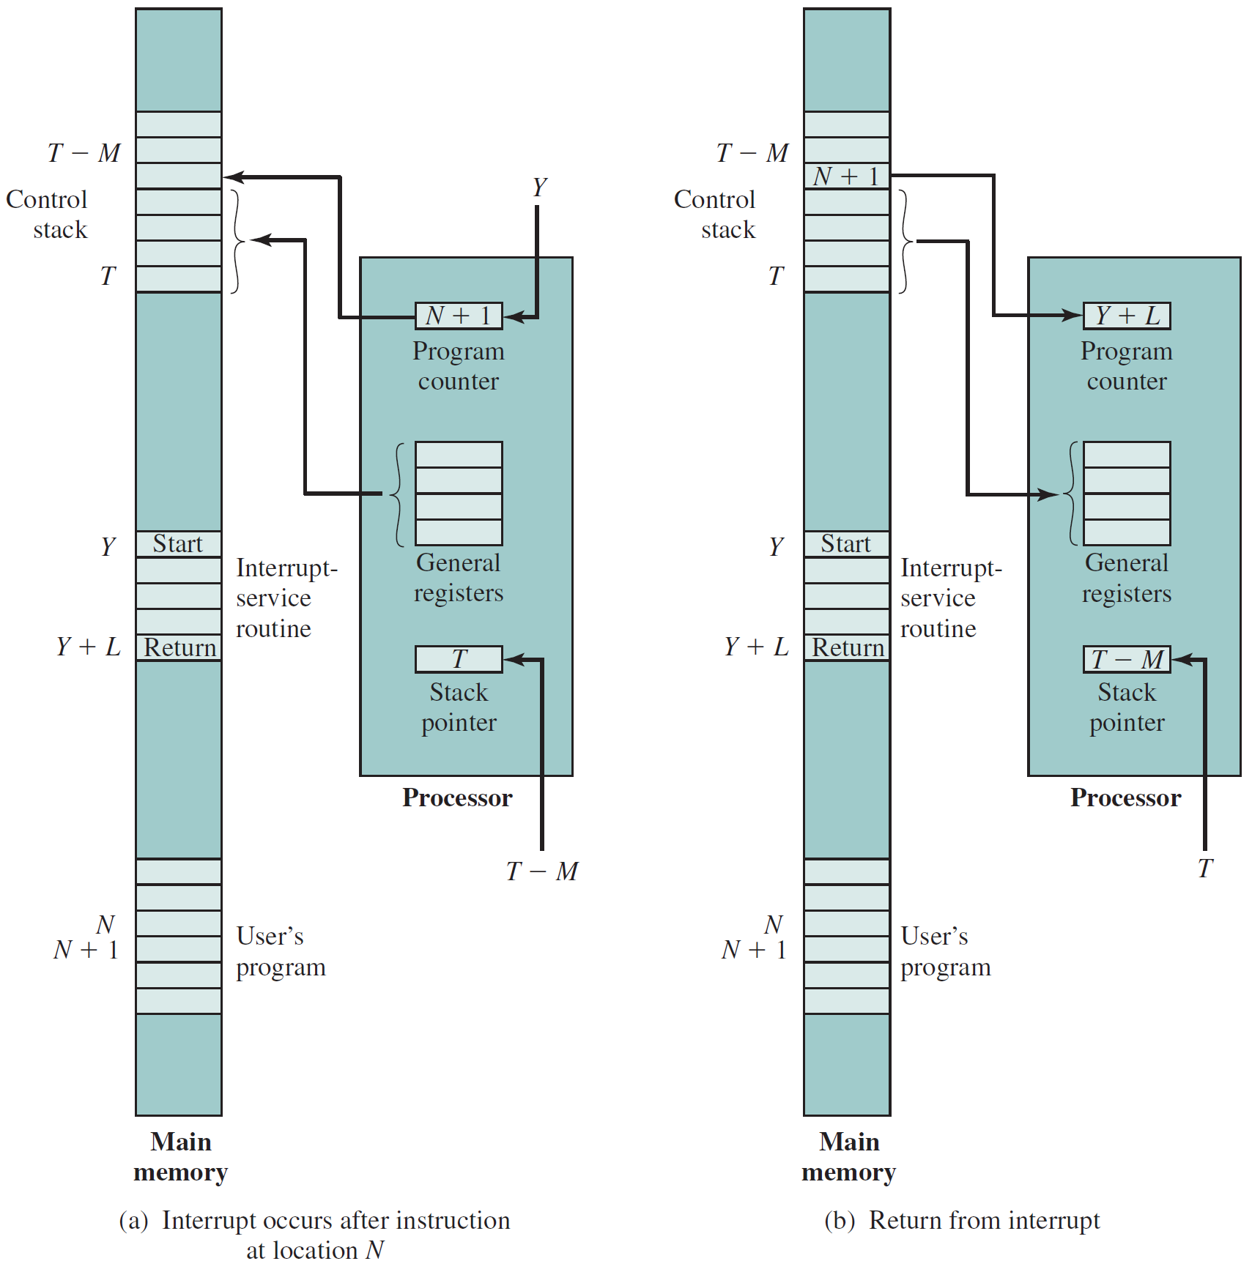
Changes in Mem. & Reg.’s upon Interrupt
3
2
5
2
3
6
1
4
4
1
5

Slide 15
Identifying Interrupting Module
How to identify the module issuing the interrupt?
Different line for each module
Limits number of devices.
Software poll (single line)
CPU asks each module in turn ➔ time consuming!!
e.g., Send TESTI/O ➔ Set address lines ➔ Check status reg.
Daisy chain or Hardware poll (single line)
All modules share a single interrupt request line.
Interrupt acknowledge sent down a chain.
Module (that issued interrupt signal) places its vector on bus.
CPU uses vector to identify handler routine.
Bus Master (single line)
Module must claim the bus before it can raise interrupt.
e.g., PCI & SCSI.

Slide 16
Multiple Interrupts & Priorities
How to deal with simultaneous interrupts?
Solution: prioritize interrupts!
With multiple lines:
Each interrupt line has a priority.
Higher priority lines can interrupt lower priority lines.
With software polling:
Priority determined by order in which modules are polled.
With daisy chain:
Priority determined by order of modules on chain.
Closer modules have higher priority.
With bus arbitration:
Only current master can interrupt.
Priority is defined by the bus arbitration protocol.

Slide 17
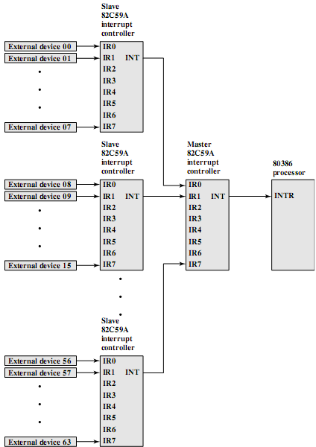
Example - PC Bus
Reading
80386 has one interrupt line!
To handle more interrupts, connect 1 (or more) interrupt arbiter ➔ Intel 8259.
Intel 8259 has 8 intrpt. lines.
Sequence of events:
8259 accepts interrupts.
8259 determines priority.
8259 signals 8086 (raises INTR line).
CPU Acknowledges.
8259 puts correct vector on data bus.
CPU processes interrupt.

Slide 18
Direct Memory Access (DMA)
Interrupt driven and programmed I/O require active CPU intervention.
CPU tests and services a device.
Transfer rate is limited (depending on CPU availability)!!
Many instructions are executed for every I/O.
CPU is tied up in managing an I/O transfer!!
DMA is a more efficient technique (when transferring large volumes of data, i.e., blocks).
Additional module on the system bus ➔ DMA controller.
DMA controller mimics CPU and takes over the bus to transfer the data with no CPU intervention!

Slide 19
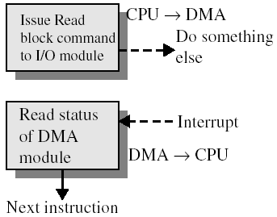
DMA Operation
CPU tells DMA controller:
Type of Operation (Rd/Wr).
Address of device.
Starting address of a data block in memory.
Amount of data to be transferred.
CPU carries on with other work.
DMA controller performs the transfer.
DMA controller sends interrupt when finished.

Slide 20
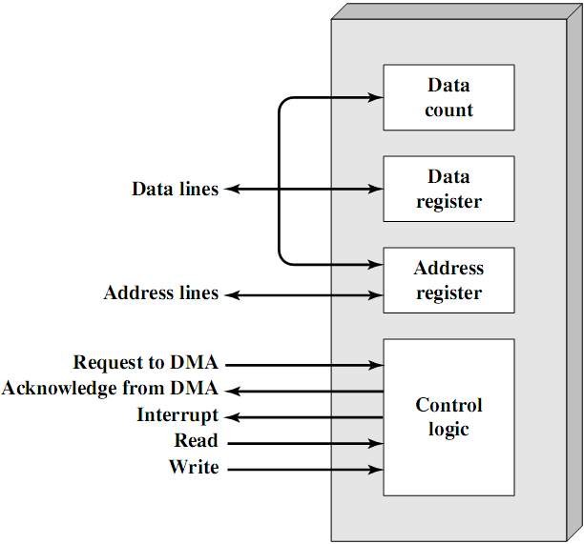
Typical DMA Controller
4
5
4
5
1
2
6
3
3

Slide 21


DMA Transfer modes
DMA controller transfers data from/to MM over the system bus.
DMA controller takes over bus for a bus cycle to transfer data by one of the following techniques:
Use bus only when CPU not using it: transparent mode.
Force CPU to suspend operation temporarily ➔ DMA steals bus cycles from CPU: cycle stealing mode.
Notice this is not an interrupt!
CPU does not switch context.
CPU gets suspended just before it accesses bus.
i.e. before an operand or data fetch or a data write.
Slows down CPU. Faster than CPU doing transfer!

Slide 22
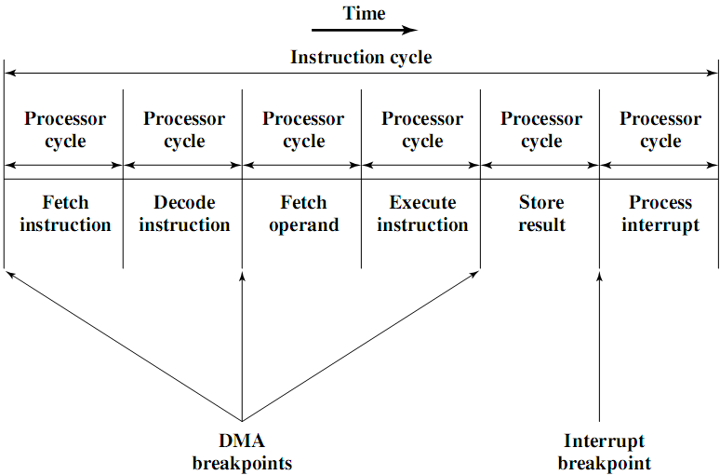
DMA and Interrupt Breakpoints During an Instruction Cycle

Slide 23
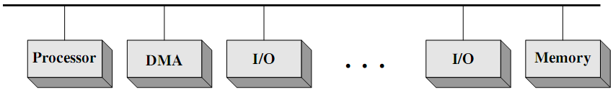
DMA Configurations (1)
Features: single-bus, detached DMA controller.
DMA module acts as a surrogate processor.
DMA module uses programmed I/O.
Each transfer uses system bus twice.
I/O device ➔ DMA controller ➔ memory.
CPU is suspended twice per transfer.
DMA controller has no I/O interfaces.
Inexpensive yet inefficient!

Slide 24
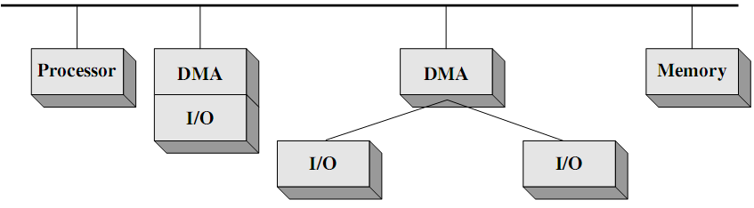
DMA Configurations (2)
Features: single-bus, integrated DMA controller.
Controller may support more than one device.
Each transfer uses system bus once.
DMA controller ➔ memory.
CPU is suspended once per transfer.
DMA controller has one or more I/O interfaces.
Efficient yet expensive!

Slide 25
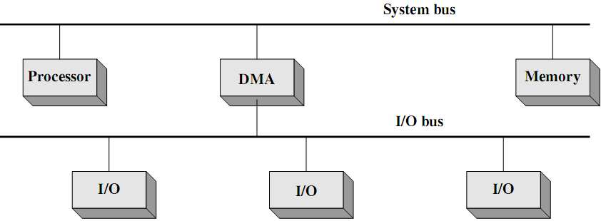
DMA Configurations (3)
Features: separate I/O bus.
Connecting all DMA-capable devices.
Each transfer uses system bus once.
DMA controller ➔ memory
CPU is suspended once.
DMA controller has only one I/O interface.
Easily expandable configuration.

Slide 26
Evolution of I/O function
No I/O module.
CPU directly controls i/o device.
I/O module responding to CPU.
Programmed I/O.
I/O module interrupting CPU.
Interrupt-driven I/O.
I/O module accessing memory.
Direct-memory access (DMA).
I/O module executing program.
I/O channel.
I/O module executing program from local memory.
I/O processor, .e.g., GPU.
NOTE: On occasions, no distinction is made between the terms: I/O channel and I/O processer!!!

Slide 27
I/O Channels
I/O channels:
an extension to the DMA concept
able to execute I/O instructions
I/O channel equipped with special-purpose processor, referred to as I/O processor (IOP)!!!!
CPU instructs I/O channel to do the transfer
I/O processor fetches and executes I/O program from memory.
I/O channel does the entire transfer.
Improves speed
Takes load off CPU.
Dedicated processor is faster.

Slide 28
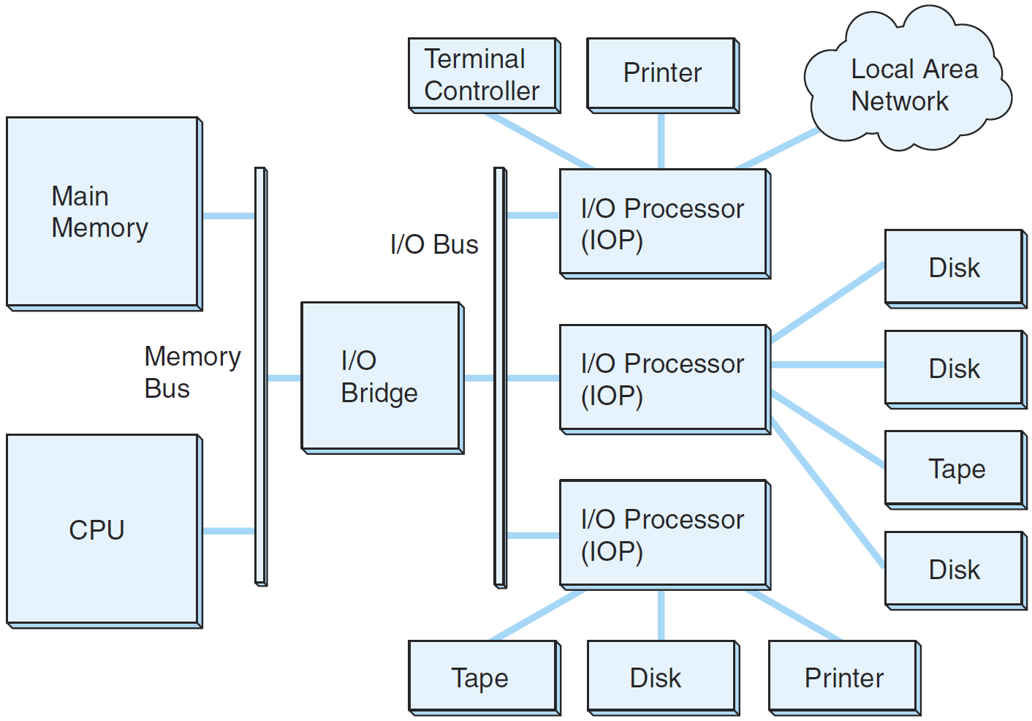
A Channel I/O Configuration
“The Essentials of Computer Organization and Architecture”, Null and Lobur

Slide 29
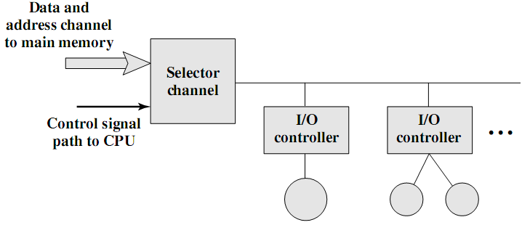
I/O Channel Architecture – Selector
Channel controls multiple high-speed devices.
At any given time, channel is dedicated to data transfer with only one of these devices.
Each device/set of devices is/are handled by a controller (I/O module).

Slide 30
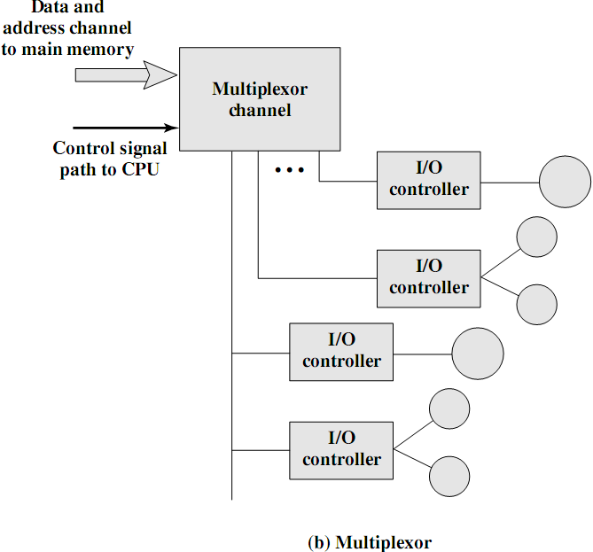
I/O Channel Architecture – Multiplexor
Handles multiple low-speed devices at the same time.
A byte multiplexor accepts or transmits characters as fast as possible to multiple devices.
Example: 3 devices with different rates and individual streams A1A2A3A4 ..., B1B2B3B4 . . ., and C1C2C3C4 might result in the character stream A1B1C1A2C2A3B2C3A4 …

Slide 31
Reading Material
Stallings, Chapter 7:
Pages 228-237
Pages 240-243
Pages 246-248

